Slide 1

Lecture 22: Resource Access Control (Chapter 8)
Deepak Gangadharan

Slide 2

Basic Priority-Inheritance Protocol - Preliminaries
Assigned Priority: Priority assigned to a job according to the scheduling algorithm
At any time $t$, each ready job $J_{l}$ is scheduled and executes at its current priority $π_{l}(t)$, which may differ from its assigned priority and may vary with time
The current priority $π_{l}(t)$ of a job $J_{l}$ may be raised to the higher priority $π_{h}(t)$ of another job $J_{h}$ → $J_{l}$ inherits the priority of higher priority job $J_{h}$ and executes at inherited priority $π_{h}(t)$

Slide 3
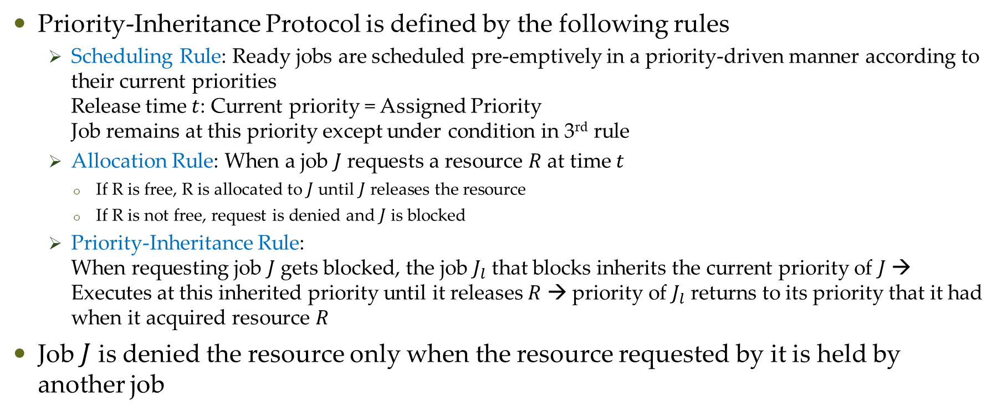
Basic Priority-Inheritance Protocol - Definition
Priority-Inheritance Protocol is defined by the following rules
Scheduling Rule: Ready jobs are scheduled pre-emptively in a priority-driven manner according to their current priorities Release time $t$: Current priority = Assigned Priority Job remains at this priority except under condition in 3rd rule
Allocation Rule: When a job $J$ requests a resource $R$ at time $t$
If R is free, R is allocated to $J$ until $J$ releases the resource
If R is not free, request is denied and $J$ is blocked
Priority-Inheritance Rule: When requesting job $J$ gets blocked, the job $J_{l}$ that blocks inherits the current priority of $J$ → Executes at this inherited priority until it releases $R$ → priority of $J_{l}$ returns to its priority that it had when it acquired resource $R$
Job $J$ is denied the resource only when the resource requested by it is held by another job

Slide 4
Basic Priority-Inheritance Protocol - Example
Priority Inheritance

Slide 5









Basic Priority-Inheritance Protocol – Complex Example
5 jobs and 2 resources Black and Shaded.
Black boxes show critical sections when jobs are holding Black and shaded boxes show critical sections when jobs are holding Shaded
$$π_{4}=1$$
$π_{4}=$4
$$π_{5}=2$$
$$π_{5}=1$$
$$π_{5}=5$$
t=0
t=2
t=4
t=7
t=5

Slide 6
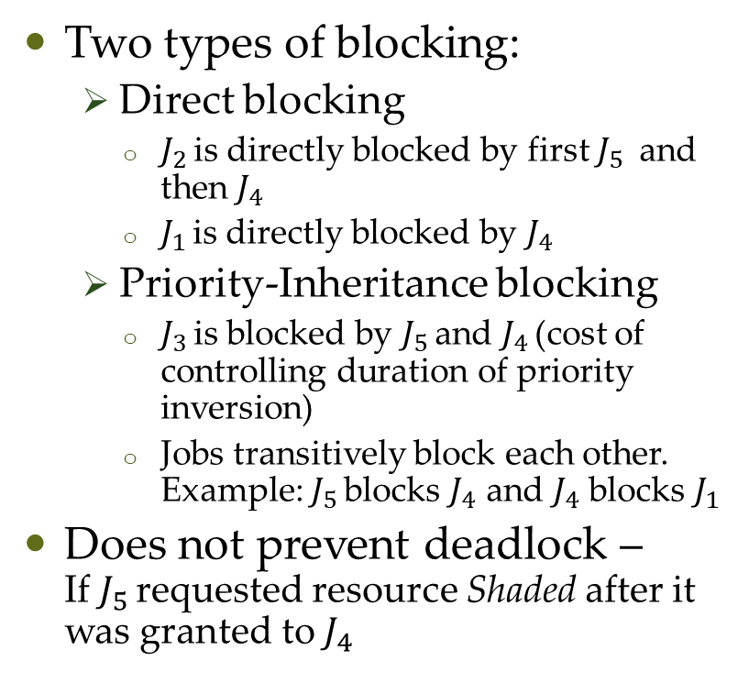
Properties of Priority-Inheritance Protocol
Two types of blocking:
Direct blocking
$J_{2 }$is directly blocked by first $J_{5 }$ and then $J_{4 }$
$J_{1 }$is directly blocked by $J_{4 }$
Priority-Inheritance blocking
$J_{3 }$is blocked by $J_{5 }$and $J_{4 }$(cost of controlling duration of priority inversion)
Jobs transitively block each other. Example: $J_{5 }$blocks $J_{4}$ and $J_{4}$ blocks $J_{1}$
Does not prevent deadlock – If $J_{5 }$requested resource Shaded after it was granted to $J_{4 }$

Slide 7
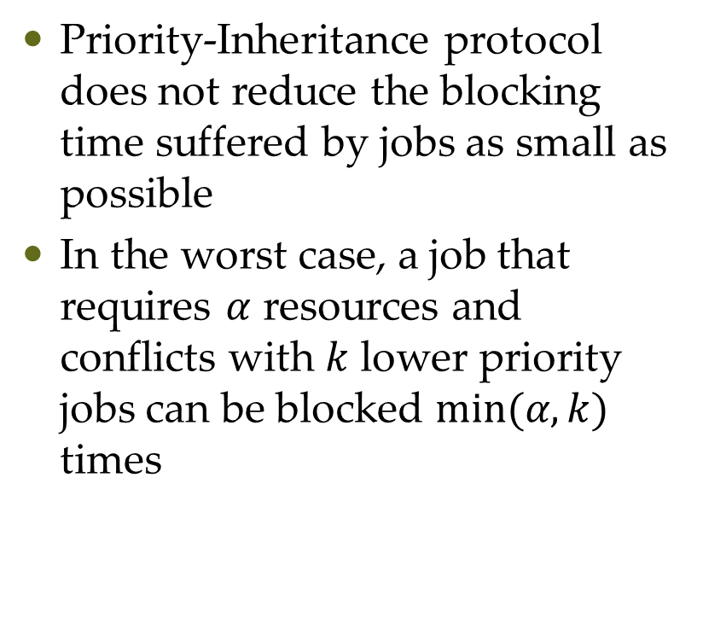
Properties of Priority-Inheritance Protocol
Priority-Inheritance protocol does not reduce the blocking time suffered by jobs as small as possible
In the worst case, a job that requires $α$ resources and conflicts with $k$ lower priority jobs can be blocked $min⁡(α,k)$ times

Slide 8
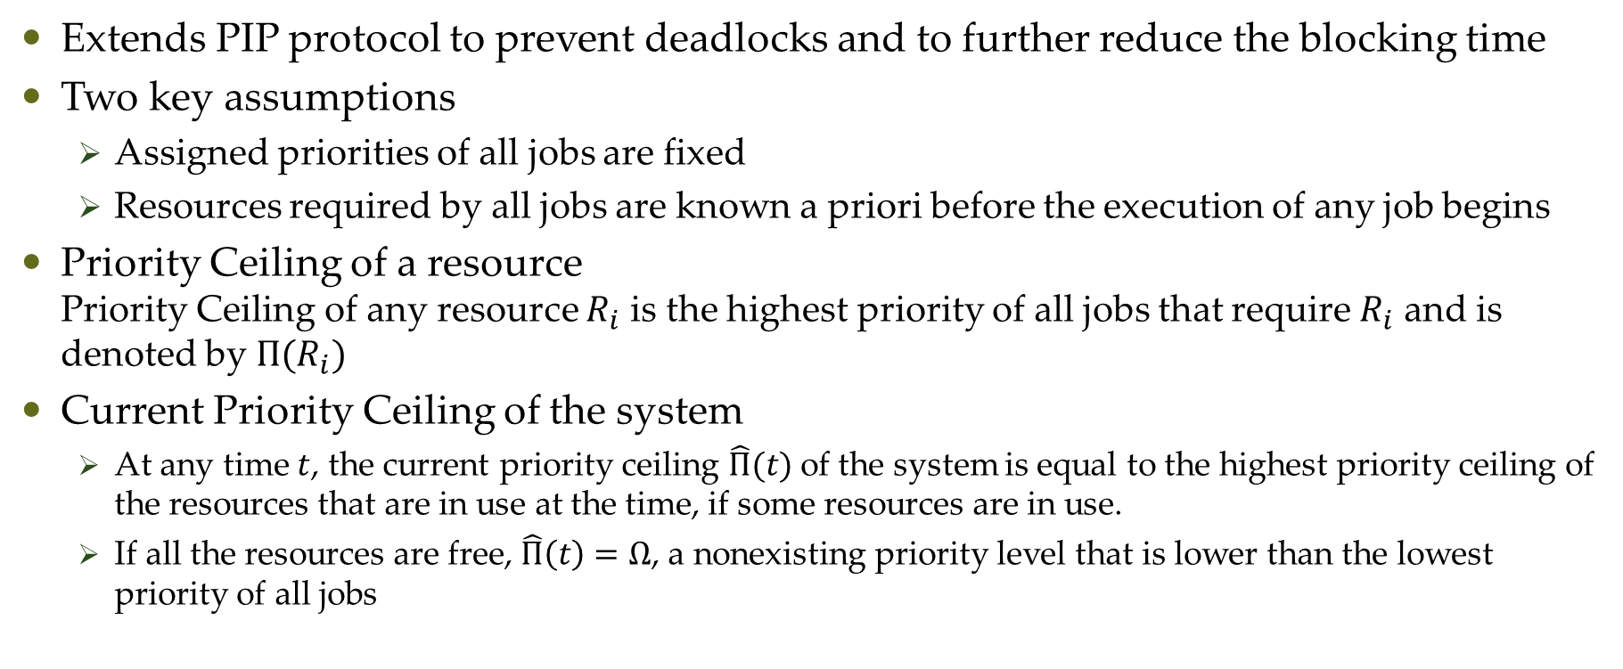
Basic Priority-Ceiling Protocol - Introduction
Extends PIP protocol to prevent deadlocks and to further reduce the blocking time
Two key assumptions
Assigned priorities of all jobs are fixed
Resources required by all jobs are known a priori before the execution of any job begins
Priority Ceiling of a resource Priority Ceiling of any resource $R_{i}$ is the highest priority of all jobs that require $R_{i}$ and is denoted by $Π(R_{i})$
Current Priority Ceiling of the system
At any time $t$, the current priority ceiling $\hat{Π}(t)$ of the system is equal to the highest priority ceiling of the resources that are in use at the time, if some resources are in use.
If all the resources are free, $\hat{Π}\left(t\right)=Ω$, a nonexisting priority level that is lower than the lowest priority of all jobs

Slide 9
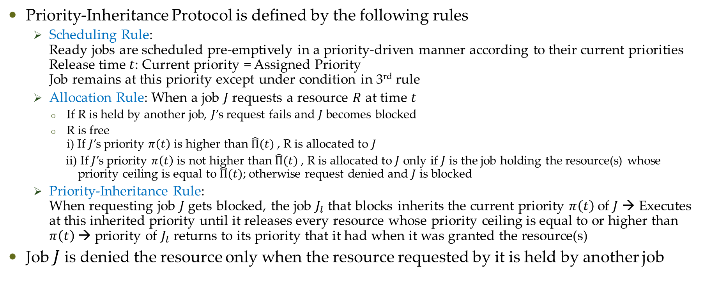
Basic Priority-Ceiling Protocol - Introduction
Priority-Inheritance Protocol is defined by the following rules
Scheduling Rule: Ready jobs are scheduled pre-emptively in a priority-driven manner according to their current priorities Release time $t$: Current priority = Assigned Priority Job remains at this priority except under condition in 3rd rule
Allocation Rule: When a job $J$ requests a resource $R$ at time $t$
If R is held by another job, $J$’s request fails and $J$ becomes blocked
R is free i) If $J$’s priority $π\left(t\right)$ is higher than $\hat{Π}(t)$, R is allocated to $J$
ii) If $J$’s priority $π\left(t\right)$ is not higher than $\hat{Π}(t)$, R is allocated to $J$ only if $J$ is the job holding the resource(s) whose priority ceiling is equal to $\hat{Π}(t)$; otherwise request denied and $J$ is blocked
Priority-Inheritance Rule: When requesting job $J$ gets blocked, the job $J_{l}$ that blocks inherits the current priority $π\left(t\right)$of $J$ → Executes at this inherited priority until it releases every resource whose priority ceiling is equal to or higher than $π\left(t\right)$→ priority of $J_{l}$ returns to its priority that it had when it was granted the resource(s)
Job $J$ is denied the resource only when the resource requested by it is held by another job

Slide 10
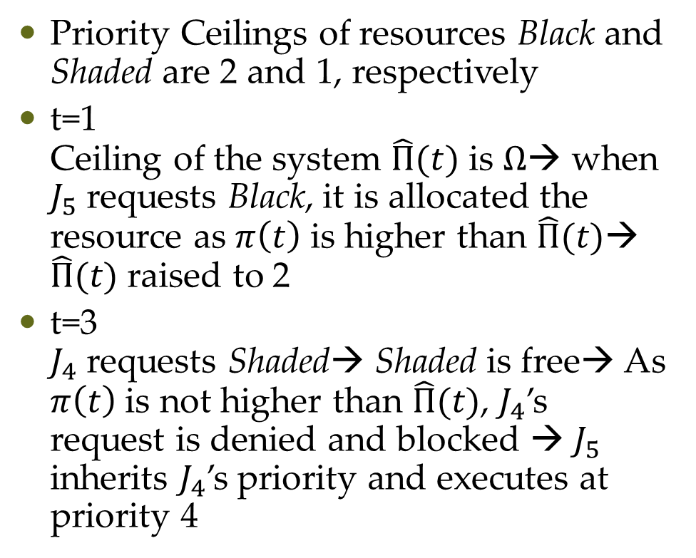
Basic Priority-Ceiling Protocol - Example
Priority Ceilings of resources Black and Shaded are 2 and 1, respectively
t=1 Ceiling of the system $\hat{Π}(t)$ is $Ω$→ when $J_{5}$ requests Black, it is allocated the resource as $π\left(t\right)$ is higher than $\hat{Π}(t)$→ $\hat{Π}(t)$ raised to 2
t=3 $J_{4}$ requests Shaded→ Shaded is free→ As $π\left(t\right)$ is not higher than $\hat{Π}(t)$, $J_{4}$’s request is denied and blocked → $J_{5}$ inherits $J_{4}$’s priority and executes at priority 4

Slide 11
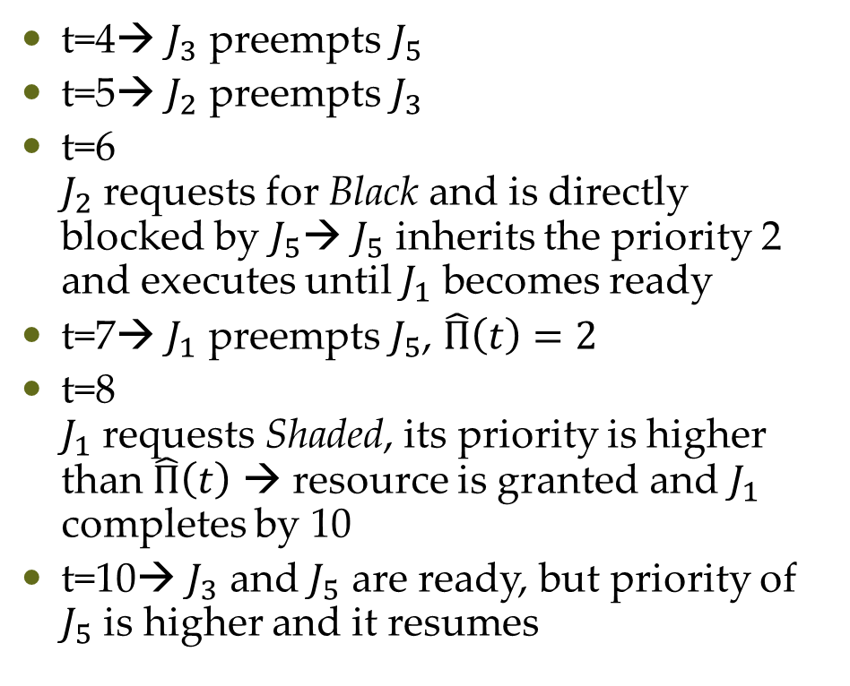
Basic Priority-Ceiling Protocol - Example
t=4→ $J_{3}$ preempts $J_{5}$
t=5→ $J_{2}$ preempts $J_{3}$
t=6 $J_{2}$ requests for Black and is directly blocked by $J_{5}$→ $J_{5}$ inherits the priority 2 and executes until $J_{1}$ becomes ready
t=7→ $J_{1}$ preempts $J_{5}$, $\hat{Π}\left(t\right)=2$
t=8 $J_{1}$ requests Shaded, its priority is higher than $\hat{Π}\left(t\right)$ → resource is granted and $J_{1}$ completes by 10
t=10→ $J_{3}$ and $J_{5}$ are ready, but priority of $J_{5}$ is higher and it resumes

Slide 12
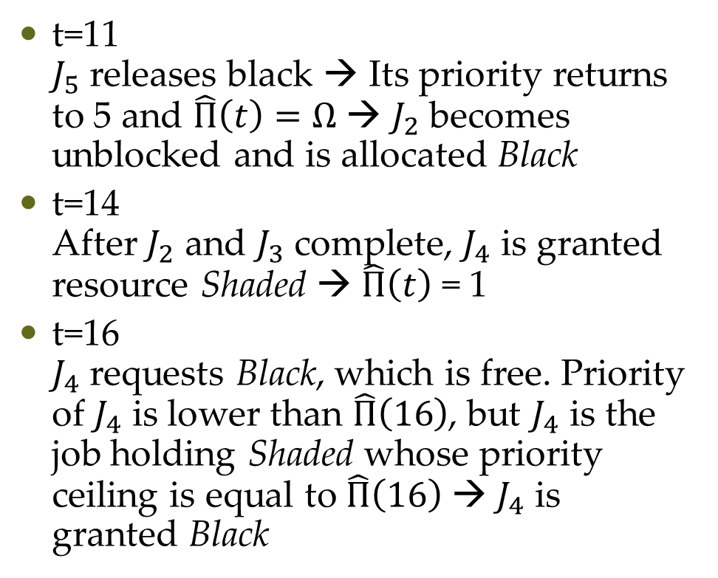
Basic Priority-Ceiling Protocol - Example
t=11 $J_{5}$ releases black → Its priority returns to 5 and $\hat{Π}\left(t\right)=Ω$ → $J_{2}$ becomes unblocked and is allocated Black
t=14 After $J_{2}$ and $J_{3}$ complete, $J_{4}$ is granted resource Shaded → $\hat{Π}\left(t\right)$ = 1
t=16 $J_{4}$ requests Black, which is free. Priority of $J_{4}$ is lower than $\hat{Π}\left(16\right)$, but $J_{4}$ is the job holding Shaded whose priority ceiling is equal to $\hat{Π}\left(16\right)$ → $J_{4}$ is granted Black

Slide 13
Basic Priority-Ceiling Protocol
Direct Blocking
Priority-Inheritance Blocking
Avoidance Blocking

Slide 14
Questions?

