Slide 1
Clustering with Genetic Algorithm
Dimas Kamurapi 05111640000002
M Adistya Azhar 05111640000103
Faizal Khilmi M 05111640000120

Slide 2
Singleton
Data Set

Slide 3
Car Evaluation Data set
Number of Attributes : 6
Number of Instances : 1728
Attribute Characteristics : Categorical
Attribute Information
Class Values:
unacc, acc, good, vgood
Attributes:
buying: vhigh, high, med, low.
maint: vhigh, high, med, low.
doors: 2, 3, 4, 5more.
persons: 2, 4, more.
lug_boot: small, med, big.
safety: low, med, high.

Slide 4
Singleton
Flow Chart

Slide 5
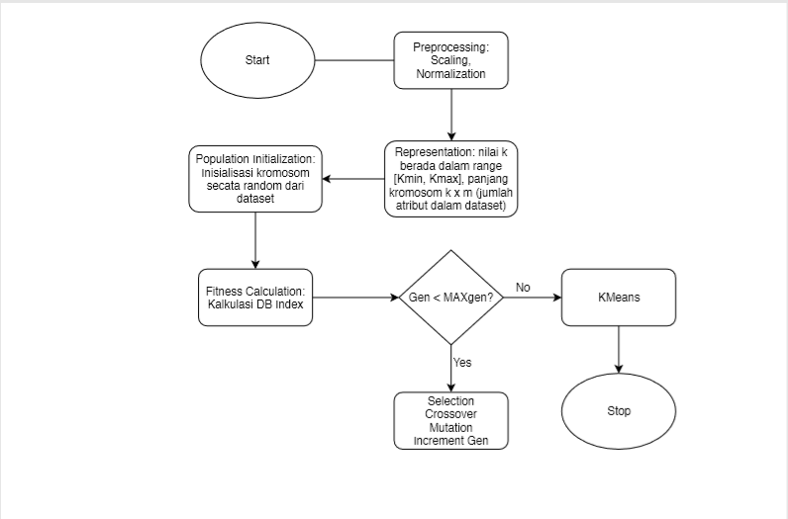
Flow Chart

Slide 6
Singleton
Environment

Slide 7
Python 3.6 with library (numpy & panda) for processing data
Javascript for GUI

Slide 8
Singleton
Input Output

Slide 9
Input :
Dataset
Kmax
MaxGen
Number of Individual
Output :
Cluster Centroid
Error Rate

