Slide 1





FOOD PRESERVATION THROGH DATA SCIENCE

Slide 2



IDEATION

Slide 3




DATA SCIENCE

Slide 4
APPLICATION AND FUTURE THOUGHTS
Preservability can be found easily.
We can classify the factors into preservable and non preservable conditions
We are looking forward to make this dataset much more relevant to out real world and train the algorithm much more effectively
It might be a sensation If any industry can implement this data science in their business field

Slide 5
THANK YOU☺

Slide 6
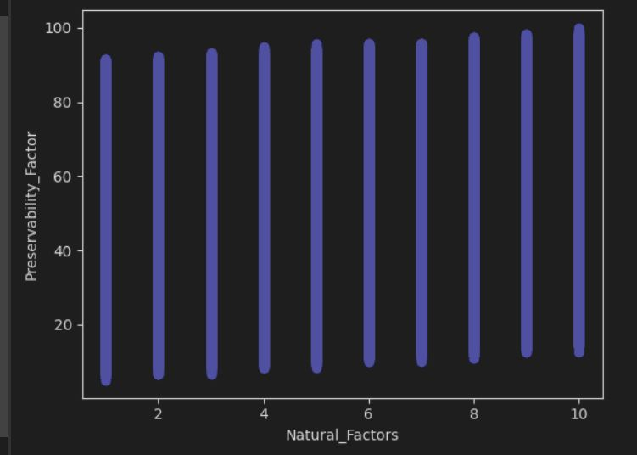
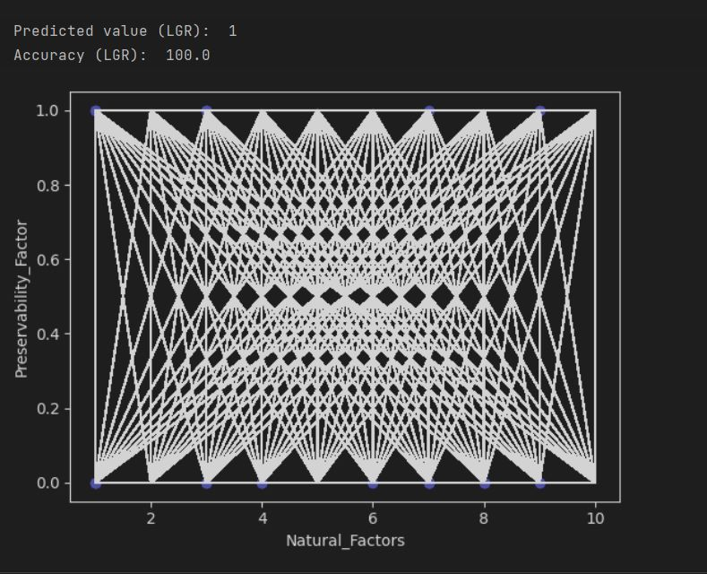
CODE AND OBSERVATIONS

Slide 7
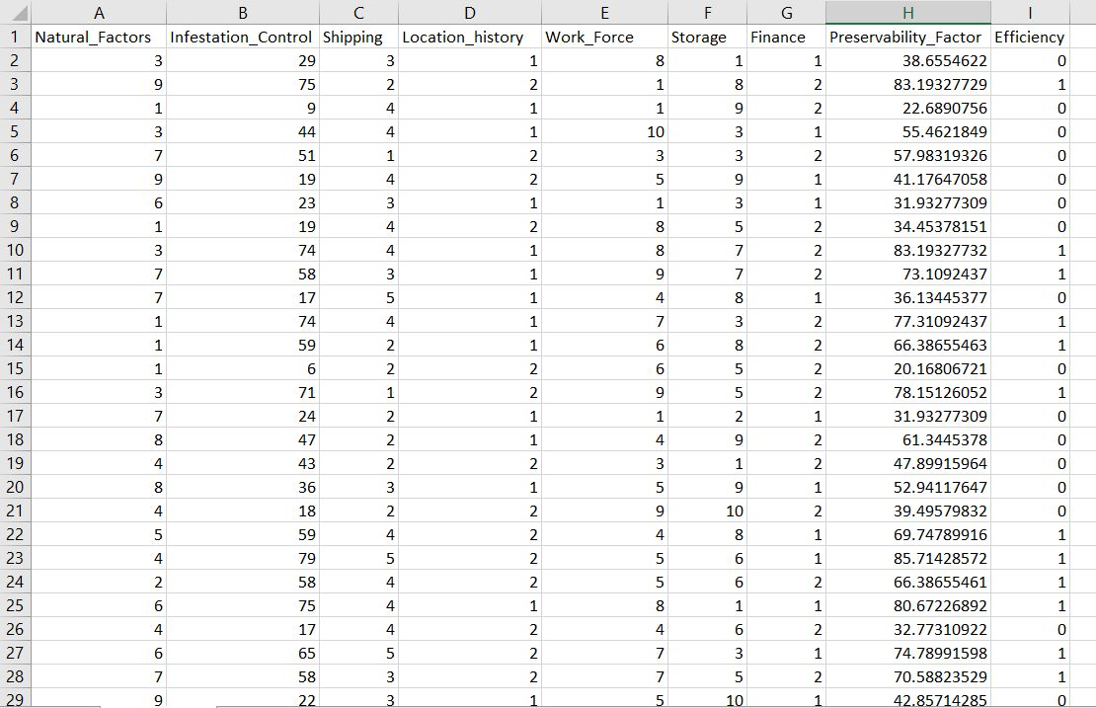
DATASET

Slide 8
OUTCOME AND BUSINESS USE CASE
The major outcome we get from this model is preservability.
BUSINESS USE CASE: Preserving the food is one of the major challenge that food manufacturing industry is facing now a days. By analyzing the data accurately at each and every step of manufacturing and storing process we can ace the preservability of a food material. As the preservability increases it in turn increase the profitability of the company.

Slide 9
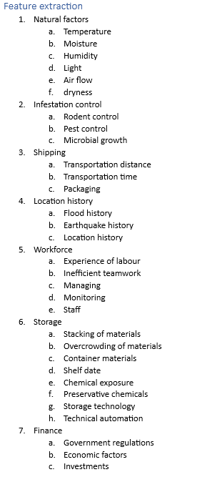
Feature Engineering
After considering the created features, we went through the phase of feature selection and reduction and extracted the following features
1. Natural_Factors
2. Infestation_control
3. Shipping
4. Location_history
5. Work_Force
6. Storage
7. Finance

Slide 10
Many industries can manufacture food , But only some can preserve food efficiently and profitably.
Outcome: Preservability of Material

Slide 11
