Slide 1

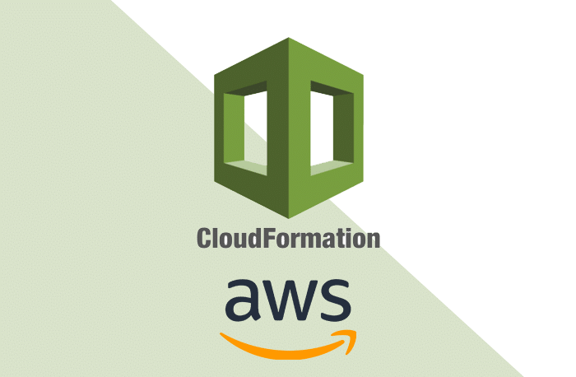
AWS CloudFormation overview
Amazon web services

Slide 2
AGENDA About Cloud Formation Create EC2 Instance Create S3 bucket Create Lambda function Template creation Stack Creation Getting Instance list using Lambda
Amazon web services

Slide 3
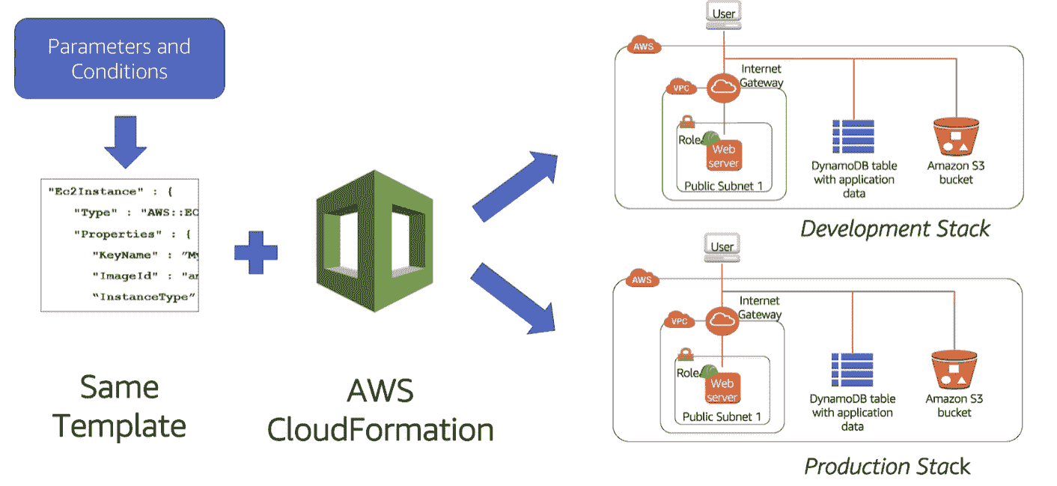
CloudFormation: CloudFormation is an infrastructure automation platform for AWS that deploys AWS resources in a repeatable, testable and auditable manner.
Amazon web services

Slide 4
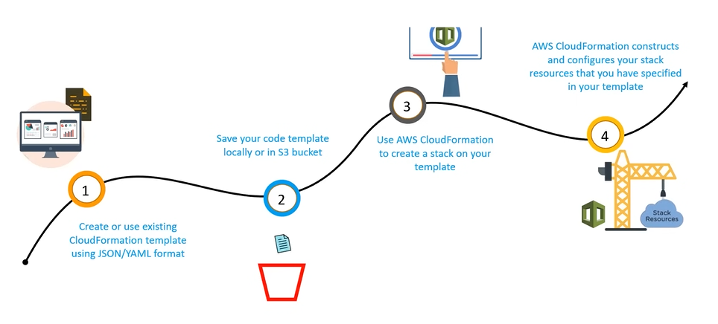
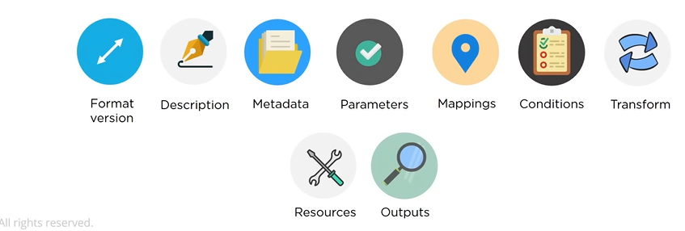
Template: format text file in JSON or YAML language that describe ours aws infrastructure . to create and modify templates we can use aws CloudFormation designer or text editor tool basic structure of cloud formation: { "AWSTemplateFormateVersion" : "2010-09-09", "Description" : "", "Metadata" : {}, "Parameter" : {}, "Mapping" : {}, "Conditions" : {}, "Resources" :{}, "Outputs" :{} }
Amazon web services

Slide 5
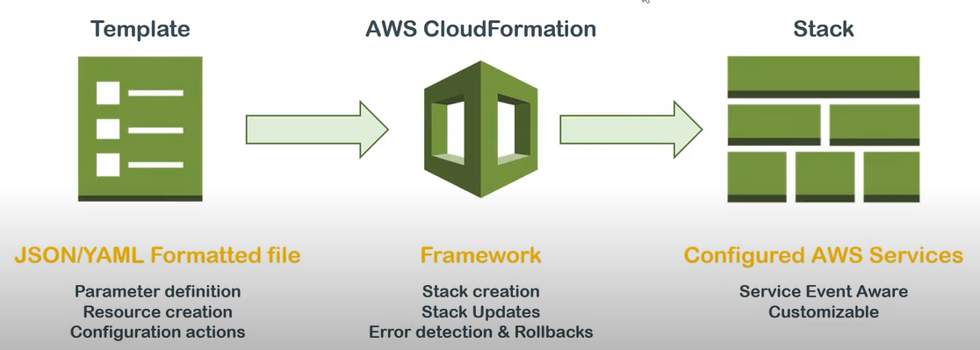
Stack: A collection od resources is called a Stack and it can be managed in a single unit CloudFormation template define a stack in which the resources can be create, delete or update in a predictable way. Or stack is a collection of AWS resources that you can manage as a single unit. 2 ways we can create stack using CloudFormation 1st way - including the function within the cloud template 2nd way - storing the zip file in s3 bucket and adding the cloud formation template
Amazon web services

Slide 6
Few main AWS services:: EC2:- You can use CloudFormation to define EC2 instances, including their AMI, instance type, security groups, and more. S3:-You can use CloudFormation to define S3 buckets, including their bucket policy, encryption settings, and lifecycle rules. Lambda:-The following template uses an AWS Lambda (Lambda) function and custom resource to append a new security group to a list of existing security groups.
Overall, CloudFormation provides a powerful way to automate and manage your infrastructure in AWS, enabling you to deploy resources quickly and consistently, while also reducing the risk of errors and saving costs. By following these best practices, how to create,Ec2, Service using cloud Formation and how to control, and how to delete long term instance delete also scalable, cost-effective, and flexible EC2 deployments using CloudFormation.
Amazon web services

