Slide 1
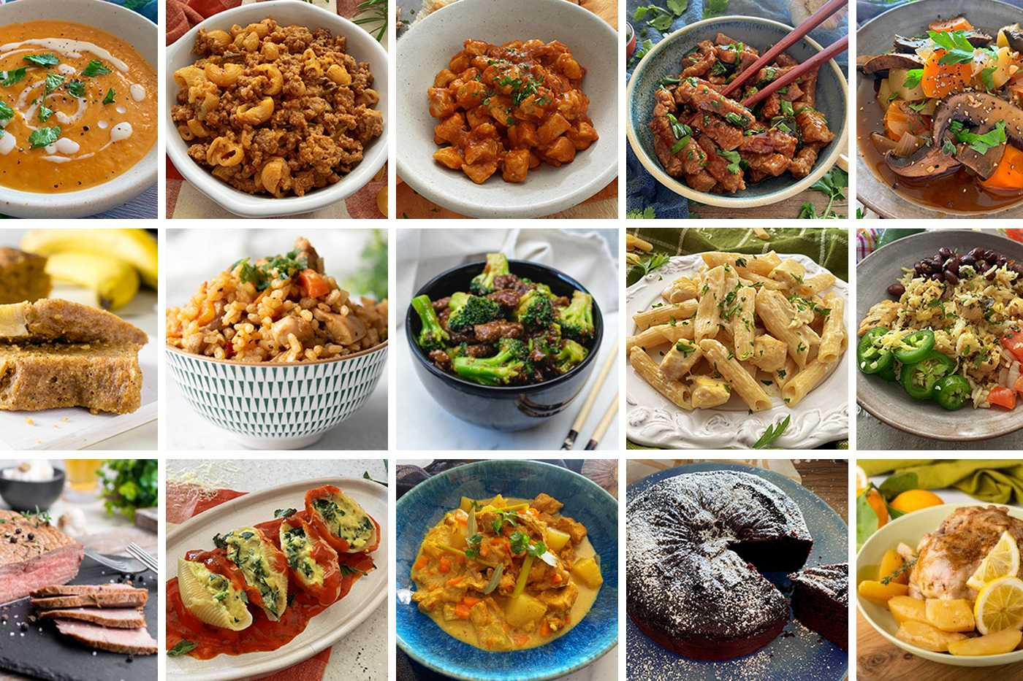
REAL LIFE LAB (RLL) PROJECT
PROJECT NAME : Food Recipes
GROUP-2
Presented By :
Aditya Raj 2587374
Chaitra Reddy R 2587574
Chappidi Charitha 2587321
Chetan Kumbar 2587004
Daggumati Venkata Satya Karthik 2587378
Dolu Indu 2586864
Gorrela Purna Srilakshmi 2587564
Gurram Thulasiram Reddy 2586993

Slide 2
CONTENTS
Title
Contents
Modules
Objective
Introduction
Admin and user components
Software requirements
Food Recipes app
Database schema
Testing reports
Conclusion
Thank you

Slide 3
MODULES
Name | Domain | Modules
1. Aditya Raj | FSD User/ Admin | Sign In & Welcomepage
2. Chaitra Reddy R | FSD User | Reset Password
3. Chappidi Charitha | FSD User | Homepage & Receipe
4. Chetan Kumbar | FSD Admin/User | Sign up
5. Daggumati Venkata Satya Karthik | FSD User | Update Profile
6. Dolu Indu | FSD User | Review & User Dashboard
7. Gorrela Purna Srilakshmi | FSD Admin | Admin Review & Admin Dashboard
8. Gurram Thulasiram Reddy | FSD Admin | Admin Receipe & Admin Homepage

Slide 4
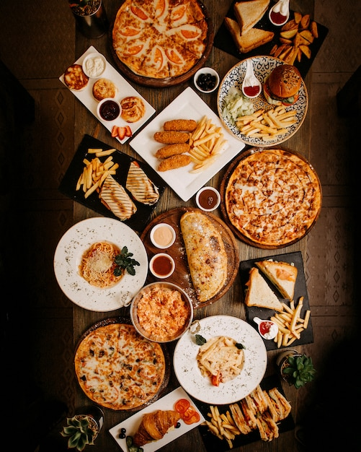
OBJECTIVE
To Create a dynamic and responsive Java application to allow a user to register to the application and search for recipes online.
Time Saving
User -friendly
Flexible

Slide 5

INTRODUCTION
Food Recipes App has two parts
i.Admin
ii.User
The Admin Section is like the control hub of our Application, giving users to explore the app..
Users can create personalized accounts, conveniently review, and try the recipe.

Slide 6
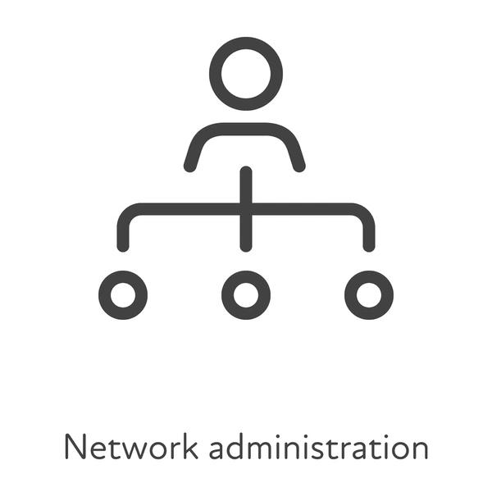
ADMIN AND USER
COMPONENTS

Slide 7
ADMIN COMPONENTS
Welcome page
Admin dashboard
Admin Registration
Admin login
Admin receipe
Admin review

Slide 8
USER COMPONENTS
User dashboard
User register
User login
Change Password
User profile
User review

Slide 9
SOFTWARE REQUIREMENTS
Database: MySql Workbench Back-end: Spring Boot Front-End: Angular Testing: Postman, Junit
Web Server:Tomcat

Slide 10
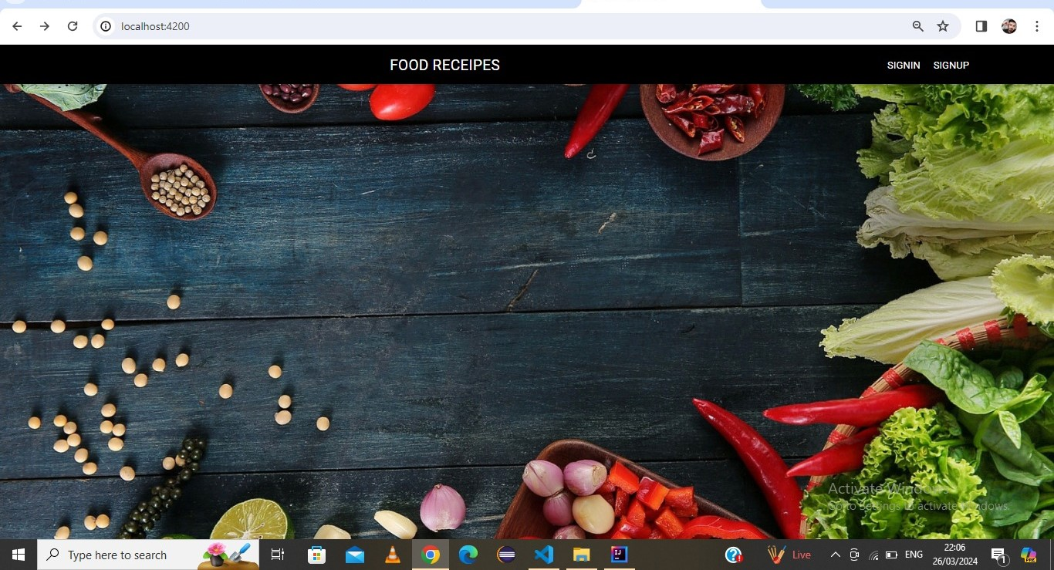
WELCOME PAGE

Slide 11
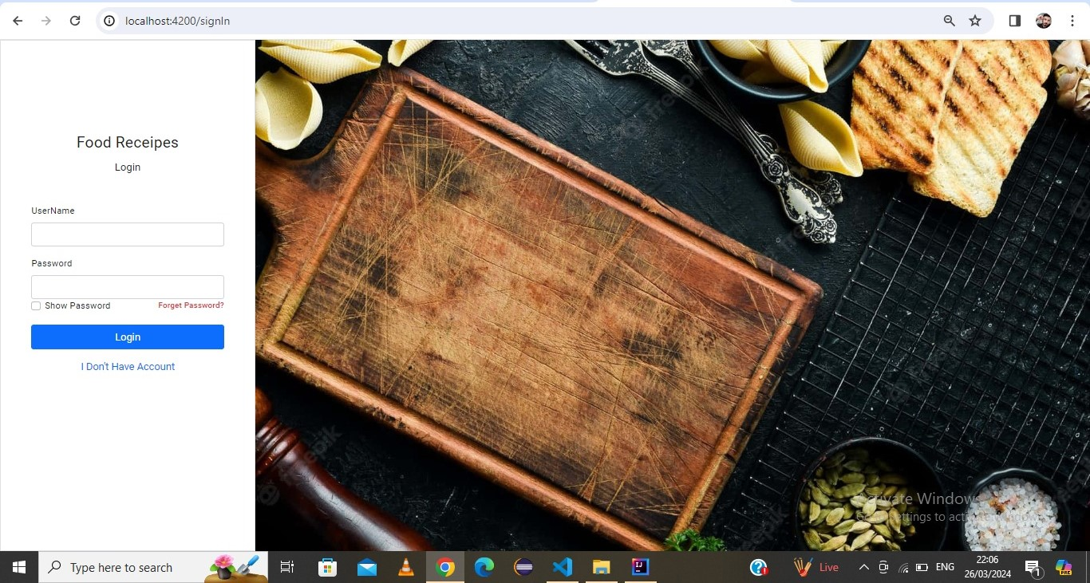
SIGN IN

Slide 12
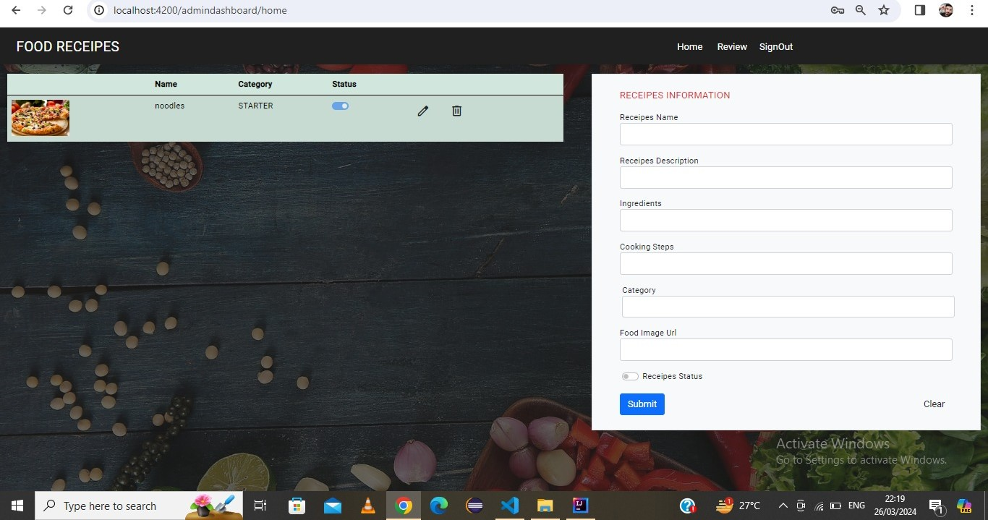
ADMIN DASHBOARD

Slide 13
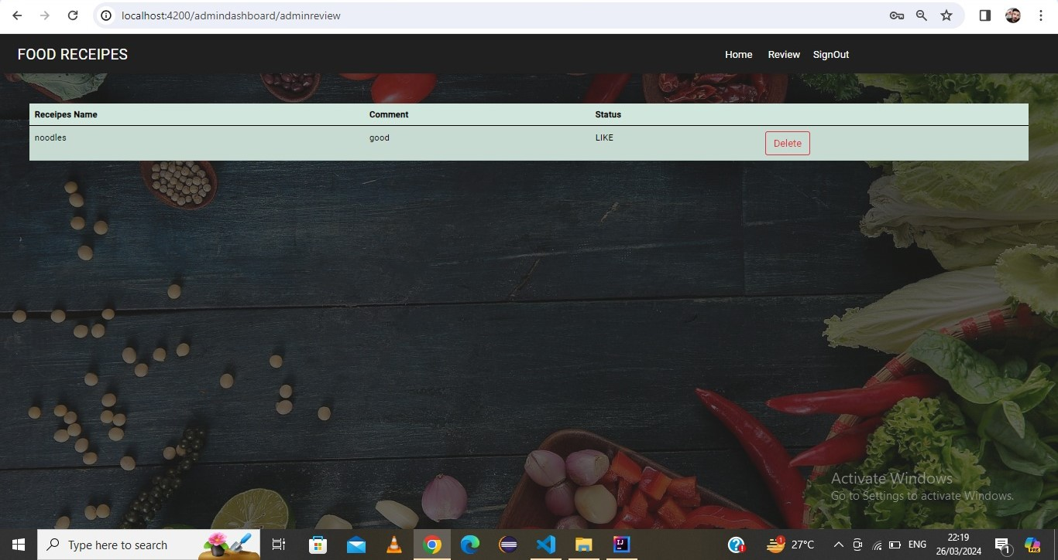
ADMIN REVIEW

Slide 14
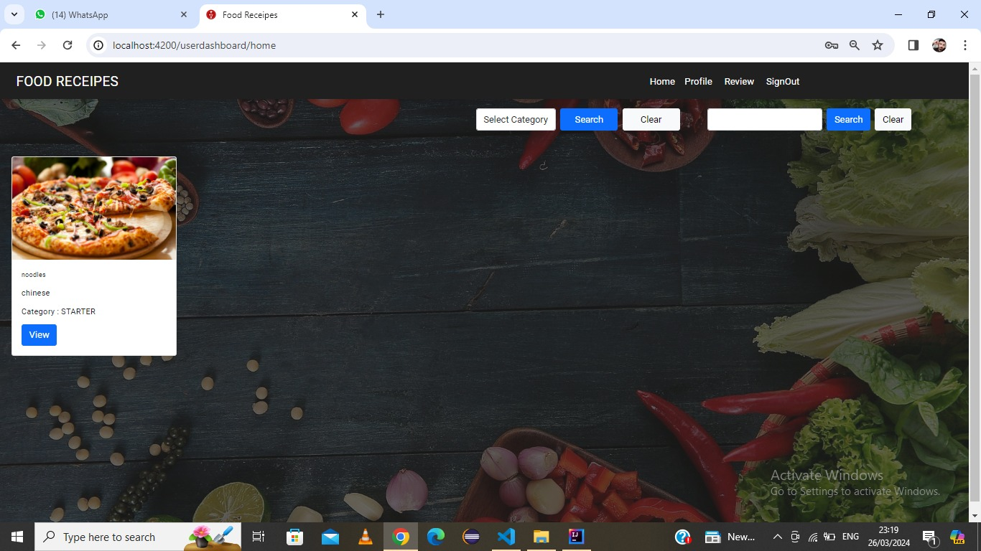
USER DASHBOARD

Slide 15
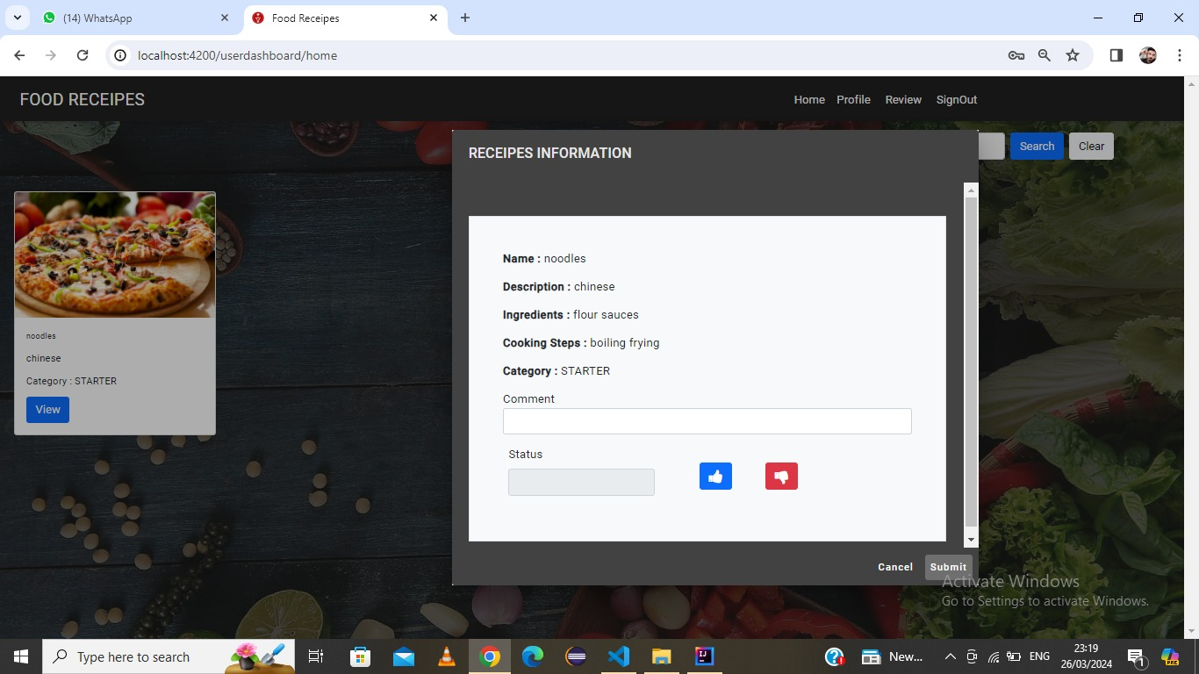
RECEIPE INFO DIALOG BOX

Slide 16
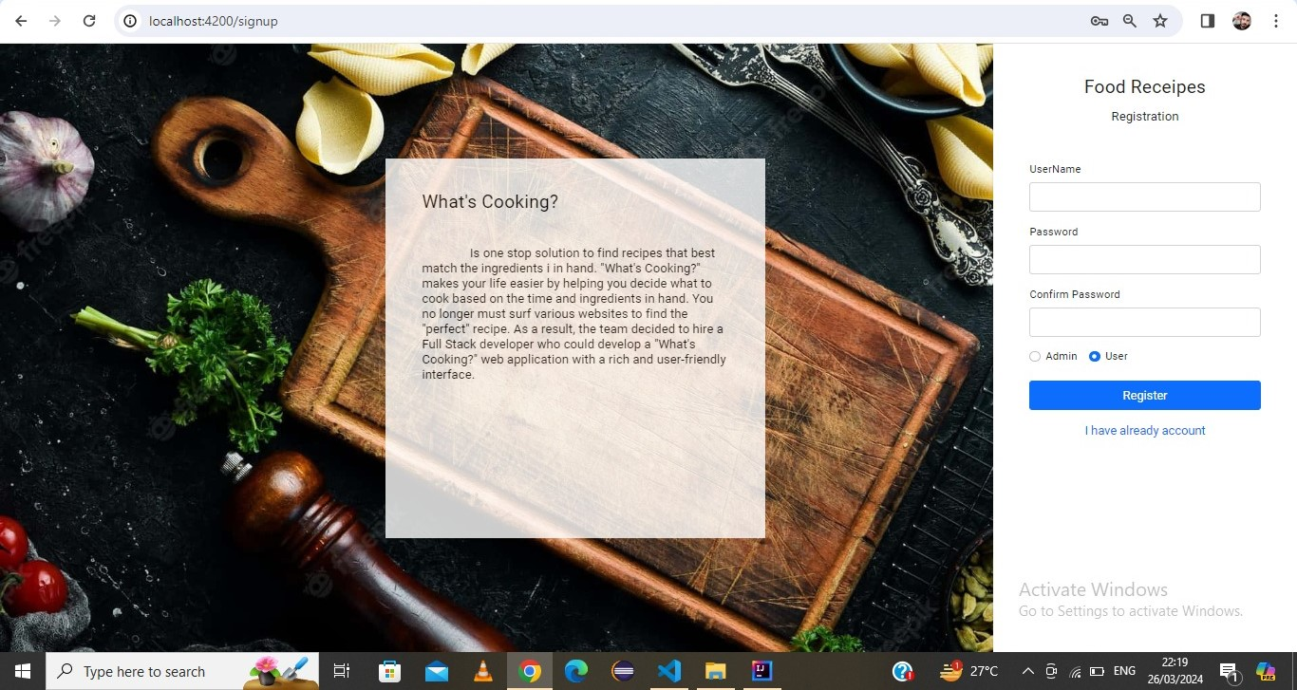
User REGISTRATION

Slide 17
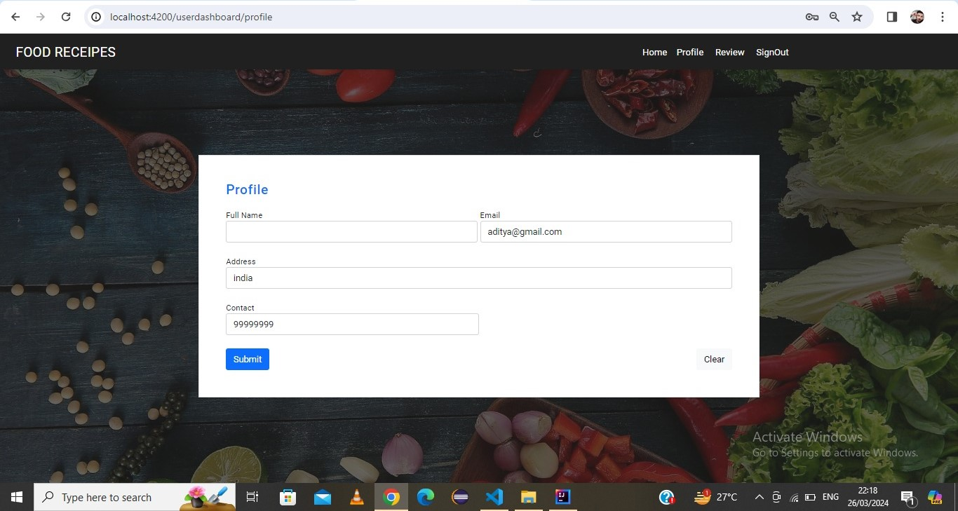
USER LOGIN

Slide 18
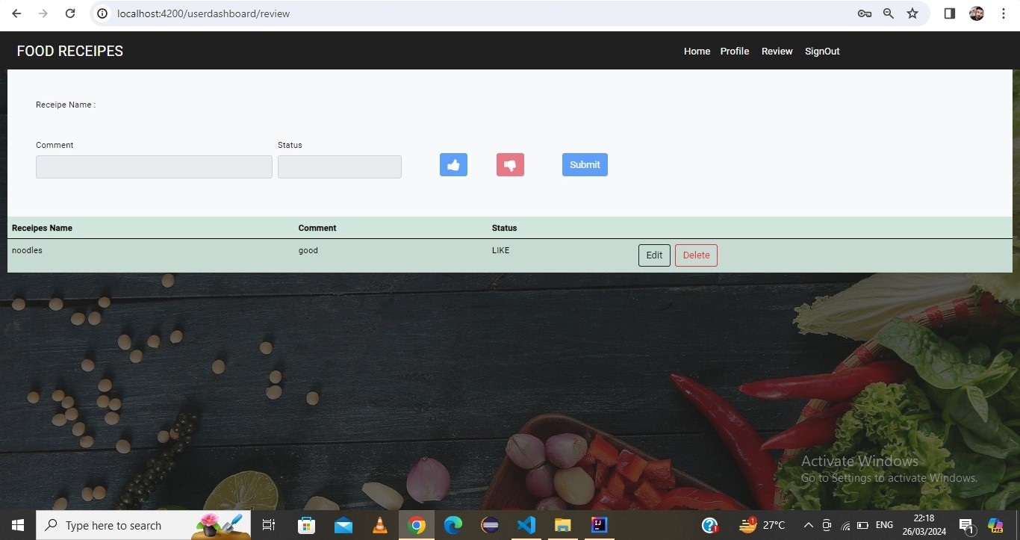
USER REVIEW

Slide 19
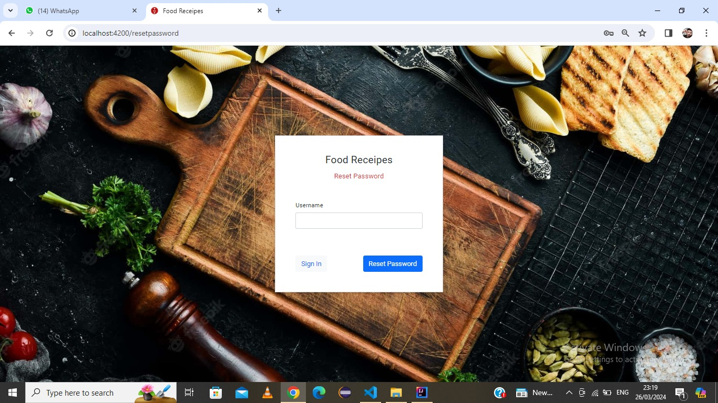
Change password

Slide 20
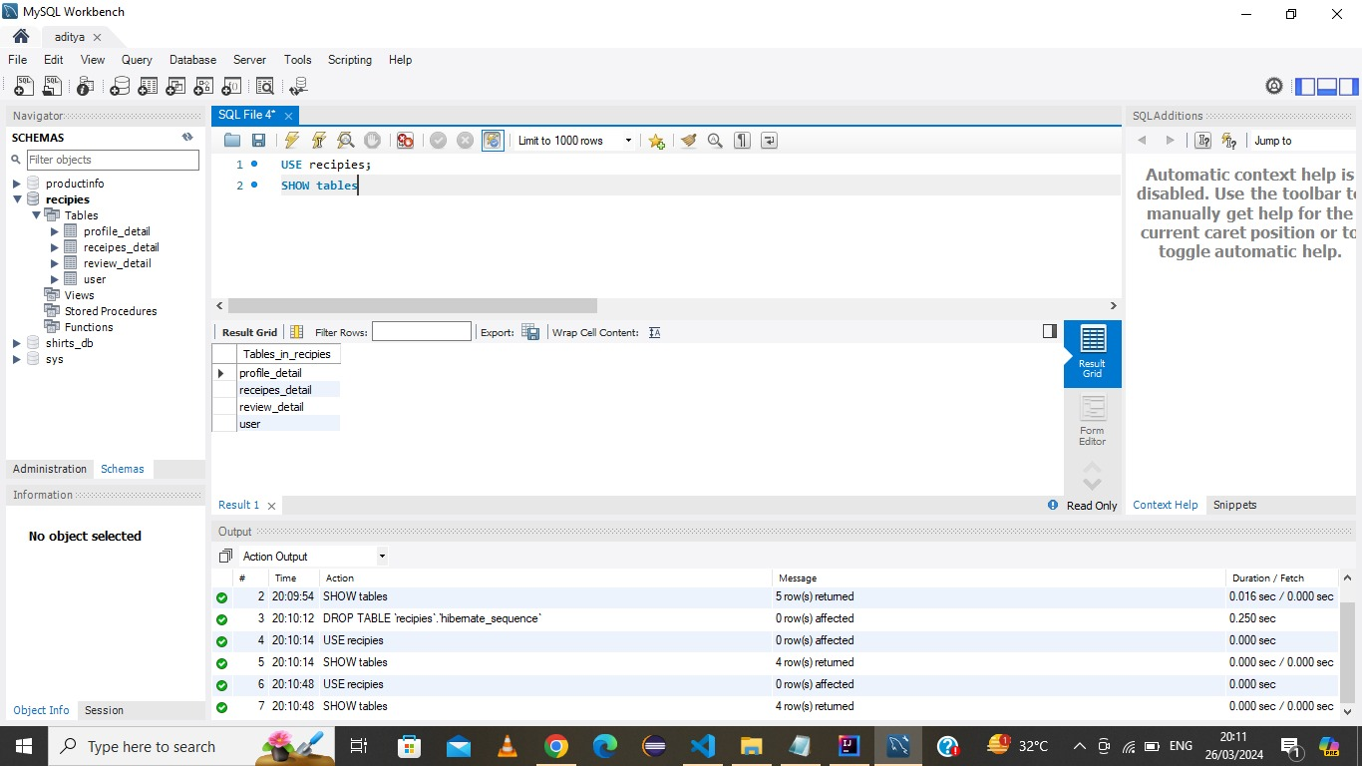
DATABASE SCHEMA

Slide 21

POSTMAN TESTING
REPORTS

Slide 22
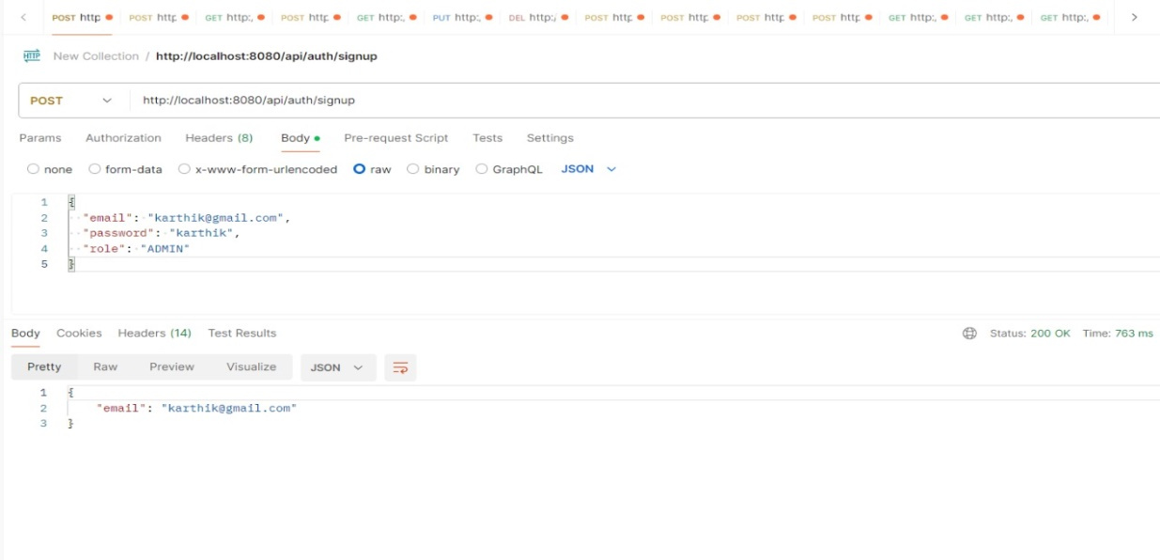
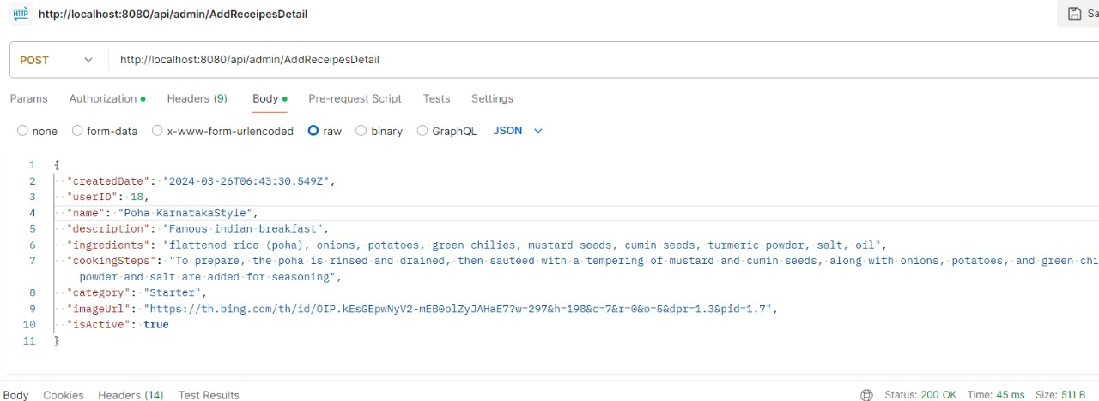
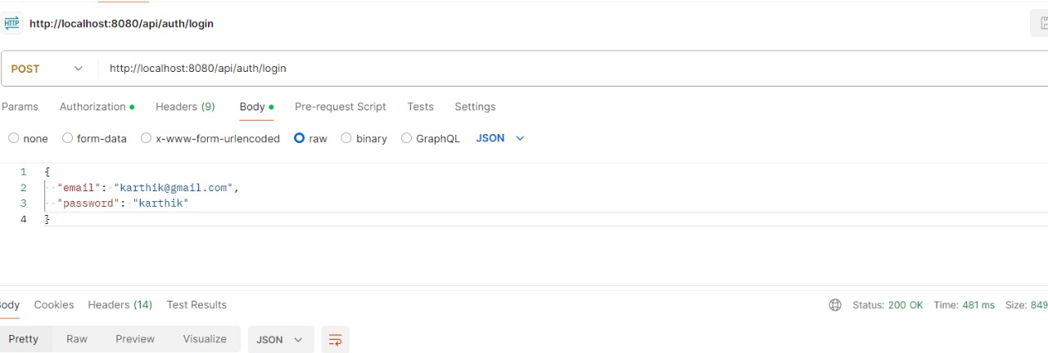
Admin

Slide 23
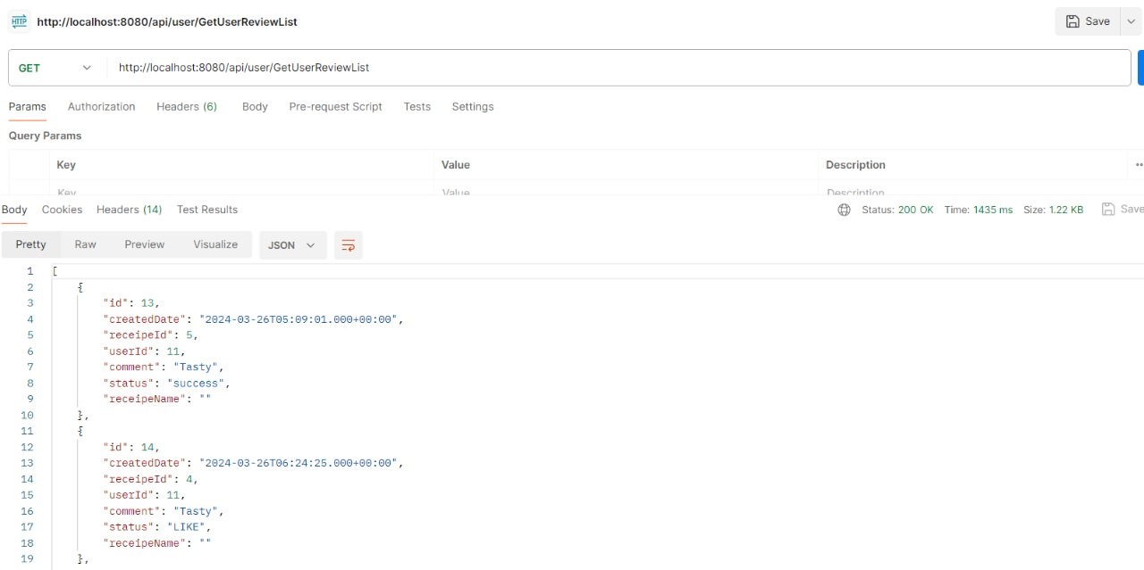
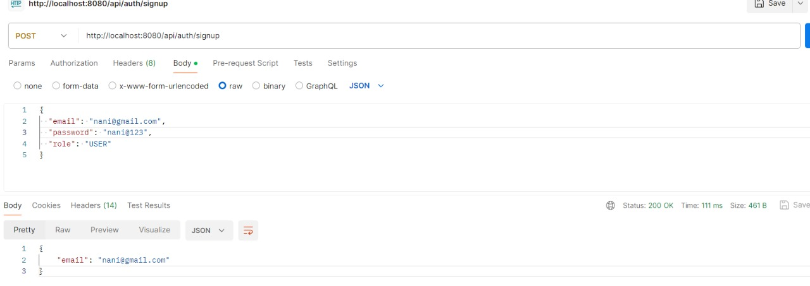
USER

Slide 24
CONCLUSION
The main objective of the application is to understand the concept and implementation of Java, Spring Boot, Databases and Angular technology.
Our project helps the users to easily find out their choice of taste and recipe.

Slide 25
THANK YOU !

