Slide 1
Covid-19 Impact analysis
Kesav Adithya Venkidusamy
DSC530 T301-2221 Exploratory data analysis
Dr. parajulee

Slide 2

What is covid-19
Coronavirus disease or COVID-19 is an infectious disease caused by the virus called sars-cov-2
Most people infected with the virus will experience mild to moderate respiratory illness and recover without requiring special Treatment. However, some will become seriously ill and require medical attention
The virus can spread from an infected person’s mouth or nose in small liquid particles when they cough, sneeze, speak, sing or breathe
Older people and those with underlying medical conditions like cardiovascular disease, diabetes, chronic respiratory disease, or cancer are more likely to develop serious illness
Anyone can get sick with COVID-19 and become seriously ill or die at any age

Slide 3

What is cdc and its role in covid-19?
The centers for disease control and prevention (CDC) is the national public health agency of the united states.
The agency's main goal is the protection of public health and safety through the control and prevention of disease, injury, and disability in the US and worldwide.
CDC is playing an essential role in the response to the Covid-19.
CDC’s response to COVID-19 is designed to limit human-to-human transmission, minimize the impact of COVID-19 in vulnerable countries with limited preparedness capacity, and reduce specific threats that pose current and future risk to Americans

Slide 4

Datasets for analysis
Numerous Covid-19 datasets available for public use in CDC websites.
Datasets feature case surveillance, deaths, population, race, sex, and age
CDC reports aggregate counts of COVID-19 cases and death numbers daily online.
Among numerous datasets available in CDC, below are ones considered for the analysis
Provisional COVID-19 Deaths by Sex and Age
Provisional COVID-19 Deaths by Week, Sex, and Age
Conditions contributing to COVID-19 deaths, by state and age, provisional 2020-2021

Slide 5
Datasets considered for analysis
Dataset 1: Provisional COVID-19 deaths by week, sex, and age
Data as of – Date of Analysis
State - Jurisdiction of occurrence
MMWR Week – MMWR week number
End Week - Last week-ending date of data period
Sex - Sex
Age Group - Age group
Total Deaths – Deaths from all causes of deaths
COVID-19 Deaths - Deaths Involving COVID-19
Dataset 2: Conditions contributing to COVID-19 deaths, by state and age, provisional 2020-2021
Start Date - First week-ending date of data period
End Date - Last week-ending date of data period
Group - Time-period Indicator for record: by Month, by Year, Total
State - Jurisdiction of occurrence
Condition - Condition contributing to deaths involving COVID-19
Age Group - Age group
COVID-19 Deaths - COVID 19 Deaths

Slide 6
VARIABLES from data set considered for analysis
Dataset 1: Provisional COVID-19 deaths by week, sex, and age
End Week - Last week-ending date of data period
Age Group - Age group
COVID-19 Deaths - Deaths Involving COVID-19
Age_split - Calculated field based on age; people having age less than 55 are classified as “Young” and greater are classified as “Old”
Dataset 2: Conditions contributing to COVID-19 deaths, by state and age, provisional 2020-2021
Start Date – Start of the month of data period
End Date – End of the month of data period
Condition - Condition contributing to deaths involving COVID-19
COVID-19 Deaths - COVID 19 Deaths
Underlying_condition - Calculated field based on underlying condition; those having underlying condition are populated with “Yes” and those don’t are populated with “No”

Slide 7
Data wrangling
Dataset 1: Provisional-COVID-19-Deaths-by-Week-Sex-and-Age
The dataset contains duplicate values on age_group. So, a filter condition has been applied on age_group field to select only “All Ages”
“end_week” field present in the dataset is in string format. It has been converted to datatime datatype using to_datetime function
“Covid_deaths” and “Total_deaths” fields present in dataset are in string format. The same has been converted to “float” type
Actual covid infection and deaths started occurring from the month of March and April of 2020. So, the previous months present in the dataset are removed.
Dataset 2: Conditions contributing to COVID-19 deaths, by state and age, provisional 2020-2021
This dataset contains duplicates in groups, state and age_group. So, filtered the data to select the group “By Month”, state as “United States” and age_group as “All Ages”
“start_date” and “end_date” are in string format. So, converted those columns to date format using “to_datetime” function
“Covid_deaths” field present in dataset is in string format. The same has been converted to “float” type
Actual covid infection and deaths started occurring from the month of March and April of 2020. So, the previous months present in the dataset are removed

Slide 8
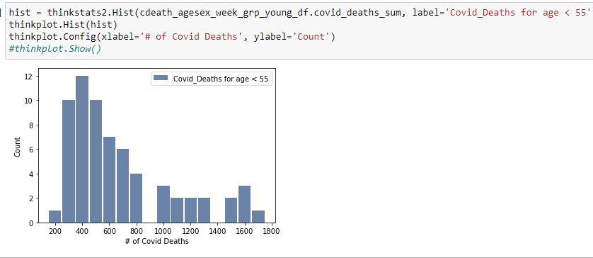
Histograms - Weekly Covid deaths by age
Weekly Covid deaths for age < 55
The histogram shown is for number of covid-19 deaths for the people having age less than 55.
The histogram shows positive skewness (right skewed)
The dataset contains the data for week ending date from 01/2020 to 08/2021.
The covid death count in the month of Jan, Feb and March of 2020 is negligible and considered as outliers as Covid infection and deaths due to covid started occurring from March and April 2020 respectively.
The outliers are removed from dataset by applying filter condition on week end date.

Slide 9
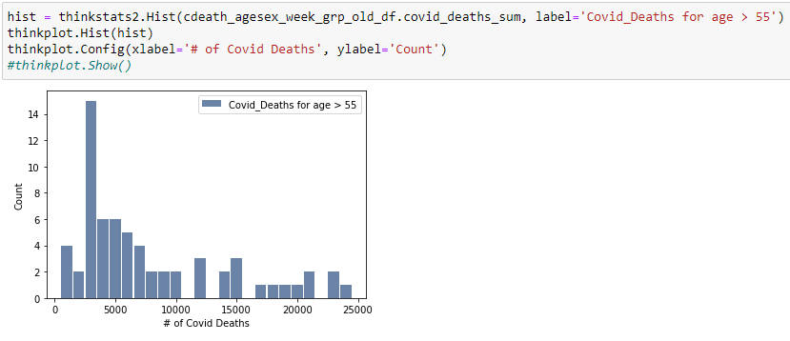
Histograms - Weekly Covid deaths by age
Weekly Covid deaths for age > 55
The histogram shown is for number of covid-19 deaths for the people having age greater than 55.
The histogram also shows positive skewness (right skewed)
The dataset contains the data for week ending date from 01/2020 to 08/2021.
The covid death count in the month of Jan, Feb and March of 2020 is negligible and considered as outliers as Covid infection and deaths due to covid started occurring from March and April 2020 respectively.
The outliers are removed from dataset by applying filter condition on week end date.

Slide 10
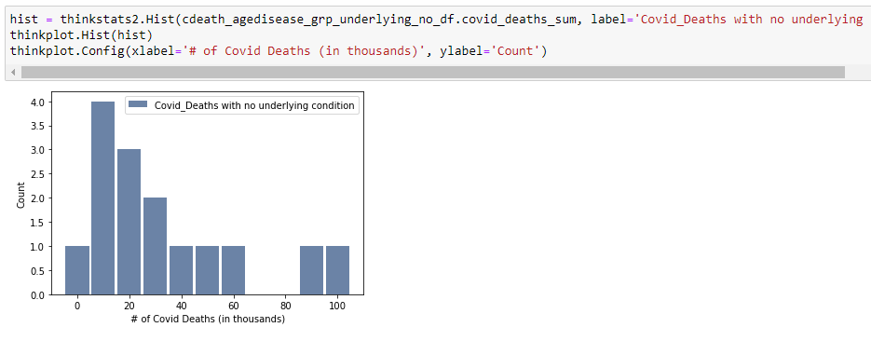
Histograms - monthly covid-19 death by underlying condition
Monthly Covid deaths with no underlying condition
The histogram shown is for number of covid-19 deaths for the people without any underlying conditions like cardiovascular problem, diabetes and blood pressure.
The histogram also shows positive skewness (right skewed)
The dataset contains the data for every month from 01/2020 to 08/2021.
The covid death count in the month of Jan, Feb and March of 2020 is negligible and considered as outliers as Covid infection and deaths due to covid started occurring from March and April 2020 respectively.
The outliers are removed from dataset by applying filter condition on month start date.
The aggregated death count has been converted to thousands to enhance the histogram result

Slide 11
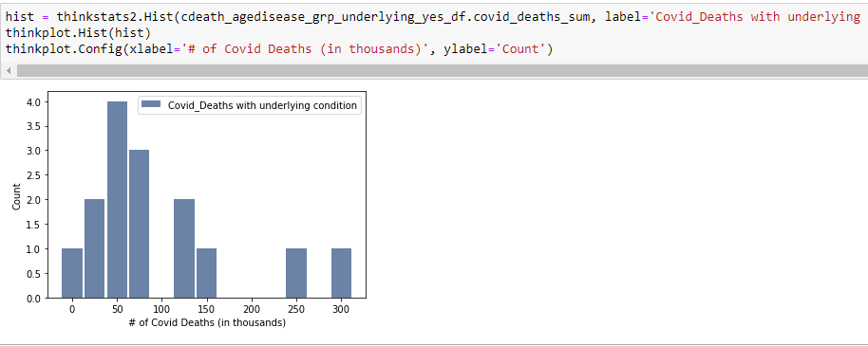
Histograms - monthly covid-19 death by underlying condition
Monthly Covid deaths with underlying condition
The histogram shown is for number of covid-19 deaths for the people with some underlying conditions like cardiovascular problem, diabetes and blood pressure.
The histogram also shows positive skewness (right skewed)
The dataset contains the data for every month from 01/2020 to 08/2021.
The covid death count in the month of Jan, Feb and March of 2020 is negligible and considered as outliers as Covid infection and deaths due to covid started occurring from March and April 2020 respectively.
The outliers are removed from dataset by applying filter condition on month start date.
The aggregated death count has been converted to thousands and round off to nearest 25 to enhance the histogram result

Slide 12
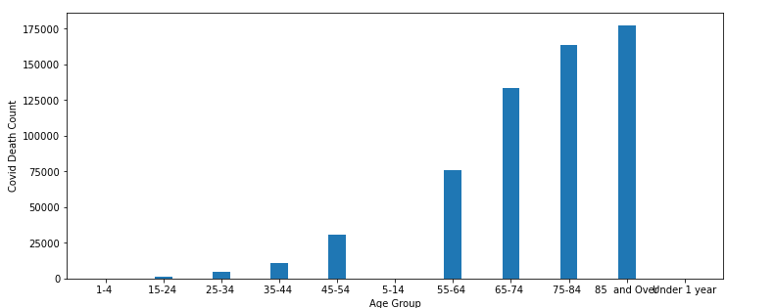
HISTOGRAMS
Total Number of covid deaths by Age group

Slide 13
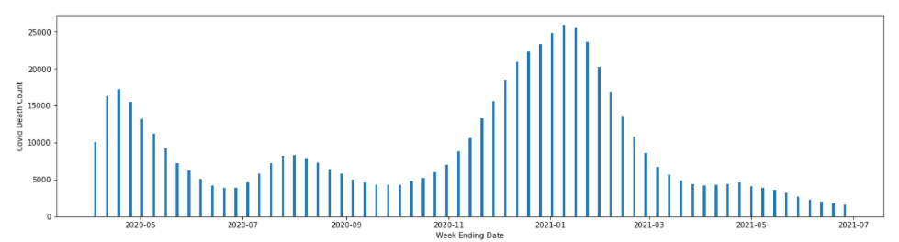
HISTOGRAMS
Total Number of covid deaths by week ending date

Slide 14
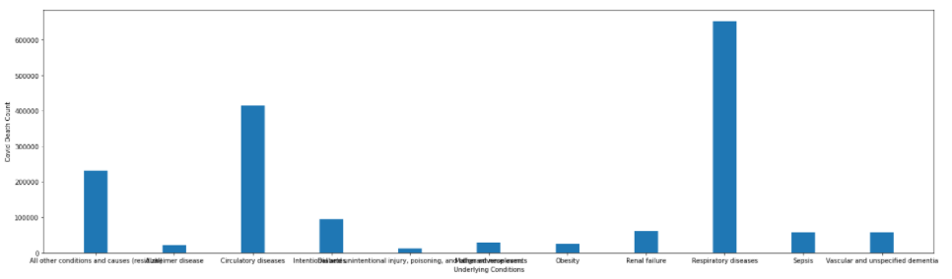
HISTOGRAMS
Total Number of covid deaths by underlying conditions

Slide 15
Summary Statistics
Weekly Covid deaths for age < 55
Mean: 681.54
Variance: 155278.85
Standard deviation: 394.05
Weekly Covid deaths for age > 55
Mean: 7907.69
Variance: 40366346.15
Standard deviation: 6353.45
Monthly Covid deaths without underlying condition
Mean: 33.33
Variance: 895.24
Standard Deviation: 29.92
Monthly Covid deaths underlying condition
Mean: 95
Variance: 7071.43
Standard Deviation: 84.09
Please note that the actual death count has been converted to thousands by dividing the values by 1000

Slide 16
Summary Statistics Analysis
Weekly Covid deaths for young and old people
The mean of covid-19 deaths for the younger people (having age less than 55) is very less (681.54) compared to older people (having age greater than 55) whose value is 7907.69.
The mean values tell the covid-19 death for older people is way high compared to young people.
The variance and standard deviation which is the spread of distribution is high for both kind of people.
This might be because infection and death count due to Covid is very less compared to the mean during the initial weeks and increased exponentially in the later weeks.
Monthly Covid deaths without underlying condition
The mean of monthly covid-19 deaths for the people without any underlying condition is less (33.33) compared to those having underlying conditions like blood pressure, diabetes and cardiovascular diseases whose value is 95
The mean values tell the covid-19 death for the people having underlying condition is high compared to those without any.
The variance and standard deviation which is the spread of distribution is high for both kind of people.
This might be because infection and death count due to Covid is very less compared to the mean during the initial weeks and increased exponentially in the later weeks.

Slide 17
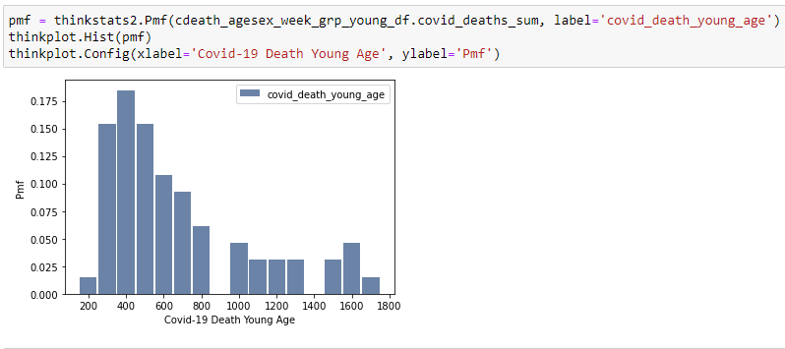
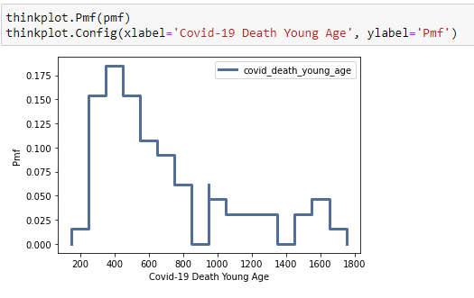
PMF - Weekly Covid-19 deaths for younger age
PMF of covid deaths for the young people using bar graph
PMF of covid deaths for the young people using step function

Slide 18
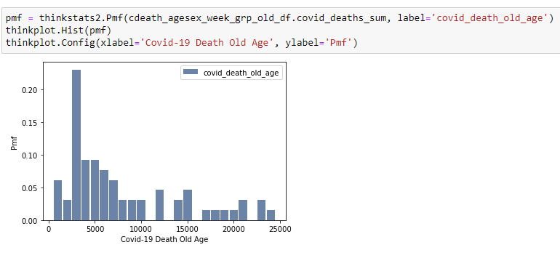
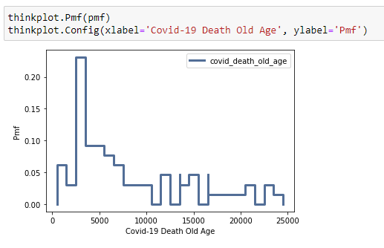
PMF - Weekly Covid-19 deaths for older age
PMF of covid deaths for the older people using bar graph
PMF of covid deaths for the older people using step function

Slide 19
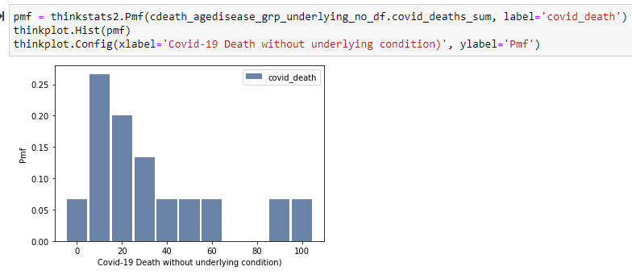
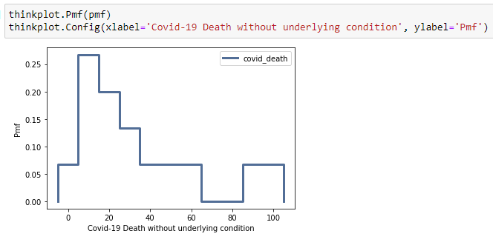
PMF - Monthly Covid-19 deaths for people without underlying condition
PMF of covid deaths for the people without underlying condition using bar graph
PMF of covid deaths for the people without underlying condition using step function

Slide 20
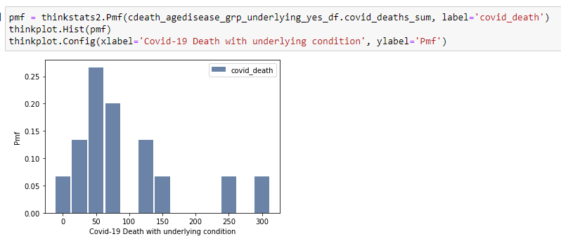
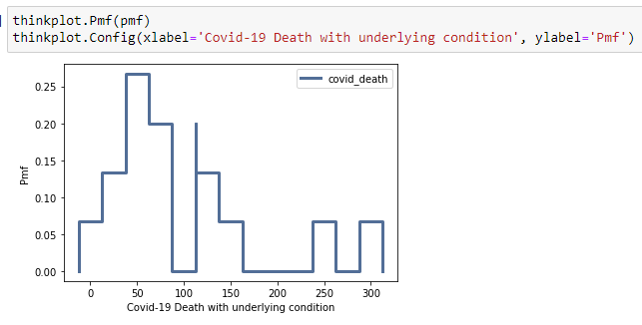
PMF - Monthly Covid-19 deaths for people with underlying condition
PMF of covid deaths for the people with underlying condition using bar graph
PMF of covid deaths for the people with underlying condition using step function

Slide 21
PMF Observation
Weekly Covid deaths for young and old people
PMF is probability mass function which maps each value to its probability
PMF of covid deaths for young and old people are represented using both bar graphs and step functions for easy understanding
From the PMF chart of weekly covid death count for young (age < 55) and old people (age >= 55), it is clear that its likely that covid death for old people is way high compared the covid death of young people
The death count for young people is in hundreds whereas it is in thousands for the old people having age greater than 55.
Monthly Covid deaths without underlying condition
Similarly, PMF of covid deaths for the people with and without underlying conditions are represented using both bar graphs and step functions for easy understanding
From the PMF chart of monthly covid death count for people with underlying condition and old people, it is clear that its likely that covid death for people with underlying condition is high compared the covid death of young people

Slide 22
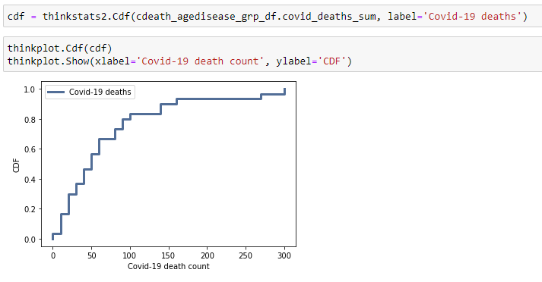
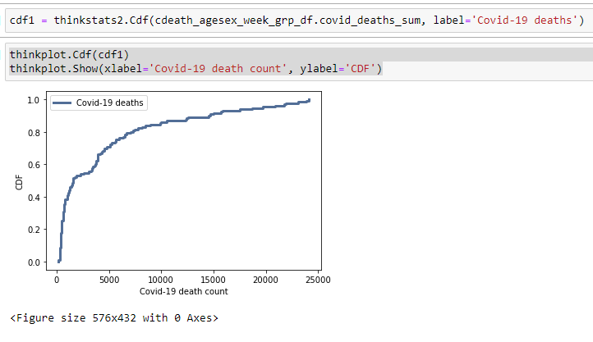
CDF - Monthly Covid-19 deaths
CDF of monthly covid death count by underlying condition
CDF of weekly covid death count by age

Slide 23
CDF Observation
CDF (Cumulative Distributed Function) is a function that maps from a value to a percentile rank
CDF generated for covid deaths by age tells that around 80% of the Covid deaths are less than or equal to 7500 which may corresponds to young people having age less than 55.
Similarly, CDF generated for monthly covid deaths for the people with and without underlying condition tells around 80% of the Covid deaths are less than 100 thousands (please note that value is divided by 1000).

Slide 24
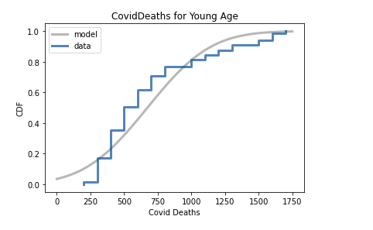
Analytical Distribution
Analysis
I wanted to compare the distributions of covid deaths for young people and old people.
The plot illustrates how approximately normal the covid deaths for young people (blue line) is compared to the normal modal (gray line).
It is relatively close but still deviates from the normal modal.

Slide 25
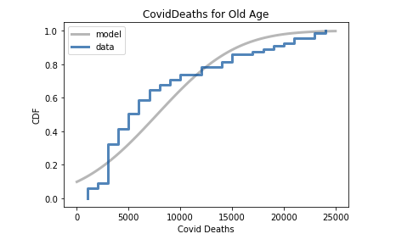
Analytical Distribution
The plot illustrates how approximately normal the covid deaths for old people (blue line) is compared to the normal modal (gray line).
Here also, we see deviation in the distribution compared to the normal modal.

Slide 26
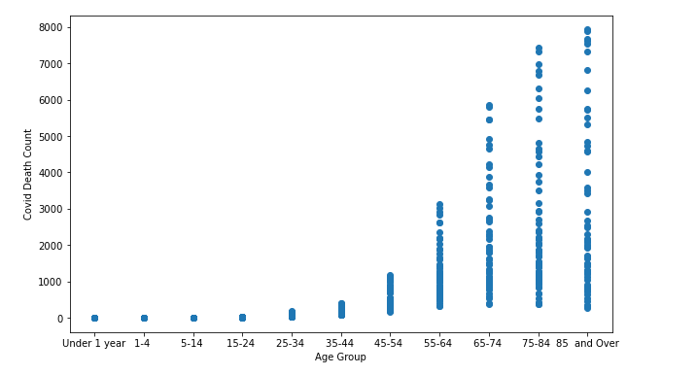
Scatter plots
In this scatter plots for the weekly covid deaths by age data, we can see that there is a spread of points for covid deaths is more for old people compared to young people. Moreover, the spread is below 2000 for younger people whereas spread is throughout the chart for older people.

Slide 27
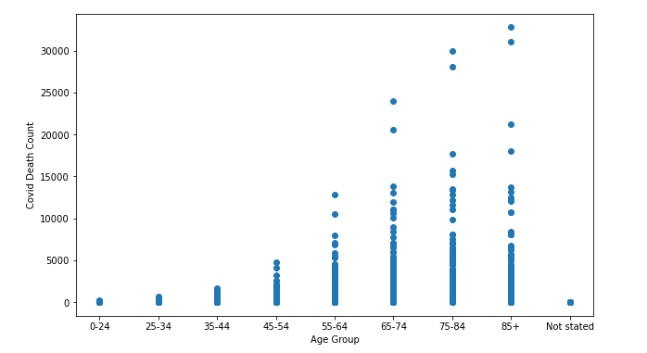
Scatter plots
In this scatter plots for the monthly covid deaths for the people with and without underlying condition also, we can see that there is a spread of points is more for the older people compared to young people. It make sense as older people are more prone to underlying conditions compared to young people

Slide 28
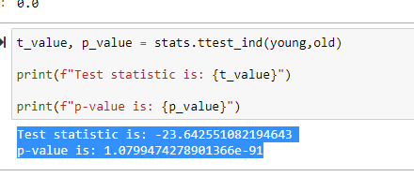
Hypothesis test - Weekly covid deaths for young and old people
Looking at the PMF graphs, I noticed the covid deaths for young and old people did not have a normal distribution, but looks like bimodal distribution. I want to compare the mean deaths for young and old people
Null Hypothesis
H0 = mean of covid deaths for young people == mean of covid deaths for old people
Alternative Hypothesis
HA = mean of covid deaths for young people != mean of covid deaths for old people
Observation: With a significant p-value, with 99% confidence, we can reject the null hypothesis in favor of alternative hypothesis that the difference in average covid death for young and old people is not due to chance

Slide 29
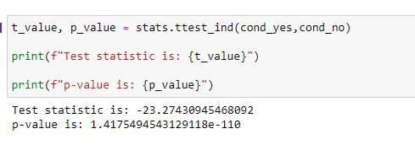
Hypothesis test - Monthly covid deaths for healthy people and people with underlying conditions
Looking at the PMF graphs, I noticed the covid deaths for the people with and without underlying conditions did not have a normal distribution, but looks like bimodal distribution. I want to compare the mean deaths for the people with and without underlying conditions
Null Hypothesis
H0 = mean of covid deaths for healthy people == mean of covid deaths for people with underlying conditions
Alternative Hypothesis
HA = mean of covid deaths for healthy people != mean of covid deaths for people with underlying conditions
Observation: Based on p-value, we can tell that the test is statistically significant and so we can reject the null hypothesis in favor of alternative hypothesis that the difference in average covid deaths of healthy and the people with underlying condition is not due to chance

Slide 30
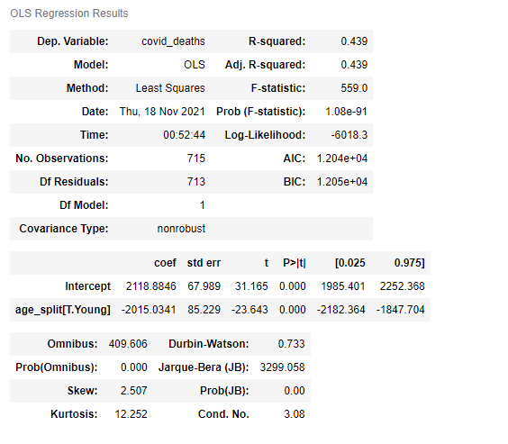
Regression analysis - Weekly covid deaths for young and old people
Simple Regression
Endog variable: Covid Deaths
Exog Variable: Young or old people
R-squared: 43.9%
Observation: Although p-values are significant for both young and old people, old age people (having age >= 55) is having high t value with 31.165 indicating the old age people are having correlation with Covid deaths compared to young age people (having age < 55) who t value is -23.643. These values confirm that covid death is seen high for old age people compared to young age people.

Slide 31
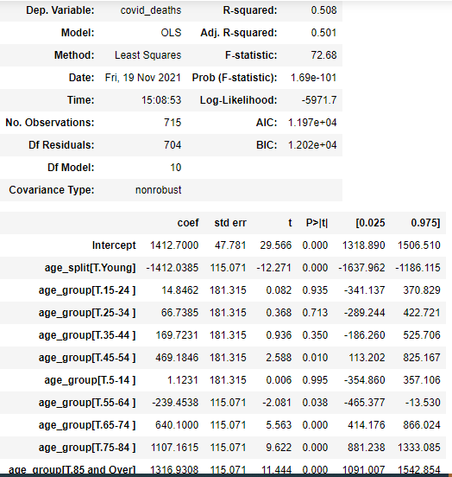
Regression analysis - Weekly covid deaths for young and old people
Multiple Regression
Dependent variable: Covid Deaths
Exog Variable: age split and age group
R-Squared: 50.8%
Observation: The p-values for young people (having age < 55) are in the range of .01 to 0.995 which implies that these age don’t have much impact on dependent variable “Covid deaths”. However, the p-values for old people are statistically significant implies major covid deaths are occurred to old age people (having age > 55).

Slide 32
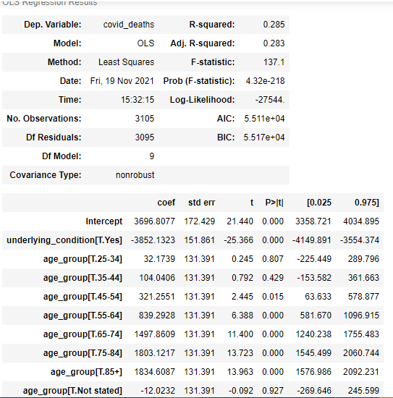
Regression analysis – monthly covid deaths for healthy and people with underlying condition
Multiple Regression
Dependent variable: Covid Deaths
Exog Variable: underlying condition and age group
Observation: The p-values healthy and people with underlying condition are statistically significant. When we drilled down to age group, we see p-values for young people are in the range of .015 to 0.927 which implies that these age don’t have much impact on dependent variable “Covid deaths”.
However, the p-values for old people are statistically significant implies major covid deaths are occurred to old age people (having age > 55). It makes sense as old people are more prone to underlying condition compared to young people.

Slide 33
References
CDC dataset:
https://data.cdc.gov/browse
https://data.cdc.gov/NCHS/Provisional-COVID-19-Deaths-by-Sex-and-Age/9bhg-hcku
https://data.cdc.gov/NCHS/Conditions-Contributing-to-COVID-19-Deaths-by-Stat/hk9y-quqm
ThinkStats:
http://thinkstats2.com
https://github.com/AllenDowney/ThinkStats2

