Slide 1
Predicting Credit Approval for Loan Applications
CS6220 Data Mining Techniques: Fall 2024
Team Members:
Maitreya Darokar
Abhyuday Sureka
Abdelrahman Zeidan
Dominic Cauteruccio

Slide 2
Introduction:
Overview
Literature Review
Dataset
Methodology

Slide 3
Overview
Introduction
Literature Review
Dataset Overview
Methodology
Code
Results
Discussion
Conclusion and Future Research

Slide 4
Introduction
Project Goal: To determine the best model to classify loan applications and predict whether they will be approved or denied.
Models Evaluated:
Logistic Regression
Support Vector Machine (SVM)
Artificial Neural Network (ANN)
Decision Tree
Random Forest
Importance:
Helps banks manage loan approval processes and mitigate financial risk.
Assists applicants in determining their chances of loan approval, allowing better planning.

Slide 5
Literature Review
Evaluating Credit Risk: Widely researched, with uncertainty around the best-performing models.
Common models: Logistic Regression, Support Vector Machine, and Artificial Neural Networks (ANN).
Further improvements have been made on traditional models
Quantile Regression Forests (QRF)
Sparrow Search Algorithm with Support Vector Machines
Key Insights:
ANN models have demonstrated high accuracy due to their ability to capture complex, non-linear relationships.
Random Forest has been found effective for predicting loan defaults.
SHAP (Shapley Additive exPlanations) can be used for model interpretability, ensuring transparency in predictions.
Synthetic Minority Oversampling Technique (SMOTE) used for imbalanced dataset

Slide 6
Dataset Overview
Source: Kaggle - "Credit Approval Loan Data"
Key Features:
Customer ID: Unique identifier for each customer
Credit Limit: The credit limit assigned to the applicant
SEX: Gender of the applicant
EDUCATION: Applicant's educational level
MARRIAGE: Marital status of the applicant
AGE: Age of the applicant (in years)
PAY_0 to PAY_6: Payment status for the first 7 months
BILL_AMT1 to BILL_AMT6: Bill statement amounts for the first 6 months
PAY_AMT1 to PAY_AMT6: Amount paid in the first 6 months
Approval Status: Target variable indicating whether the loan was approved

Slide 7
Methodology
1. Data Preprocessing:
Handled missing values
One-hot encoded categorical features.
Scaled numerical features using StandardScaler.
SMOTE
2. Exploratory Data Analysis (EDA):
Identified correlations and trends, e.g., strong correlation between credit history, income, and loan approval.
3. Model Selection:
Logistic Regression, SVM, ANN, Decision Tree, and Random Forest.
4. Model Evaluation:
5-fold cross-validation to evaluate performance metrics (accuracy, precision, recall, F1-score).

Slide 8
Model Building and Results:
Model Building
Logistic Regression
Support Vector Machine
Artificial Neural Network
Random Forest and Decision Tree

Slide 9
Model Building
Step 1: Dividing the dataframe vertically to X family and y target
Step 2: Using StandardScaler() function to balance the data
Step 3: Cutting the data Horizontally
Step 4: Using ‘y_test’ and ‘y_predict’
Step 5: Performing Cross Validation on the models
Step 6: Obtaining scores from the statistical models being used

Slide 10
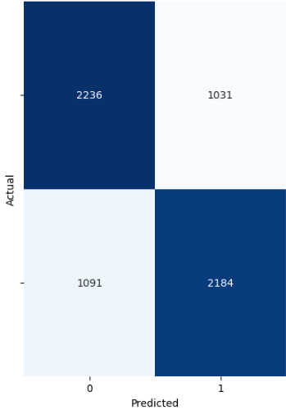
Logistic Regression Results
Evaluation Metrics (5-fold cross-validation):
Accuracy: 67.82%
Precision: 68.14%
Recall: 66.96%
F1-Score: 67.54%
These results demonstrate that Logistic Regression achieved a well-rounded performance, with a solid balance between precision and recall. The F1-score of 67.54% reflects its overall effectiveness in classifying loan applications accurately.

Slide 11
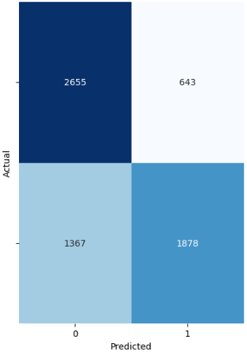
SVM Results
Evaluation Metrics (5-fold cross-validation):
Accuracy: 69.04%
Precision: 74.95%
Recall: 57.20%
F1-Score: 64.87%
SVM delivered high precision (74.95%), indicating strong performance in correctly identifying safe loan applications. However, its recall was comparatively lower (57.20%), suggesting some limitations in capturing all risky applications. The F1-score of 64.87% indicates a moderate balance between precision and recall.

Slide 12
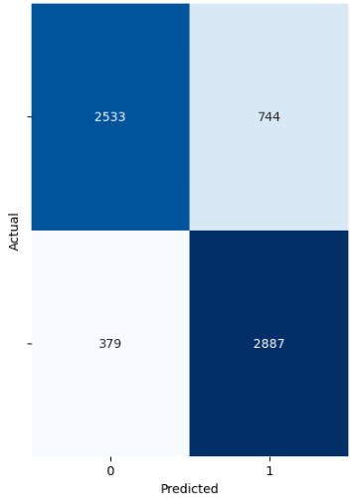
Artificial Neural Network (ANN) Results
Parameter Tuning:
5 separate Parameter Settings to find the best results
Performance improved with more complexity, until 3 hidden layers, each with 200 nodes
Performance degradation after that
3 Hidden layers, 200 nodes each was best model
Evaluation Metrics:
Accuracy: 81.92%
Precision: 79.27%
Recall: 86.46%
F1-Score: 82.70%
Conclusion:
Strong performance across the board with high accuracy
High F1 score showed balance between precision and recall

Slide 13
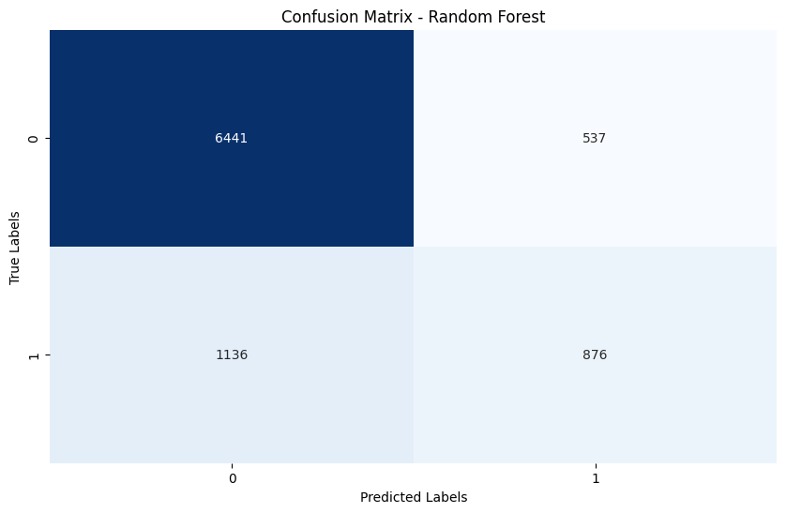
Random Forest Results
Configurations: A total of 4 different hyperparameters settings used for experiments: Naive, Conservative, Aggressive, and Balanced.
Evaluation Metrics:
Accuracy: 85.93%
Precision: 87.42%
Recall: 83.94%
F1-Score: 85.64%
Conclusion:
Out of the different hyperparameter configurations tested, the Aggressive and Balanced configurations performed the best, providing a good accuracy as well as a strong F1 score showcasing a good balance between precision and recall.
Aggressive setting:
n_estimators = 500,
max_depth = None,
min_samples_split = 2,
min_samples_leaf = 1,
class_weight = 'balanced_subsample'
Confusion Matrix for Aggressive Config

Slide 14
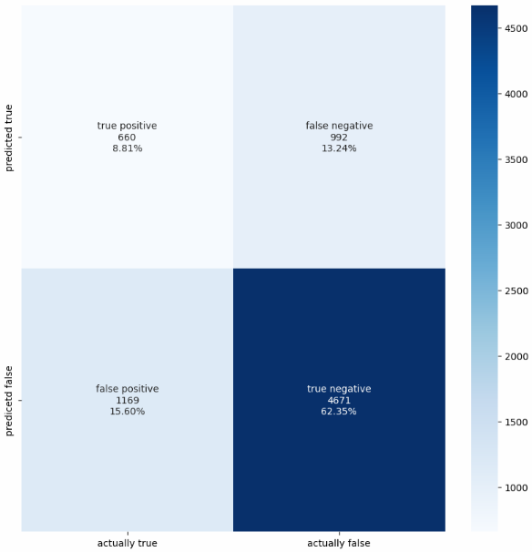
Decision Tree Results
Evaluation Metrics:
Avg Accuracy: 74.65%
Avg Precision: 78.45%
Avg Recall: 67.97%
F1-Score: 72.82%
Conclusion: The Decision Tree model was particularly effective at predicting defaults with high precision and recall but struggled with predicting non-defaults.

Slide 15
Conclusion:
Discussion about Models
Key Findings and Future Work
References

Slide 16
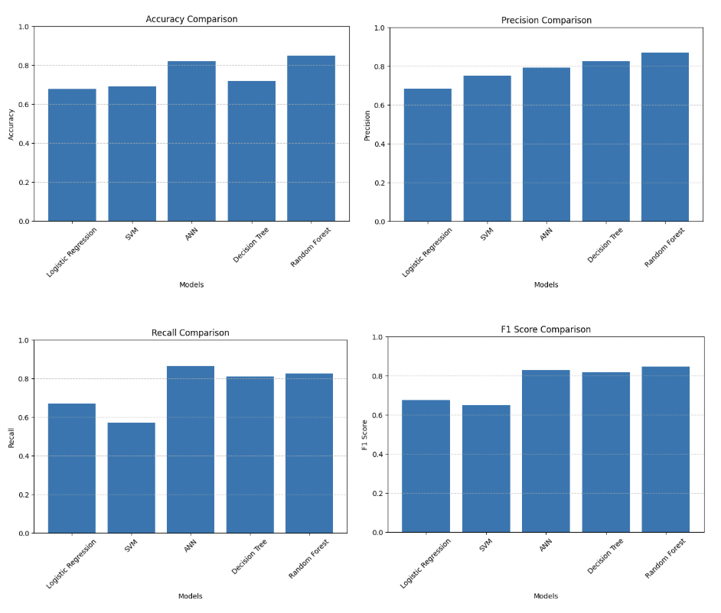
Discussion
Evaluated 5 machine learning models for credit approval prediction
Compared performance metrics: Accuracy, Precision, Recall, F1-score
Applied models: Random Forest, ANN, SVM, Decision Tree, Logistic Regression
Best Performing Model - Random Forest
Highest overall accuracy: 85.93%
Best F1-score: 85.64%
Key strengths:
Ensemble learning capability
Handles complex feature interactions
Consistent performance across metrics
Most effective with 500 estimators and balanced weights

Slide 17
Discussion (contd.)
Other Model Performance:
Neural Network Performance
Configuration: 3 hidden layers, 200 nodes each
Strong performance metrics:
Accuracy: 81.92%
F1-score: 82.70%
Key finding: Performance peaked at 3 layers
Important observation: Signs of overfitting with 4 layers
Other Models Performance:
Decision Tree:
High interpretability
Accuracy: 72%
Strong in risk identification (83% precision)
Logistic Regression:
Balanced baseline performance
Accuracy: 67.82%
F1-score: 67.54%
Support Vector Machine (SVM):
High precision: 74.95%
Lower recall: 57.20%
Best for minimizing false positives

Slide 18
Conclusion and Future Work
Key-Findings:
Random Forest: Achieved the best overall performance.
ANN: Performance of ANN was close to Random Forest, and optimum performance could be achieved through the most optimal architectural structure.
SVM: Provided Precision over recall, best for minimizing false positives
Decision Tree: Balance of performance and interpretability
Logistic Regression: Provided a reliable baseline
Model Improvements:
Hybrid architectures combining Decision Trees and Random Forests
Enhanced feature engineering with financial domain knowledge
Practical Considerations:
Focus on fairness metrics
Demographic bias evaluation
Regulatory compliance
Model interpretability
Implementation Goals:
Balance performance with transparency
Ensure ethical lending practices
Maintain practical applicability

Slide 19
References
[1] O. A. Amos, B. O. Tunbosun and O. B. Mustapha, "Application of artificial neural network to loan recovery prediction," International Journal of Housing Markets and Analysis, vol. 9, (2), pp. 222-238, 2016. Available: https://link.ezproxy.neu.edu/login?url=https://www.proquest.com/scholarly-journals/application-artificial-neural-network-loan/docview/1844321074/se-2 . DOI: https://doi.org/10.1108/IJHMA-01-2015-0003.
[2] B. Patel, H. Patil, J. Hembram and S. Jaswal, "Loan Default Forecasting using Data Mining," 2020 International Conference for Emerging Technology (INCET), Belgaum, India, 2020, pp. 1-4, doi: 10.1109/INCET49848.2020.9154100. keywords: {Classification algorithms;Boosting;Data mining;Prediction algorithms;Logistics;Predictive models;Forestry;loan;credit;prediction;data mining},
[3] Quantile Regression using Random Forest Proximities: https://arxiv.org/abs/2408.02355
M. Li et al., “Quantile Regression using Random Forest Proximities,” arXiv.org, Aug. 05, 2024. https://arxiv.org/abs/2408.02355
[4] N. V. Chawla, K. W. Bowyer, L. O. Hall, and W. P. Kegelmeyer, “SMOTE: Synthetic Minority Over-sampling technique,” Journal of Artificial Intelligence Research, vol. 16, pp. 321–357, Jun. 2002, doi: 10.1613/jair.953.
[5] S. Lundberg and S.-I. Lee, “A unified approach to interpreting model predictions,” arXiv.org, May 22, 2017. https://arxiv.org/abs/1705.07874
[6] J.-H. Trustorff, P. M. Konrad, and J. Leker, “Credit risk prediction using support vector machines,” Review of Quantitative Finance and Accounting, vol. 36, no. 4, pp. 565–581, Jul. 2010, doi: 10.1007/s11156-010-0190-3.
[7] X. Shen and X. Wang, “Prediction of personal default risks based on a sparrow search algorithm with support vector machine model,” Mathematical Biosciences & Engineering, vol. 20, no. 11, pp. 19401–19415, Jan. 2023, doi: 10.3934/mbe.2023858.

