Slide 1

SMART INDIA HACKATHON 2026
TADIT (तड़ित)
AI nowcasting of thunderstorms & lightning, 0–6 hours ahead
Problem Statement ID – SIH26072
Problem Statement Title- AIML Based Nowcasting of Thunderstorm and Lightning
Theme- Disaster Management
PS Category- Software
Team ID-
Team Name (Registered on portal)

Slide 2



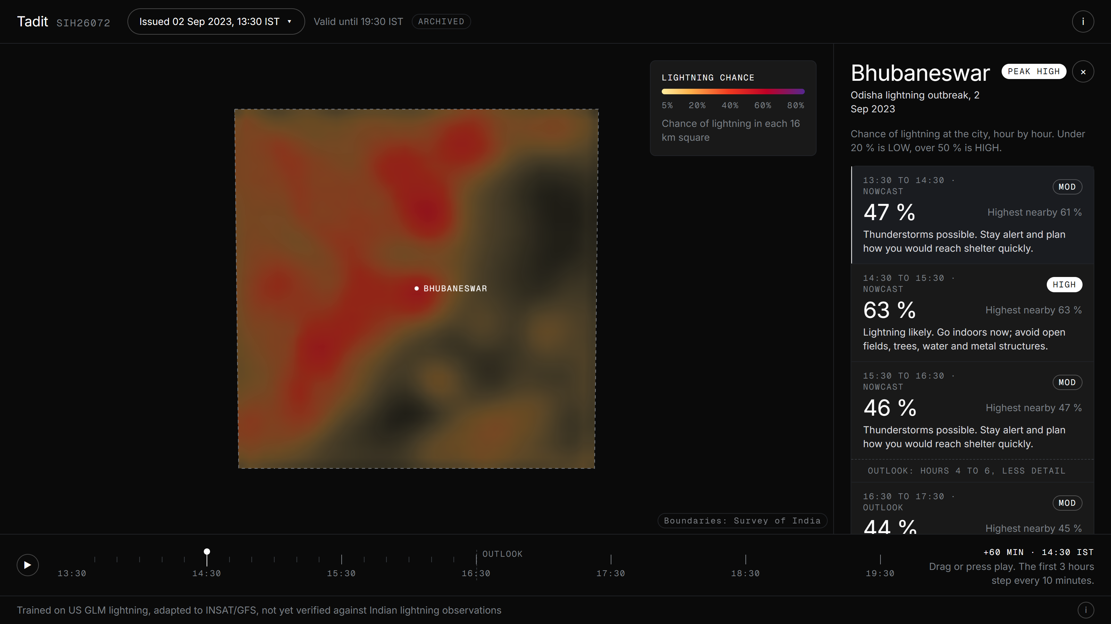











TADIT: AI LIGHTNING NOWCASTING
Your Team Name
Tadit (तड़ित = lightning) fuses radar, satellite, lightning and weather-model data into one AI that forecasts where lightning will strike, in 10-min steps to 3 h and hourly to 6 h.
Live prototype: tadit.pages.dev
Proposed Solution
tadit.pages.dev
How It Addresses the Problem
Multimodal AI fusion: one model reads Doppler radar, INSAT / GK2A satellite imagery, lightning strikes and GFS weather-model fields together.
3 h → 6 h
IMD’s nowcasts look 3 h ahead. Tadit forecasts 6 h: 10-min steps to 3 h, then hourly.
No radar? Still works
Seamless 0–6 h: Tier 1 deep-learning nowcast in 10-min steps for 0–3 h, then Tier 2 AI-corrected NWP hourly for hours 4–6, switching at the measured crossover hour.
Large parts of India lack radar. Satellite + NWP alone reaches 0.461 CSI at hour 1.
From maps to action
City-level hourly risk with advice (“go indoors now”) for officials and the public.
What it delivers: lightning probability per 16 km cell, radar-like storm intensity at 2 km, and LOW / MODERATE / HIGH risk with plain advice for each city.
Innovation & Uniqueness
Working prototype: Bhubaneswar lightning outbreak, 2 Sep 2023, forecast issued 13:30 IST (satellite + GFS, no radar)
Mid-fusion U-Net with NWP cross-attention + FiLM: all 18 lead times in one pass.
Built for India’s gaps: keeps working without radar or a lightning feed; runs today on INSAT-3DR/3DS or GK2A satellite + GFS.
1
2
Modality dropout: robust to any missing sensor, with free drop-a-sensor tests.
Observe
Fuse
Forecast
Alert
radar, satellite, lightning, NWP
one multimodal AI model
10-min steps to 3 h, hourly to 6 h
city risk + advice
Measured tier crossover stitches nowcast and NWP into one 0–6 h product.
Working prototype: the Tadit web app shows an animated India map and hourly city risk, live at tadit.pages.dev.
3
0.613
6 / 6
India
lightning CSI at hour 1, 1.8× persistence
lead hours beating raw NWP lightning
beats persistence vs FY-4A satellite lightning
4
India-adapted in training (INSAT / GFS-like inputs) with leak-free lightning labels.

Slide 3







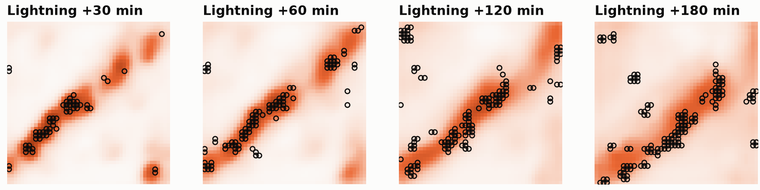


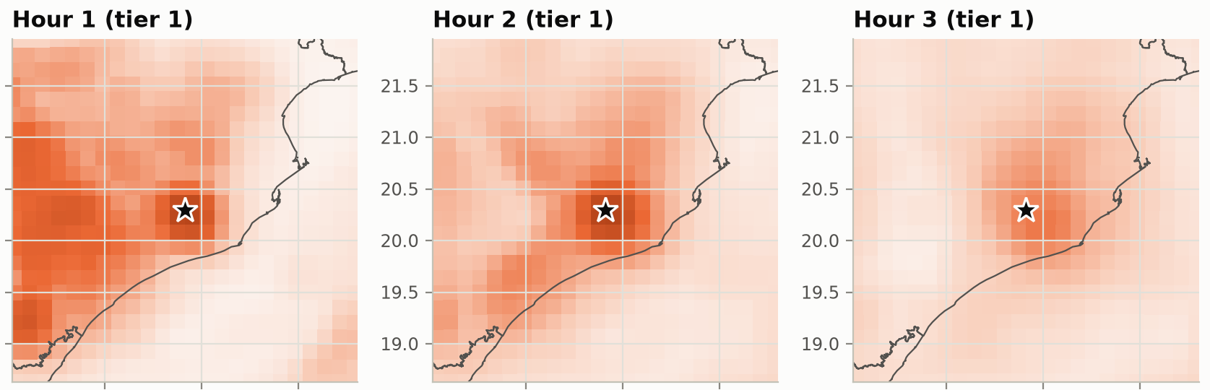

TECHNICAL APPROACH
Your Team Name
System architecture: from raw observations to a 0–6 h lightning forecast
1 · DATA SOURCES
2 · PREPROCESSING
3 · AI MODELS
4 · SEAMLESS OUTPUT
Radar
TIER 1 · Fusion nowcaster (0–3 h, 10-min steps)
Switch at hour 3
Tier 1 for hours 1–3, Tier 2 for 4–6: the crossover measured on held-out storms.
NEXRAD VIL (training); IMD DWR reader built, not yet on live data
384 km tiles on one map grid
60M params · modality dropout
Radar / satellite at 2 km, lightning at 8 km
Per-source encoders
Gated fusion
U-Net + attention
18 lead times
Satellite
INSAT-3DR/3DS · GK2A · GOES IR
each sensor at native res.
+ ‘missing’ embeddings
NWP cross-attn · FiLM
VIL 2 km · lightning 8 km
Leak-free lightning labels (past 5 min only)
Probability maps
Lightning
GLM (training); ILDN partnership offered
NWP only from runs issued before the forecast
TIER 2 · AI-corrected NWP (lead hours 1–6)
JSON: hourly risk + sources used
Weather model
50% of samples degraded to INSAT & GFS quality
GFS / HRRR forecast fields
Compact U-Net
Lightning + VIL, 16 km
Tadit web app & alerts
GFS 0.25° · HRRR
Methodology
Forecasts vs Reality
Technology Stack
Data: 3,000 real US storm events (SEVIR) + HRRR; split by date, so test storms are unseen.
Held-out US storm: forecast lightning chance (shading) vs observed flashes (o)
Oklahoma City, 26 Aug 2019: CSI 0.61 / 0.54 / 0.55 for hours 1–3 vs persistence 0.52 / 0.33 / 0.18
AI / ML
Python
PyTorch
NumPy
bf16
Train: Intensity-weighted radar loss + focal lightning loss; modality dropout; one night on an RTX 5060 Ti.
DATA
xarray
h5py
s3fs
Herbie
pyproj
cfgrib
Evaluate: CSI / POD / FAR per lead hour vs persistence and raw NWP; drop-a-sensor tests.
WEB
India, Bhubaneswar 2 Sep 2023: hours 1–3 from satellite + GFS only (★ city)
React
TypeScript
Vite
MapLibre GL
India: Run on INSAT / GK2A + GFS; checked against FY-4A satellite lightning.
INFRA
AWS Open Data
Cloudflare Pages
RTX 5060 Ti (16 GB)
Serve: Maps + JSON exported to a static web app on Cloudflare Pages.

Slide 4








FEASIBILITY AND VIABILITY
Your Team Name
Technical Feasibility
Operational Feasibility
Economic Viability
Built, trained and tested today
Runs on India’s own data
Low cost, scalable, policy-aligned
Working two-tier AI: 60M-parameter fusion U-Net for 0–3 h plus an NWP post-processor for 3–6 h, trained on 3,000 real storm events.
Indian data readers: INSAT, IMD radar, GFS and strike feeds; INSAT and GFS verified on real files.
No new hardware: reuses radar, satellite and NWP data IMD already collects; open GK2A / GFS as backup.
Fast: a full 0–6 h forecast takes a few minutes per city, mostly data download; the model itself runs in seconds.
INSAT cross-checked: our INSAT reader matches the GK2A satellite on the same scene (r = 0.87).
Near-zero serving cost: forecasts are static files served from a free CDN (Cloudflare Pages).
Light: trained overnight on one 16 GB consumer GPU; the deployed model file is 120 MB.
Works with gaps: runs on whichever sources are live, and every output lists what it used.
Scales simply: ≈30 tiles of 384 km cover India, and one GPU can refresh them all.
Reliable build: open-source Python / PyTorch stack, covered by 38 automated tests.
Easy to plug in: standard map + JSON outputs for IMD’s nowcast portal and alert apps; the web viewer needs no backend.
Policy fit: supports MoES’s Mission Mausam (₹2,000 cr) goals of more frequent nowcasts and no undetected weather events.
Potential Challenges & Risks
Strategies to Overcome Them
01
Limited access to data: Indian lightning archives (ILLN / ILDN) and radar volumes are not openly available, so early findings may be misleading.
Improves with Indian data: ILDN (Tripura University) has offered to partner and share lightning data for SIH-2026; as the model gets validated data, it recalibrates and gets more accurate.
01
02
Trained on US storms, used in India: monsoon storms, terrain and INSAT’s slower scans differ from the US training data.
India-mode training: half of all samples are degraded to INSAT (4 km, 15–30 min scans) and GFS (~24 km) quality; fine-tune on Indian cases as they come in.
02
03
Sparse radar and sensor outages: radar does not cover all of India, and feeds drop out during storms.
Modality dropout: the model runs on whatever is live. Without radar, hour-1 CSI only dips from 0.613 to 0.592; satellite + NWP alone still scores 0.461.
03
04
Calibration and false alarms: probabilities are tuned to US storm frequency, not Indian climate.
Regional recalibration with IMD, and alerts issued as risk levels, not raw numbers. On a dry Delhi day the forecast stayed at 0.04.
04
05
Adoption into IMD operations: a new tool must fit forecasters’ workflows and existing alert channels.
Phased rollout: pilot at one regional centre (e.g. Bhubaneswar) side by side with current nowcasts, then scale state by state.
05
CSI = critical success index for lightning (higher is better), on held-out 2019 US storms. Trained on US GLM lightning, adapted to INSAT/GFS, not yet verified against Indian lightning observations. Tile count is an estimate from India’s land area.

Slide 5









IMPACT AND BENEFITS
Your Team Name
2,558 lives
lost to lightning in India in 2023: 39.7% of all deaths from forces of nature, the largest single share (NCRB). Today’s operational nowcasts look only 3 hours ahead.
PS SIH26072 · MoES / IMD
Theme: Disaster Management
Potential Impact on Target Audience
Benefits of the Solution
IMD Forecasters
4 DATA SOURCES
Aviation & Airports
Saves lives where lightning strikes hardest: MP, Bihar, Odisha, UP and Jharkhand account for 59% of India’s lightning deaths. Timely alerts build public trust in IMD warnings.
MoES · forecast centres
Radar
Satellite
AAI · airlines · IAF
Storm and lightning maps in 10-min steps at 2 km. Doubles the nowcast window, 3 h to 6 h.
Lightning
NWP
Storm hazard maps for rerouting and safer ground operations, with fewer diversions and go-arounds.
Social
Cuts losses to crops, livestock, flights and power grids. Built on existing and open data (IMD radar, INSAT, GFS): no new sensors are needed, and the model runs on a single GPU.
Disaster Managers
0–6 h
Power & Telecom
Economic
NDMA · SDMAs · districts
grid, towers, rail signalling
Earlier, district-level alerts to clear fields, fairs, beaches and schools before the first strike.
seamless AI
lightning nowcast
Pre-position repair crews and shield lines, towers and signalling from lightning and squalls.
Flags lightning-prone zones for forest-fire watch, supports climate adaptation as severe convective weather grows, and helps solar and grid operators plan for storms.
Environmental
Farmers & Labourers
Citizens & Cities
most exposed, out in the open
Tier 1 · 0–3 h multimodal fusion
hyper-local alerts
Atmanirbhar: runs on India’s own INSAT-3DR/3DS satellites and GFS, and keeps forecasting when radar or lightning feeds drop out, so it covers districts beyond radar range.
Hours, not minutes, to leave fields and shelter livestock, via Damini and Meghdoot apps.
Tier 2 · 3–6 h AI-corrected NWP
Tested on Bhubaneswar, Kolkata and Guwahati storms, plus a dry-day control in Delhi.
Strategic
10-min steps to 3 h · hourly to 6 h
Measured,
not claimed
1.8×
+70%
0.461
0.71 vs 0.04
Lightning CSI by lead hour (higher is better)
TIER 1
TIER 2
Our nowcast
Held-out 2019 storms scored against real satellite lightning (GLM).
better than persistence at hour 1
over raw NWP lightning at hour 6
hour-1 CSI with no radar
India: storm vs dry day
0.297 at 6 h
Raw NWP
Lightning CSI 0.613 vs 0.341; the gap grows to 5.5× by hour 3
CSI 0.297 vs 0.175, and ahead of NWP at every hour from 1 to 6
Satellite + NWP only: the usual case outside Indian radar coverage
Storm probability 1 h ahead: Bhubaneswar outbreak (2 Sep 2023) vs Delhi dry day
0.175 at 6 h
Persistence
0.080 at 3 h
“From a 3-hour to a 6-hour lightning warning: one seamless AI nowcast, built on India’s own satellites.”
CSI = critical success index for lightning in a 16 km cell during each lead hour; Tier 1 is used for hours 1–3 and Tier 2 for hours 4–6. India probabilities from GK2A satellite + GFS input, no radar. Trained on US GLM lightning, adapted to INSAT/GFS, not yet verified against Indian lightning observations. Death figures: NCRB, Accidental Deaths & Suicides in India 2023.

Slide 6
RESEARCH AND REFERENCES
Your Team Name
Data Sources
Methods & Research Papers
Live prototype: click here
tadit.pages.dev
SEVIR storm events: radar VIL, GOES-16 IR, GLM lightning. Veillette et al., NeurIPS 2020 · registry.opendata.aws/sevir
MODEL DESIGN
Code & results: click here
github.com/adit1290codesrank/sih2026
TRAIN
Ronneberger et al., U-Net, MICCAI 2015 · arXiv:1505.04597
Perez et al., FiLM conditioning, AAAI 2018 · arXiv:1709.07871
HRRR US weather model (NWP input + baseline), NOAA · registry.opendata.aws/noaa-hrrr-pds
Leinonen et al., Thunderstorm nowcasting with deep learning: multi-hazard data fusion, GRL 2023 (closest prior work) · doi
India Check vs Real Lightning
TRAIN
GFS 0.25° global weather model, NOAA · registry.opendata.aws/noaa-gfs-bdp-pds
DEEP-LEARNING NOWCASTING
FY-4A satellite lightning, CSI for hours 1 / 2 / 3 (persistence in brackets)
INDIA
Shi et al., ConvLSTM precipitation nowcasting, NeurIPS 2015 · arXiv:1506.04214
Bhubaneswar · GK2A
0.24 / 0.22 / 0.20 (0.20 / 0.01 / 0.00)
Ravuri et al., Skilful nowcasting with deep generative models, Nature 597 (2021) · doi
INSAT-3DR Imager L1B (3RIMG_L1B_STD), ISRO / SAC · mosdac.gov.in
Gao et al., Earthformer (SEVIR benchmark), NeurIPS 2022 · arXiv:2207.05833
Bhubaneswar · INSAT
0.24 / 0.16 / 0.13 (0.20 / 0.01 / 0.00)
INDIA
SENSORS & WEATHER MODELS
Guwahati · INSAT
hour 6: MODERATE risk storm hit the city then
GK2A AMI L1B satellite, KMA via NOAA, no login · registry.opendata.aws/noaa-gk2a-pds
Dowell et al., HRRR Part I, Weather & Forecasting 37 (2022) · doi
INDIA
Goodman et al., GOES-R GLM, Atmos. Research 125 (2013) · doi
Real Storms We Forecast
NOAA/NASA, GLM Lightning Cluster-Filter ATBD (330 ms / 16.5 km flashes) · pdf
FY-4A LMI corrected lightning events, Zhang et al., ESSD 18, 5773–5791 (2026), CC-BY 4.0 · doi:10.5194/essd-18-5773-2026 · data
Blaylock, Herbie NWP download tool, Zenodo · doi
Bhubaneswar, 2 Sep 2023: 61,000 lightning strikes in two hours (Organiser); 10 killed in six districts (Deccan Herald)
Kolkata, 9 May 2024: thundersquall and hailstorms lash the city (ThePrint)
VERIFY
OUR WORK
ISRO Cherrapunji DWR (RSCHR_L2B_STD), tested, not used · mosdac.gov.in
Tadit frozen results and scorecard, results/RESULTS.md · live site tadit.pages.dev
TESTED
VERIFICATION & PHYSICS
Schaefer, Critical success index as a warning-skill score, Weather & Forecasting 1990
Government Sources
Survey of India boundaries (OVSF/1M/7) · onlinemaps.surveyofindia.gov.in
Greene & Clark, Vertically integrated liquid (VIL) from radar, Monthly Weather Review 1972
MAPS
Maddox, Mesoscale convective complexes (−52 °C cloud-top threshold), BAMS 1980
NCRB, Accidental Deaths & Suicides in India 2023 (lightning deaths) · data.gov.in
IMD station-wise nowcast service (3 h horizon) · mausam.imd.gov.in
Cabinet approves Mission Mausam, 2024 · pmindia.gov.in
ILDN Indian Lightning Detection Network, CeLTS, Tripura University: partnership offered (Sep 2026) · ildn.in
PARTNER

