Slide 1
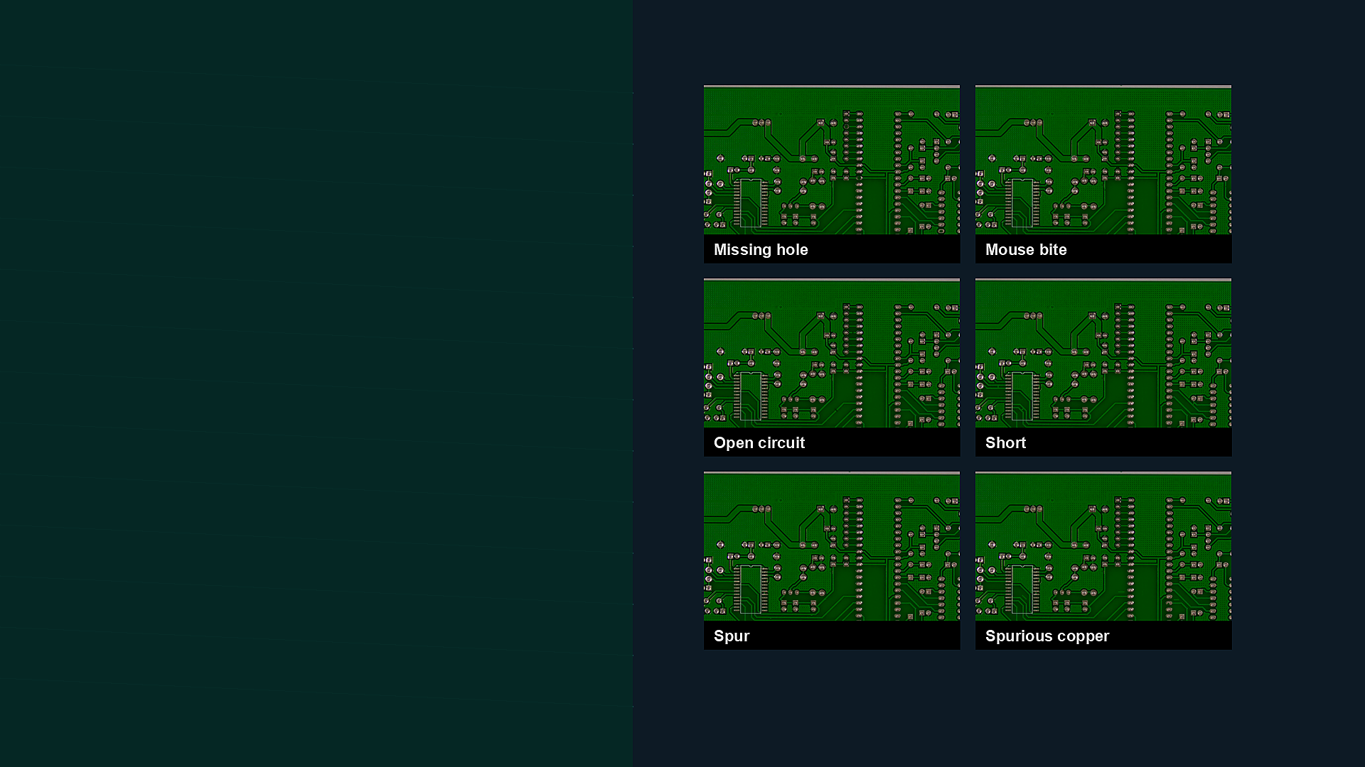
ESCS'26 / CSCE'26
Real-Time PCB Defect Detection for Embedded Visual Inspection
A same-split comparison of YOLO11s and RT-DETR-L
Aditya Varun Dhayapulay and Paul Salvador Inventado California State University, Fullerton
1

Slide 2
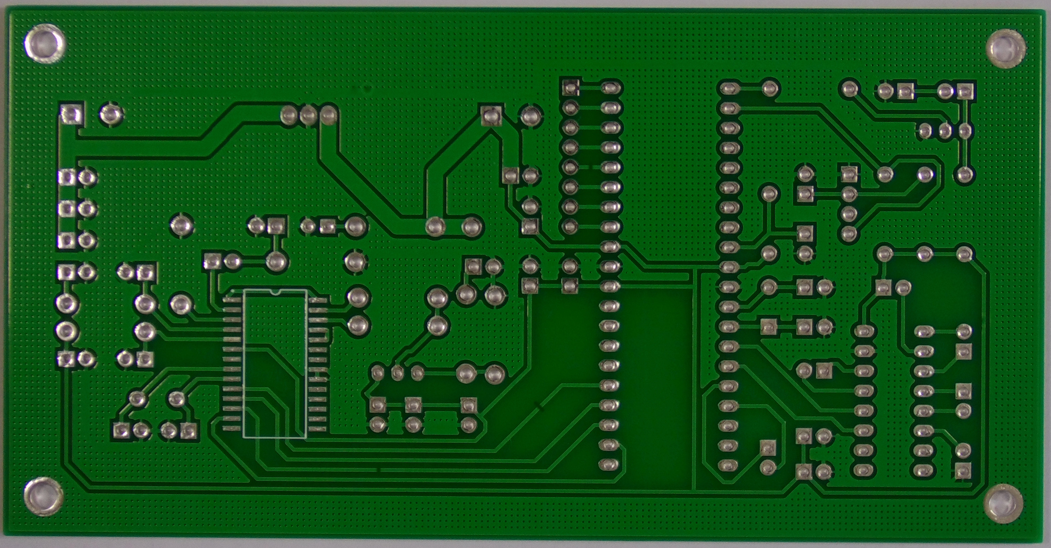
MOTIVATION
Why PCB Inspection Is Hard
INSPECTION RISK
OUTPUT NEEDED
small defects
boxes + classes
missing holes, shorts, spurs
not image-level labels
Defects can become more expensive after assembly.
Localization supports review, repair, and process analytics.
A useful detector must balance recall, box quality, and latency.
Small visual defects must become actionable locations
ESCS'26 | 2

Slide 3
GOAL
Research Question
Under one controlled PCB defect split, how do YOLO11s and RT-DETR-L compare for real-time visual inspection?
INPUT
MODELS
OUTPUTS
PCB image
YOLO11s vs RT-DETR-L
boxes, classes, metrics
Deployment-oriented: accuracy, localization, latency, and failure behavior.
Contribution is a reproducible benchmark, not a new detector architecture.
ESCS'26 | 3

Slide 4
CONTRIBUTIONS
What the Camera-Ready Version Adds
01
Preserves practical comparison
02
Adds matched resolution
03
Tests high-res RT-DETR-L
YOLO11s-1280 vs RT-DETR-L-640
YOLO11s-640 vs RT-DETR-L-640
1280 px, batch size 1
04
Fixes per-class semantics
05
Adds deployment artifact
canonical class-ID mapping
Hugging Face Space demo
Practical result + controlled evidence + honest deployment scope.
ESCS'26 | 4

Slide 5
DATASET
Dataset and Defect Taxonomy
Missing hole
Mouse bite
Open circuit
Short
Spur
Spurious copper
TRAIN IMAGES
VALIDATION
TEST
BALANCING
5,551
1,016
1,016
800
deterministic split
2,106 instances
2,179 instances
copy-paste train images
All reported configurations use the same validation and test image assignments.
ESCS'26 | 5

Slide 6
PROTOCOL
Reproducible Evaluation Protocol
1
Hardware
2
Software
3
Evaluation
4
Metrics
Tesla V100-SXM2-32GB
Ultralytics 8.4.51 / PyTorch 2.5.1
batch 1, workers 0, no TTA
P, R, F1, mAP50, mAP50-95, latency
Baseline gate: archived checkpoint metrics must reproduce within 0.001 before new experiments are trusted.
Observed differences were approximately 10⁻⁸, confirming exact split/evaluator reproduction.
ESCS'26 | 6

Slide 7
PROTOCOL
Models and Training Settings
Configuration | Image size | Epochs | Batch | Purpose
YOLO11s original | 1280 | 50 | 12 | accepted practical
RT-DETR-L original | 640 | 10 | 4 | accepted practical
YOLO11s controlled | 640 | 50 | 12 | matched resolution
RT-DETR-L controlled | 640 | 10 | 4 | matched resolution
RT-DETR-L high-res | 1280 | 10 | 1 | high-res analysis
The 1280-pixel RT-DETR-L run completed; the planned 960-pixel fallback was not needed.
ESCS'26 | 7

Slide 8
REVIEWER RESPONSE
The Key Fairness Issue: Resolution
Accepted practical setup
Camera-ready fix
YOLO11S
RT-DETR-L
MATCHED
HIGH-RES RT
1280 px
640 px
640 vs 640
1280 px
more spatial detail
lower input resolution
same split and evaluator
separate analysis
Useful as a deployment comparison, but not an architecture-only ablation.
Separates practical configurations from resolution-controlled evidence.
ESCS'26 | 8

Slide 9
RESULTS
Accepted Practical Comparison
Model | P | R | F1 | mAP50 | mAP50-95 | Total ms
YOLO11s 1280 | 0.880 | 0.866 | 0.873 | 0.902 | 0.502 | 15.2
RT-DETR-L 640 | 0.886 | 0.839 | 0.862 | 0.887 | 0.470 | 49.8
Recall
mAP50-95
YOLO11s
0.866
YOLO11s
0.502
RT-DETR-L
0.839
RT-DETR-L
0.470
higher is better
stricter localization
Total latency
YOLO11s
15.2
Interpretation: practical deployment choice among completed configurations.
RT-DETR-L
49.8
milliseconds; lower is better
ESCS'26 | 9

Slide 10
RESULTS
Matched-Resolution Results
Model | P | R | F1 | mAP50 | mAP50-95 | Total ms
YOLO11s 640 | 0.870 | 0.852 | 0.861 | 0.892 | 0.482 | 13.2
RT-DETR-L 640 | 0.867 | 0.839 | 0.853 | 0.881 | 0.462 | 49.0
Recall
mAP50-95
YOLO11s
0.852
YOLO11s
0.482
RT-DETR-L
0.839
RT-DETR-L
0.462
same 640 px resolution
same evaluator
YOLO11s remains slightly stronger on recall and strict mAP while remaining much faster in this measured setup.
ESCS'26 | 10

Slide 11
RESULTS
High-Resolution RT-DETR-L Finding
Model | P | R | mAP50 | mAP50-95 | Total ms
RT-DETR-L 640 | 0.867 | 0.839 | 0.881 | 0.462 | 49.0
RT-DETR-L 1280 | 0.766 | 0.534 | 0.604 | 0.295 | 74.4
MAP50-95 CHANGED
TOTAL LATENCY
INTERPRETATION
0.462 -> 0.295
49.0 -> 74.4 ms
separate row
did not improve
higher cost
not the matched comparison
More pixels alone did not compensate for the fixed high-resolution training setup and computational cost.
ESCS'26 | 11

Slide 12
RESULTS
Per-Class Behavior at 640 px
Class | YOLO R | RT R | YOLO mAP50-95 | RT mAP50-95
Missing hole | 0.986 | 1.000 | 0.569 | 0.567
Mouse bite | 0.763 | 0.765 | 0.403 | 0.403
Open circuit | 0.850 | 0.880 | 0.525 | 0.513
Short | 0.892 | 0.865 | 0.551 | 0.505
Spur | 0.767 | 0.729 | 0.381 | 0.342
Spurious copper | 0.853 | 0.795 | 0.462 | 0.443
Strong classes
Missing hole, Open circuit, Short
Harder classes
Mouse bite and Spur remain subtle
Per-class analysis matters because aggregate mAP can hide inspection risk.
ESCS'26 | 12

Slide 13
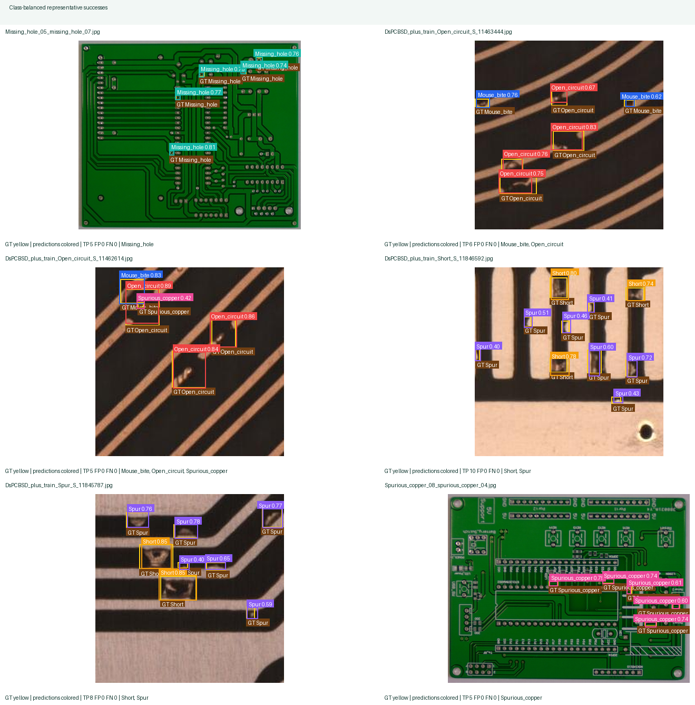
QUALITATIVE AUDIT
Representative Successes
SELECTION
class-balanced
matched YOLO11s-640
Shows localization across the six-class taxonomy.
Bounding boxes support review and repair workflows.
Visual audit complements aggregate metrics.
ESCS'26 | 13

Slide 14
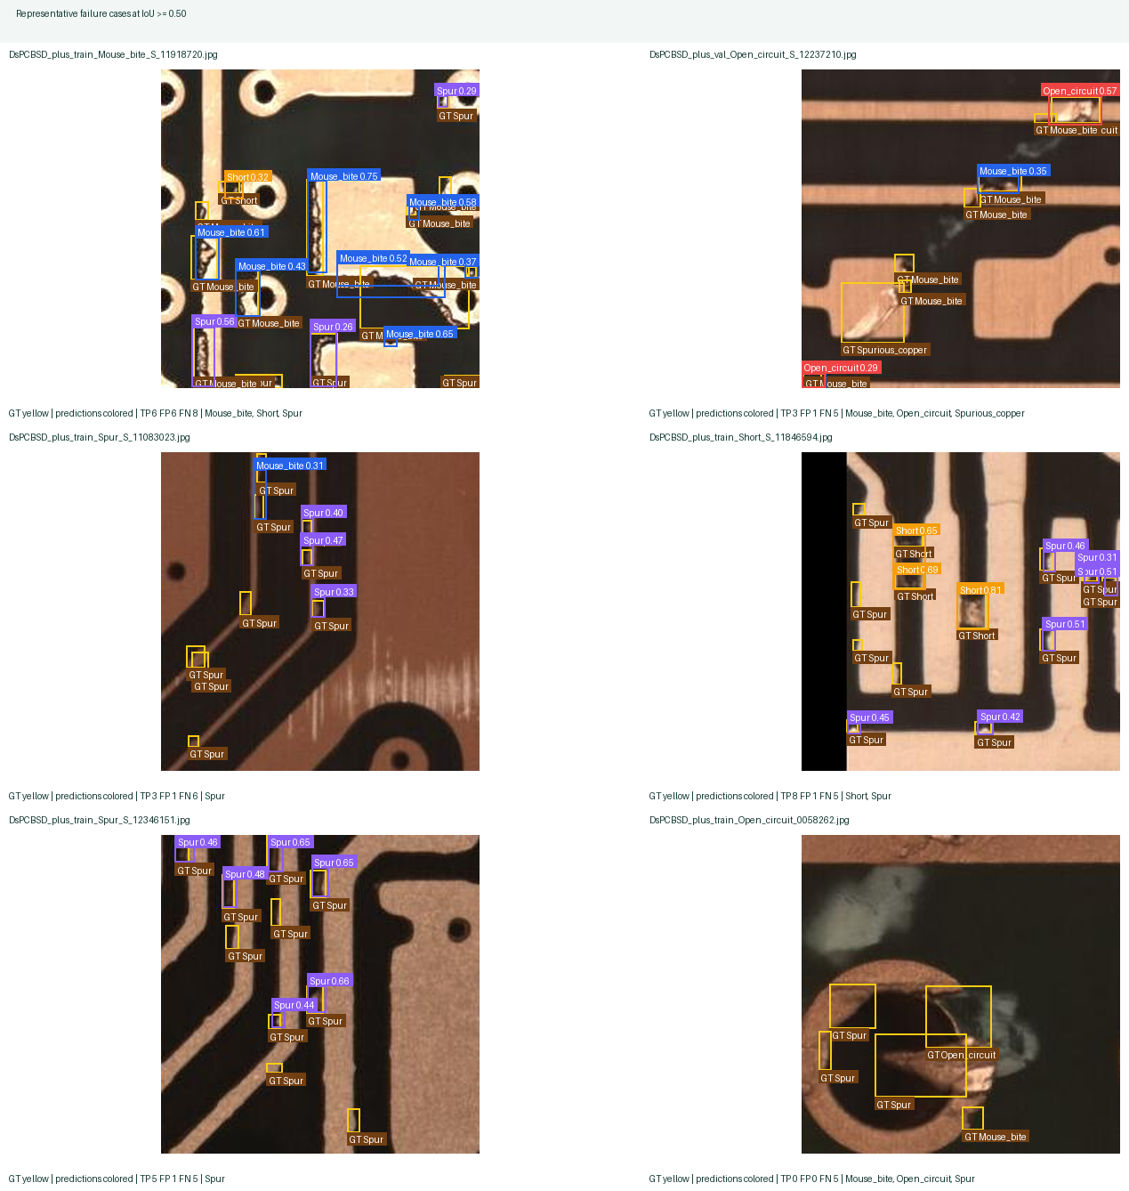
QUALITATIVE AUDIT
Representative Failure Cases
SELECTION SCORE
5FN + FP
miss-weighted audit
False negatives are prioritized because missed defects are costly.
Small/subtle classes motivate high-resolution reinspection.
mAP50-95 exposes loose localization that mAP50 may hide.
ESCS'26 | 14

Slide 15
DEPLOYMENT
Online Deployment Artifact
Browser workflow: upload PCB image, run detector, inspect annotations, download results.
Demonstrates packaging and usability.
Reports class counts, confidence values, and annotated detections.
Not an embedded-device benchmark.
No Jetson/TensorRT latency claims.
Hugging Face Space
adiivd-pcb-defect-detection.hf.space
ESCS'26 | 15

Slide 16
SCOPE
Limitations and Future Work
Current scope
Next steps
V100 latency, not edge latency.
Same split, but not fully resource-normalized.
In-distribution data, not factory-domain validation.
Real factory captures and lighting variation.
Resource-normalized training and latency budgets.
High-resolution crop reinspection.
Jetson/TensorRT benchmarking when hardware is available.
ESCS'26 | 16

Slide 17
CLOSE
Takeaways
PRACTICAL RESULT
CONTROLLED RESULT
DEPLOYMENT LESSON
YOLO11s-1280
YOLO11s-640
compare carefully
higher recall, mAP50-95, lower latency
competitive at matched resolution
resolution and latency both matter
A deployment-oriented benchmark should separate completed configurations from controlled ablations.
Thank you. I welcome your questions.
Aditya Varun Dhayapulay | California State University, Fullerton
ESCS'26 | 17

