Slide 1





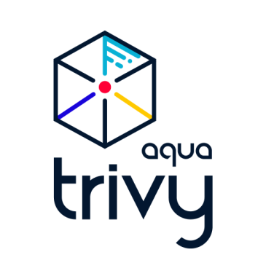
Migration Workflow
.NET → Java Spring Boot / React with GitHub Copilot (Agent Mode)
Technology Context: Original app .NET; Target Java Spring Boot and React; Repos Bitbucket; CI/CD Jenkins and OpenShift; Artifacts Artifactory
Human User
GitHub Copilot (Agent Mode)
CI/CD: Jenkins and OpenShift
% = Copilot effectiveness
Share Bitbucket repo and context files: frameworks, vendor tools, tech stack
Analyze .NET app; document architecture, data and API interactions, configurations
60%
Deliver documentation
70%
Review documentation
Request migration plan
Generate migration plan based on documentation and context; apply Java Spring Boot and React best practices; use engineer persona
70%
60%
Review migration plan
Generate new application code; preserve functionality; add unit tests and integration tests
50%
70%
Review generated codebase
Generate Jenkins pipelines and build/deploy configurations
70%
Review generated infrastructure-as-code and externalize configurations
Push to Bitbucket
60%
Pipeline triggers from Bitbucket
Build binaries
Push artifacts to Artifactory
Create container images (Docker)
Run security and quality scans (Aqua Trivy)
Deploy images to OpenShift (k8s pods)

