Slide 1





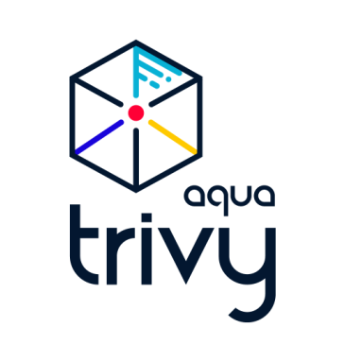
Migration Workflow
.NET → Java Spring Boot / React with GitHub Copilot (Agent Mode)
Technology Context: Original app .NET; Target Java Spring Boot and React; Repos Bitbucket; CI/CD Jenkins and OpenShift; Artifacts Artifactory
Human User
GitHub Copilot (Agent Mode)
CI/CD: Jenkins and OpenShift
Stars = Copilot effectiveness (more stars = less human oversight)
Share Bitbucket repo and context files: frameworks, vendor tools, tech stack
Legend
> 71%
60–70%
Analyze .NET app; document architecture, data and API interactions, configurations
< 60%
Deliver documentation
Review documentation
Request migration plan
Generate migration plan based on documentation and context; apply Java Spring Boot and React best practices; use engineer persona
Review migration plan
Generate new application code; preserve functionality; add unit tests and integration tests
Review generated codebase
Generate Jenkins pipelines and build/deploy configurations
Review generated infrastructure-as-code and externalize configurations
Push to Bitbucket
Pipeline triggers from Bitbucket
Build binaries
Push artifacts to Artifactory
Create container images (Docker)
Run security and quality scans (Aqua Trivy)
Deploy images to OpenShift (k8s pods)

