Slide 1
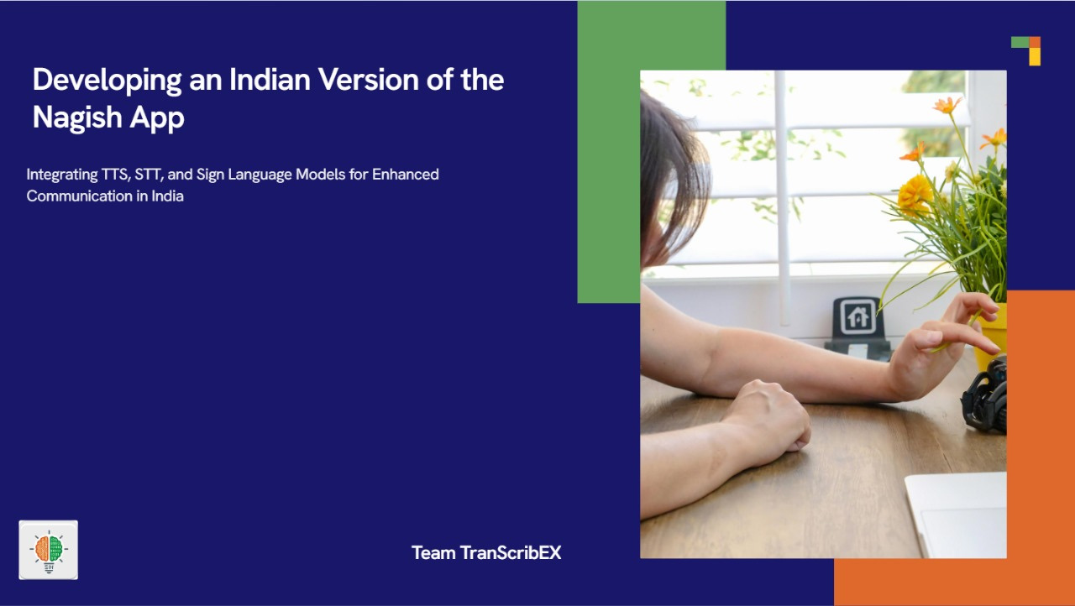


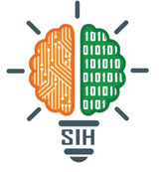
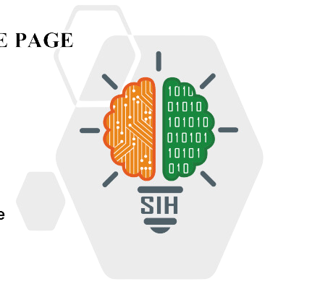
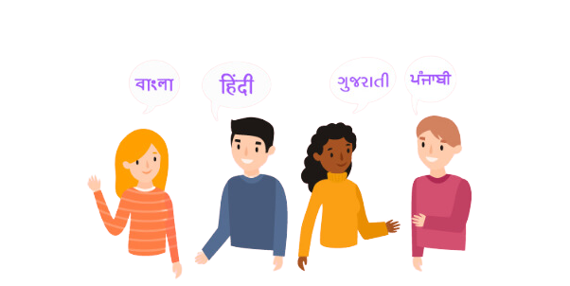
SMART INDIA HACKATHON 2024
Problem Statement ID – SIH1717
Problem Statement Title- Indian version of Nagish App
Theme- Miscellenous
PS Category- Software/Hardware
Team ID-
Team Name (Registered on portal) - Team TranScribeX

Slide 2
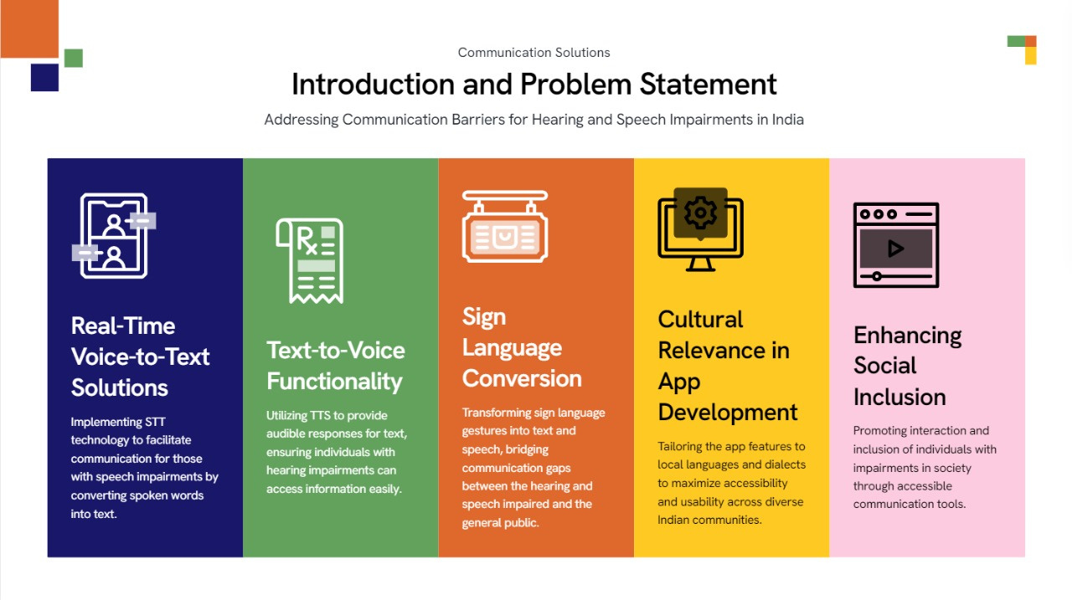
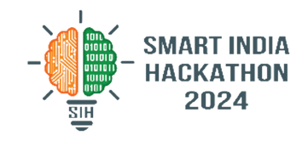


Slide 3
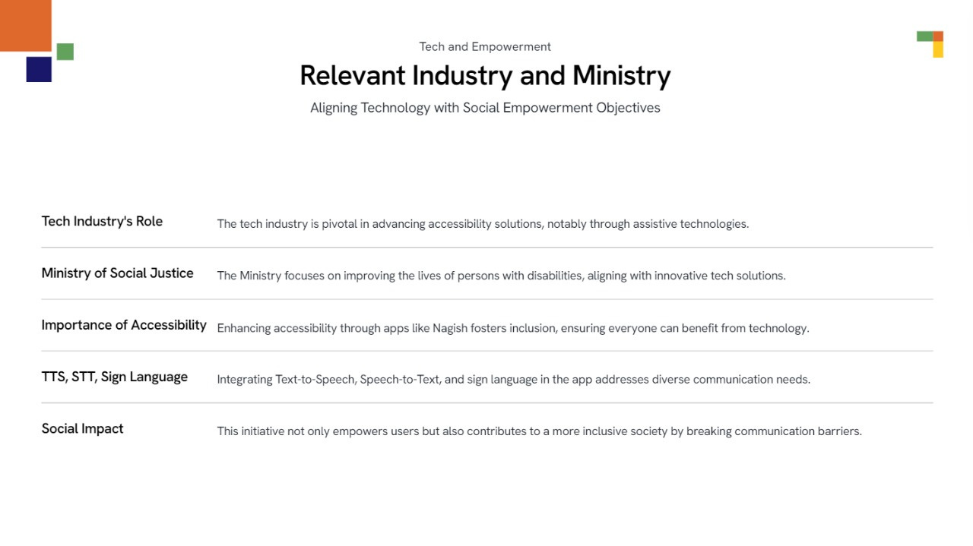

Ministry of Social Justice and Empowerment

Slide 4
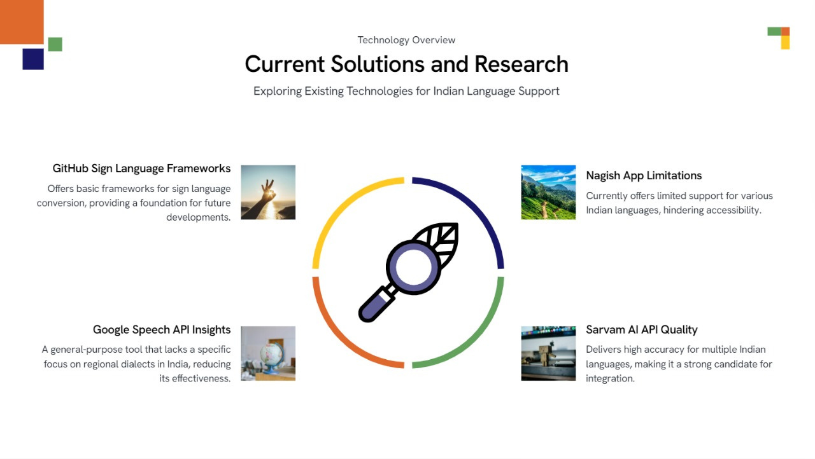

Slide 5
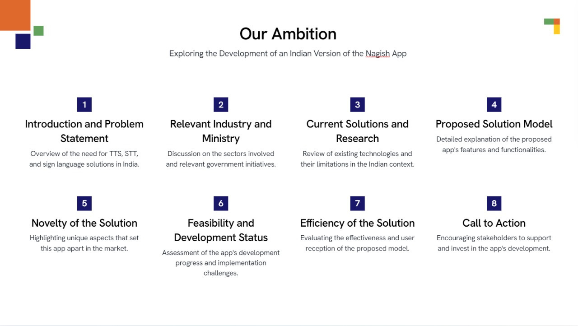

OUR SOLUTION

Slide 6
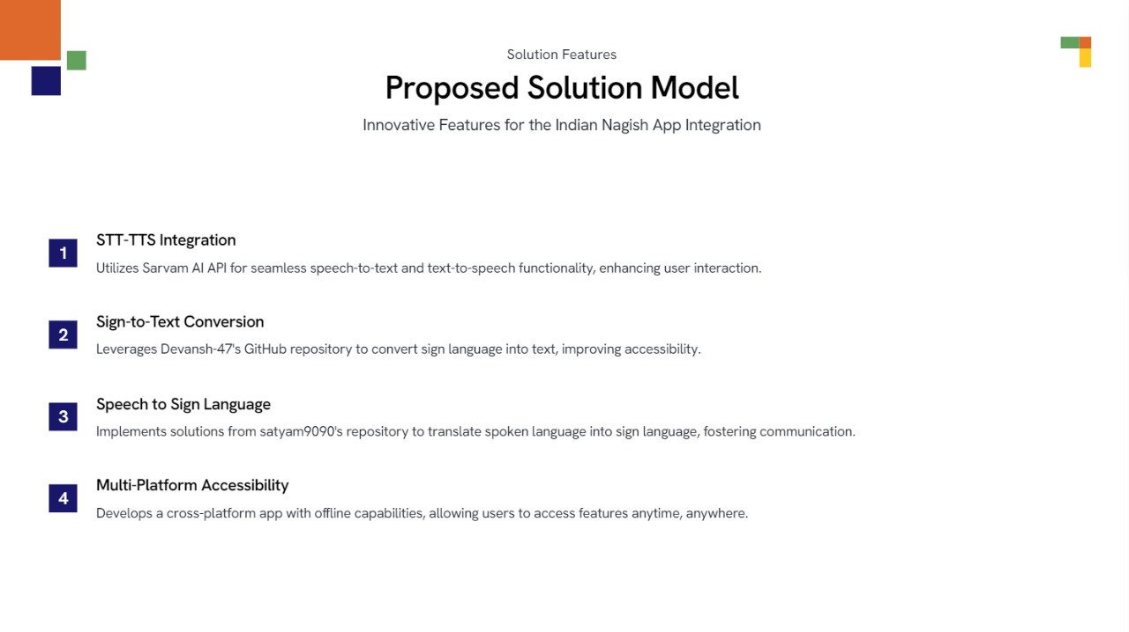


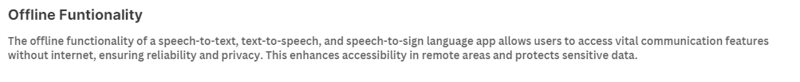
Offline Funtionality
The offline functionality of a speech-to-text, text-to-speech, and speech-to-sign language app allows users to access vital communication features without internet, ensuring reliability and privacy. This enhances accessibility in remote areas and protects sensitive data.

Slide 7

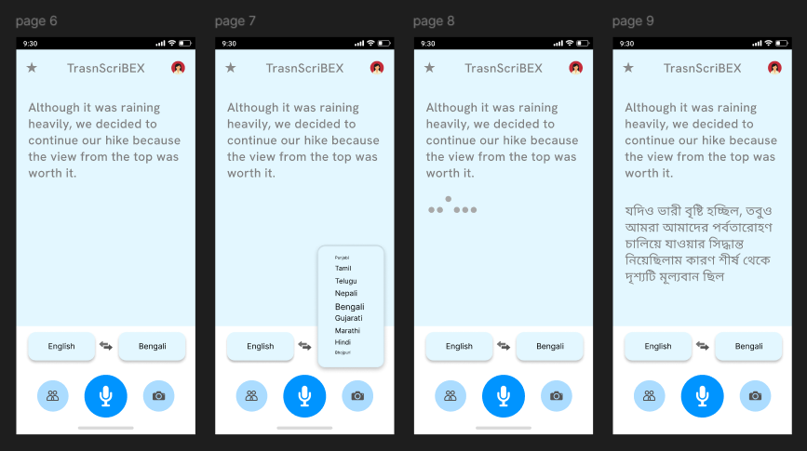
PROTOTYPE DEVELOPMENT STATUS
Current Status: 3/5
Two core models (Sarvam AI STT-TTS and Sign Language-to-Text) are functional with existing repositories.
Integration and user interface design are still in progress.
View Demo
view Figma design
Here

Slide 8
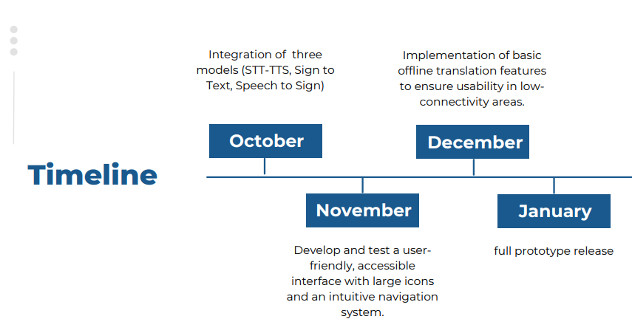

Slide 9
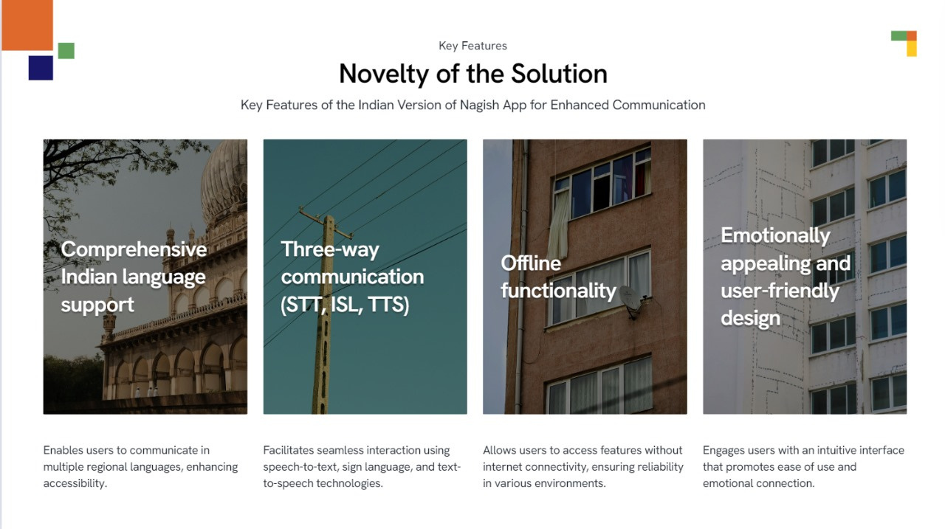

Slide 10
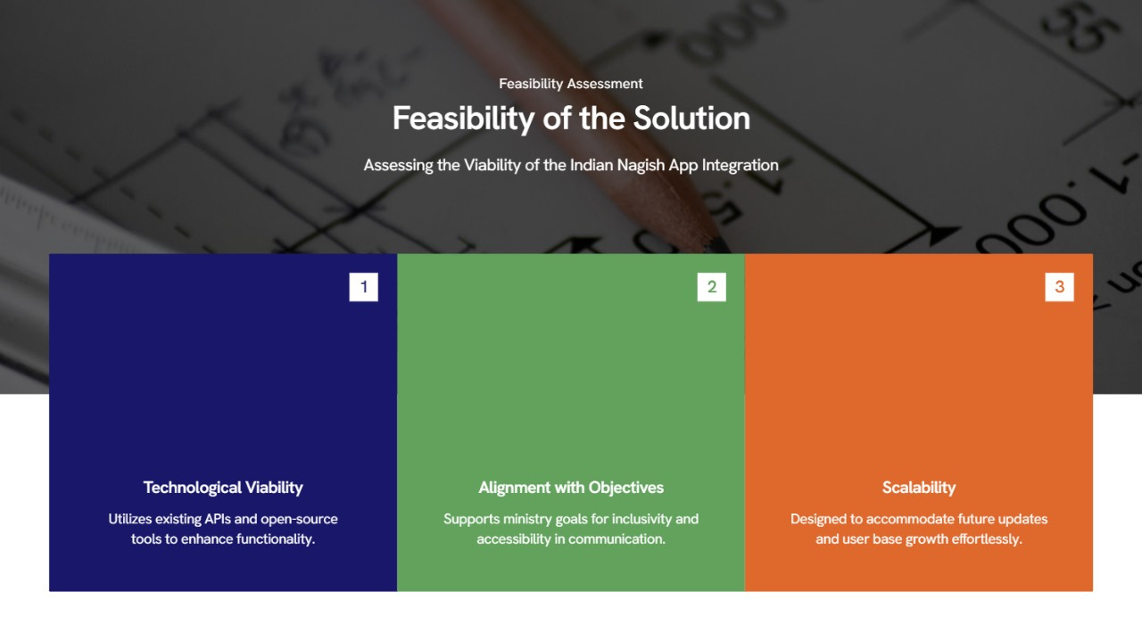

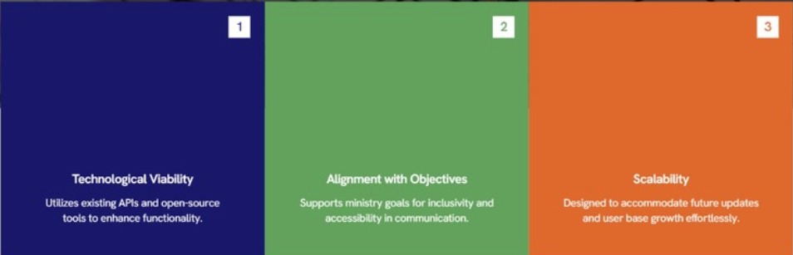

Alignment with Technology:
Industry Relevance:
Technological Feasibility:
Financial Feasibility:
Scalability:
Real-time speech-to-text aGoogle Speech-to-Text and Tkinter ensure low-cost, scalable development.
Can be easily integrated into existing systems and extended to mobile/web platforms.
Open-source technologies reduce development costs.
Minimal maintenance; scalable with usage-based APIs.
Open-source technologies reduce development costs.
Minimal maintenance; scalable with usage-based APIs.
Real-time speech-to-text and sign language translation addresses accessibility needs for hearing-impaired individuals.
Healthcare: Facilitates communication in hospitals and clinics.
Education: Assists hearing-impaired students with real-time lecture translation.
NGOs/Government: Enhances communication in social services for the disabled.

Slide 11
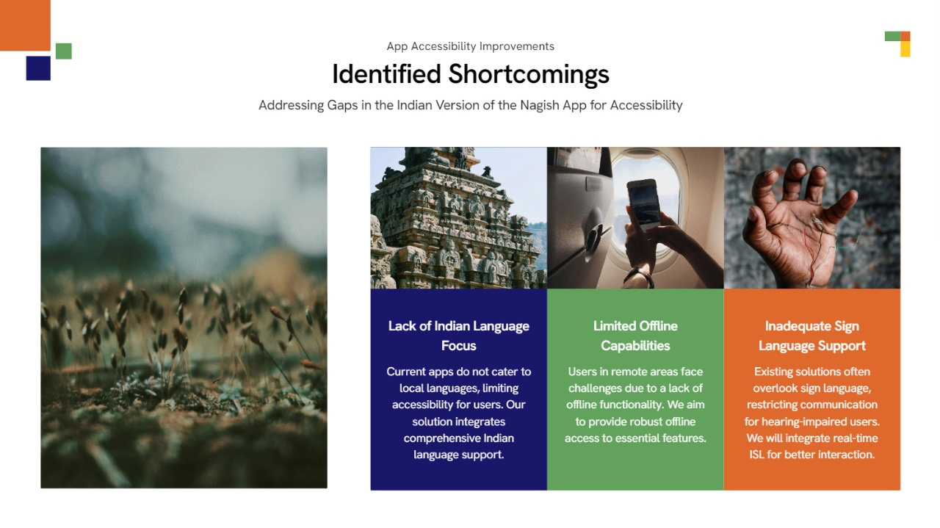

Slide 12
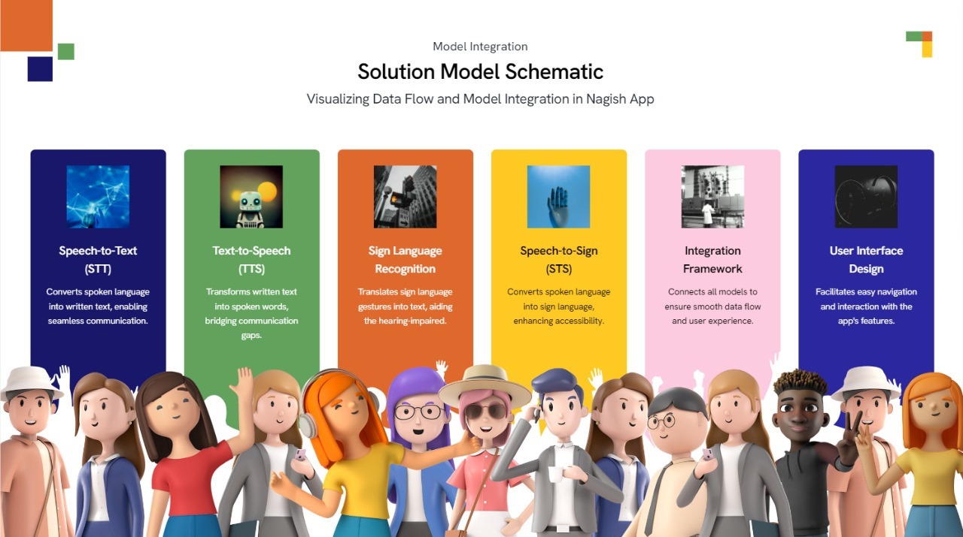

Slide 13
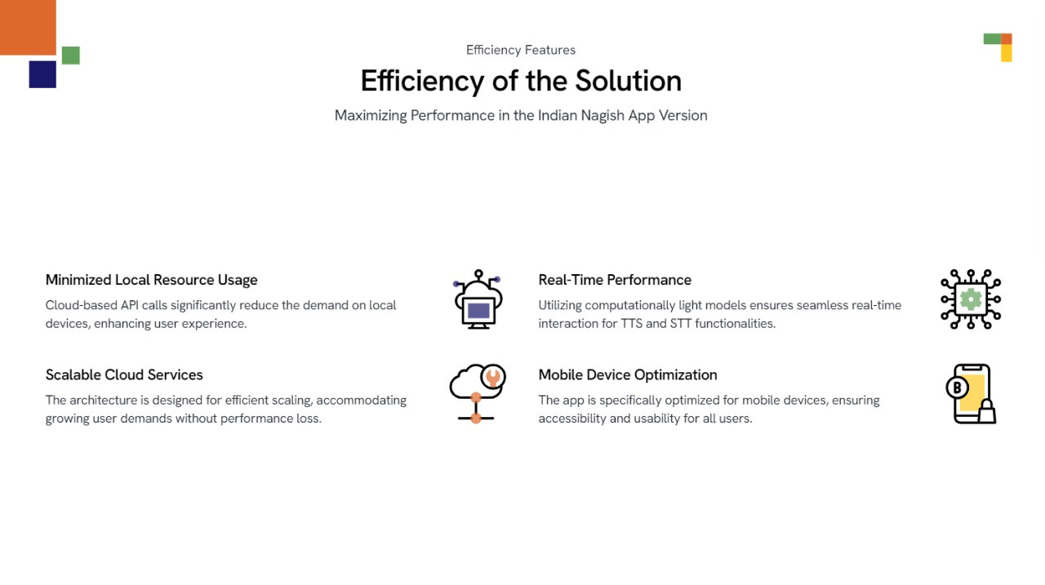

Slide 14
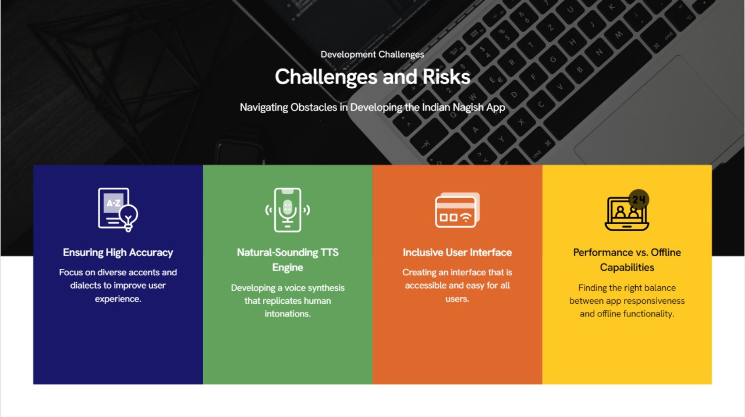

Slide 15
