Slide 1
ELECTRIC VEHICLES IN WASHINGTON
Business Intelligence Final Project – Group 7

Slide 2
Agenda
Introduction
Dataset Summary
Project Objective
Goals and Purpose
Dataset Summary
Tableau Dashboards
Clustering
Recommendation for EV Adoption
References

Slide 3
Introduction
This study uses data from the Washington State Licensing Division and HIFLD to analyze trends in electric vehicle (EV) ownership, focusing on BEVs and PHEVs.
It examines regional adoption patterns, and the environmental impacts of BEV and PHEV use across Washington State.

Slide 4
Electric Vehicle Dataset
The dataset was chosen for its accessibility, regular updates, and relevance to EV adoption analysis in Washington.
With Seattle’s tech focus, this data tracks the state’s progress toward sustainable transportation and cleaner energy solutions.

Slide 5
Dataset Summary
VIN (110)
County
City
State
Postal Code
Model Year
Make
Model
Income
Car Price Latest
Car Price Launched
Electric Vehicle Type
CAFV Eligibility
Electric Range
Base MSRP
Legislative District
DOL Vehicle ID
Vehicle Location
Electric Utility
2020 Census Tract
Data Set - Data Set
Income, Car Price Latest and Car Price Launched extracted from other data sources

Slide 6
Project Objective
Analyze EV ownership trends in Washington State.
Analyze electric vehicle (EV) adoption patterns based on customer segmentation using clustering
Analyze EV adoption trends, customer demographics, and regional distribution.
Highlight sustainability metrics and policy impacts for informed decision-making.

Slide 7
Goals and Purpose
Evaluate regional adoption rates and environmental impacts, highlighting tech-driven areas like Seattle.
Provide insights for policy and sustainability goals to promote cleaner transportation.
Leverage updated registration data to analyze BEV and PHEV adoption trends across Washington State.
Examine Seattle's influence on EV adoption and its role in advancing state-wide sustainable transportation.

Slide 8
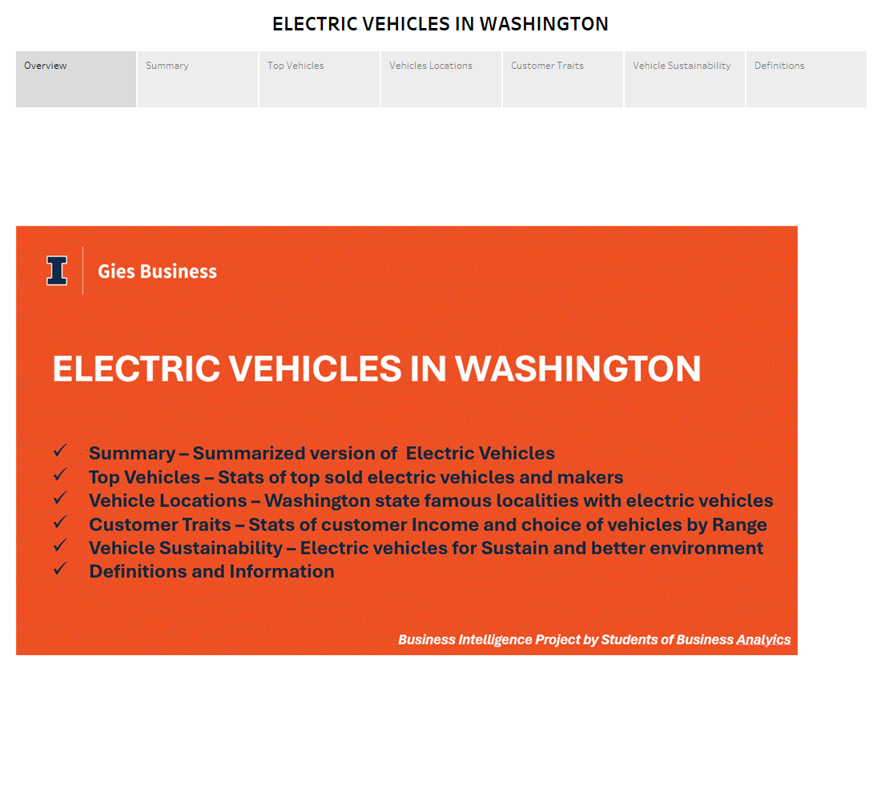
Comprehensive Analysis: Explores electric vehicle adoption trends, including top models, popular localities, and customer demographics in Washington state.
Sustainability Focus: Highlights the role of EVs in promoting environmental sustainability and driving eco-conscious decision-making.

Slide 9
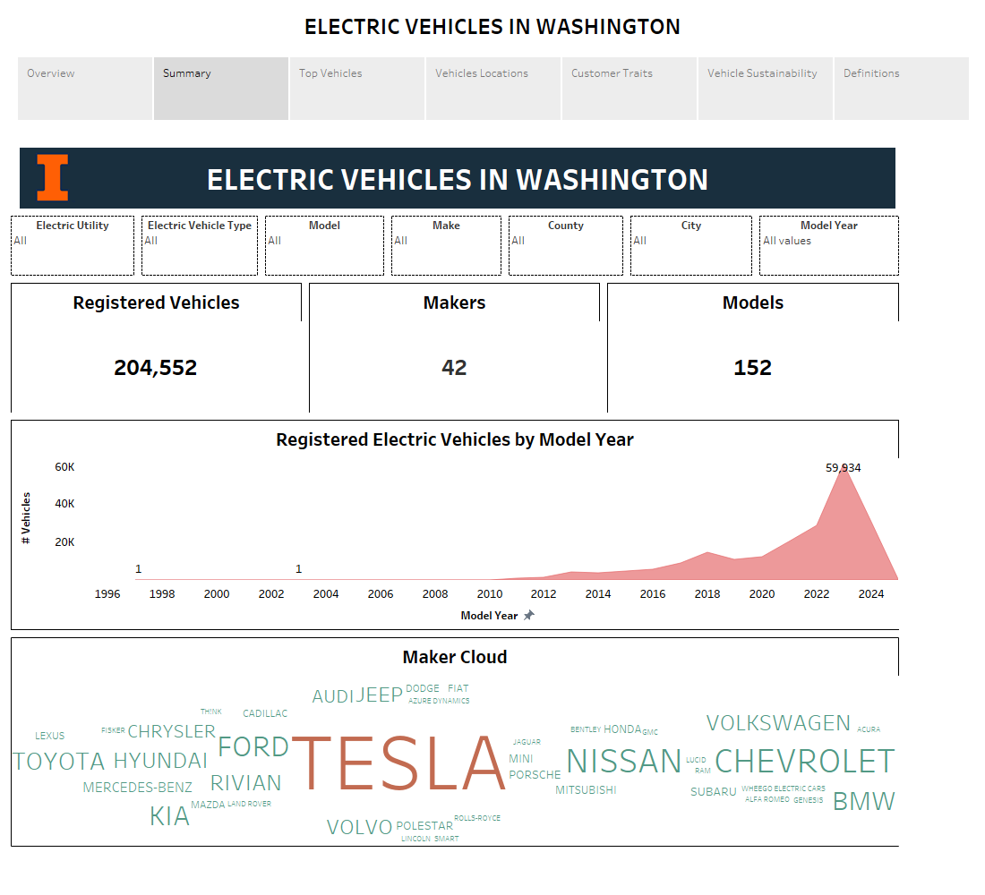

Slide 10
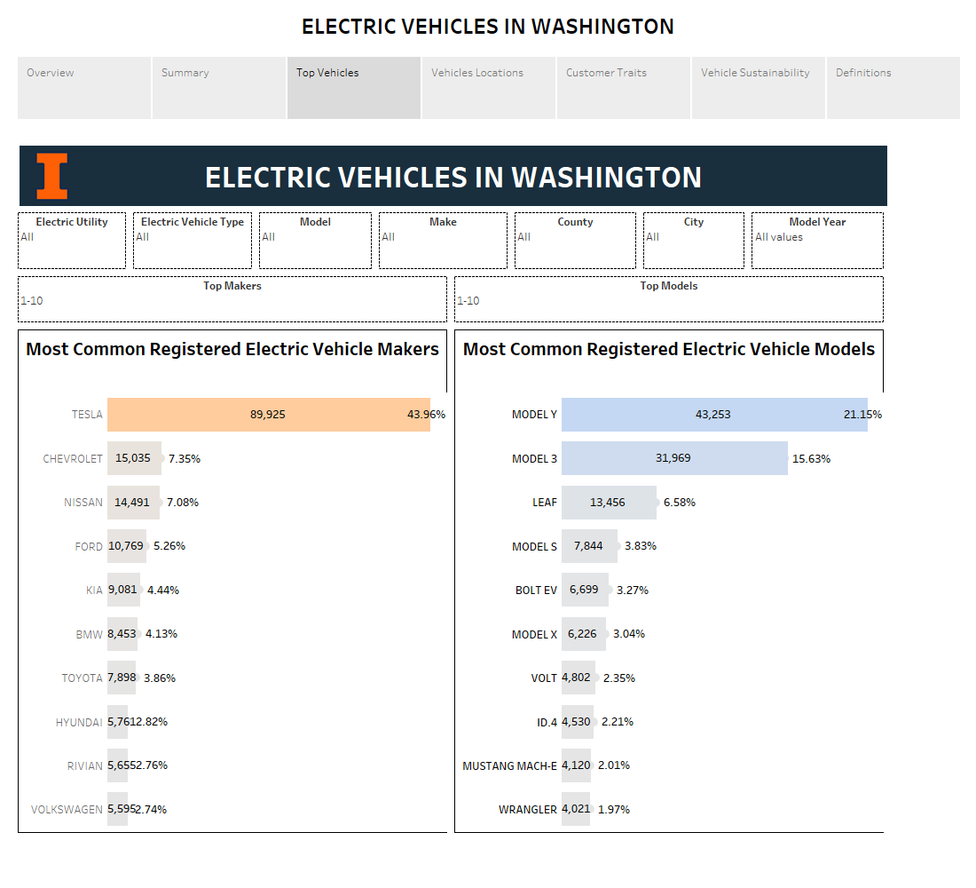

Slide 11
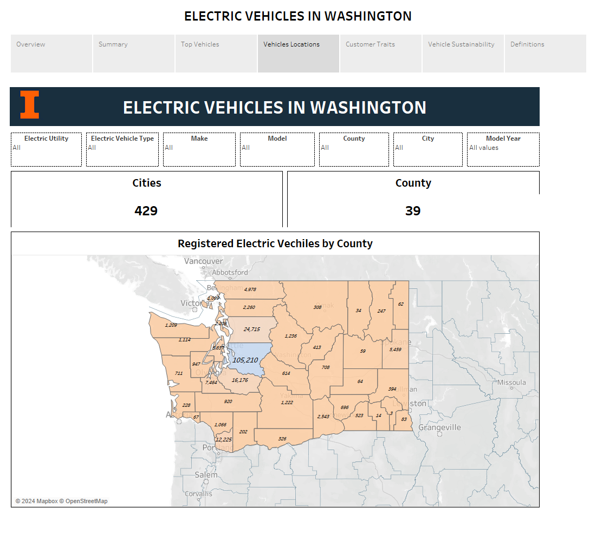

Slide 12
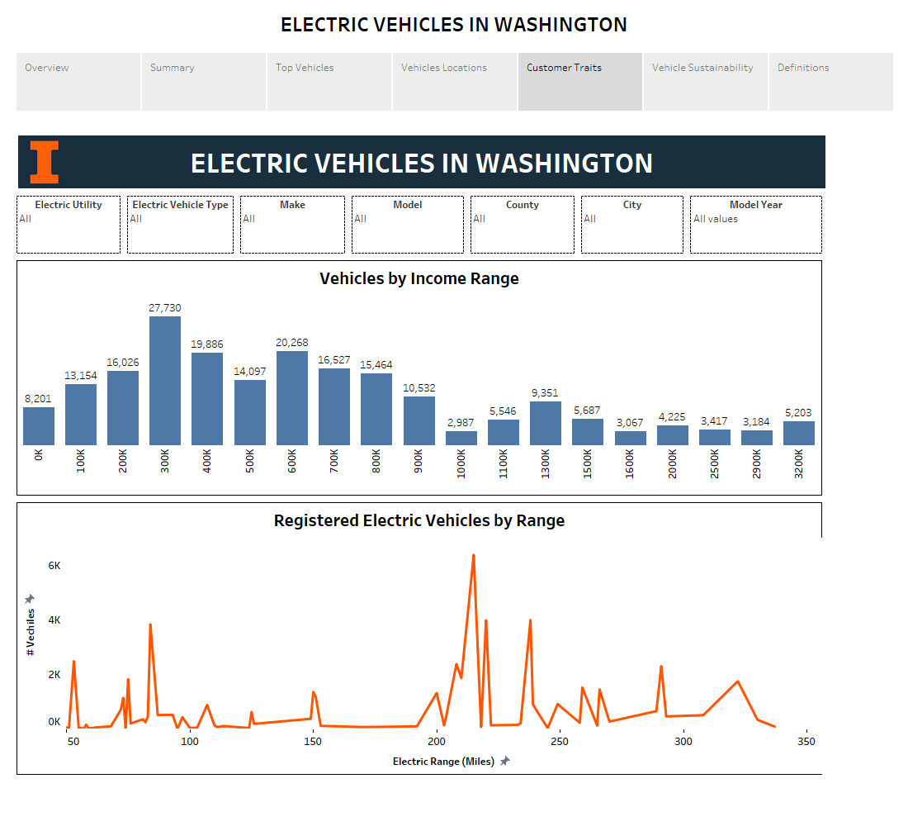

Slide 13
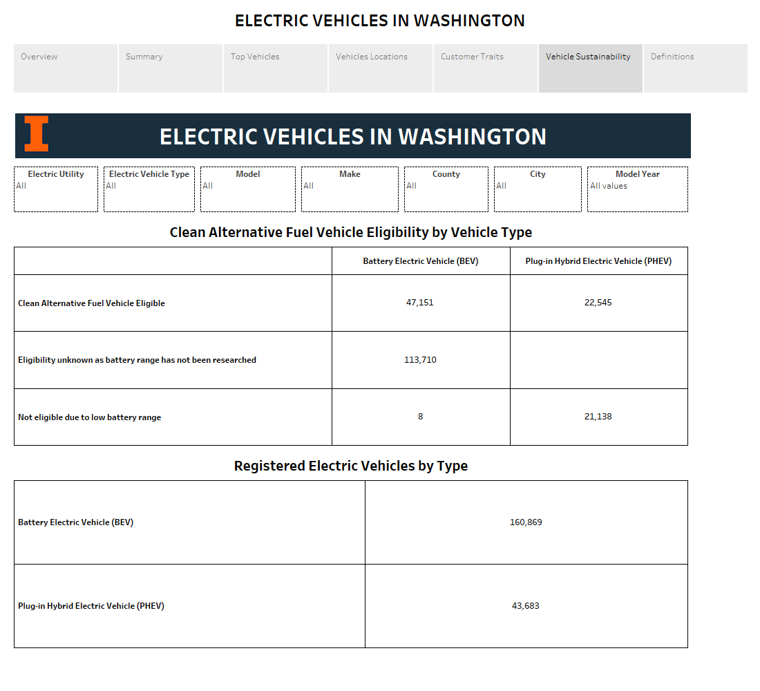

Slide 14
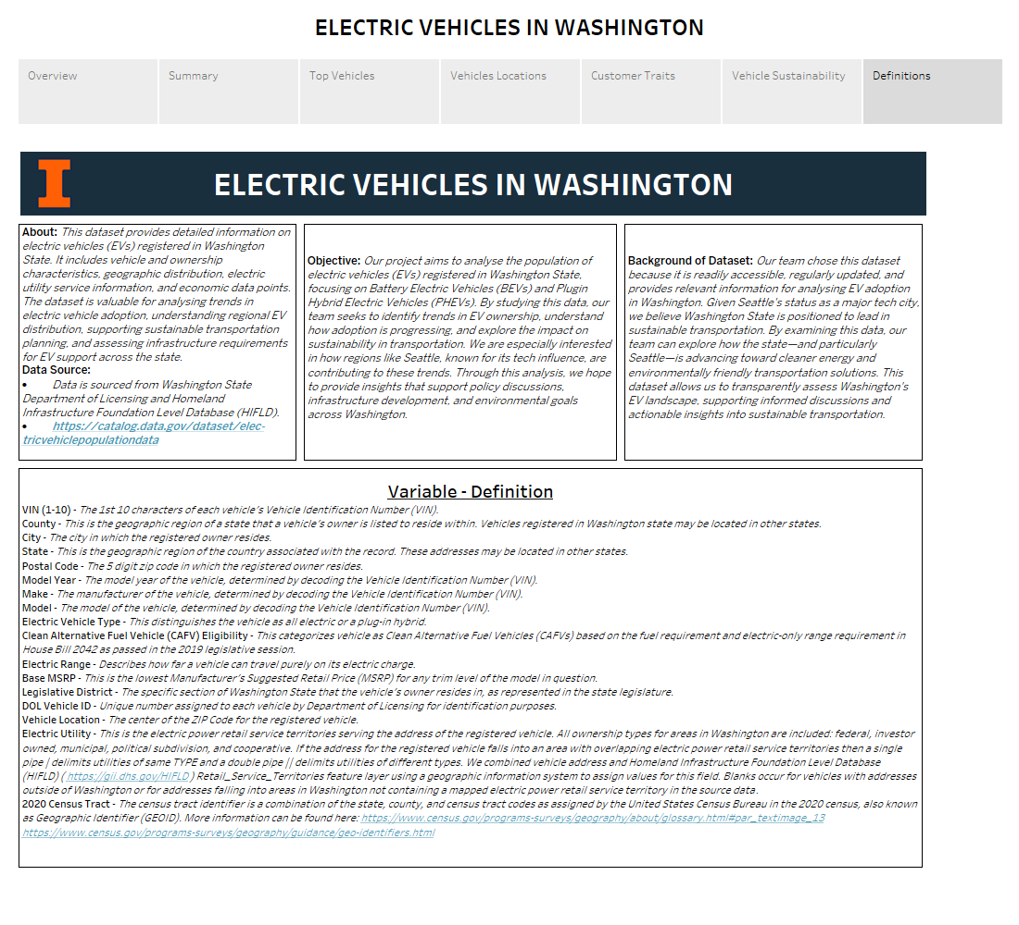

Slide 15
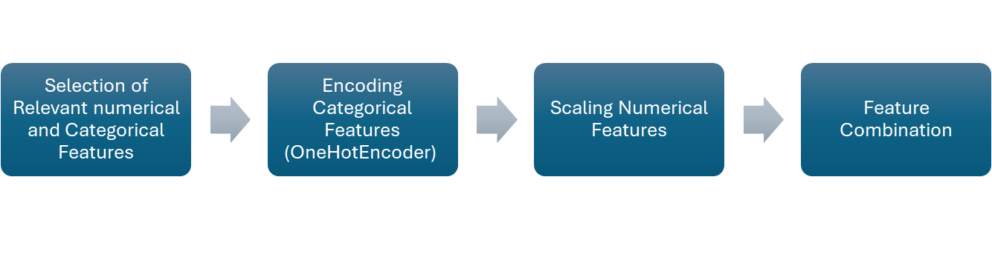
Data Preprocessing for K Mean Clustering
We selected 12 relevant numeric and categorical columns for preprocessing.
The dataset has 204,544 rows and 746 combined features after preprocessing.
Notes:
Key Insight:
The large number of features suggests a high-dimensional dataset, requiring techniques like clustering to identify meaningful patterns.

Slide 16
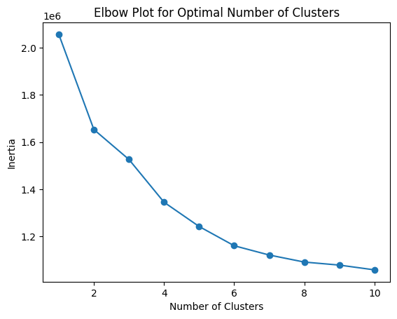
Elbow Plot
The "elbow" is at 4 clusters, suggesting this is an optimal number of clusters.

Slide 17
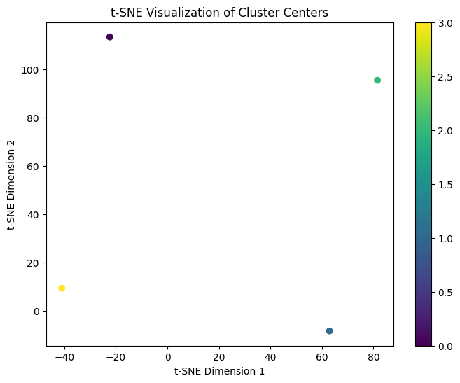
t-SNE Visualization
The clusters are well-separated in t-SNE space, confirming that the clustering algorithm captured distinct groupings.
Cluster Counts:
Cluster 1: 119,005 data points
Cluster 0: 33,410 data points
Cluster 2: 32,519 data points
Cluster 3: 19,610 data points
Notes:
(t-Distributed Stochastic Neighbor Embedding) is a machine learning algorithm
Reduces high-dimensional data into two or three dimensions for easy visualization.

Slide 18
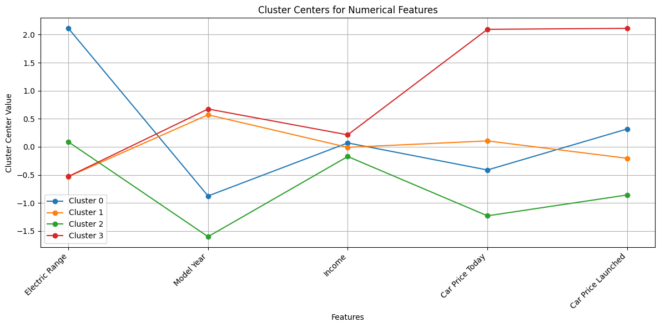
Cluster centres for Numerical Features
Cluster 0: Cost-conscious buyers who prioritize long range over the latest models
Cluster 1: Buyers looking for newer, affordable EVs with moderate range.
Cluster 2: Budget-conscious buyers prioritizing affordability over range or model recency.
Cluster 3: Affluent buyers focusing on premium, cutting-edge EVs with less emphasis on range.
Key Insight: Clear differentiation of clusters based on EV features, income levels, and pricing.
Notes:
Cluster 0 aligns with cost-conscious, long-range buyers.
Cluster 1 reflects newer, moderately priced EV adopters.
Cluster 2 fits budget-conscious, older model adopters.
Cluster 3 represents premium, high-income EV buyers.

Slide 19
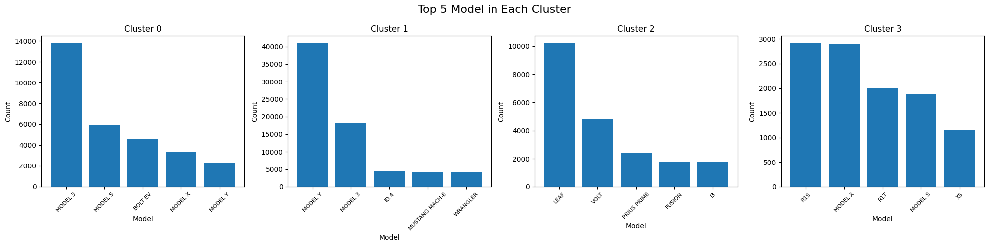
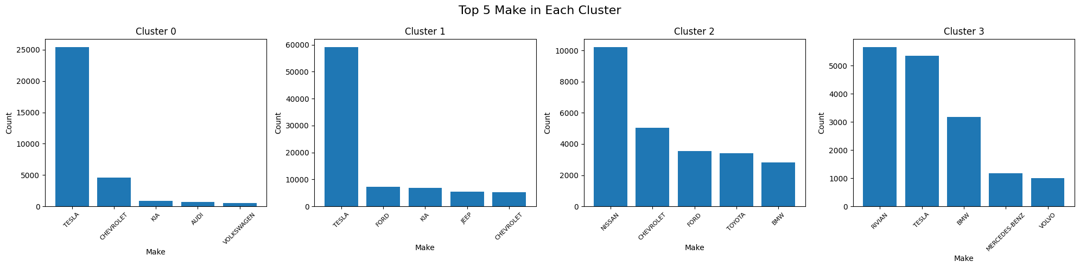
Top 5 Model in Each Cluster
Top 5 Make in Each Cluster

Slide 20
Key Insights from Cluster Analysis
Cluster 0: The dominance of Tesla (known for long-range EVs like the Model 3 and Model S) supports the inference that this cluster prioritizes electric range.
Cluster 1: Tesla followed by Ford, Kia, Jeep, and Chevrolet as secondary players. The presence of newer models like the Mustang Mach-E and ID.4 supports the inference of adoption of recent EVs with moderate range.
Cluster 2: The Nissan Leaf and Chevrolet Volt are budget-friendly, older EVs, matching the cluster’s preference for affordability and older models. It is followed by Ford, Toyota, and BMW.
Cluster 3: Models like the Rivian R1S and Tesla Model X followed by BMW, and Mercedes-Benz support the preference for cutting-edge, high-priced EVs.

Slide 21
Recommendation for EV Adoption
Targeted Marketing:
Highlight affordability and long range in suburban regions.
Emphasize luxury features and sustainability benefits.
Pricing Strategies:
Offer competitive pricing for budget-conscious clusters (0, 2).
Promote premium pricing for affluent clusters (3).
Incentive Programs:
Provide government-backed incentives for older EV upgrades.
Promote tax rebates for luxury EVs to affluent customers in Cluster 3.

Slide 22
References
Electric Vehicle Data Set - https://catalog.data.gov/dataset/electric-vehicle-population-data
Income Data - https://www.irs.gov/statistics/soi-tax-stats-individual-income-tax-statistics-2021-zip-code-data-soi-0
Car Prices 1 - https://www.kbb.com/car-prices/
Car Prices 2 - https://www.edmunds.com/
Car Prices 3 - https://www.caranddriver.com/
Car Prices 4 – Official Car Brand Portals
Car Prices 5 – Google Search Engine

Slide 23
Thank You
Aditya Agarwal
Hritika Ravindra Bhavsar
Lasya Venkata Lalpet
Shambhavi Singh
Yunzhe Yu

