Slide 1

Untrash get professionals to clear your mess
Team Name: noob_coders

Slide 2
The Problem
Our Solution
Future (No, not the singer)
The Team (a.k.a. Noobs)

Slide 3
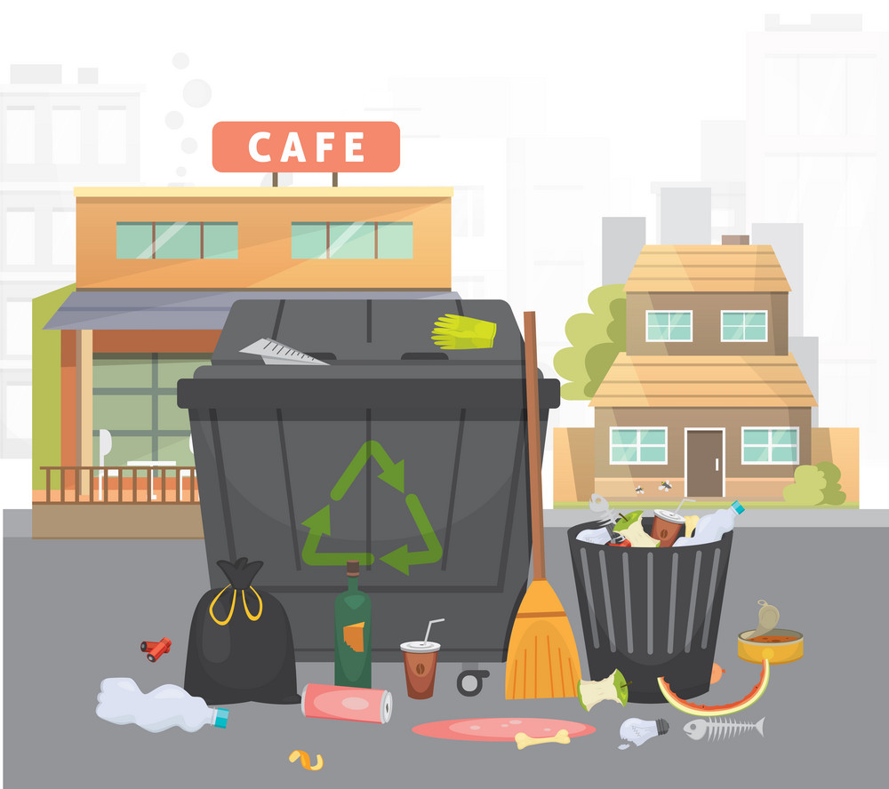

Problem
Metropolitan cities face a common issue of waste management and find it difficult to maintain a proper system of waste segregation and processing. Municipalities and Treatment plants currently face challenges in keeping a track of wastes being picked up by workers along with the disposal system incorporated by various resident societies and industries. Put forth a solution that gives a coherent system to simplify the process thereby providing transparency as well as placing an efficient system into place.
Often issues like late or no collection of waste is faced by peoples.
The agencies often just dump the waste and do not follow proper waste disposal methods.
The waste disposal system in the metropolitan cities is based on tender system, which does not hold the company responsible for faults.

Slide 4
Our Solution
X works as a intermediary to facilitate interaction between people and various waste disposal agencies.
People can select different agencies on a subscription basis as per the plans offered by the agencies.
The decision can be based of a detailed summary provided by each agency, which will include information on types of waste collected, disposal methods, other benefits offered(if any), and the subscription plans.
For the convenience of the people, the collection truck can be tracked and contacted.
The consumer can get benefits like coupons and discounts.

Slide 5
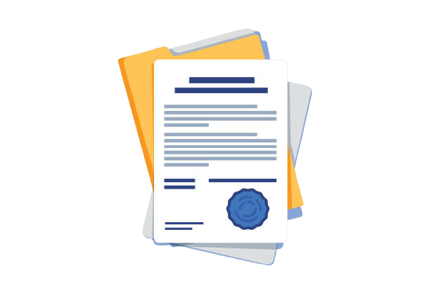

Sample Info-Sheet
Company A
We collect only wet and dry waste.
Common collection point for the whole apartment building.
Wet waste is used for composting. (Get 15% off on our manure)
Dry waste is sent for recycling.
Subscribe for 1/3/6/12 months.
Extra pick-up available against payment
Sample Info-Sheet
Company B
We collect only wet, dry and electronic waste.
Door-to-door collection.
Wet waste is used for composting. (Get 10% off on our manure)
Dry and electronic waste is sent for recycling.
Subscribe for 1/3/6/12 months.
3 extra pick-up available per month for free.

Slide 6


Future
App support for Android and iOS.
Expand to non-metro cities.

Slide 7

The Team
Aaditya Mahanta 21BCI0046
Aditi Agarwal 21BCI0062
Poulomi Biswas 21BCI0047
Shikhar 21BCI0063
Thank You

