Slide 1
INTADM21AJ007- eMediCare
POD Member Name :
1.Shekhar Deshpande
2.Kashish Manglani
3.Narendran Ravichandran
4.Aditaya Maharana
5.Swastika Maji
Date of Design : 11th May,2021

Slide 2
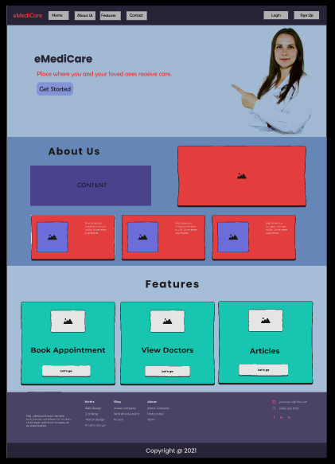
Homepage
2

Slide 3
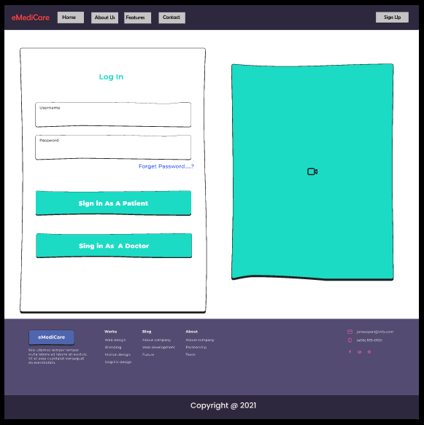
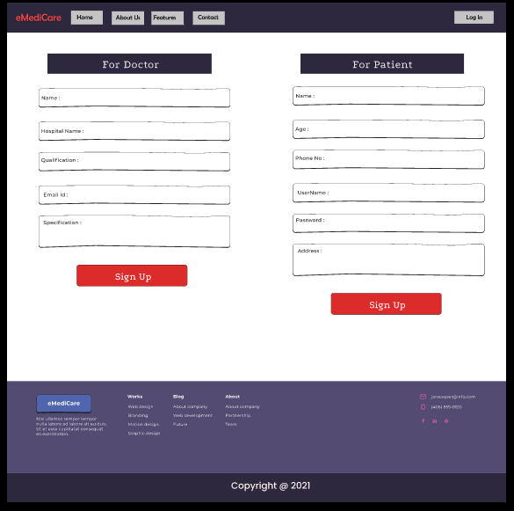
Log In Page
Sign Up Page

Slide 4
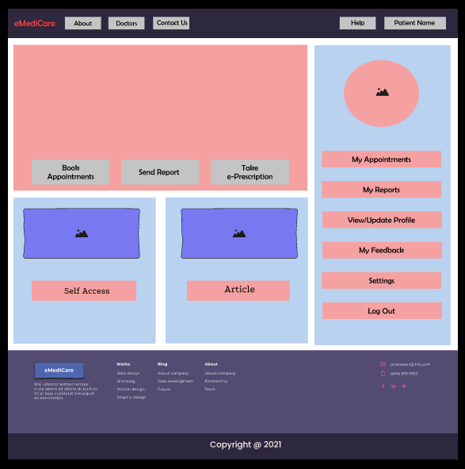
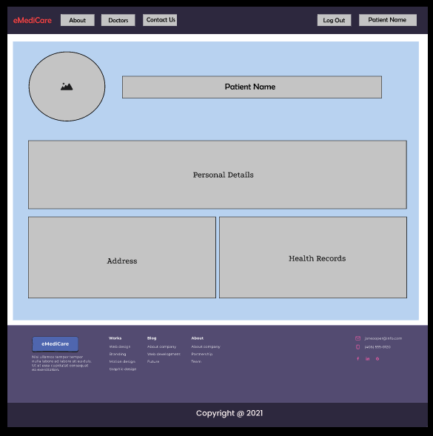
Patient Homepage
Edit Details
3

Slide 5
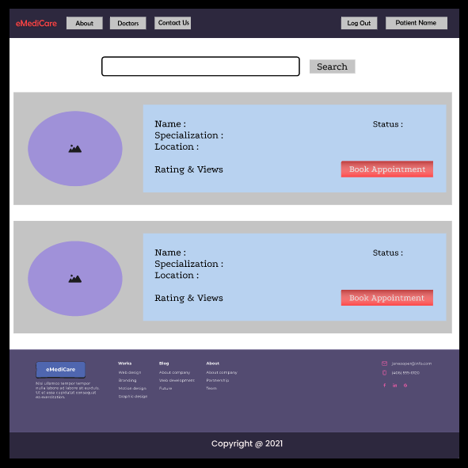
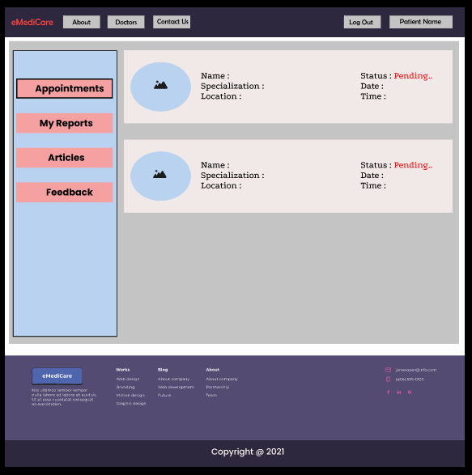
Book Appointment
View Appointment
4

Slide 6
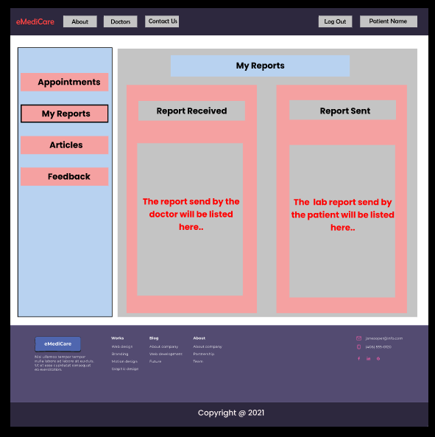
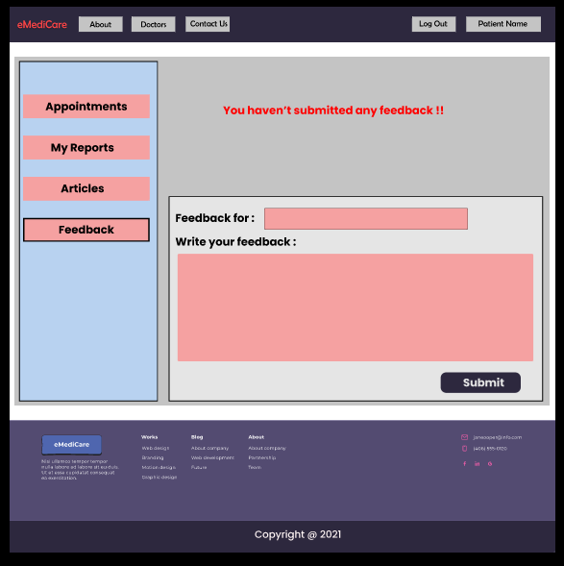
Reports
Feedback

Slide 7
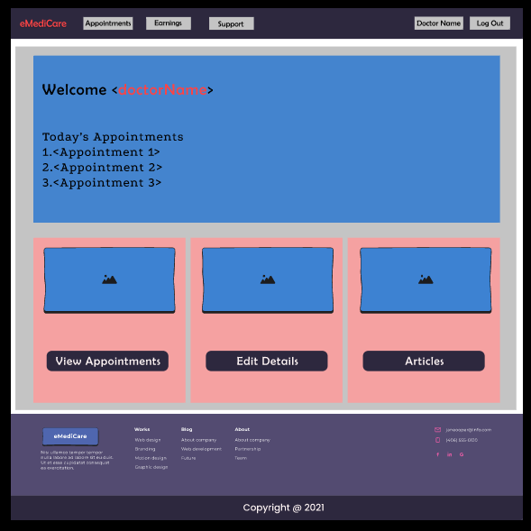
Doctor Homepage

Slide 8
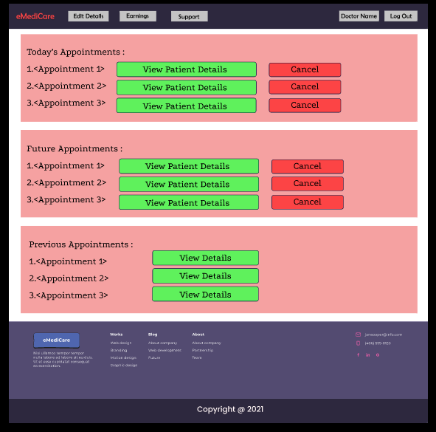
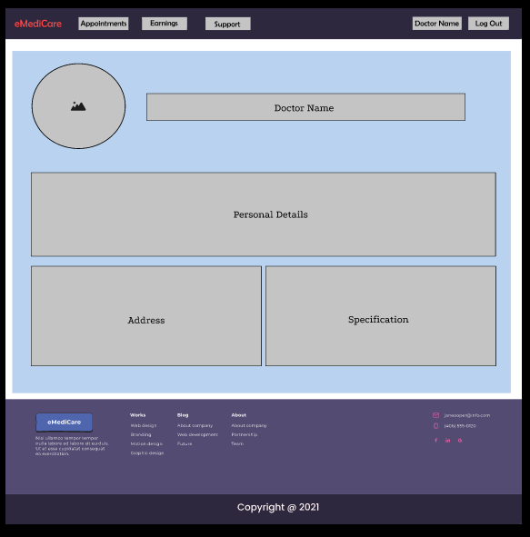
Edit Details
View Appointment

Slide 9
Thank You!
POD Member Name
1.Shekhar Deshpande(904868@cognizant.com)
2.Kashish Manglani(904858@cognizant.com)
3.Narendran Ravichandran(903984@cognizant.com)
4.Aditaya Maharana(904144@cognizant.com)
5.Swastika Maji(904181@cognizant.com)

