Slide 1
European Bank Data Analysis
Presenter Name: Adit Doza
Final Year Doctoral Candidate
Department of Economics
Wayne State University

Slide 2
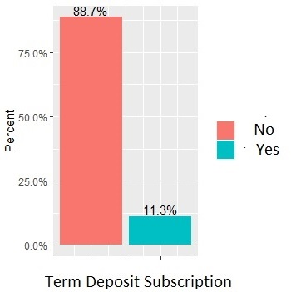
Overview of the Problem
Subscriptions of Term Deposits
No | 36,357
Yes | 4,639
Total | 41,176
The European bank has a subscription program based on term deposits and currently only 11.3% of clients has subscribed to the program
The bank has launched a marketing campaign to boost subscriptions mainly through direct phone calls
The bank needs to identify if the clients are receptive to such campaigns from a list of given parameters
They also have a predictive model to evaluate the probability of subscription based on given parameters and need to evaluate the effectiveness of the existing predictive model

Slide 3
Main objectives and targets
We are trying to identify data patterns based on descriptive statistics, bar plot and histogram of a list of parameters by segmentation of subscription status to make the bank aware of their target client base and generate more revenue for the bank
Assist the bank on evaluating the effectiveness of the current marketing campaign and provide necessary recommendations to improve the campaign effectiveness to acquire more clients as subscribers
Evaluate their existing predictive model, based on certain evaluation metrics (sensitivity and specificity test)
Propose alternate models (logistic regression, decision tree) that may assist them in making better model predictions

Slide 4
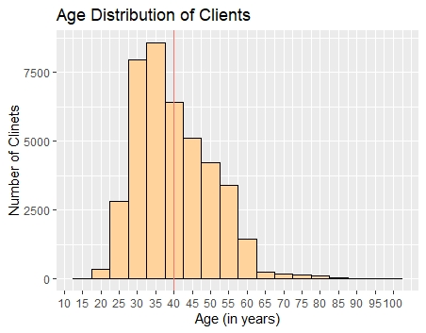
Overall Age Distribution of Clients
The mean age of the clients are 40.02, and the median age of the clients are 38
Most of the clients ranges from ages from 20-60 years

Slide 5
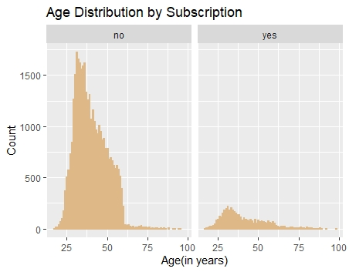
Age Distribution of Clients by Subscription Status
A large proportions of the clients who has subscribed ranges between ages 25-60 years

Slide 6
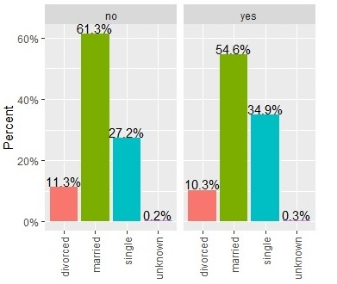
Marital Status of Clients by Subscription
Subscription Status
A large portion of clients who has subscribed to term deposits are married (54.6%) and next largest group are single applicants (34.9%) out of total 4,639 Subscribers
Marital Status

Slide 7
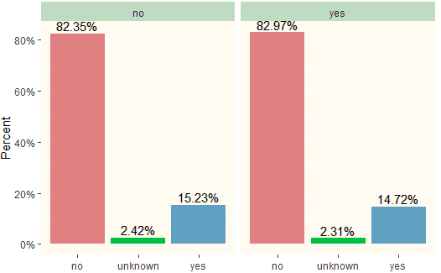
Loan Status of Clients by Subscription
Subscription Status
A large percentage of Subscribers (82.97%) do not have any loans
Subscribers of term deposits are also less likely to have loans compared to Non-subscribers
Loan Status

Slide 8
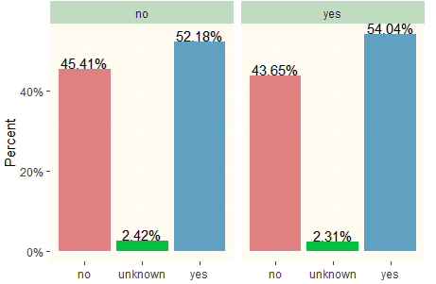
Home Ownership of Clients by Subscription
Subscription Status
A higher percentage (54.04%) of subscribers own their own homes
Subscribers also has a slightly higher home ownership compared to nonsubscribers
Home Ownership

Slide 9
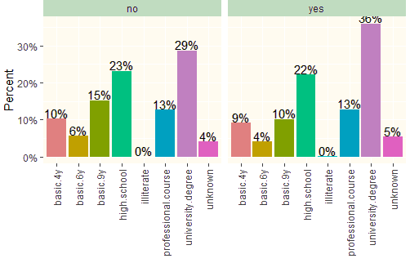
Education level of Clients by Subscription
Subscription Status
A Large proportion of Subscribers are university graduates (36%), followed by high-school graduates (29%) and professional course completers (13%) respectively
Level of Education

Slide 10
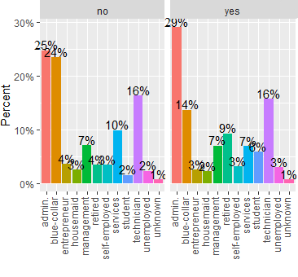
Job Category of Clients by Subscription
Subscription Status
Among Subscribers majority(29%) does admin job, followed by technician job (16%) and blue-collar job (14%)
Job Category

Slide 11
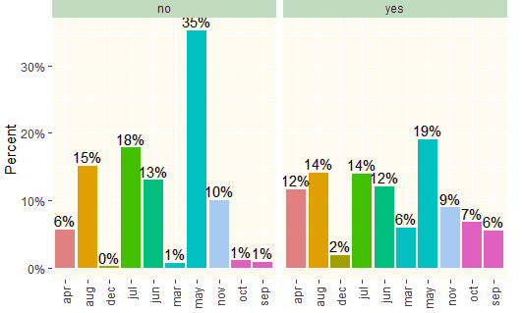
Monthly Contact of Clients by Subscription
Subscription Status
Among Subscribers May is the most frequent(19%) month of last contact
Subscribers/Non-Subscribers were not contacted during the months of January & February
Month (Last Contact)

Slide 12
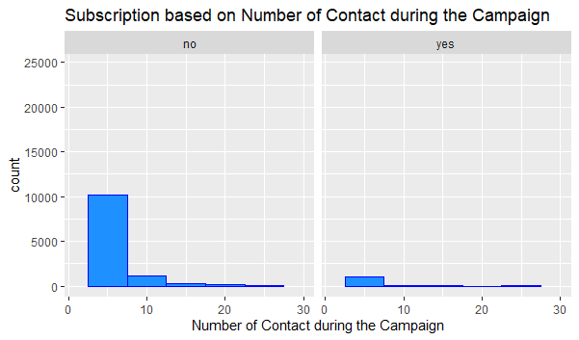
Subscription based on Number of campaigns
Based on the plot among Subscribers, it is observed that campaigns up to 7 are the most effective
Bank can save cost (resources) by limiting up to 7 campaigns
Number of Campaigns | Subscription & Percentages | Number of Campaigns | Subscription & Percentages
1 | 2,299 | 5 | 120
 | 49.56% |  | 2.59%
2 | 1,211 | 6 | 75
 | 26.10% |  | 1.62%
3 | 574 | 7 | 38
 | 12.37% |  | 0.82%
4 | 249 | 8 | 17
 | 5.37% |  | 0.37%

Slide 13
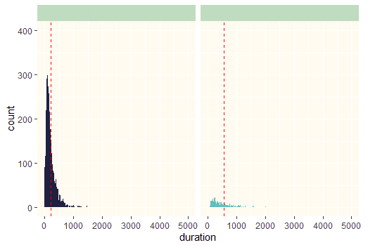
Subscription based on Call duration
Subscription Status
Yes
No
The Average Call Duration for Subscribers is 553seconds (For Non-subscribers it is 221s)
Beyond 1000s we see not many people subscribe to term deposits

Slide 14
Recommendations for the bank
Focus on clients of ages between 25-60 years old as bank can maximize the number of subscribers and can generate more revenue and profits
Focus more on married clients with better financial standing, it will boost subscriptions and enhance quality of clients
Give incentives such as signup bonus to highly educated clients to boost subscriptions
Increase the proportion of blue-collar workers by providing better deposit schemes such as higher interest rate

Slide 15
Recommendations for the bank
Increase monthly contact in January and February as well to promote repeat business and prevent clients from switching over to competitors
Reduce the number of campaign calls to 7 as it is the most cost effective based on the data pattern and cost containment will ensure better profit margins
Reduce call duration to less than 1000s as another cost containment measure to increase profit margins

Slide 16
Predictive models, their use case and importance
We mainly work with predictive models as it assists the organization make more informed decisions based on varying statistical probabilities
Testing a campaign with different models can be useful to streamline and implement different strategies that may be more beneficial to the interest of the organization and stake-holders
I will propose alternative model algorithms after evaluation of the pre-existing model to evaluate if better options are available to the organization

Slide 17
Evaluating Existing Model Performance
To evaluate the existing model performance of the bank, we first need to evaluate the overall mean performance of the model which comes out to be 88.8%
Next, I calculated the Sensitivity and Specificity of the existing model
Sensitivity is the process of correctly identifying the number of subscribers that has actually subscribed (In other words the number of True Positives)
Based on the existing model calculation, it comes out to be 73.6%
Therefore, number of False positives for the model 100-73.6%= 22.4%

Slide 18
For specificity, we calculated the number of people that has not subscribed when they did not subscribe (i.e. the number of True Negatives)
Based on existing Model this comes out to be 90.7%
Therefore, Number of False Negatives = 100-90.7% = 9.3%
Overall: although our model has performed relatively well for Specificity test (correctly identified 90.7% False Negatives), it did not do a good job for Sensitivity Test (only correctly identified 73.6% of true positives).
Next, I will test two models: 1) Logistic Regression model and 2) Decision Tree model
 | Subscribed | Not Subcribed
Yes | 73.60% | 23.40%
No | 9.70% | 90.30%
Note: Green shaded describes the Sensitivity (True Positives) and Purple Shaded describes the Specificity (True Negatives)

Slide 19
1) Logistic Regression Model
I have split the data into training and test with a 70-30 split (standard for ML algorithm)
For the Logistic Regression Model (1 dependent variable and the rest 21variables as predictors)
 | Subscribed | Not Subscribed
Yes | 97.4% | 2.6%
No | 56.5% | 43.5%
Note: Green shaded describes the Sensitivity (True Positives) and Purple Shaded describes the Specificity (True Negatives)
Our Sensitivity was found to be 97.4% (True Positives) but this time Specificity was only 43.5% (True Negatives)
Although we want a model with higher Sensitivity (True Positives) we cannot compromise too much on Specificity (True Negatives)

Slide 20
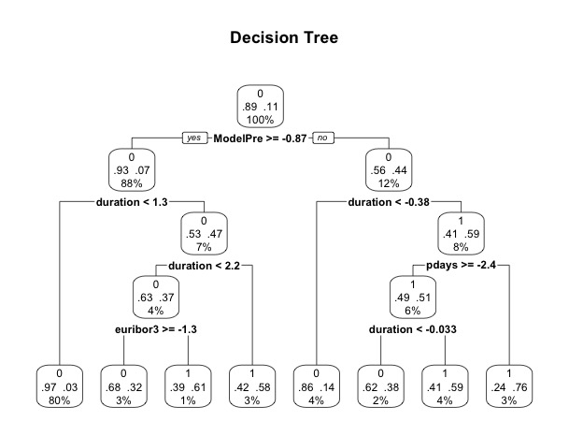
2) Decision Tree Model
 | Subscribed | Not Subscribed
Yes | 95.4% | 4.6%
No | 43.6% | 57.4%
Our Sensitivity was found to be 95.4% (True Positives) and Specificity was found to be 57.4% (True Negatives)
This gives a perfect balance with a little compromise on the Sensitivity, we get a higher Specificity.
Decision Tree seems to be an overall good model.

Slide 21
Conclusion
Based on the data-analysis and existing model evaluation it is apparent that there are a lot of room for improvements.
The bank may adopt the suggested recommendations to improve their overall profitability and long-term sustainability.
They may also adopt newer prediction models (machine learning algorithms) to better assess the probability of clients that are more likely to subscribe.
The Decision Tree model seems to be a better prediction model based on the overall evaluation.

Slide 22
Future Work
Due to time and space limitations, I only considered a limited number of predictive classifiers.
Future work would also consider a broad set of methodologies.

Slide 23
Thank You!

