Slide 1
SOLAR EYE
PROJECT(2018)
INFORMATION TECHNOLOGY
Mahin Raza

Slide 2
CONTENTS
Introduction
Literature Review
Problem Definition
Requirement Analysis
Proposed Methodology(modules)

Slide 3
INTRODUCTION
The Internet of Things (IoT) is the network of physical objects—devices, vehicles, buildings and other items embedded with electronics, software, sensors, and network connectivity—that enables these objects to collect and exchange data.
When IoT is augmented with sensors and actuators, the technology becomes an instance of the more general class of cyber physical system which also encompasses technologies such as smart grids ,virtual power plants, smart homes,intelligent transportation and smart cities.

Slide 4
LITERATURE REVIEW
As energy demand is increasing day by day. We need to continuously innovate in the field of technology to fulfill these energy needs. Researchers are in struggle to utilize the Solar Energy effictively.
1) What is a Solar panel made up of ?
Solar panels are used for the generation of electricity. The panels are made up of various cells. A solar cell is an electronic device which is made of silicon. It is a simple P-N junction.
2) Progress in the field of Solar panels till date
The junction of the solar plates were earlier made up of homojunctions ,which is a semiconductor interface that occurs between layers of similar semiconductor material, these materials have equal band gaps in between.

Slide 5
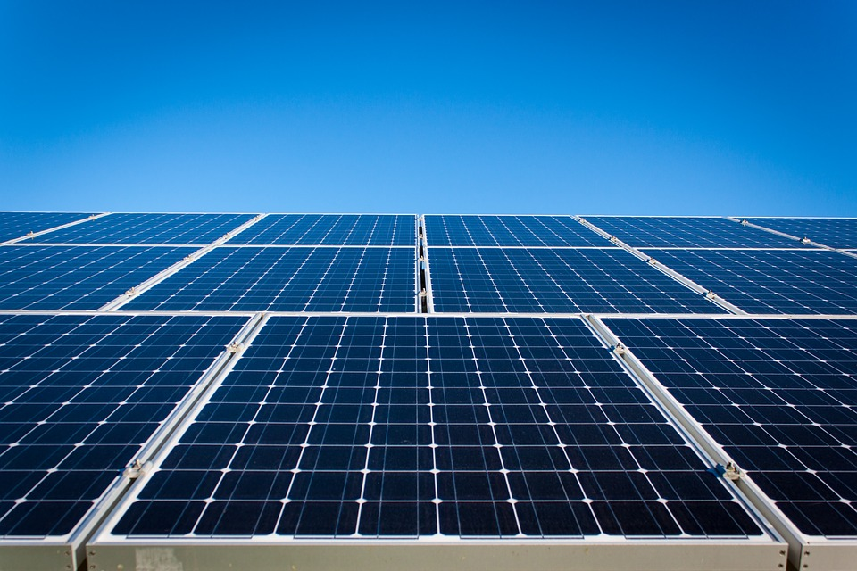
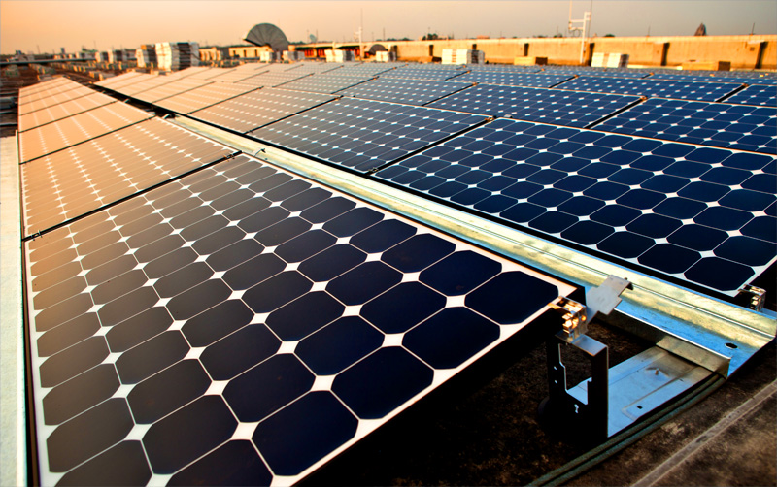
Later, the heterojunction method was introduced and the innovation is continuing in the field. “But the major issue still remains in terms of the efficiency. The enhancement of the material could not lead to the drastic increase of the efficiency level”.
“Till now different Solar Cells and their setups have been presented and used. From the start to now a lot of improvement has been done.Large amount of work is further needed to make the technology completely expolitable with high efficiency“.

Slide 6
PROBLEM DEFINITION
The energy generated by the solar panels have not been at 100%. It has been a mere 20-25% of what it is actually capable of. The rest of the energy either cannot be harnessed due to the solar panel material limitancy or due the large distance between the earth and the sun.
The energy that is lost if tapped or harnessed, it can add to the various resources that use solar energy and provide more to the mankind.
Efficiency of max 30% has been achieved by using various organic materials. The use of rare and expensive material can be replaced with organic material like DSSC(Dye Sensitised Solar Cell).
To increase the efficiency, various other methodologies are currently under research.

Slide 7
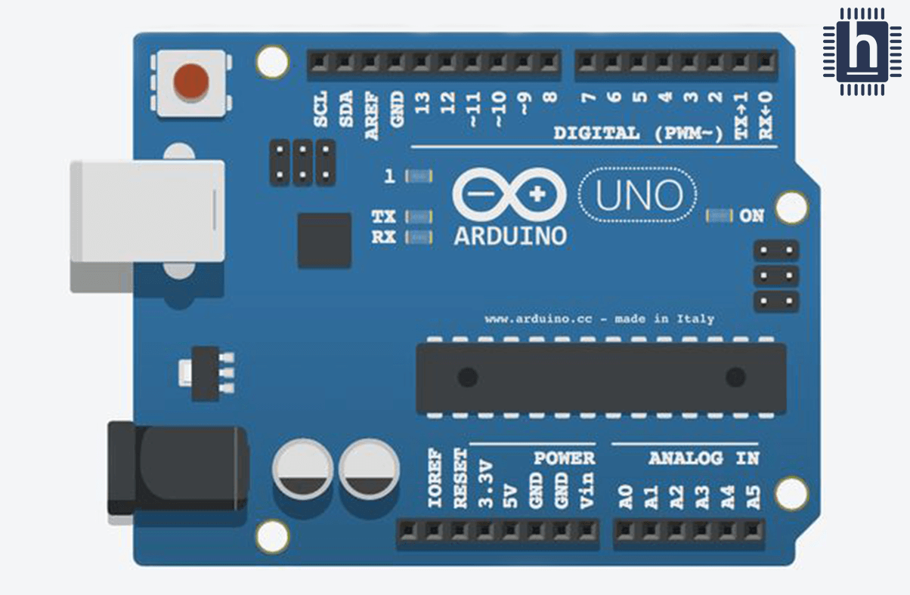
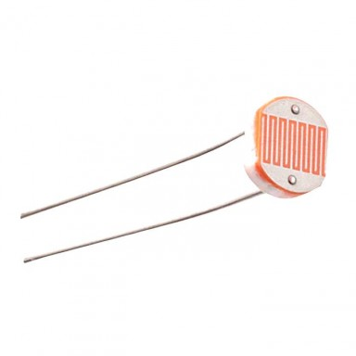
REQUIREMENT ANALYSIS
SOFTWARE
HARDWARE
Arduino Breadboard
Wires and Resistors
Heat Sensors
LDR Sensors
Solar Panels
Pipes
Jumper Cables

Slide 8
FUNCTIONAL REQUIREMENTS
It is the requirement which specifies what the system should do.
Heat sensing ability at continous periods.
Arduino board performance on encountering an Input
Meter sensing and displaying the amount of energy generated by the solar panels.
NON FUNCTIONAL REQUIREMENTS
It is the requirement which specifies how the system performs a certain function.
Rotation performed of the panel depending upon the light intensity.
The pumping of coolant throughout the solar panel on crossing the threshold value of the heat in the panel as detected by the heat sensors.

Slide 9
PROPOSED METHODOLOGY
MODULE SPLIT UP ARE AS FOLLOWS
Describing issues in existing methodology
Describing need for new methodology
Describing algorithm/method of implementation
Describing Modules and its functionalities
System Design

Slide 10
Describing issues in existing methodology
SOLAR PANEL SETUP ISSUE
Solar panels can generate electricity without any waste or pollution, or dependence on the Earths natural resources once they are constructed.
A useful characteristic of solar photovoltaic power generation is that it can be installed on any scale as opposed to conventional forms of power generation that require large scale plant and maintenance.
The problem with fixed racks is that the orientation of the solar panels is kept unchanged during the entire year.

Slide 11
They are typically installed in a south facing position (or in a north one, in the southern hemisphere) to get more sunlight during the winter, but small adjustments would be advantageous.
SOLAR PANEL HEATING ISSUE
As the solar panels nowadays are fixed at a particular angle, the sunlight will fall on the solar panel for a fixed amount of time, hence the decrease in the amount of energy that it can take which in turn will result in the less amount of energy being produced.
Also the solar panels when get overheated, it is stated that the efficiency of the solar panel decreases drastically, therefore producing less amount of energy.
Even though the melting point of solar cells is high, it is highly likely that a damage can occour to the solar cells. The cost of replacing the damaged solar cell is very expensive.

Slide 12
Describing need for new methodology
SOLUTION TO SOLAR PANEL ISSUE
Keeping in mind the issues present in the existing methodologies that's where electronically adjustable racks enter. They are as simple and as strong and easy to manage as fixed racks, but they allow small adjustments during the year; they just have to be installed in an easy-to-access location, or on the ground.
Trackers generate more electricity than their stationary counterparts due to increased direct exposure to sunrays during all times of the days . This increase can be as much as 10 to 25% depending on the geographic location of the tracking system.

Slide 13
Solar trackers generate more electricity in roughly the same amount of space needed for fixed-tilt systems, making them ideal for optimizing land usage.
Solar trackers generate more electricity in roughly the same amount of space needed for fixed-tilt systems, making them ideal for optimizing land usage.
PIPELINE SETUP IN SOLAR PANELS
The solar panels when exposed to continuous heat, the results can lead to decreasing efficiency of the amount of electricity produced. The cooling system present on the setup will lead to the decreasing in the temperature of the solar panel, which inturn helps in the increasing of the energy conversion hence lead to a better efficiency.

Slide 14
Describing method of implementation
The following are the steps of implementation for the solar setup:
Detection of sunlight by LDR’S, if light is present:
a)The direction of the light is taken into account through its intensity.
b)The intensity is taken as input in the Arduino board.
The Arduino board compares the intensity between the two LDR’s and sends the signals to the motors through the resistors which are embedded on the breadboard.
Once the motors receive the signals from the Arduino controller , the motor rotates the solar setup in the direction of the sunlight.

Slide 15
This allows the solar panels to face the sunlight in the perpendicular direction throughout the day. Hence increasing the efficiency of the energy conversion up to 40%.
However sometime due to intense heat from sunlight, the solar panels gets heated that causes decrease in efficiency of electricity by 10%.
So to tackle this situation we placed heat sensors, which detects temperature of the solar panels.
If the temperature goes above the predetermined threshold the cooling system will automatically start the circulation of coolant throughout the panels thus absorbing heat and decreasing the temperature pf panels.
Finally the sunlight will be converted to electricity and stored in a device.

Slide 16
Describing Modules and its functionalities
Arduino uno
The Arduino Uno is a microcontroller board based on the ATmega328 (datasheet).
It has 14 digital input/output pins (of which 6 can be used as PWM outputs), 6 analog inputs, a 16 MHz ceramic resonator, a USB connection, a power jack, an ICSP header, and a reset button.
It contains everything needed to support the microcontroller; simply connect it to a computer with a USB cable or power it with a AC-to-DC adapter or battery to get started.

Slide 17
Solar panel
Solar panels are devices that convert light into electricity.
They are called solar panels because most of the time, the most powerful source of light available is the Sun, called Sol by astronomers.
Some scientists call them photovoltaics which means, basically, light-electricity. A solar panel is a collection of solar cells.
Lots of small solar cells spread over a large area can work together to provide enough power to be useful.
LDR
Light dependent resistors (LDR), are light sensitive devices most often used to indicate the presence or absence of light, or to measure the light intensity.
In the dark, their resistance is very high, sometimes up to 1MΩ, but when the LDR sensor is exposed to light, the resistance drops dramatically, even down to a few ohms, depending on the light intensity.

Slide 18
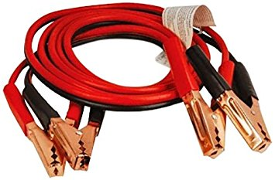
LDRs have a sensitivity that varies with the wavelength of the light applied and are nonlinear devices. They are used in many applications but are sometimes made obsolete by other devices such as photodiodes and phototransistors. Some countries have banned LDRs made of lead or cadmium over environmental safety concerns.
Jumper cable
A jump wire is an electrical wire or group of them in a cable with a connector or pin at each end (or sometimes without them – simply "tinned"), which is normally used to interconnect the components of a breadboard or other prototype or test circuit, internally or with other equipment or components, without soldering.

Slide 19
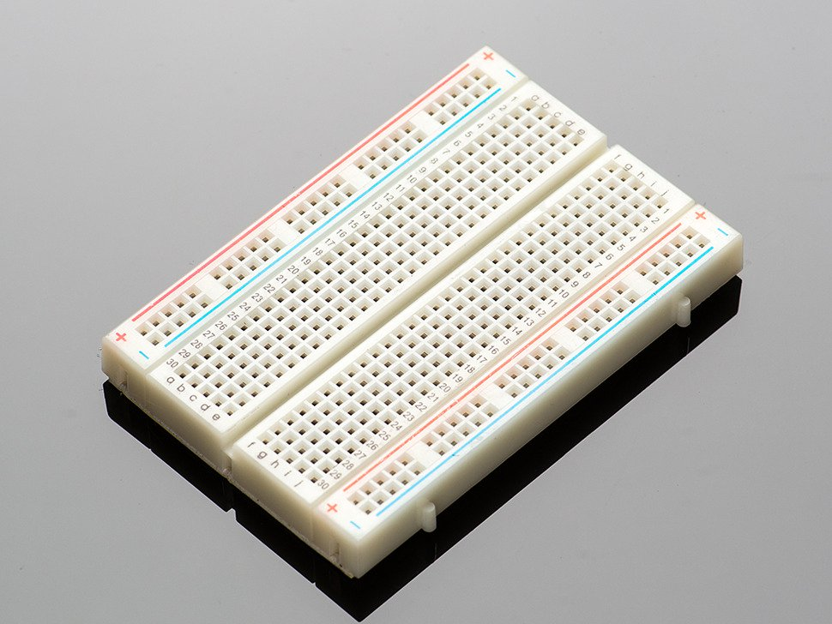
Breadboard
A breadboard is a solderless device for temporary prototype with electronics and test circuit designs.
Most electronic components in electronic circuits can be interconnected by inserting their leads or terminals into the holes and then making connections through wires where appropriate.
The breadboard has strips of metal underneath the board and connect the holes on the top of the board.
The metal strips are laid out as shown below. Note that the top and bottom rows of holes are connected horizontally and split in the middle while the remaining holes are connected electricaly.

Slide 20
Motor
A motor converts electrical energy into mechanical energy.
Cooling Agent
It will be used to decrease the temperature of the Solar panel setup.
It is in liquid state.
Temperature/Heat Sensor
A temperature sensor is a device, typically, a thermocouple or RTD, that provides for temperature measurement through an electrical signal.
A thermocouple is made from two dissimilar metals that generate electrical voltage in direct proportion to changes in temperature.
An RTD (Resistance Temperature Detector) is a variable resistor that will change its electrical resistance in direct proportion to changes in temperature in a precise, repeatable and nearly linear manner.

Slide 21
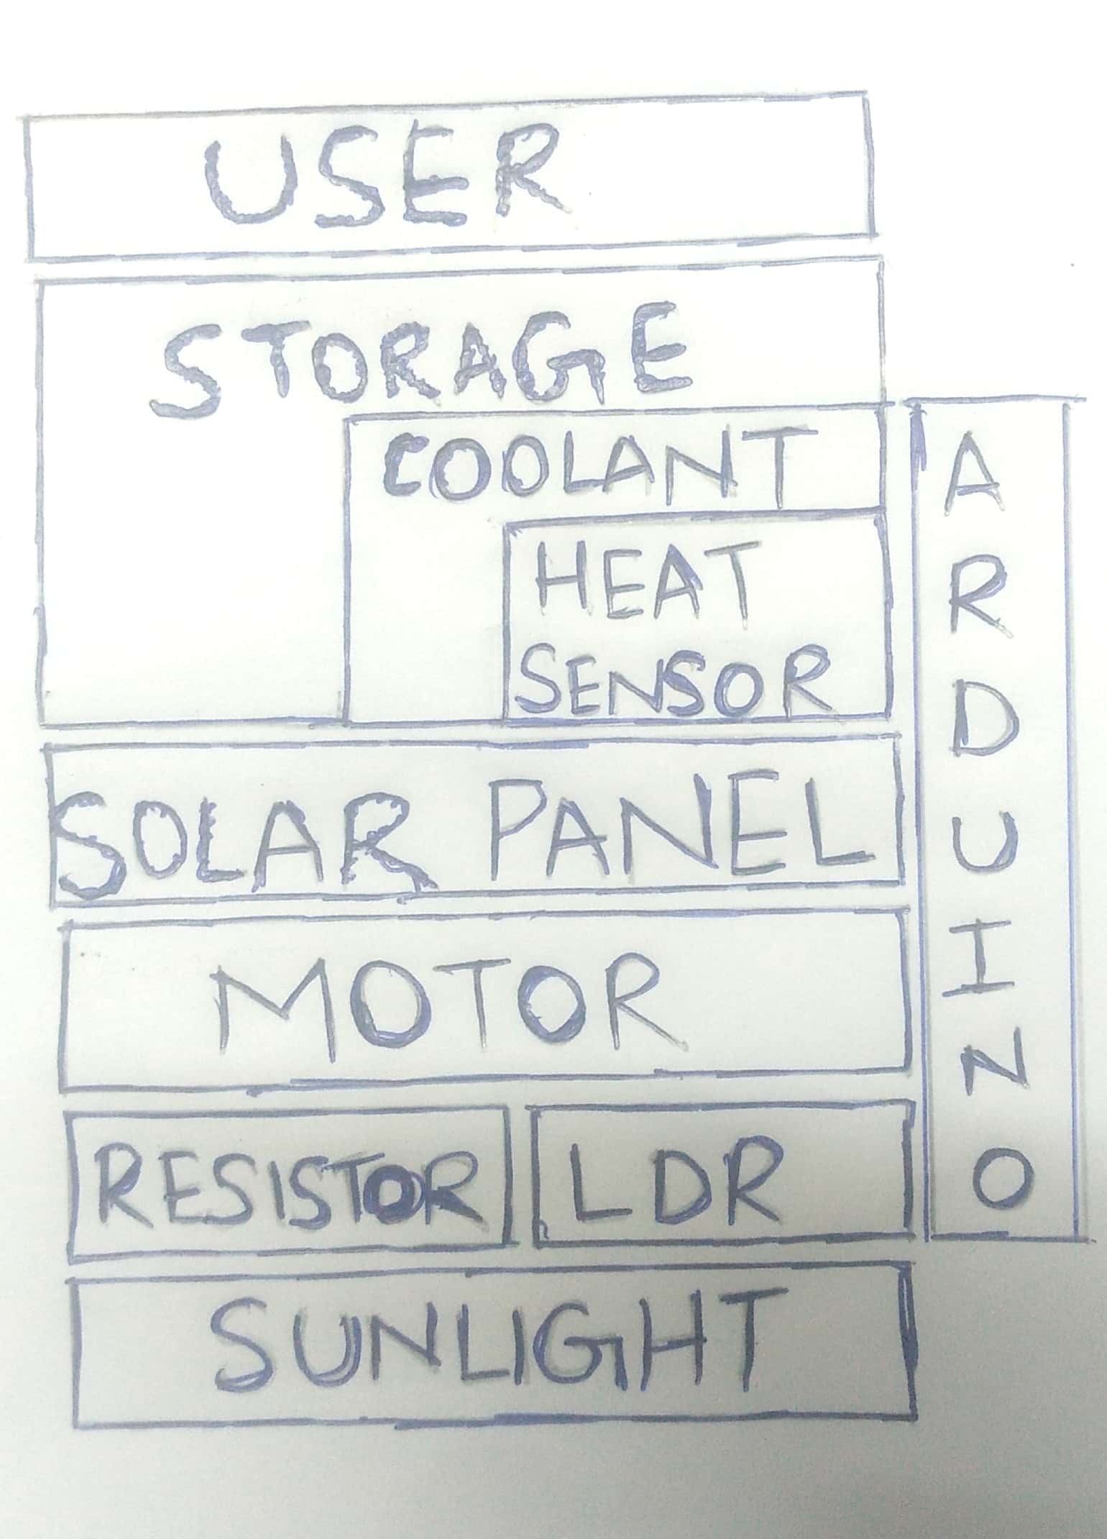
System Design
System Architecture

Slide 22
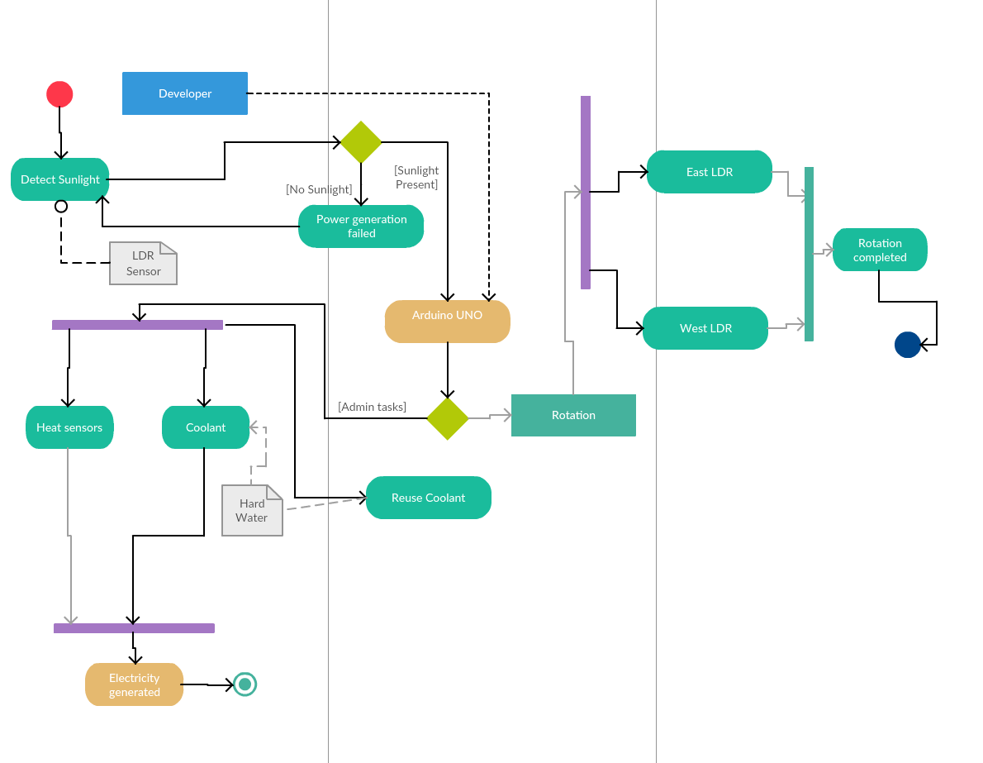
FLOW DIAGRAM

