Slide 1
Computer Science Project 2015-2016
Aditeya Baral X ‘C’
Shuvam Mishra
X ‘C’
Rohan Ben Joseph X ‘D’
Bishop Cotton Boys’ School

Slide 2
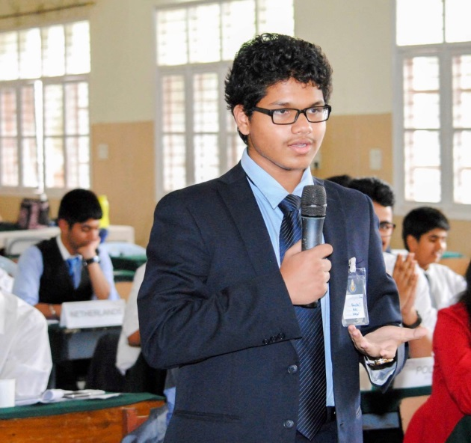
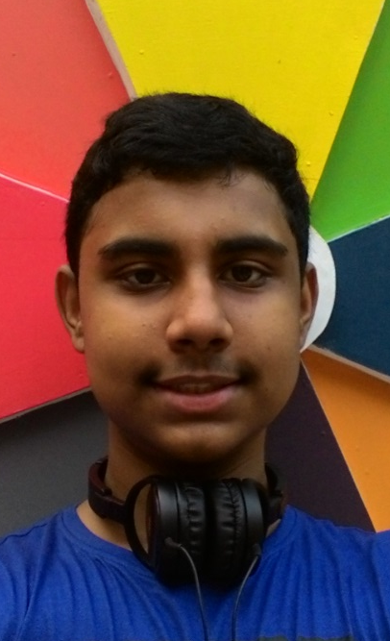
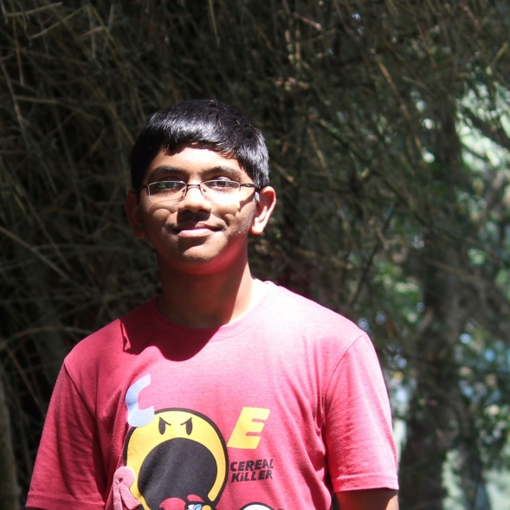
Project participants
Rohan Ben Joseph
Aditeya Baral
Shuvam Mishra

Slide 3
Project Description
This project is a working model of an airport booking system which involves not only airline tickets but also food and an in-flight entertainment section.
Further, it is based on the Heathrow Airport’s Model of an Ideal Airport in which flight timings are synchronized to various locations at regular intervals.
Full-fledged meals from various cuisines served in-flight and pre-rented movies complete the experience.

Slide 4
THANK YOU

