Slide 1
coderunner
Aditeya Baral
E L Mahima
Vinay Kirpalini

Slide 2
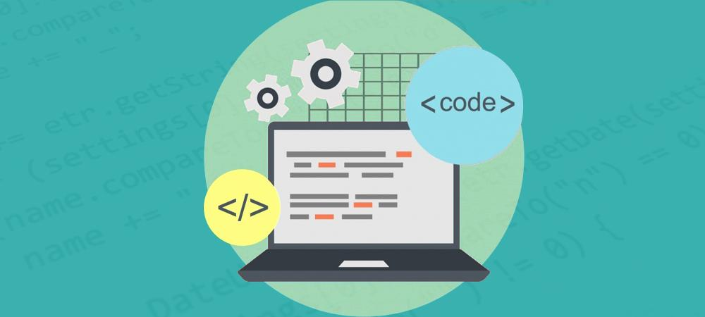
Learn to code using coderunner

Slide 3
Why coderunner?
What if there was a platform for a college student to tone his/her technical skills from the scratch and become technically sound?

Slide 4

What does coderunner do?

Slide 5
And how does it work?
The whole web application consists of several web pages. The user has to log in, and the log in page redirects the user to the dashboard where the user can choose the domain of technical field he wishes to work on.
The dashboard then leads to the practice portal where the user can code, and the code is tested with the testcase and compiled.
It’s a platform to nurture one’s coding skills.

Slide 6

Features of the website?

Slide 7
What is unique?
-> Rich front end functionality with HTML, CSS, JavaScript, Bootstrap, jQuery for all the webpages.
-> Rich backend functionality with PHP for 4 pages.
-> Has a database system connected to the website.
-> Website is hosted online.

Slide 8

THANK YOU

