Slide 1

ELECTRICAL AND ELECTRONICS ENGINEERING
& USER INTERFACE
Short term load forecasting using ANN
Group - 13
Team Members
Adhwaidh K - CB.SC.U4AIE24003
Adith S - CB.SC.U4AIE24004
Chaitanya Varma - CB.SC.U4AIE24017

Slide 2
Introduction
Electricity demand forecasting is vital for efficient energy production and distribution.
Short-term load forecasting (STLF) helps utility companies plan power generation and reduce operational costs.
This project uses historical weather and load data to predict future energy demand.

Slide 3
Literature Review
S. No. | Title | Year | Methodologies | Key Contributions
1. | The Short-Term Load Forecasting Using an Artificial Neural Network | 2021 | ANN | Analyzed daily and weekly variations in historical loads to enhance forecasting accuracy.
2 | Short Term Load Forecasting Using Artificial Neural Network | 2017 | ANN | Addressed load forecasting by considering different load profiles for weekdays and weekends.
3 | Short-Term Aggregated Residential Load Forecasting using BiLSTM and CNN-BiLSTM | 2023 | BiLSTM, CNN-BiLSTM | Investigated the capabilities of BiLSTM and CNN-BiLSTM models for day-ahead forecasting at an hourly resolution.

Slide 4
S. No. | Title | Year | Methodologies | Key Contributions
4. | Short Term Load Forecasting by Artificial Neural Network | 2017 | ANN | Established a short-term load forecasting model emphasizing its transparent structure and ease of implementation.
5. | Short-Term Load Forecasting Using an LSTM Neural Network for a Colombian Grid Operator | 2023 | LSTM Neural Network | Proposed a neural network-based model to forecast short-term load for a Colombian grid operator, considering a seven-day time horizon.
6, | Electric Load Forecasting Using an Artificial Neural Network | 1991 | Backpropagatio n Algorithm | Proposed a nonlinear load model using backpropagation for electric load forecasting.

Slide 5
S. No. | Title | Year | Methodologies | Key Contributions
7. | Short-Term Load Forecasting Using Artificial Neural Networks | 2019 | Multistage ANN | Discussed the systematic design of a multistage ANN-based short-term load forecaster.
8. | Short-Term Load Forecasting using a Cluster of Neural Networks for Residential Load | 2016 | Cluster of Neural Networks | Proposed a model for next-day load forecasting in hourly steps using a cluster of neural networks.
9. | A Comparative Assessment of Deep Learning Models for Day-Ahead Load Forecasting: Investigating Key Accuracy Drivers | 2023 | Deep Learning Models | Conducted a comparative study of deep autoregressive models for day-ahead load forecasting.
10. | Appliance Level Short-term Load Forecasting via Recurrent Neural Network | 2021 | RNN | Presented an STLF algorithm for predicting power consumption of individual electrical appliances.

Slide 6
Research Gaps
Lack of Nonlinearity Handling: Traditional models fail to capture complex patterns.
Limited Weather Impact Consideration: Many studies do not include temperature, etc.
Lack of Real-Time Forecasting: Some models require high computation time.
Limited Deployment: Few models integrate a user-friendly web interface.

Slide 7
Problem Statement
Inaccurate forecasting leads to wastage of resources or failure in meeting demand.
Need for an intelligent system to predict load with high accuracy using weather conditions, time-based features, and historical data.

Slide 8
Objectives
Develop a data-driven model for short-term electrical load forecasting.
Integrate various features like weather data, time, and historical load values.
Use regression and neural networks for improved forecasting accuracy.
Display forecast results in a user-friendly GUI interface.

Slide 9
Dataset
Time-Based Data:
The dataset contains hourly records (datetime) spanning multiple weeks.
hourOfDay column indicates the hour of the day (0-23).
Historical Load Data:
week_X-2, week_X-3, week_X-4: Electricity demand from past weeks, useful for forecasting.
MA_X-4: Moving average of demand, helping smooth fluctuations.

Slide 10
Target Variable:
DEMAND: Represents actual electricity demand, crucial for training ANN models.
Day and Special Events:
dayOfWeek: Represents the day (e.g., 1 = Monday).
weekend: Indicates if the day is a weekend (1 for weekend, 0 for weekday).
holiday & Holiday_ID: Identifies public holidays, affecting demand.
Weather Impact:
T2M_toc: Temperature variable, which influences power consumption trends.

Slide 11
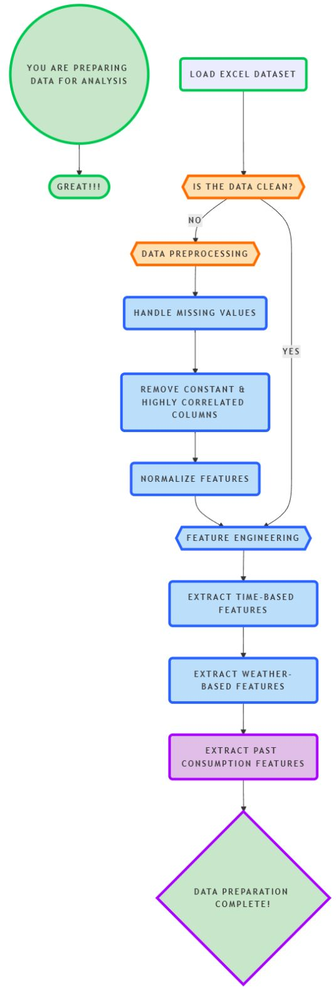
Flow Chart
Figure 1.1
13

Slide 12
Methodology
Data Collection & Preprocessing:
Load data from an Excel file.
Handle missing values and remove constant features.
Deal with multicollinearity using correlation analysis.
Feature Engineering:
Incorporate historical loads (previous day/week same hour).
Use time-related and weather features like temperature, hour, weekend, holidays.

Slide 13
Modeling Techniques:
Train a feedforward neural network with 30 neurons in the hidden layer.
Performance Metrics:
Calculate MAE (Mean Absolute Error) and MAPE (Mean Absolute Percentage Error).
Assess forecast accuracy and visualize results.
GUI Integration:
Forecast results saved as a .json file.
GUI displays load predictions, errors, plots, and interactive feedback sections.

Slide 14
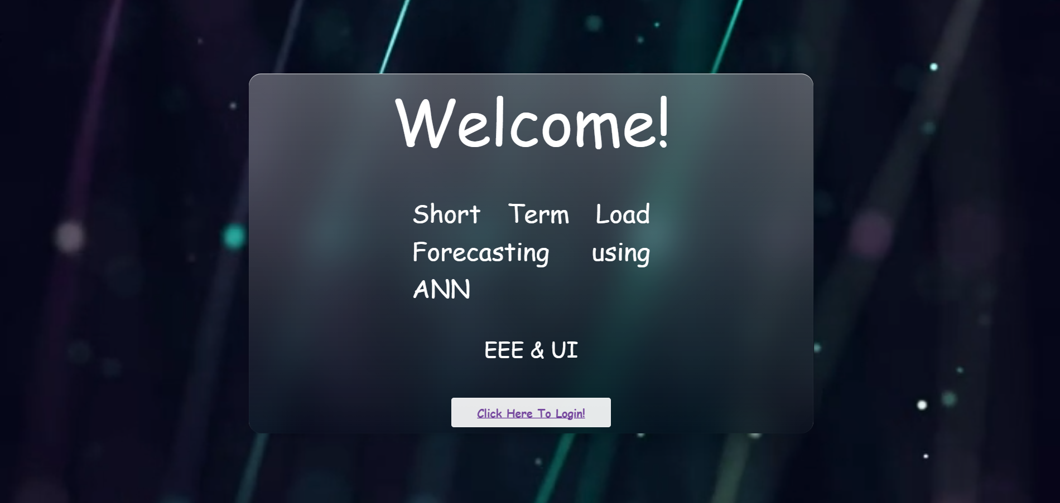
Results

Slide 15
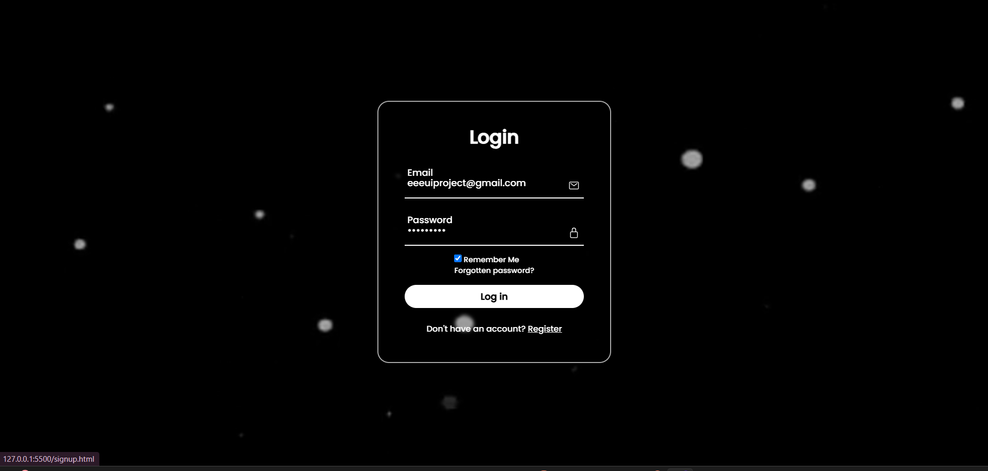

Slide 16
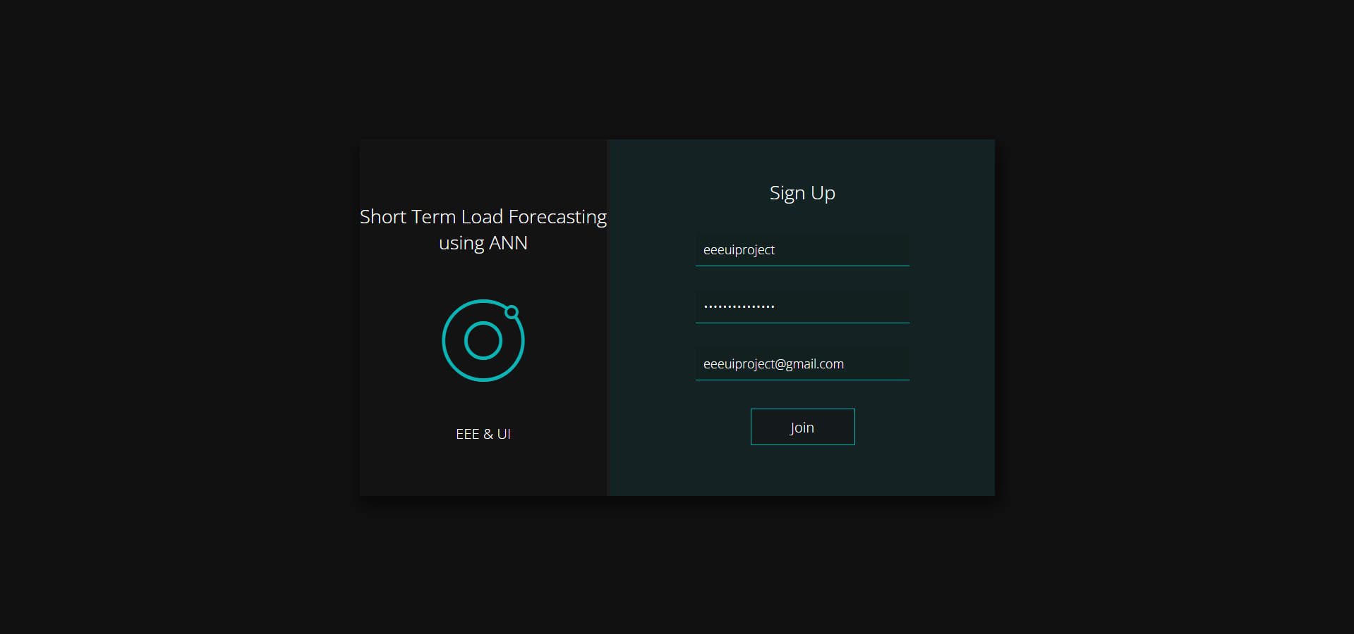

Slide 17
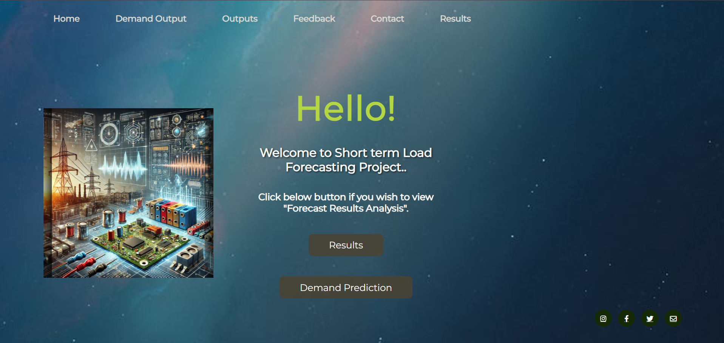

Slide 18
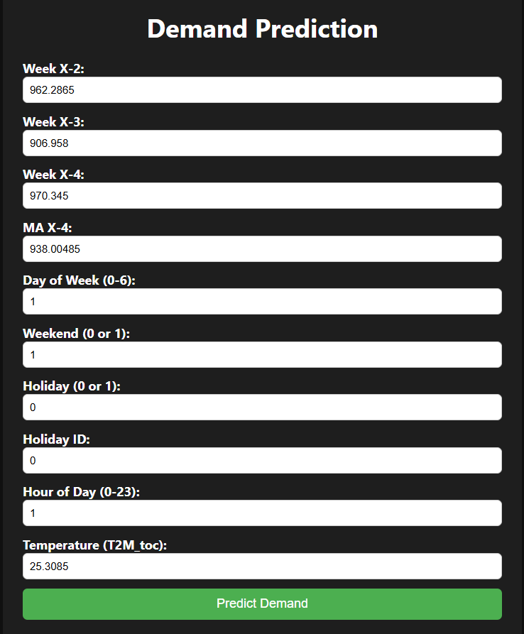

Slide 19
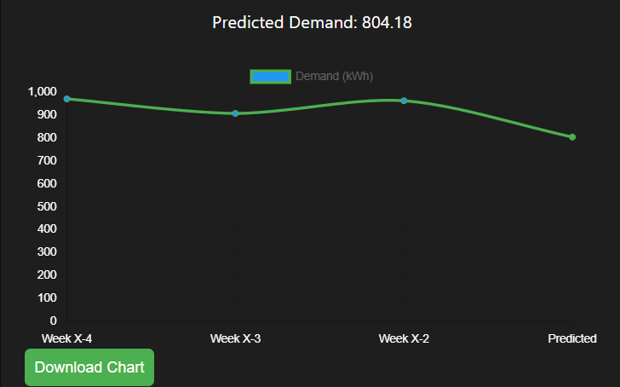

Slide 20
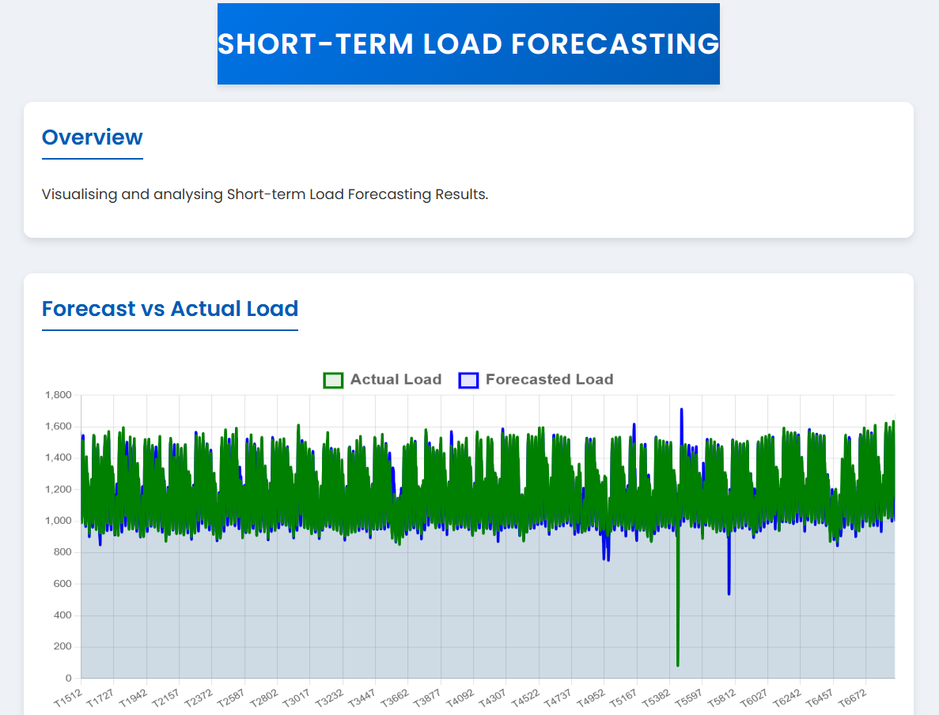

Slide 21
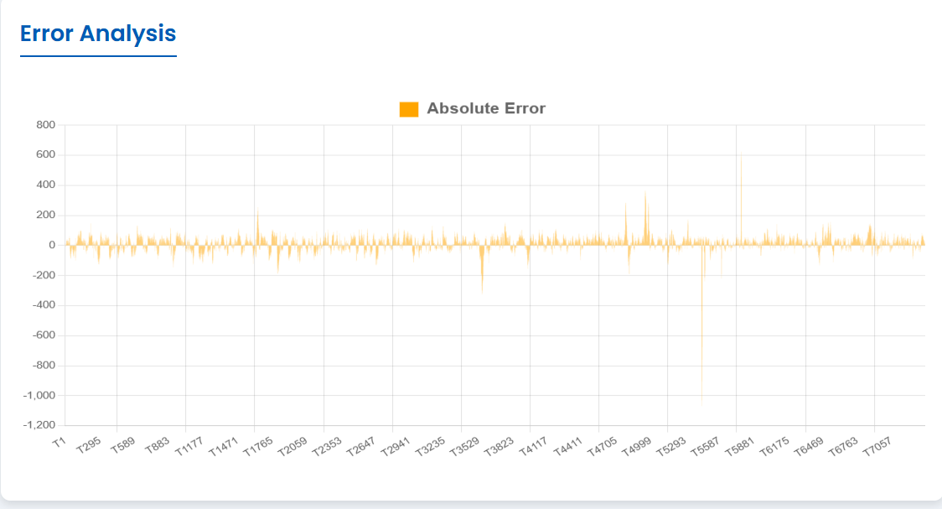

Slide 22
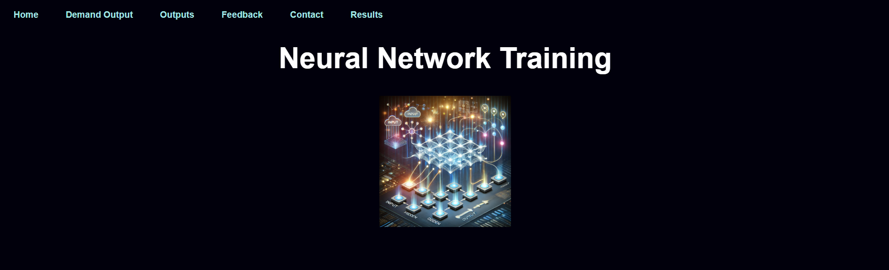

Slide 23
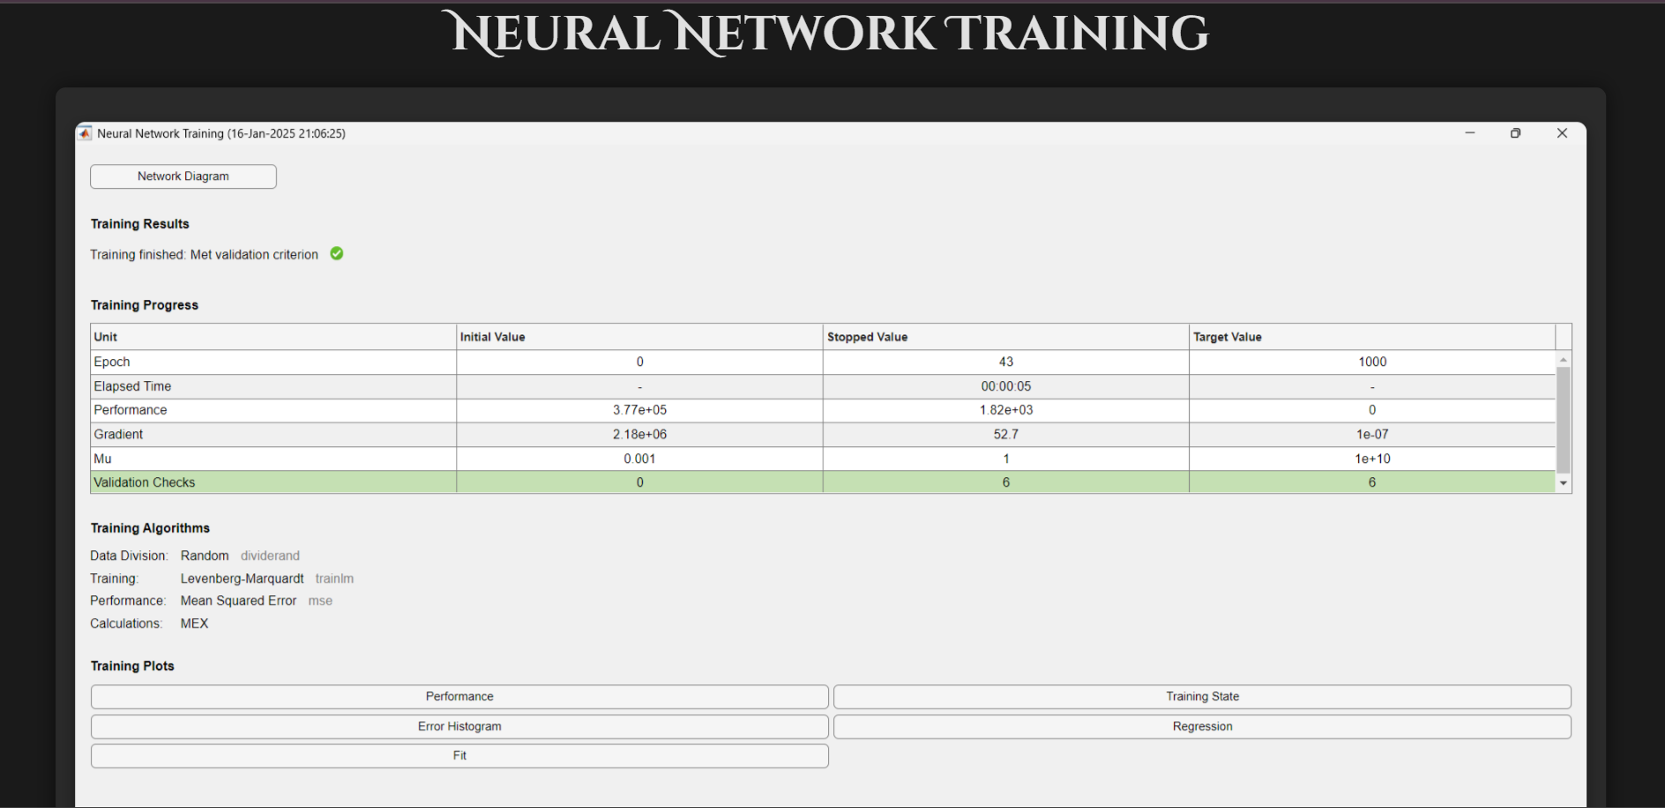

Slide 24
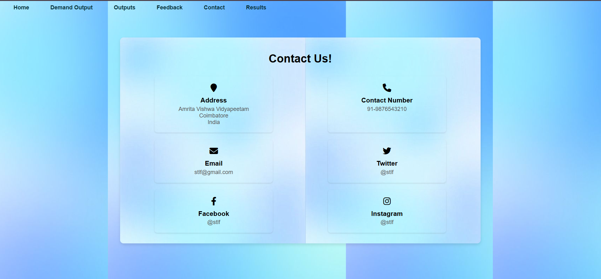

Slide 25


Slide 26
Conclusion
The neural network-based approach provided high forecasting accuracy.
GUI implementation makes the system user-friendly for non-technical users.
The methodology handles noisy, missing, and redundant data efficiently.

Slide 27
Future Scope
Include real-time data streaming from smart meters or IoT sensors.
Add deep learning models like LSTM for improved time-series predictions.
Expand to mid/long-term load forecasting.
Introduce grid optimization and price prediction modules.

Slide 28
References
[1] J. Doe, "Electric Load Forecasting Using ARIMA," IEEE Transactions on Power Systems, vol. 35, no. 4, pp. 1234-1245, 2017.
A. Smith, "Deep Learning for Power Demand Prediction," Energy Informatics Journal, vol. 28, no. 2, pp. 78-90, 2019.
[2] D. C. Park, M. A. El-Sharkawi, R. J. Marks II, L. E. Atlas, and M. J. Damborg, "Electric Load Forecasting Using an Artificial Neural Network," IEEE Transactions on Power Systems, vol. 6, no. 2, pp. 442-449, 1991.
[3] S. Kumar and S. Jain, "Short Term Load Forecasting Using Artificial Neural Network," 2017 International Conference on Computing, Communication and Automation (ICCCA), Greater Noida, India, 2017, pp. 633-637.
[4] Y. Zhang, J. Wang, and X. Wang, "The Short-Term Load Forecasting Using an Artificial Neural Network," Complexity, vol. 2021, Article ID 1502932, 2021.

Slide 29
Thank You!

