Slide 1
MedSyn
By Team DedSec

Slide 2
Contents
Introduction
The Problem
Our Idea
Impact
How it works
Conclusion
Future Plans & Existing Systems

Slide 3




Introduction
Adith Muralidharan
Arjun B Raj
Ahnaf S
Anirudh A R
We are Team DedSec from NSS College of Engineering, Palakkad, representing the Computer Science and Engineering department . Passionate about technology and innovation, we explore software development, cybersecurity, and real-world challenges. Through hackathons, cutting-edge projects, and open-source contributions, we aim to make a significant impact in the tech world.

Slide 4
The Problem
Healthcare professionals face significant challenges in sifting through extensive patient records, which is time-consuming and can lead to the oversight of essential details.
Patient records often contain numerous reports from various visits, making it difficult to quickly extract relevant information.
A tool is needed to efficiently provide a clinical synopsis patient data, taking into account the entire medical history to highlight key information for quick and informed decision-making.
This would ensure that critical details, such as medical implants or other contraindications, are prominently featured to aid healthcare providers in delivering appropriate care.
4

Slide 5

Our Idea
MedSyn uses watsonx.ai to create a GenAI powered clinical synopsis tool that extracts and presents relevant patient information in an easy-to-comprehend format. This tool saves time, reduces the risk of missing critical details, and improves patient care.

Slide 6
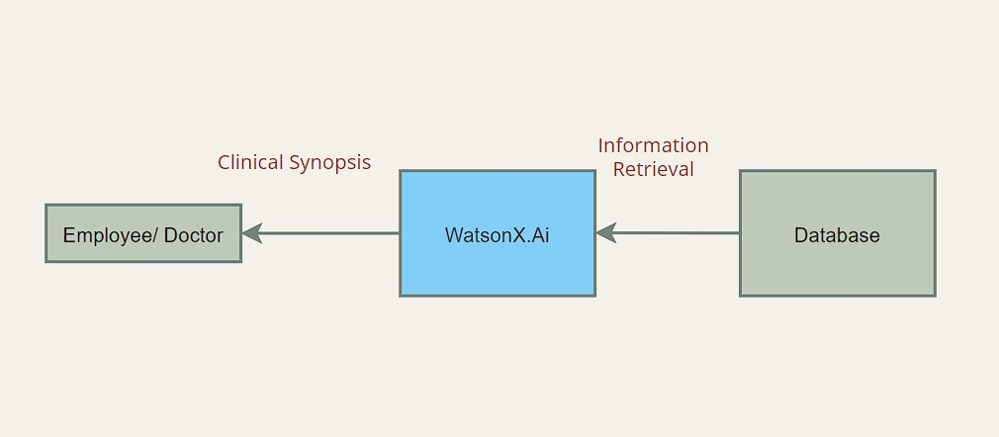
How it Works
Data Extraction:
Data extracted from Electronic Health Records (EHR) systems to extract detailed patient
data , including medical history, medications, lab results, vital signs, and clinical notes
​
GenAI powered clinical synopsis:
Using advanced natural language processing (NLP) algorithms to generate easy-to
understand summaries of patient histories, highlighting critical information ​
Contraindication Detection:
Automatically identifying potential contraindications and alerting healthcare providers to
ensure safe prescribing practices.
Customization:
Allowing doctors to customize the summaries based on their specific needs and preferences, focusing on the
most relevant patient information.
Interactive Follow-Up:
Enabling healthcare providers to ask follow-up questions and receive detailed responses, facilitating a deeper
understanding of patient conditions and treatment plans.

Slide 7
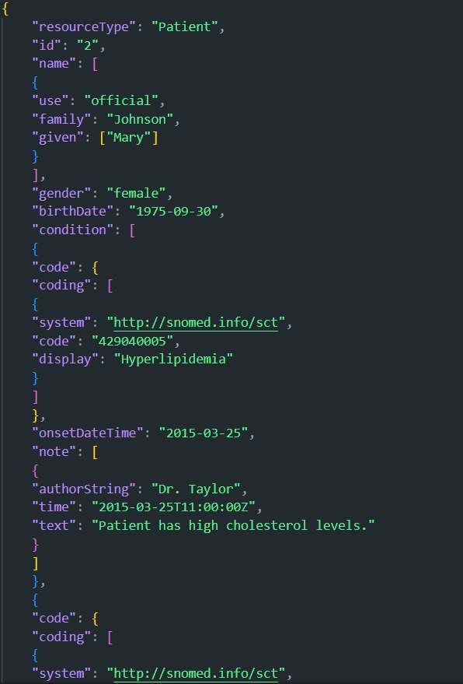
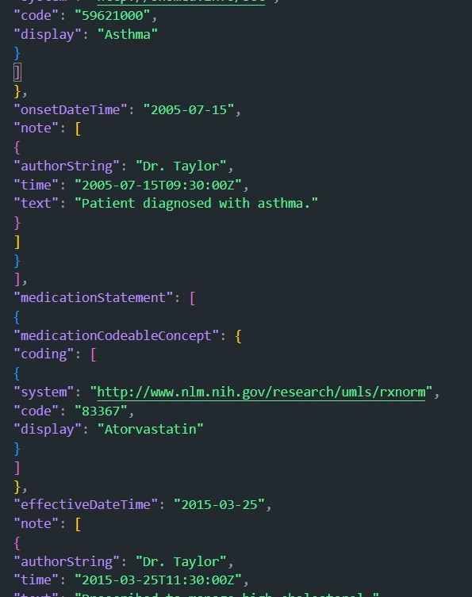
EHR (FHIR Standard)

Slide 8
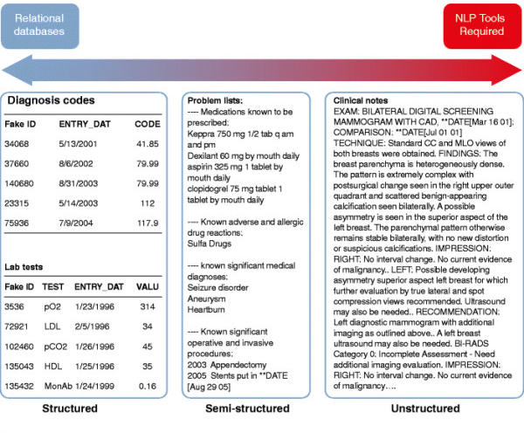
Doctor’s view of EHR

Slide 9
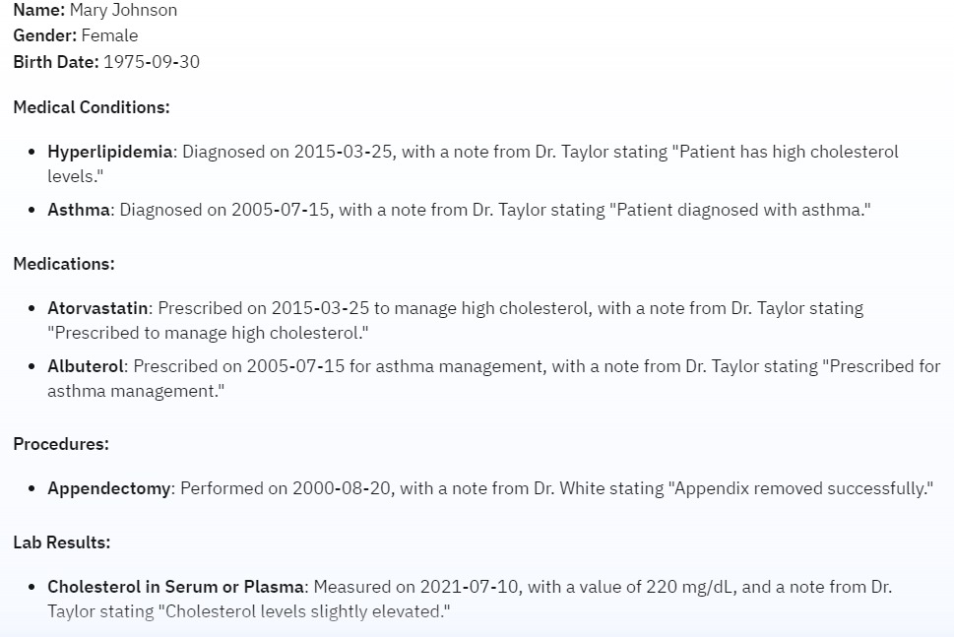
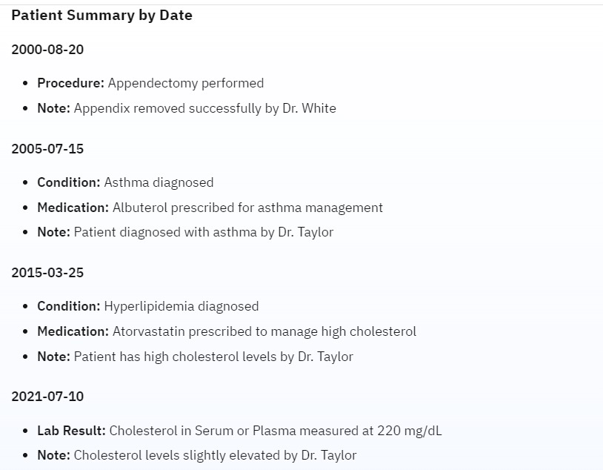
Sample Customization options
Clinical synopsis generated by MedSyn
Customized output based on date
9

Slide 10
Key Features
Natural Language Processing (NLP): Uses advanced NLP to analyse and provide synopsis of medical record history of a patient.​
Customizable synopsis: Allows customization of parameters for generating the clinical synopsis based on specific needs.​
Structured Output: Presents the information clearly, highlighting key data points such as medical history, medications, test results, and diagnoses.​
Integration with EHR Systems: Seamlessly integrates with existing EHR systems. ​
Interactive Dashboard: Features a dashboard for reviewing, editing, and validating summarized information.​
​
​

Slide 11

Implementation Plan
Research and Development
Integration and Testing
User Feedback and Iteration
Launch
Conduct market research to understand healthcare professionals' needs.
Develop and train the NLP model using watsonx.ai.
Build a prototype to demonstrate capabilities of tool to generate synopsis.
Integrate the tool with sample EHR systems using FHIR.
Test with anonymized patient data to ensure accuracy and reliability.
Deploy in a controlled environment (e.g., a partner hospital) to gather feedback.
Refine functionality and user interface based on feedback.
Finalize the product for a wider launch .
Develop marketing and training materials for onboarding new users.

Slide 12
Impact
1. Efficiency:
Time-Saving: Physicians can quickly grasp the patient's medical history ,leading
to more efficient consultations.
Automation: Automated summarization reduces the administrative burden on
healthcare staff.
2. Clarity:
Structured Summaries: Providing a structured and consistent summary format
makes it easier for healthcare providers to find the information they
need.
Highlighting Critical Information: Important details, such as chronic conditions, recent
treatments, and current medications, are emphasized.
3. Accuracy:
Reduction of Errors: Summarization can help minimize the risk of missing
critical information that might be buried in extensive records.
4. Integration with EHR Systems:
Interoperability: FHIR standards ensure that summaries can be easily
integrated into existing EHR systems.
Accessibility: Doctors can access the summarized information directly within the patient's EHR.
5. Customization:
Tailored Format :The ability to customize reports into required formats based on the doctor’s
preferences or specific clinical needs.

Slide 13
Future Plan
Advanced Analytics:
Incorporate predictive analytics to identify potential health risks based on summarized
patient data.
Patient Portal:
Develop a companion app for patients to view their summarized medical records.
Expansion to Other Languages:
Expand the tool's capabilities to support multiple languages for international use.

Slide 14
Already Existing Systems
Epic Systems: A leading EMR system that offers tools for data extraction, analysis, and summarization to help healthcare providers manage patient care efficiently.
Cerner Corporation: Another major EMR provider with advanced analytics and data summarization features to support clinical workflows and decision-making.

Slide 15

Conclusion
MedSyn aims to revolutionize healthcare professionals' interaction with patient data by providing an AI-driven summarization tool. By leveraging watsonx.ai, MedSyn enhances the efficiency and accuracy of medical practice, leading to better patient outcomes.

Slide 16
References
Figures
EHR Data Formats: https://www.researchgate.net/figure/EHR-data-structure-and-accurate-phenotyping-a-Electronic-health-record-EHR-data-can_fig2_275753011

Slide 17
Q&A

Slide 18
Thank you
By Team DedSec

