Slide 1
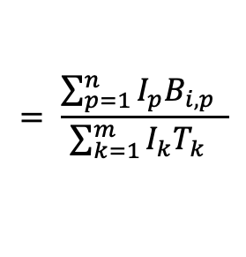
ROSETTA Code
B_{i,j} = # of observations of i BE (e.g., KRAS G12C) in ROSETTA Code j
ROSETTA Code
T_{1,j} = # of observations of BE in ROSETTA Code j
Vector T
Biological Element (BE)
ROSETTA Code
I_{1,j} = Incidence of ROSETTA Code j in the US population in 2023
Vector I
Matrix B
EG rate estimate for i^{th} Biological Element
$$= \frac{\sum_{p=1}^{n}{I_{p}B_{i, p}} }{\sum_{k=1}^{m}{I_{k}T_{k}} }$$

