Slide 1
Use of Anti-Obesity Medications in Post-Operative Metabolic and Bariatric Surgery (MBS) Patients
Adith S. Arun
February 21, 2024

Slide 2
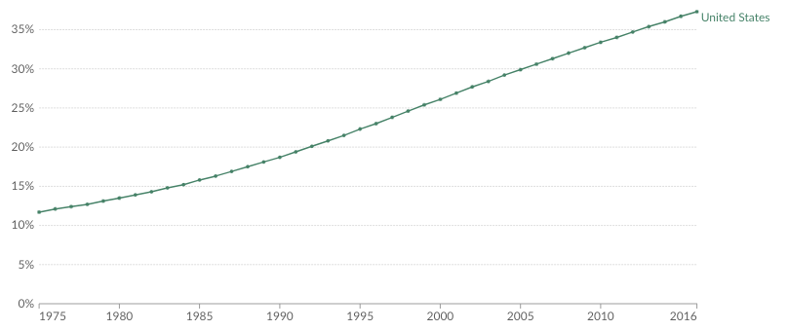
A growing and large proportion of the US population is obese (BMI > 30)
Our World In Data Report on Obesity

Slide 3
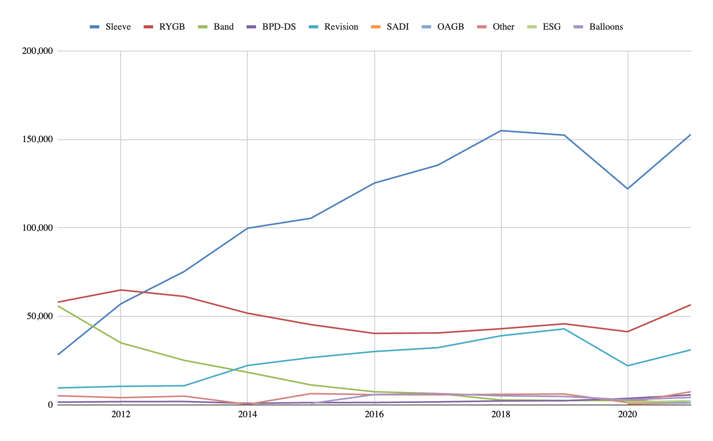
Consistent increases in MBS volume and dominance of sleeve gastrectomy (SG) in the US
ASMBS

Slide 4
There is an unmet clinical need for effective therapeutics in patients struggling to lose weight post-MBS
Data from 22 trials shows bariatric surgery compared with any nonsurgical intervention is more effective in promoting weight loss and improvement in co-morbid outcomes (Sudlow et al 2019)
While on a population level metabolic surgery is highly effective, on an individual level the response is highly variable
Poor weight loss or weight regain, resulting in less than 20% weight loss, affect up to 1 in 4 patients who undergo metabolic surgery (Mok et al 2023)

Slide 5
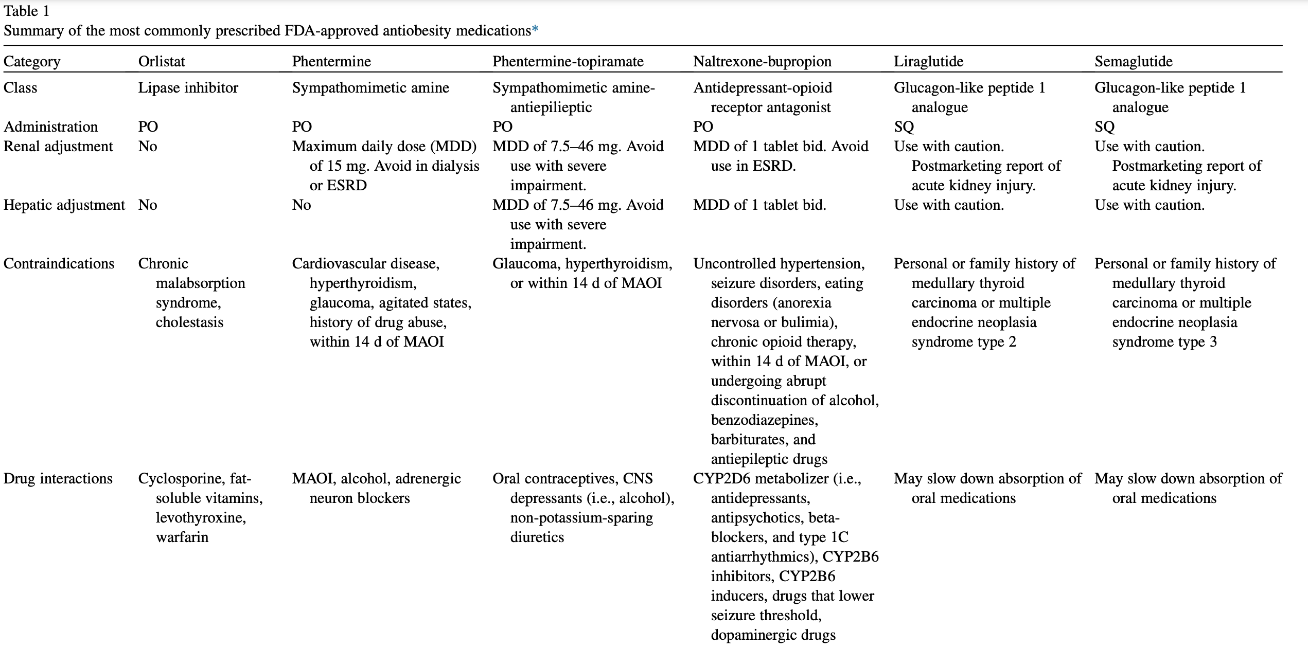
Overview of anti-obesity medications
Vosburg et al 2022, Surg Obes Relat Dis

Slide 6
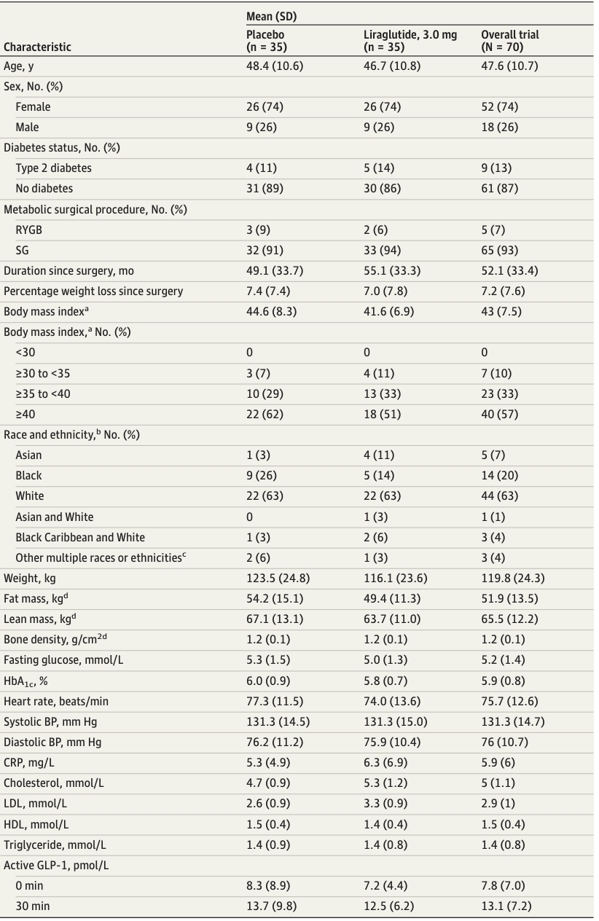
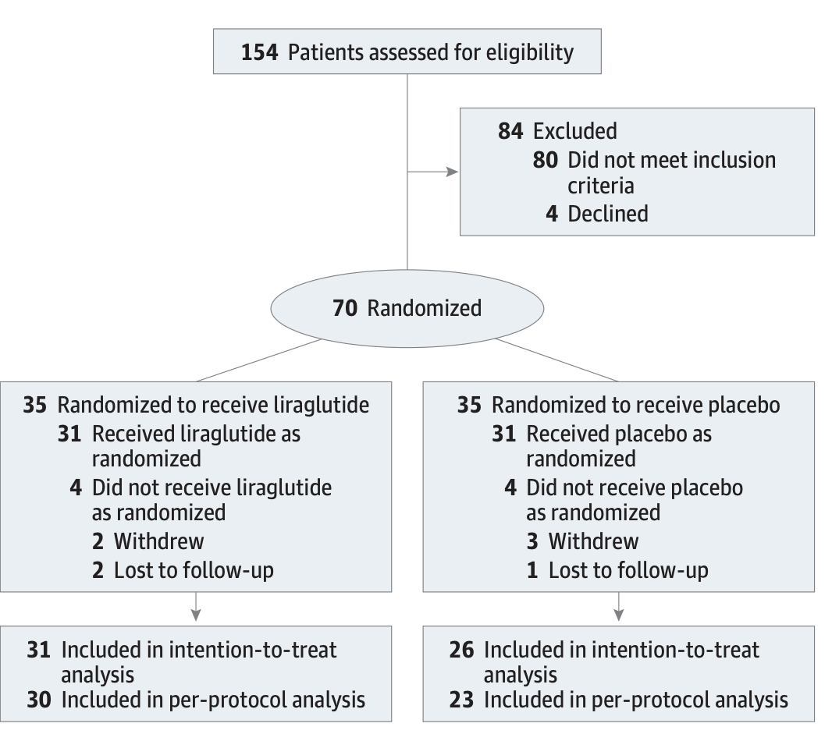
BARI-OPTIMISE Trial: Liraglutide 3.0mg against placebo in patients with poor weight loss
Mok et al 2023, JAMA Surgery

Slide 7
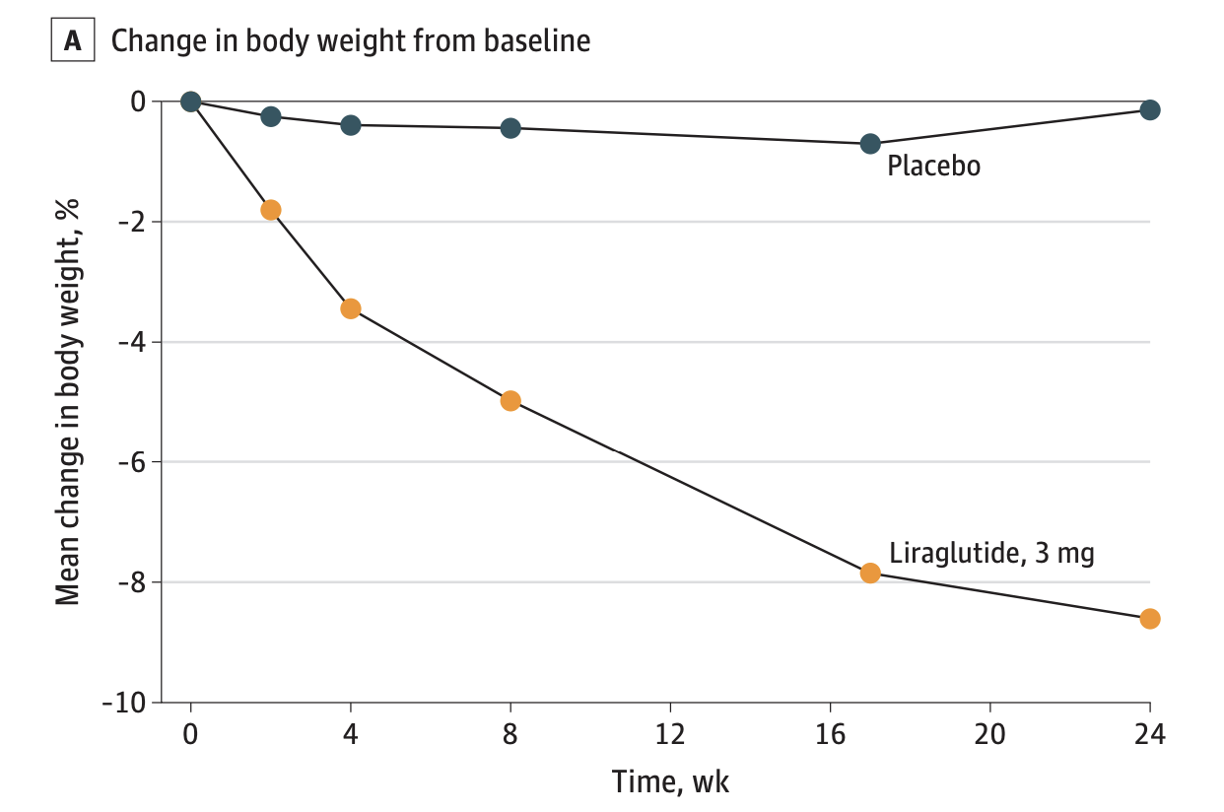
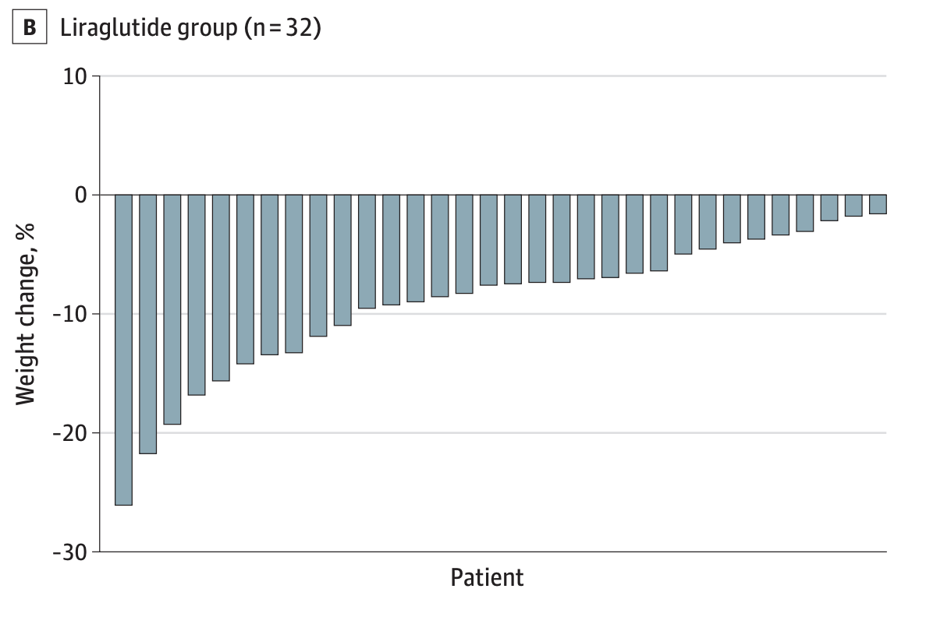
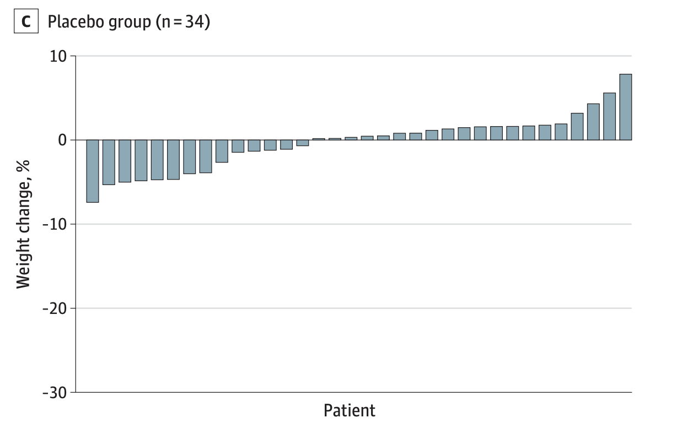
BARI-OPTIMISE: 8% weight loss with Liraglutide after 24 weeks compared to 0.5% reduction on placebo
Notable side-effect differences (Placebo vs. Liraglutide):
20% vs 51% nausea
6% vs 26% constipation
6% vs 14% fatigue
Mok et al 2023, JAMA Surgery

Slide 8
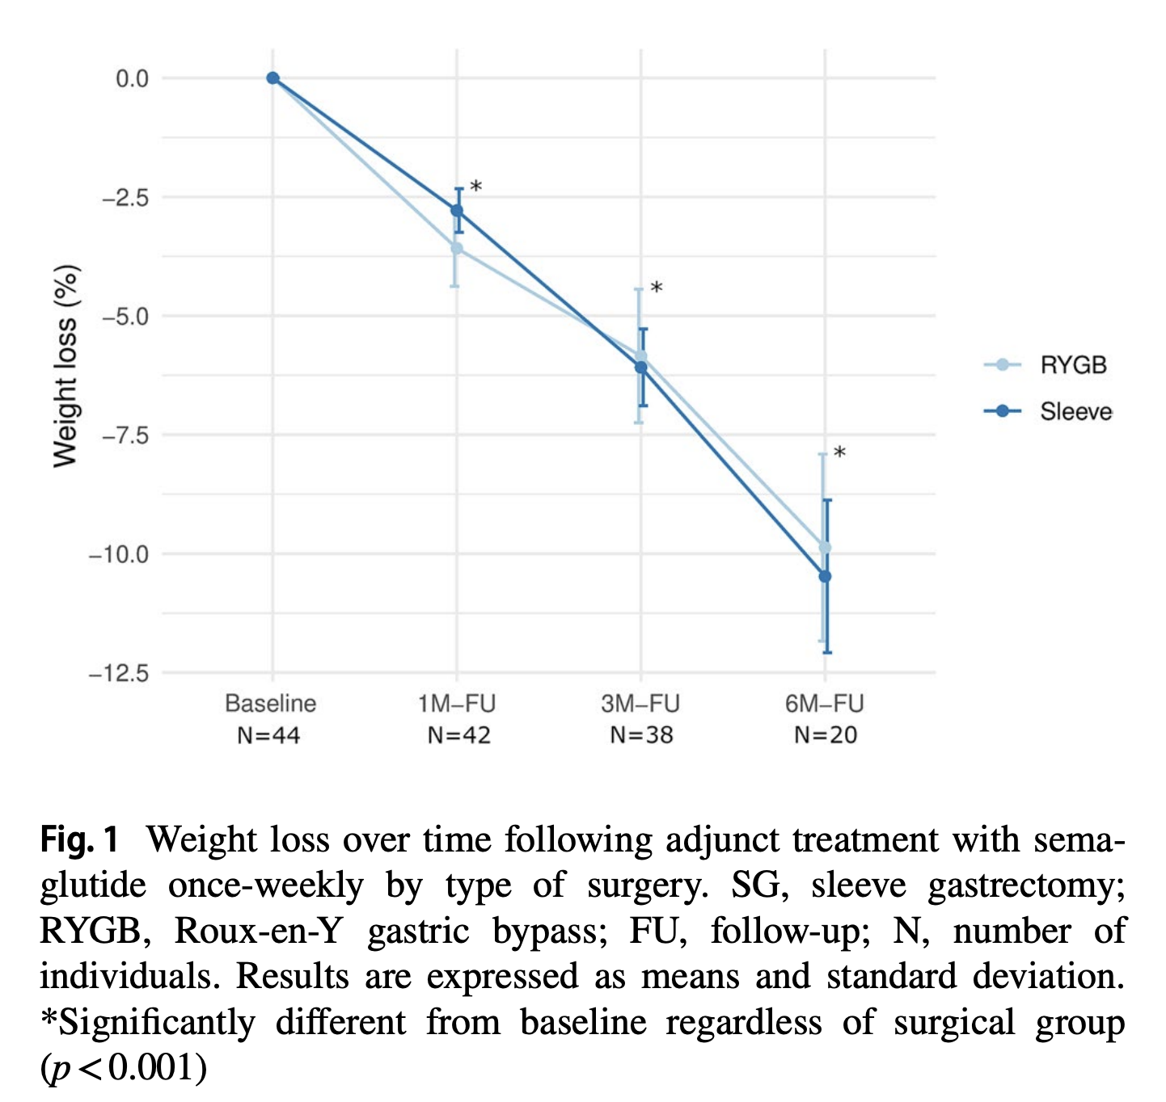
Robust 6-month weight loss (10%) in patients struggling with post-MBS weight loss given Semaglutide once weekly 0.5mg
Retrospective study with 44 patients, 15 RYGB and 29 SG
Lautenbach et al 2022, Obes. Surg

Slide 9
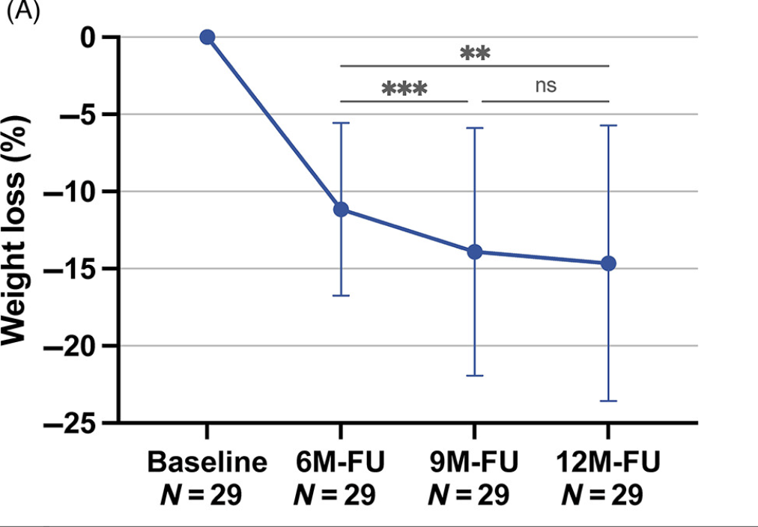
Semaglutide (up to 1mg) in weight recurrent post-MBS patients creates >10% weight loss at 6 months
Retrospective study of 29 MBS patients (11 RYGB, 18 SG)
Lautenbach et al 2023, Clin Obesity

Slide 10
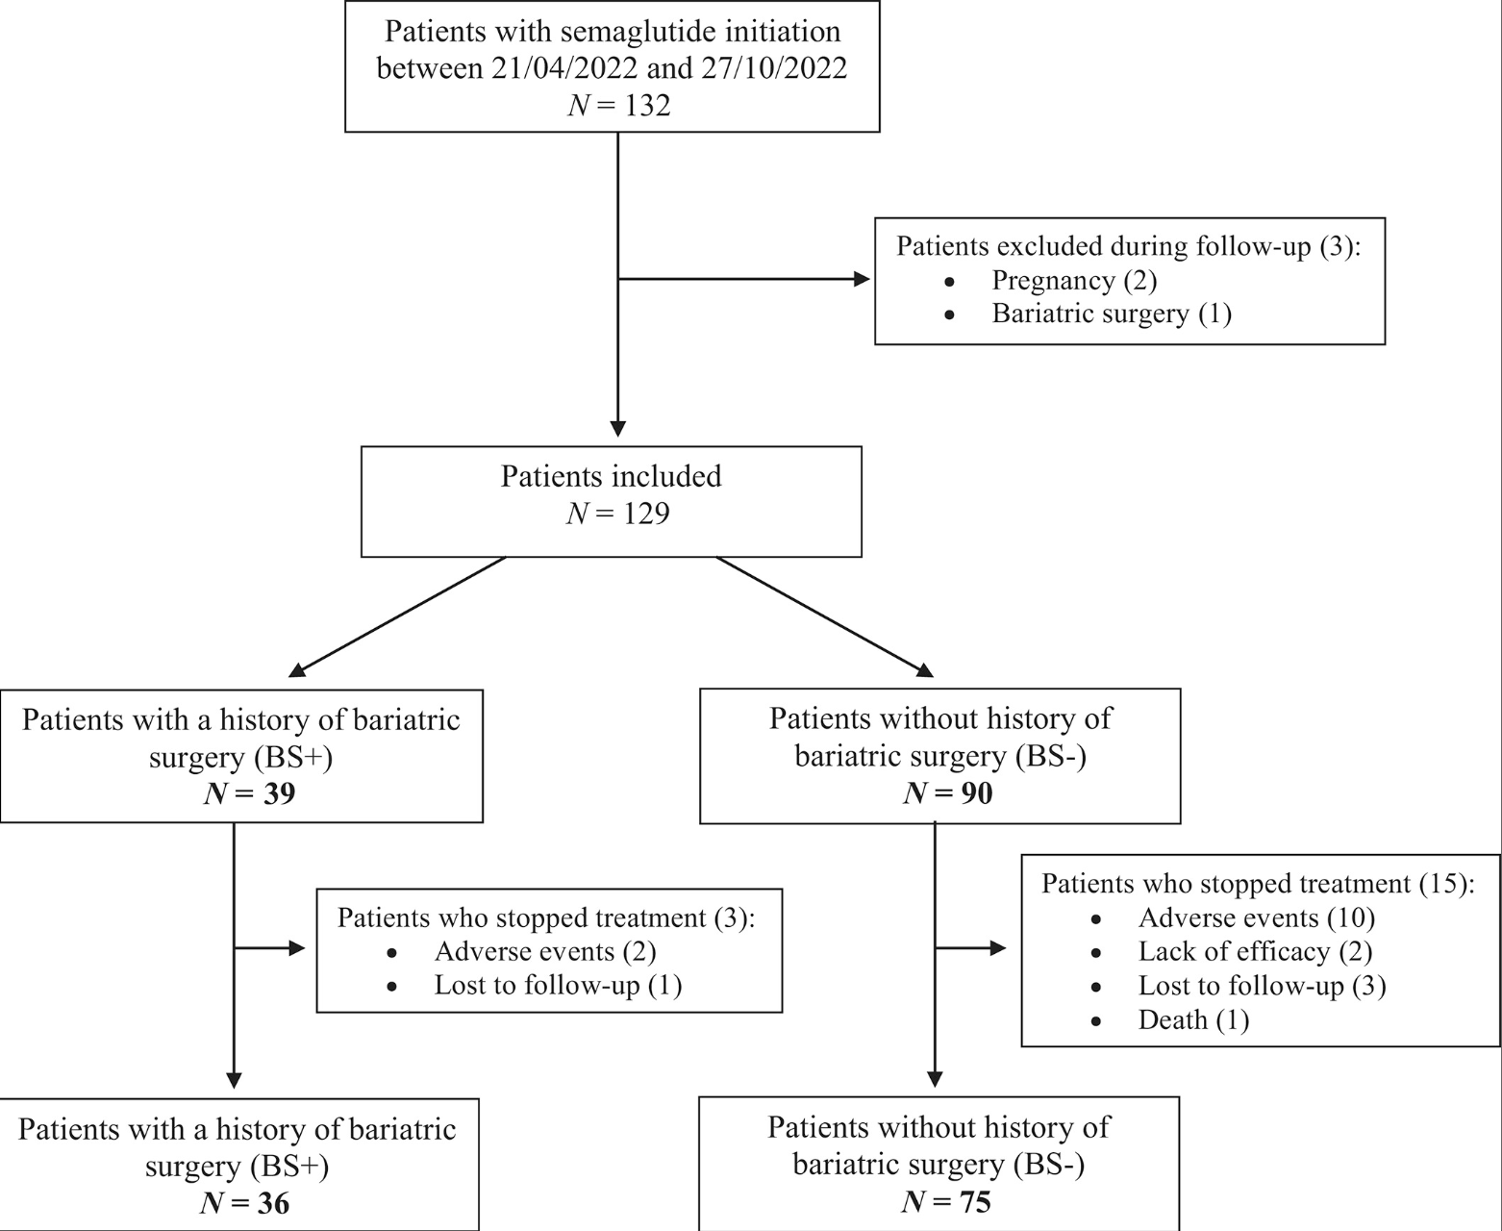
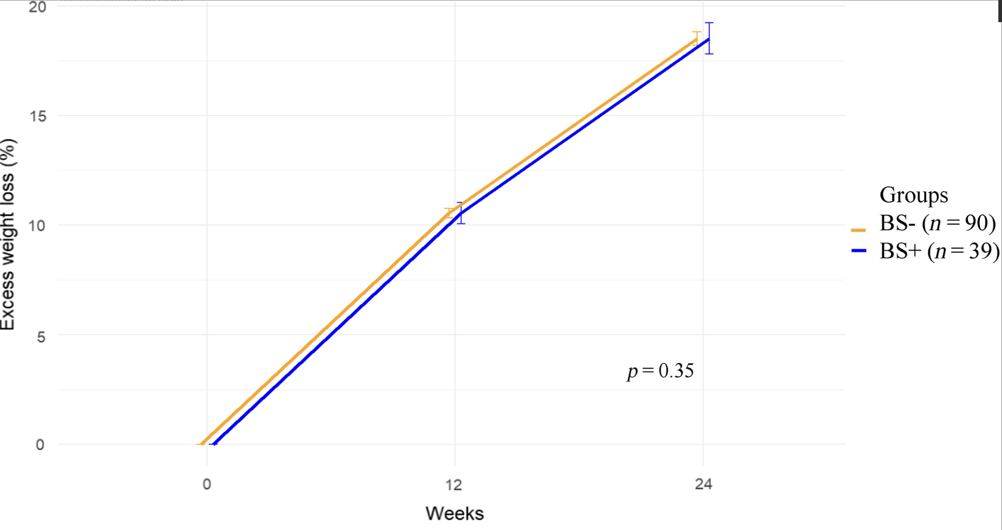
2.4mg Semaglutide in weight recurrent post-MBS patients results in 9.8% weight loss in 6 months; similar to non-MBS individuals
The %EWL was calculated as ((pre-surgery weight − follow-up weight)/(operative excess weight)) × 100
Operative excess weight = (pre-surgery weight − ideal weight)
Bonnet et al 2023, Obesity

Slide 11
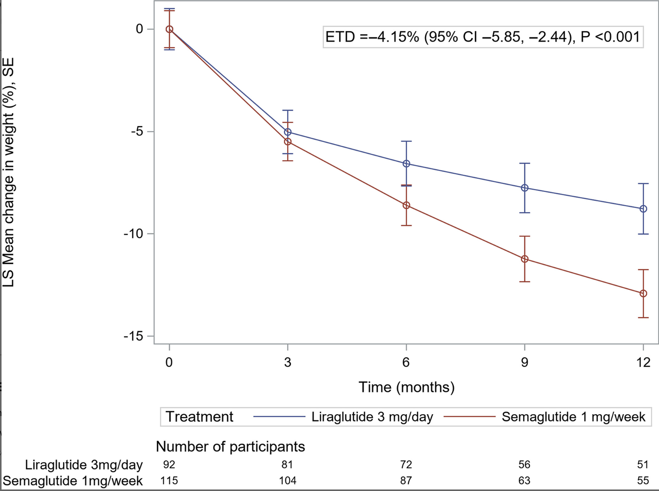
Semaglutide 1mg/week results in significantly greater weight loss than Liraglutide 3mg/day
Retrospective 207 adult, Semaglutide (n = 115), Liraglutide (n = 92)
-12.92% weight loss at 12 months vs -8.77%, respectively
Murvelashvili et al 2023, Obesity

Slide 12
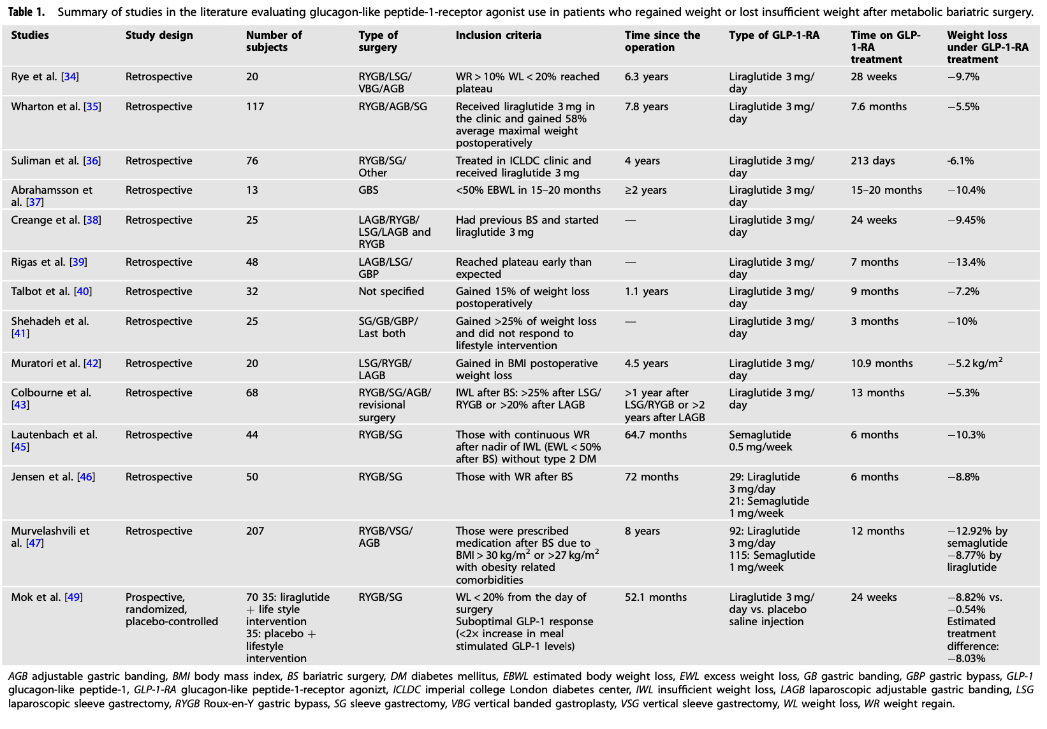
GLP-1 drugs can help weight recurrent post-MBS patients consistently lose weight (5-10% in 6 months)
Calik et al 2024, Int J Obes

Slide 13
Takeaways
Poor weight loss and weight regain affect 1 in 4 MBS patients (~60,000 patients / year in the US)
GLP-1 analogs (liraglutide, semaglutide) may help weight recurrent post-MBS patients lose weight reliably on the order of 10% in 6 months
5% weight loss in obese patients meaningfully reduce cardiovascular risk, a measure GLP-1 drugs achieve in post-MBS weight recurrent patients
Semaglutide may be more effective than liraglutide in post-MBS patients (note: data is retrospective)
Liraglutide is off patent June 2024 which will make it more accessible for patients
GLP-1 drugs (liraglutide, semaglutide, and tirzepatide) may be useful as standard therapy in treating weight recurrent post-MBS patients

Slide 14
References
Bonnet JB, Tournayre S, Anitcheou J, Faivre M, Boegner C, Jalek A, Jullien D, Attalin V, Myzia J, Marty L, Kemba Y, Nocca D, Sultan A, Avignon A. Semaglutide 2.4 mg/wk for weight loss in patients with severe obesity and with or without a history of bariatric surgery. Obesity (Silver Spring). 2024 Jan;32(1):50-58. doi: 10.1002/oby.23922. Epub 2023 Nov 5. PMID: 37927153.
Çalık Başaran N, Dotan I, Dicker D. Post metabolic bariatric surgery weight regain: the importance of GLP-1 levels. Int J Obes (Lond). 2024 Jan 15. doi: 10.1038/s41366-024-01461-2. Epub ahead of print. PMID: 38225284.
C Sudlow, A., W le Roux, C. & J Pournaras, D. Review of Advances in Anti-obesity Pharmacotherapy: Implications for a Multimodal Treatment Approach with Metabolic Surgery. OBES SURG 29, 4095–4104 (2019). https://doi.org/10.1007/s11695-019-04206-7
Lautenbach A, Wernecke M, Huber TB, Stoll F, Wagner J, Meyhöfer SM, Meyhöfer S, Aberle J. The Potential of Semaglutide Once-Weekly in Patients Without Type 2 Diabetes with Weight Regain or Insufficient Weight Loss After Bariatric Surgery-a Retrospective Analysis. Obes Surg. 2022 Oct;32(10):3280-3288. doi: 10.1007/s11695-022-06211-9. Epub 2022 Jul 25. PMID: 35879524; PMCID: PMC9532334.
Lautenbach A, Kantowski T, Wagner J, Mann O, Stoll F, Aberle J. Sustained weight loss with semaglutide once weekly in patients without type 2 diabetes and post-bariatric treatment failure. Clin Obes. 2023 Oct;13(5):e12593. doi: 10.1111/cob.12593. Epub 2023 Jun 26. PMID: 37364260.
Mok J, Adeleke MO, Brown A, Magee CG, Firman C, Makahamadze C, Jassil FC, Marvasti P, Carnemolla A, Devalia K, Fakih N, Elkalaawy M, Pucci A, Jenkinson A, Adamo M, Omar RZ, Batterham RL, Makaronidis J. Safety and Efficacy of Liraglutide, 3.0 mg, Once Daily vs Placebo in Patients With Poor Weight Loss Following Metabolic Surgery: The BARI-OPTIMISE Randomized Clinical Trial. JAMA Surg. 2023 Oct 1;158(10):1003-1011. doi: 10.1001/jamasurg.2023.2930. PMID: 37494014; PMCID: PMC10372755.
Murvelashvili N, Xie L, Schellinger JN, Mathew MS, Marroquin EM, Lingvay I, Messiah SE, Almandoz JP. Effectiveness of semaglutide versus liraglutide for treating post-metabolic and bariatric surgery weight recurrence. Obesity (Silver Spring). 2023 May;31(5):1280-1289. doi: 10.1002/oby.23736. Epub 2023 Mar 30. PMID: 36998152.
Vosburg RW, El Chaar M, El Djouzi S, Docimo S Jr, Choi D, LaMasters T, Srivastava G, Shukla AP, Oviedo RJ, Fitch A, Azagury DE; Clinical Issues Committee of the American Society for Metabolic and Bariatric Surgery. Literature review on antiobesity medication use for metabolic and bariatric surgery patients from the American Society for Metabolic and Bariatric Surgery Clinical Issues Committee. Surg Obes Relat Dis. 2022 Sep;18(9):1109-1119. doi: 10.1016/j.soard.2022.07.002. Epub 2022 Jul 14. PMID: 36028428.

