Slide 1
GT Win Probability Project
Data engineering → baseline ML model → fan-friendly dashboard (2014–2025)
What you built
Pulled Georgia Tech game + team data from the CFBD API and cached it locally
Engineered pregame features (team strength + season-to-date form) into a clean CSV dataset
Trained a supervised win/loss probability model (logistic regression + calibration)
Generated a dashboard with trends, uncertainty, and a model-vs-market comparison
Artifacts: winprob.py • analysis_report.py • gt_summary_2014_2025/dashboard.html

Slide 2
1) Data Engineering: API → Dataset
Inputs (CFBD endpoints)
/games (schedule + scores)
/ratings/elo (team strength proxy)
/talent, /recruiting/teams, /player/returning (roster proxies)
Optional: /lines (betting market implied win prob)
Outputs (clean tables)
One row per GT game with year/week/opponent/location
Pregame-only features (no using postgame stats as inputs)
Fixes for missing/non-FBS opponent data ("FCS floor")
Cached JSON responses for reproducibility and speed
Key file: data_processed/model_dataset.csv

Slide 3
2) Prediction Model: Win Probability
Baseline model designed to be simple + explainable
How it works
Supervised learning: predict gt_win (1=win, 0=loss)
Train/val/test split by season: 2014–2022 / 2023–2024 / 2025
Recency weighting: half-life ≈ 3.0 years
Calibration: sigmoid (turns scores into better probabilities)
What you report (metrics)
Validation (2023–2024) accuracy: 0.625
Validation Brier score: 0.227 (lower is better)
Test (2025) accuracy: 0.833
Test Brier score: 0.174
Important caveat: 2025 test set is small (≈12 games), so results are noisy
Model artifacts: models/gt_winprob_logreg.joblib • models/metrics.json

Slide 4
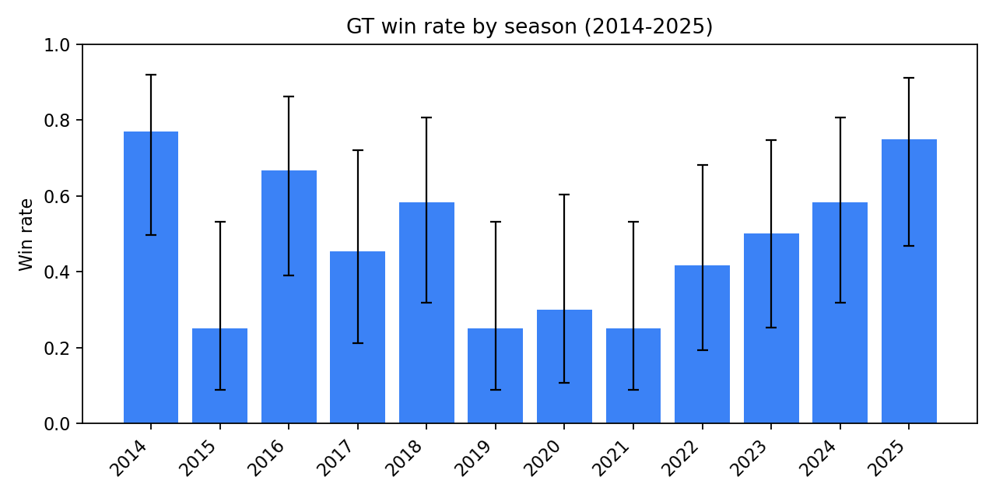
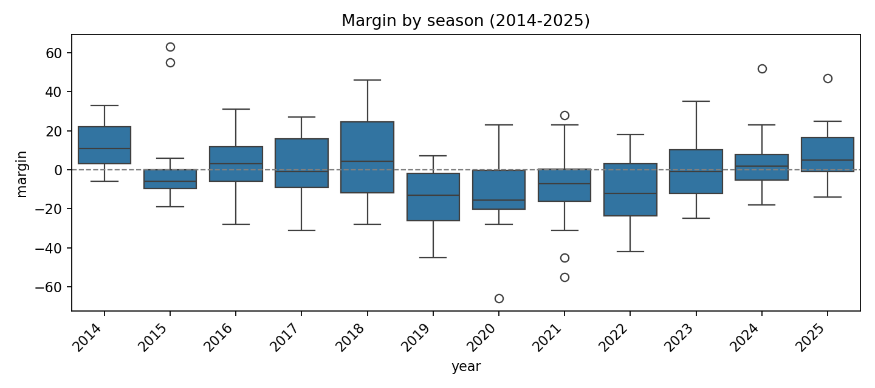
3) Dashboard: What a fan can learn
Dashboard sections
Record (2014–2025): 69-73 (win rate 48.6%)
Average scoring margin: -0.58 points/game
Home/away/neutral splits + uncertainty (confidence intervals)
Home-field effect estimate (simple regression controlling for Elo gap)
Extra context: close games, blowouts, schedule strength proxy, Elo gap vs win rate
Open: gt_summary_2014_2025/dashboard.html (includes static PNGs for offline viewing)

Slide 5
Challenges + Next Improvements
What you’d do to make it stronger
Main challenges
Small sample: GT has ~12 regular-season games/year → metrics swing a lot year to year
Missing data for some features (especially non-FBS/FCS opponents) can distort training
Football is high-variance: close games, injuries, turnovers add randomness
Market comparison is hard: odds are strong baselines and lines can be missing/inconsistent
Improvements (next steps)
Example finding: home field ≈ +2.3 points (≈ +9.9% win-prob when teams are even)
Add more pregame features (injury reports are hard; but more team/efficiency priors help)
Train on all FBS games (not only GT) then predict GT as a subset (much bigger dataset)
Use stronger non-linear models (e.g., gradient boosting) + careful cross-validation
Better probability evaluation: reliability plots, calibration by season, out-of-sample years
Positioning: this is a strong baseline + pipeline that you can keep improving

