Slide 1
GT Win Probability Project (10-slide overview)
End-to-end: data engineering → baseline ML model → fan-friendly dashboard (2014–2025)
What we built (in one pipeline)
A repeatable pipeline that pulls CFBD data → builds a clean dataset → trains a model → produces a dashboard
Goal: predict Georgia Tech win probability without using CFBD’s win expectancy
Deliverables: dataset CSV, trained model artifacts, season predictions CSVs, dashboard HTML + charts
Files: winprob.py • analysis_report.py • reports/gt_summary_2014_2025/dashboard.html

Slide 2
Slide 2/10: Problem + Scope
What question are we answering?
Core question
For a given matchup, what is GT’s pregame chance to win? (a probability, not just W/L)
We use only information available before kickoff (no postgame stats as inputs)
We do not use betting spread as a feature
What’s included
Historical games (2014–2025 regular season) to build a training dataset
Baseline model + calibration (probabilities should be meaningful)
A dashboard to explain results to fans / teammates
Why probability? It supports decisions, comparisons, and “how surprised should we be?”

Slide 3
Slide 3/10: Data Sources (CFBD API)
Where the raw data comes from
Main endpoints used
`/games`: schedule, opponent, location, scores (for label)
`/ratings/elo`: team strength proxy (pregame-ish)
`/talent`, `/recruiting/teams`, `/player/returning`: roster strength proxies
`/teams`: team name resolution + FBS/FCS classification
Optional: `/lines` for market-implied probabilities (benchmarking, not training)
Why multiple sources
A single endpoint rarely has everything you need for good pregame features
We combine strength + roster + season-to-date form to get a better signal
We cache responses to keep runs fast and reproducible
Key component: CFBDClient caches JSON in data_raw/cfbd_cache/

Slide 4
Slide 4/10: Data Engineering Pipeline
Raw API JSON → clean ML-ready table
Pipeline steps
Call CFBD endpoints (with caching) and resolve team names consistently
Build one row per GT game: (year, week, opponent, home/away/neutral)
Compute pregame features using only games before that week (season-to-date form)
Write the dataset to CSV so training is decoupled from API calls
Important engineering details
Label is `gt_win` (computed from final score) — used only as the target
Non-FBS opponents can have missing Elo/talent → we apply a floor to avoid bad imputations
Missing values are expected; we impute numerics during training (median)
Outputs: data_processed/model_dataset.csv + cached raw JSON
Command: python winprob.py build-dataset --from-year 2014 --to-year 2025

Slide 5
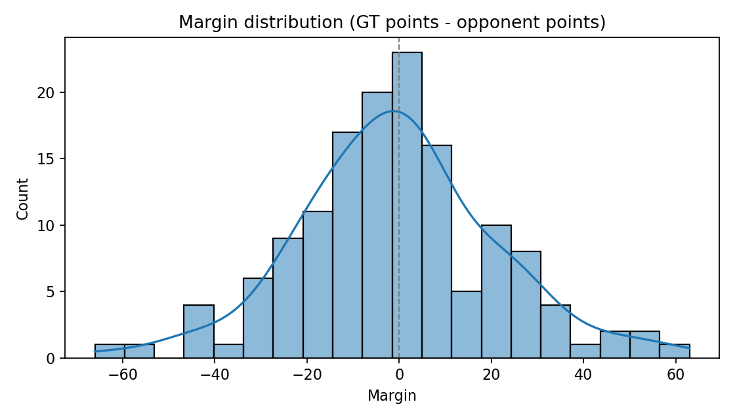
Slide 5/10: Dataset + Feature Engineering
What the model actually sees before a game
Key columns (examples)
Identifiers: game_id, year, week, opponent, location flags
Target label: gt_win (1/0)
Season-to-date form diffs: win_pct_diff, point_diff_pg_diff, points_for/against diffs
Weighted “recent form” diffs: w_* versions (recent games count more)
Strength/roster diffs: elo_diff, talent_diff, returning_diff, recruiting diffs
Opponent type: opp_is_fbs (handles FCS games more realistically)
Pregame-only rule: features use weeks < current week, not postgame stats

Slide 6
Slide 6/10: Modeling Approach
Simple baseline: logistic regression + calibration
How it works
Supervised learning: features → probability GT wins
Train/val/test split by season (avoid mixing years): 2014–2022 / 2023–2024 / 2025
Recency weighting so recent years matter more (half-life ≈ 3.0 years)
Pipeline: impute missing values → standardize → logistic regression
Calibration: sigmoid (so 0.70 means ‘should win ~70% of the time’)
Why this baseline is good
Explainable: you can tell a story about what drives probability (home field, strength gap, form)
Fast to train and easy to debug (good for a first version)
Sets a benchmark: future models should beat this to justify complexity
Train command: python winprob.py train (writes models/metrics.json)

Slide 7
Slide 7/10: Evaluation
Did the probabilities make sense?
Metrics you can explain
Accuracy: how often we picked the winner (threshold 50%)
Brier score: how close probabilities were to outcomes (lower is better)
Log loss: penalizes confident wrong predictions more than small mistakes
Calibration: do predicted probabilities match real win rates over time?
Latest run (from models/metrics.json)
Validation (2023–2024) accuracy: 0.625
Validation Brier: 0.227
Test (2025) accuracy: 0.833
Test Brier: 0.174
Caveat: test is ~12 games → treat as directional, not definitive
Best practice: keep 2025 as the clean out-of-sample test year

Slide 8
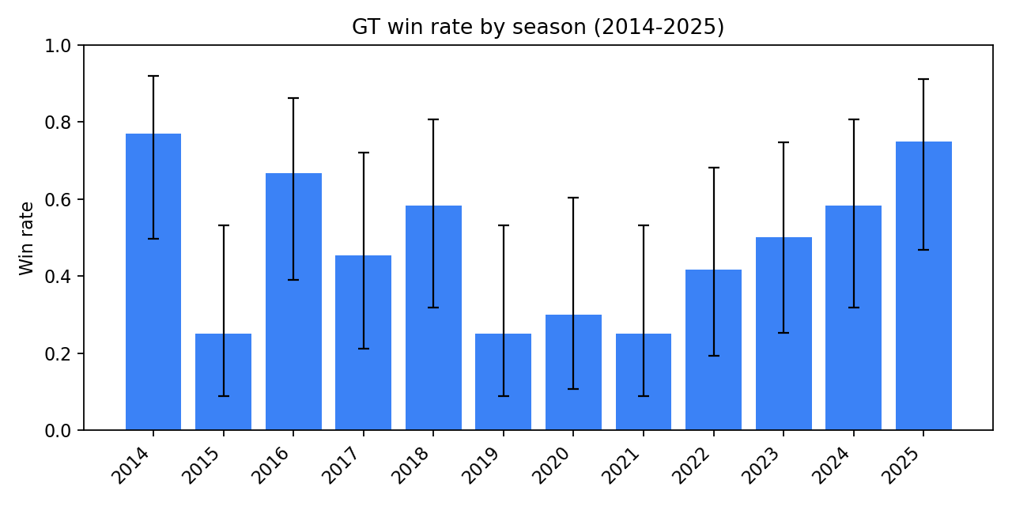
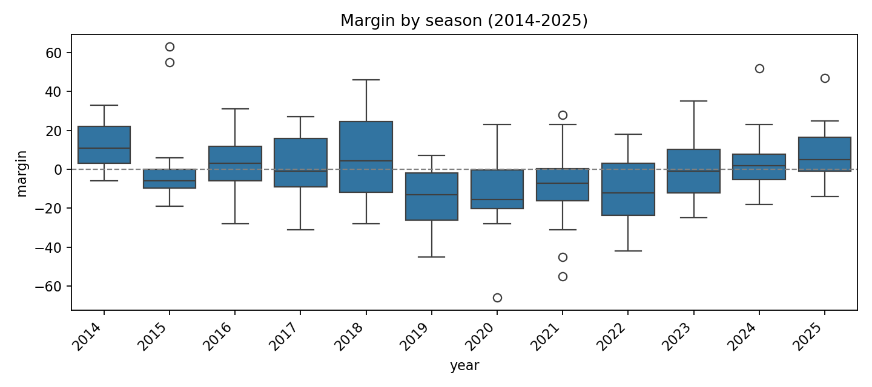
Slide 8/10: Dashboard
Turning results into something people can use
What the dashboard answers
Overall record: 69-73 (win rate 48.6%)
Was GT consistently good, or did it swing by year? (win rate by season)
How ‘dominant’ were games? (margin distribution + margin by year)
Does home field matter? (splits + regression estimate)
Context: close games, blowouts, schedule strength proxy, Elo gap vs win rate
Open: gt_summary_2014_2025/dashboard.html (static PNGs included for offline)

Slide 9
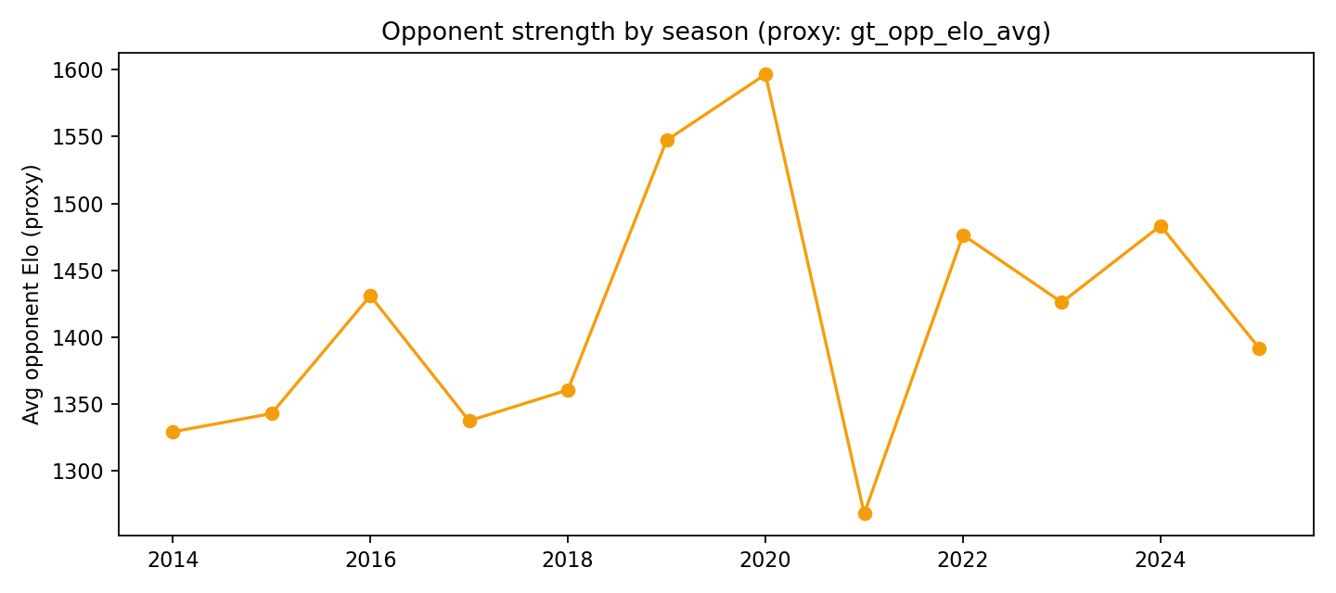
Slide 9/10: Example Insight
Home-field effect (simple regression)
What it means
Home win rate ≈ 57.5% vs away win rate ≈ 40.0%
Regression estimate: home field ≈ +2.3 points
Uncertainty (95% CI): [-3.6, 8.0] points
Win-prob shift when teams are ‘even’: about +9.9%
Key takeaway: looks helpful, but the uncertainty means it’s suggestive, not a guarantee
Why this slide matters: shows we can extract interpretable insights, not just a black-box model

Slide 10
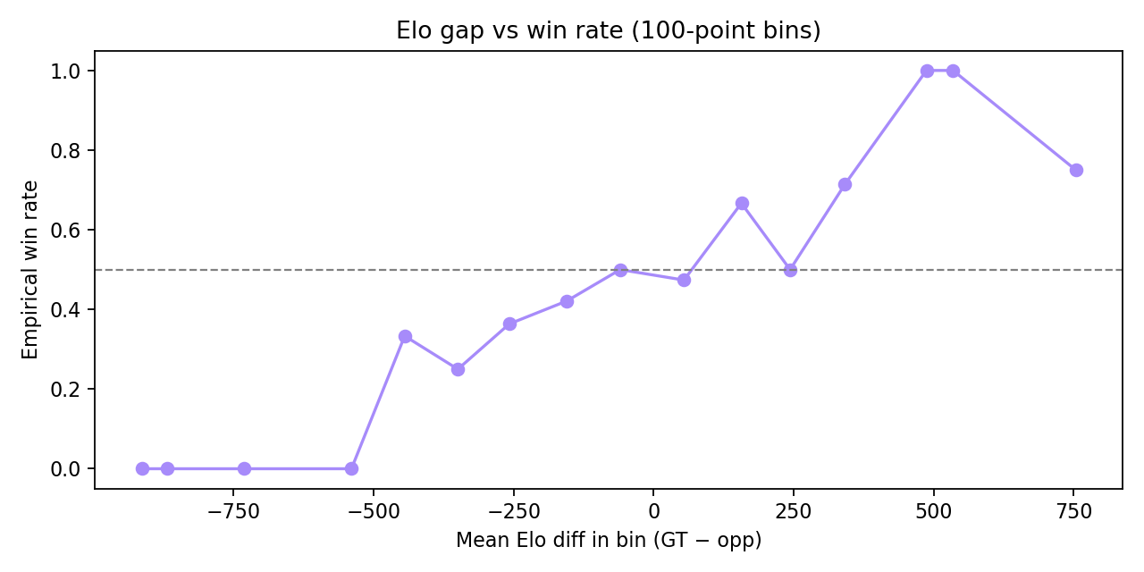
Slide 10/10: Benchmarking + Next Steps
How we judge it and what’s next
How we benchmark + what can go wrong
Benchmark idea: compare to betting market implied win prob (strong public baseline)
Small samples: a 12-game season makes “accuracy” swing a lot
Non-stationary team: coaches/players change → older seasons matter less (we use recency weighting)
Missing/uneven data (especially non-FBS opponents) can distort features
Football randomness: close games + turnovers mean probabilities will never be perfect
Next improvements (roadmap)
Train on all FBS games, then predict GT (massively larger dataset + better generalization)
Add stronger pregame team strength features (and better schedule-adjusted form)
Try non-linear models (gradient boosting) and tune with cross-validation
Improve evaluation: reliability diagrams, rolling-year backtests, more seasons for test
Product: add 2024 model-vs-market table + richer matchup explanations in the dashboard
Context stats: Overall win rate uncertainty (95% CI): 40.5%–56.7%
Context stats: Margin uncertainty (95% CI): -3.99 to +3.01 points/game
Positioning: strong baseline pipeline + explainable dashboard; ready to extend

