Slide 1
EC 498 Major Project
A 2.4 GHz Delta Sigma based Fractional Phase Locked Loop for Wireless Communication Applications
Guide : Prof Laxminidhi T
Rohan Mallya – 191EC161
Adithi S Upadhya – 191EC101

Slide 2
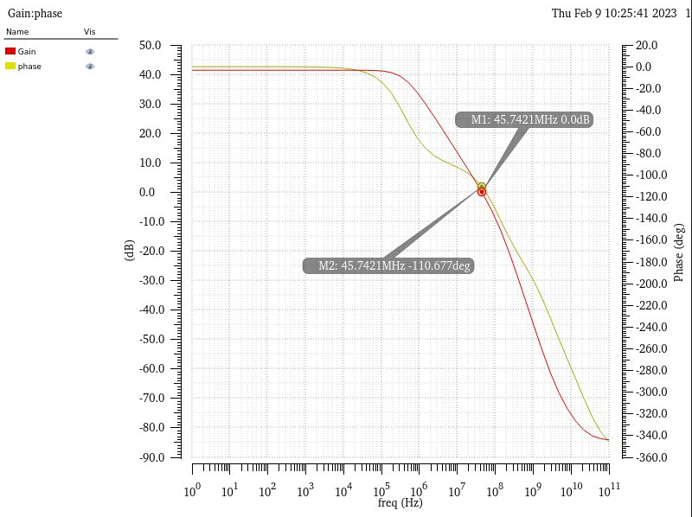
2 Stage OTA with CMFB
2 stage fully differential OTA
Technology | 65 nm
L min | 0.2u
DC Gain (with resistive and capacitive loading) | 41 dB
DC Gain (with capacitive loading only) | 47dB
Phase Margin | 70 degrees
Unity Gain Bandwidth | 45 MHz
Load Capacitance | 2pF
Load Resistor | 10k
Vdd | 1.2 V
I/p CM | 0.6V
o/p CM | 0.6V
Reference Current | 47uA

Slide 3
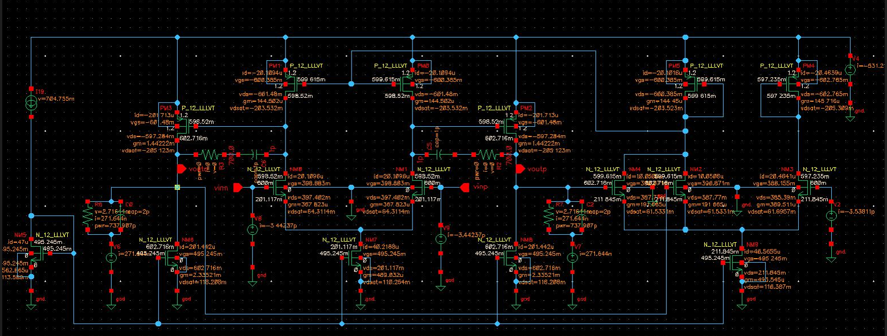
DC Operating point

Slide 4
Common Mode Feedback stability test
To check the common mode stability , we perturbed the output nodes with a 1u A pulse current with a pulse width of 1us . We observed that there were oscillations and the output common mode didn’t settle to 0.6 V
Hence to make the loop more stable we dampened the common mode feedback OpAmp by using diode connected PMOS load which stabilized the output common mode

Slide 5
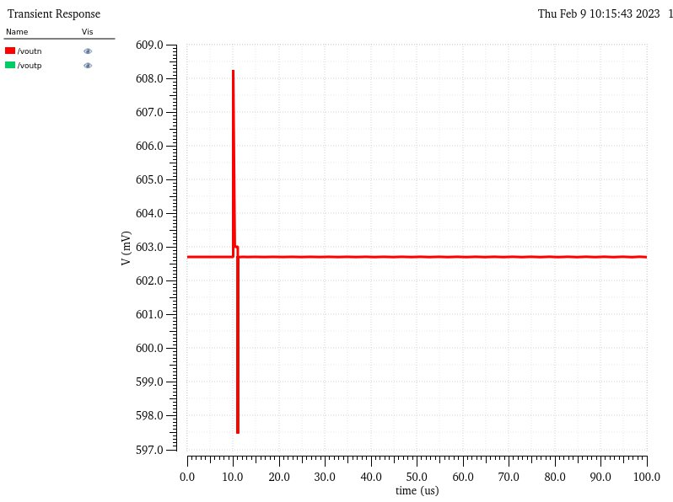
Common Mode Feedback stability
Transient response of the output common mode . Perturbed at 10us

