Slide 1
EC 498 Major Project
A 2.4 GHz Delta Sigma based Fractional Phase Locked Loop for Wireless Communication Applications
Guide : Prof Laxminidhi T
Rohan Mallya – 191EC161
Adithi S Upadhya – 191EC101

Slide 2
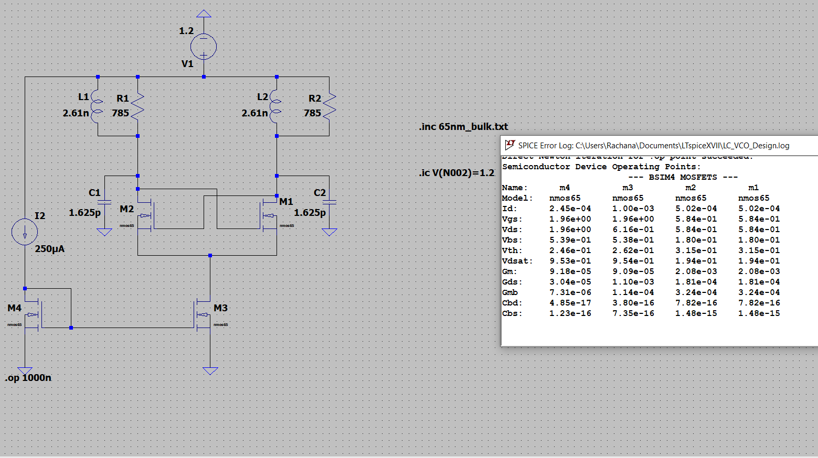
VCO Design Procedure
fo = 2.4 GHz, Vdd = 1.2 V, Power Budget = 1.2 mW, It= 1mA (Tail Current Source )
Q = 10 (Quality factor of the Inductor available at 2.4GHz)
Differential Peak to Peak Swing Vpp = 0.5 V
Rp = 393 Ohm, 4/pi * Iss * Rp = Vpp (LC Tank Filters out the fast switching square wave drain currents )
L = Rp/ 2.pi.fo.Q = 2.61 nH (Q = Rp/ LWo)
2*pi.fo = 1/root(LC)
C = 1.69 pF (account for the parasitic capacitance of the Mosfet)

Slide 3
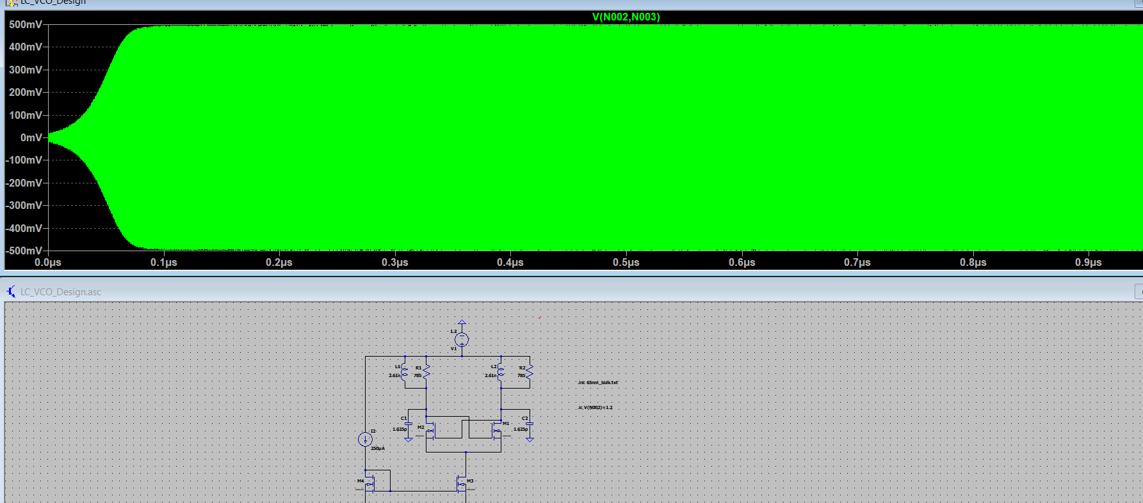
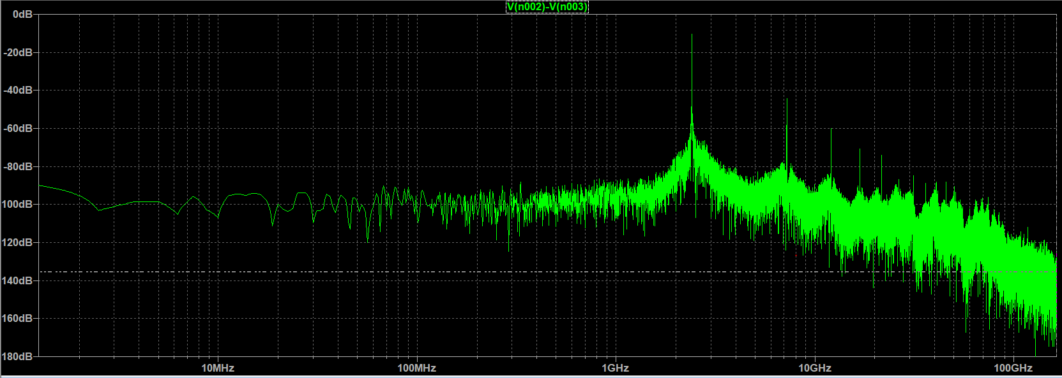

Slide 4
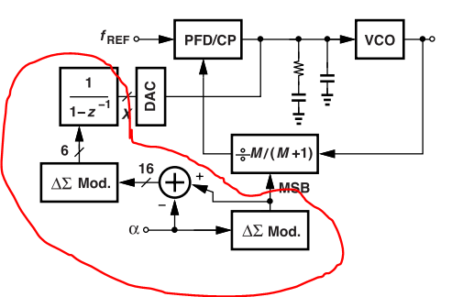
2nd Order Digital Delta Sigma Modulator
Multibit digital DSM.
RTL Implementation of the DSM and then using 65nm Standard Cells to synthesize it.
DAC Feedforward to cancel quantization error induced the DSM.

Slide 5
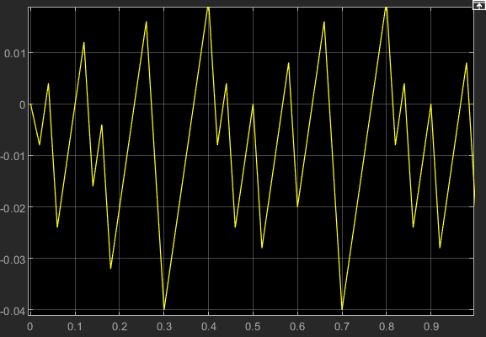
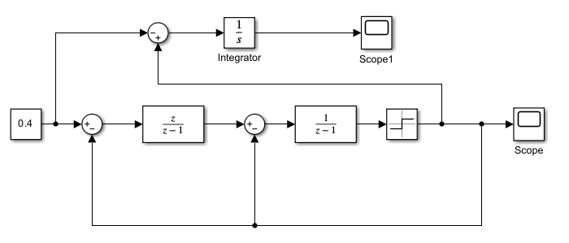
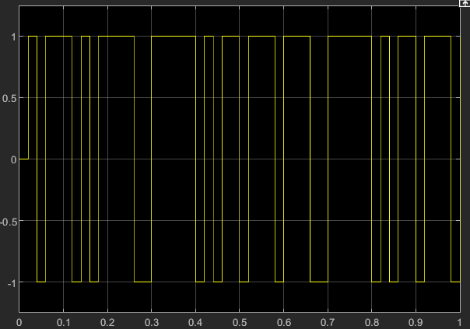
2nd Order Analog Delta Sigma Modulator
Frequency Control Word

