Slide 1
EC 498 Major Project
A 2.4 GHz Delta Sigma based Fractional Phase Locked Loop for Wireless Communication Applications
Guide : Prof Laxminidhi T
Rohan Mallya – 191EC161
Adithi S Upadhya – 191EC101

Slide 2
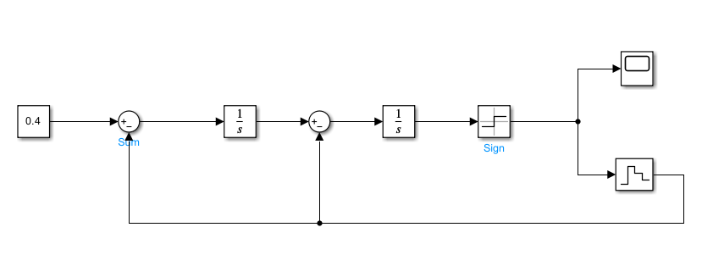
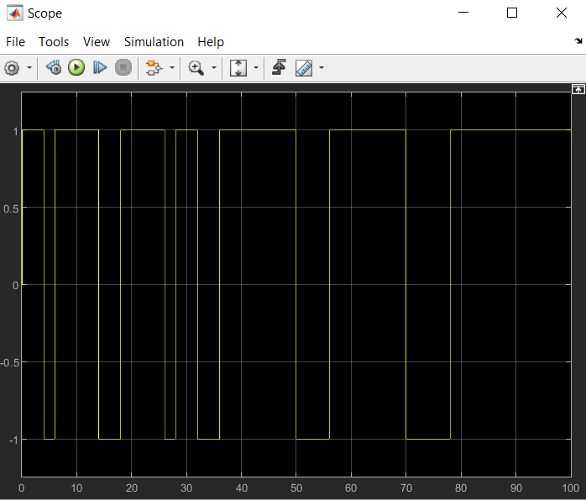
2nd order CTDSM : Simulink Model

Slide 3
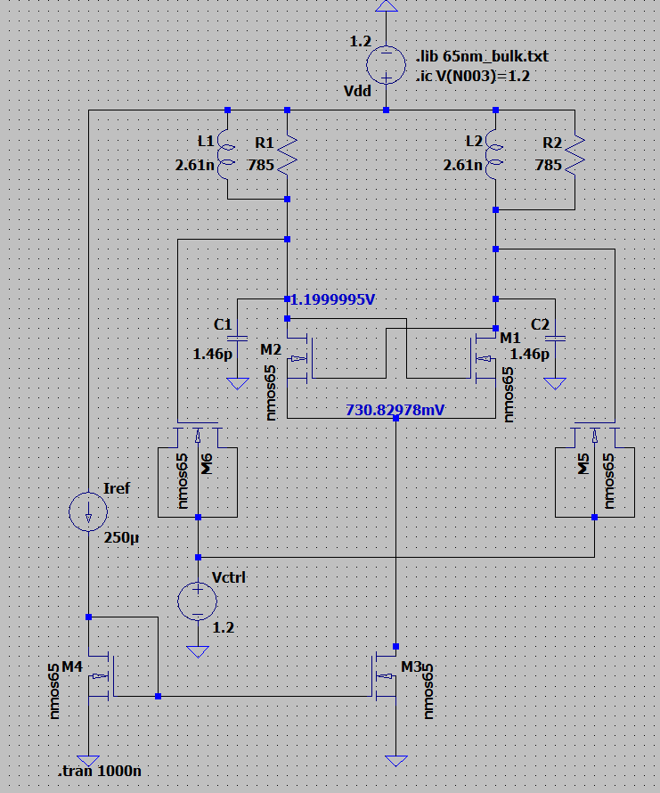
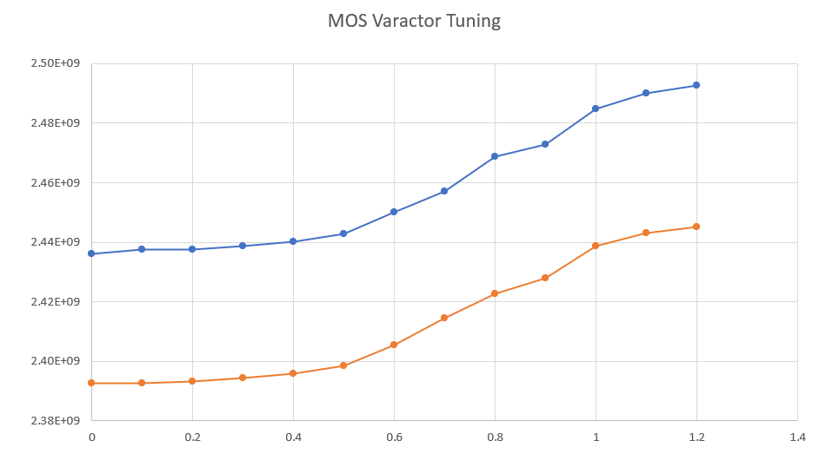
LC VCO
2 discrete frequency tuning ranges
(W/L) Varactor = 30um/0.13um

Slide 4
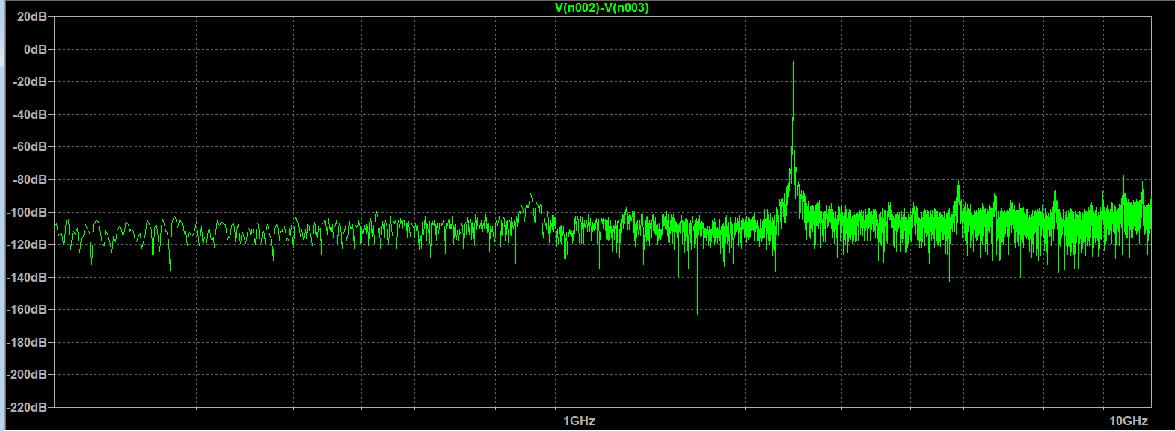
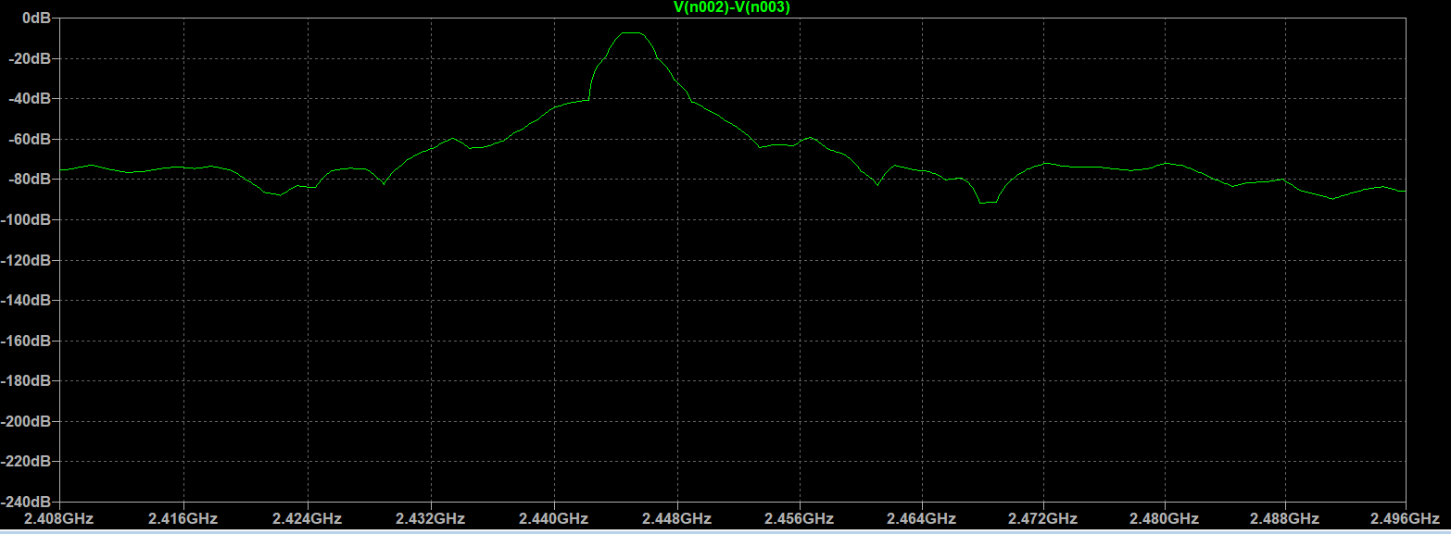
Poor Phase Noise

Slide 5
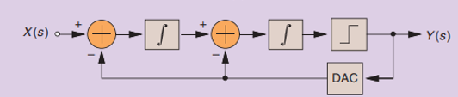
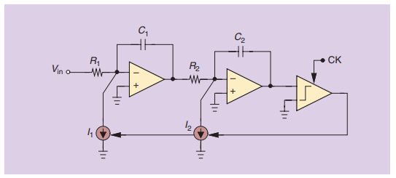
2nd Order Analog Delta Sigma Modulator
2 Stage OTA
Comparator Design
1 bit DAC
2nd Order CTDSM

Slide 6
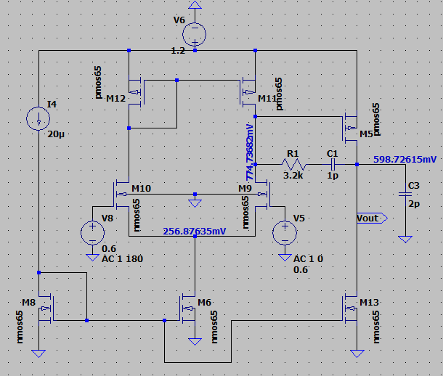
2 stage miller compensated OTA
2 stage OTA
Technology | 65 nm
L min | 0.2u
DC Gain | 50.9 dB
Phase Margin | 64 degrees
Unity Gain Bandwidth | 82 MHz
Load Capacitance | 2pF
Vdd | 1.2 V
I/p CM | 0.6V
Reference Current | 20uA

Slide 7
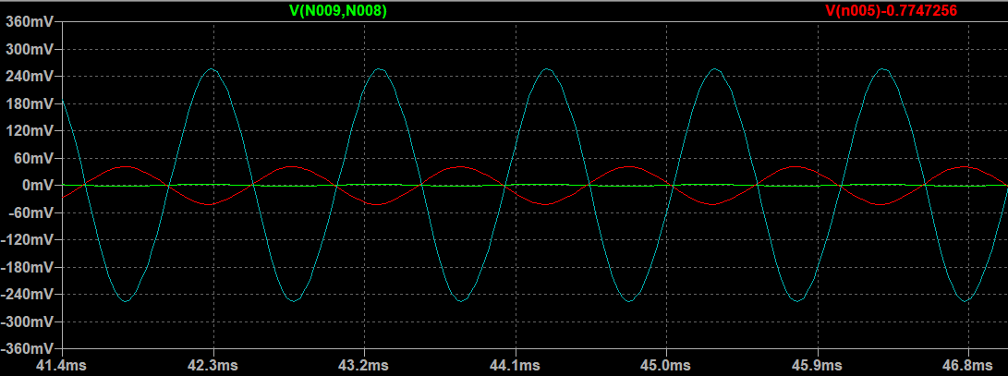
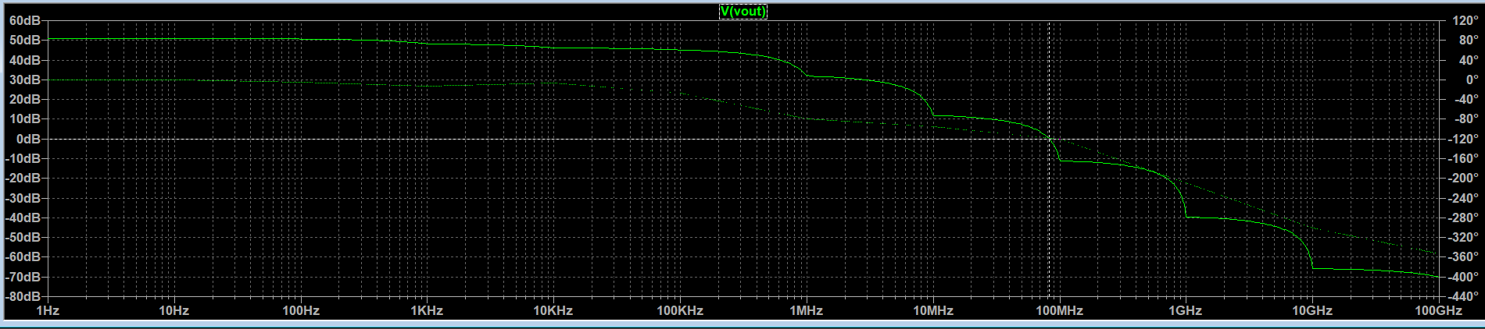

Slide 8
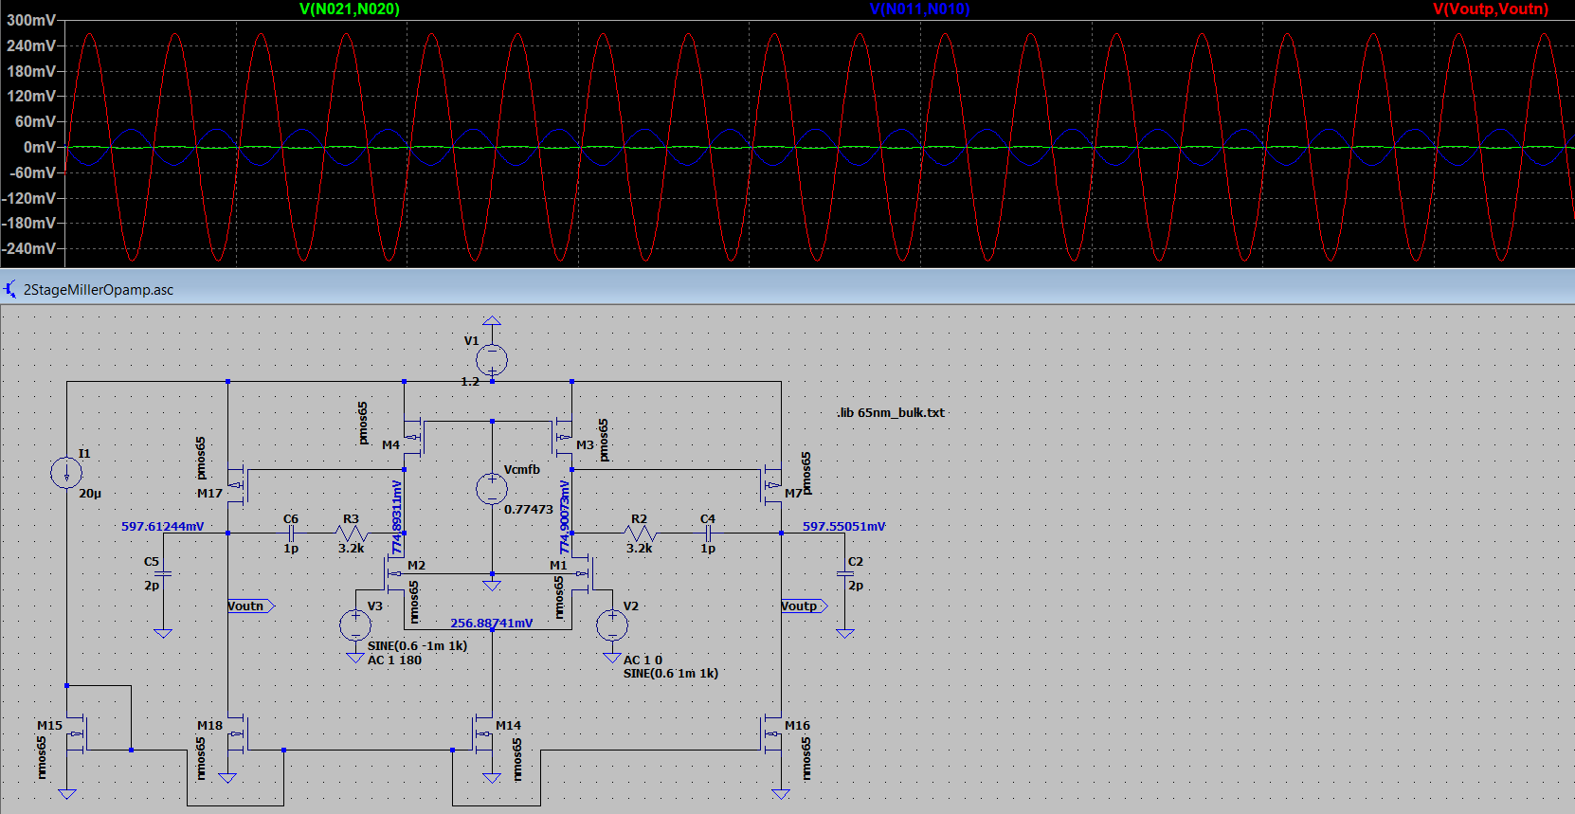
2 stage fully differential miller compensated OTA

Slide 9
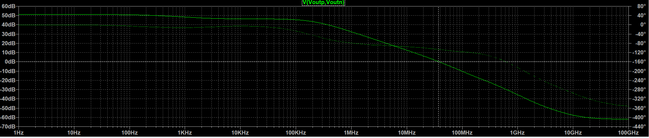
2 stage fully differential OTA
Technology | 65 nm
L min | 0.2u
DC Gain | 51.9 dB
Phase Margin | 74 degrees
Unity Gain Bandwidth | 37 MHz
Load Capacitance | 2pF
Vdd | 1.2 V
I/p CM | 0.6V
Reference Current | 20uA

Slide 10
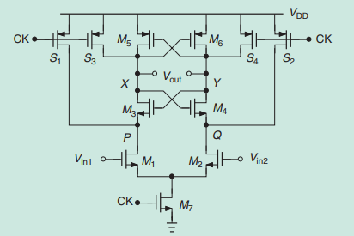
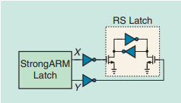
Comparator Design
StrongArm latch followed by an RS Latch

