Slide 1

Covid 19 Data Analysis
Prediction on Total Cases using Machine Learning

Slide 2

This Report Contains:
Data Analysis univariate and Bivariate analysis methods
Description of the Machine Learning Models used, Describing their fitting and prediction analysis.
Testing the Models used and analyzing their Accuracies.
Prediction using new data and Concluding on it

Slide 3
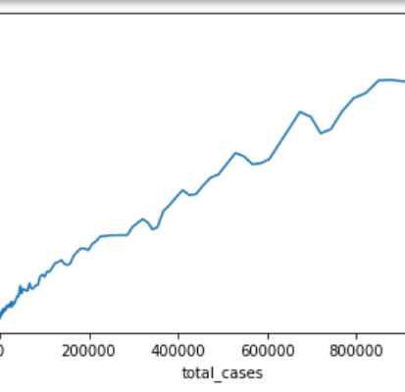
Dataset Description
Dataset contained 20670 rows and 34 columns as per 18th July,2020
Dataset was filtered to obtain data which had location as India
Dataset contained the following columns which were recorded according to the requirement
The dataset had Categorical columns such as iso_code,location and Continents etc., which were removed in later stages.
It also had columns with same repetitive data such as population etc., which was also removed in later stages

Slide 4
Mean, Mode and Median of Numerical columns in the Dataset
Column | Mean | Mode | Median
Total_cases | 136393.683417085 | 5734.0 | 0.0
New_cases | 5044.381909547738 | 693.0 | 0.0
Total_deaths | 3938.934673366834 | 166.0 | 0.0
New_deaths | 128.6532663316583 | 27.0 | 0.0
total_cases_per_million | 98.83563316582915 | 4.155 | 0.0
new_cases_per_million | 3.6553417085427142 | 0.502 | 0.0
total_deaths_per_million | 2.85429648241206 | 0.12 | 0.0
new_deaths_per_million | 0.09321608040201008 | 0.02 | 0.0
total_tests | 3757080.3421052634 | 2564154.0 | there are 114 mode values)
new_tests | 116709.27777777778 | 103523.0 | there are 108 mode values)
total_tests_per_thousand | 2.7225438596491225 | 1.8584999999999998 | 0.01
new_tests_per_thousand | 0.08456481481481484 | 0.075 | 0.001
new_tests_smoothed | 99516.63865546219 | 89872.0 | 1125.0

Slide 5
Univariate Analysis:
Histograms
Here is the histograms of various Important columns for predictive regression model building
It can be observed that the most of the data columns seemed to be right skewed
It is also observed that most of the values in the given dataset is zeroes

Slide 6
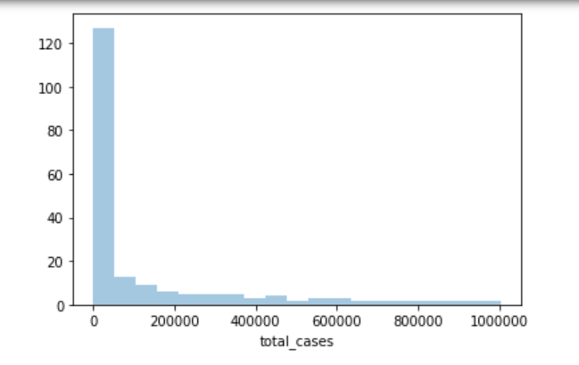
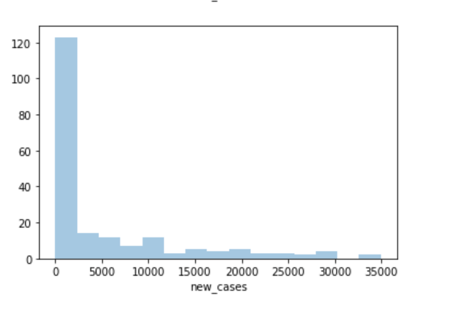
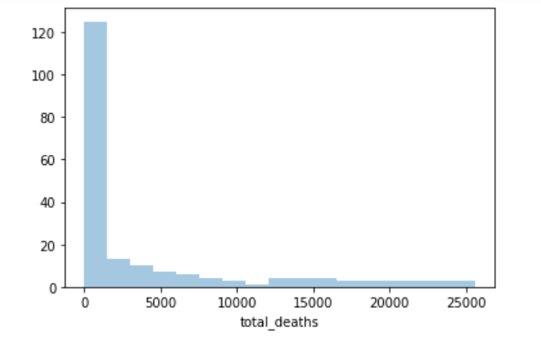
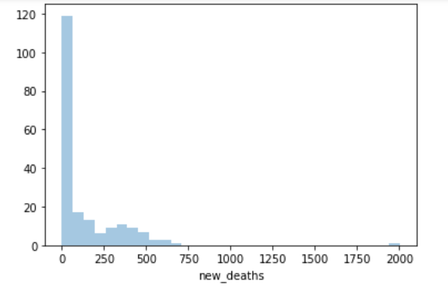

Slide 7
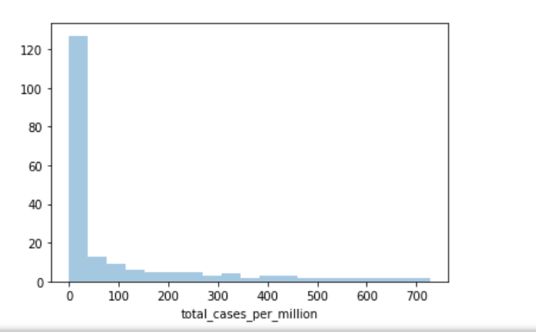
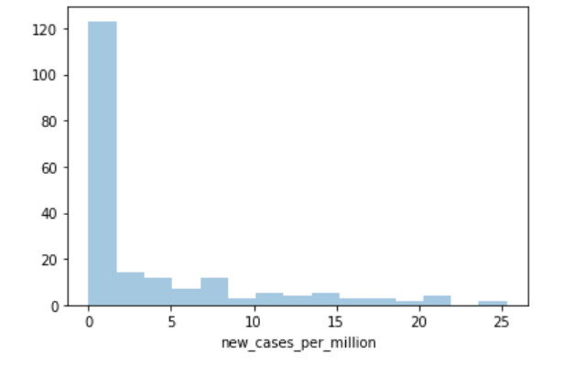
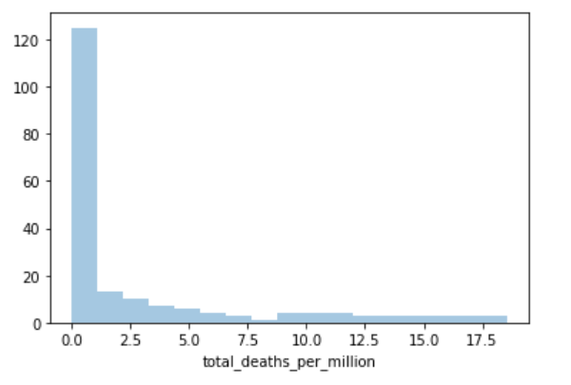
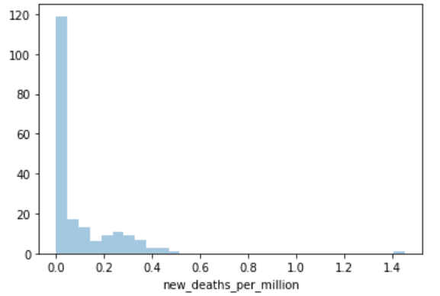

Slide 8
Bivariate Analysis using Scatter plots and Line plots
The Bivariate Analysis was done between data of any of the two Numerical columns from the dataset
Bivariate analysis shows that many of the columns have linear relationships as well exponential relationships.
Here the plots of Total Cases v/s other important features will be used

Slide 9
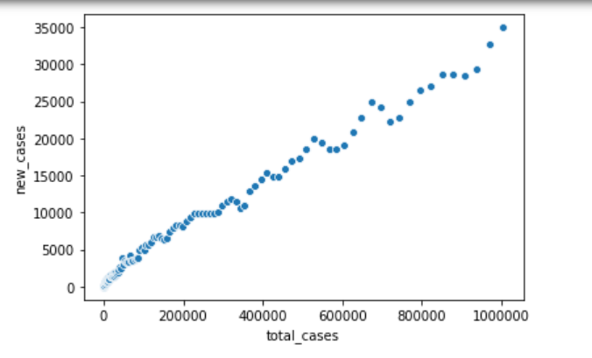
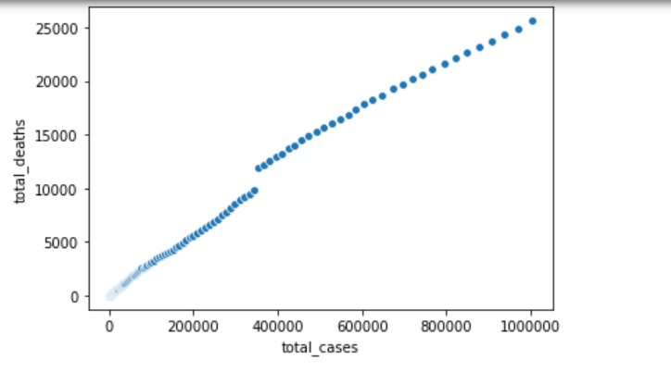
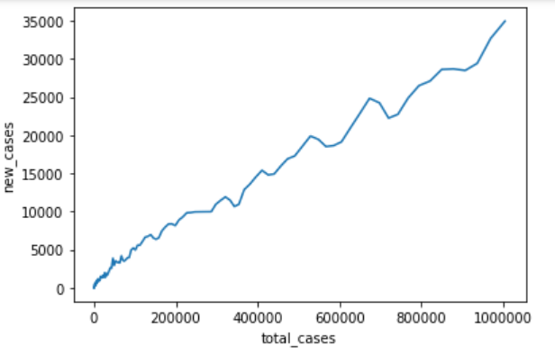
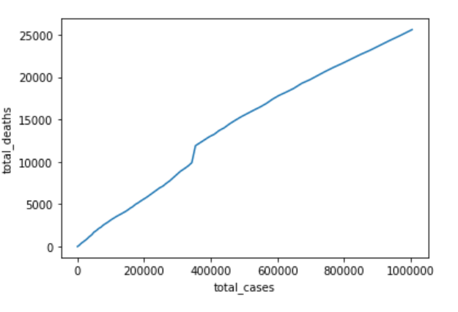

Slide 10
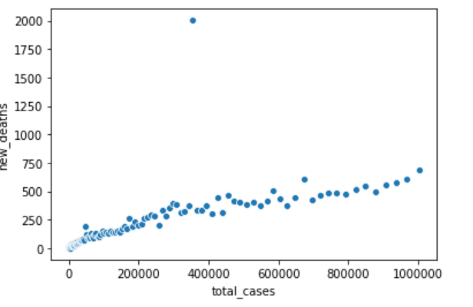
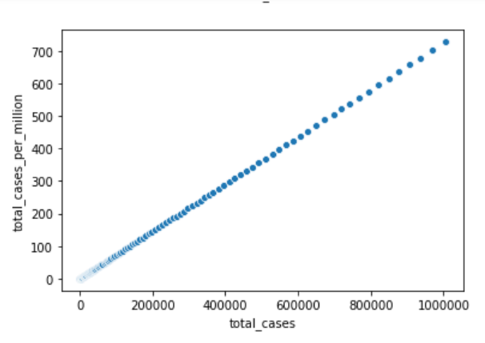
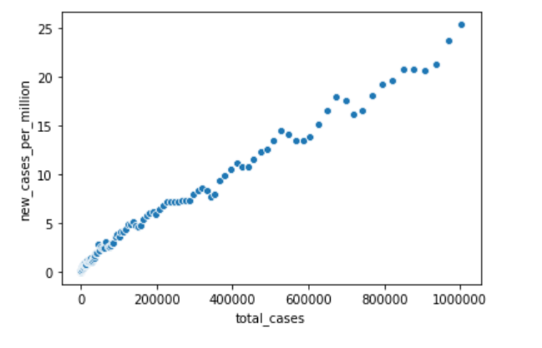
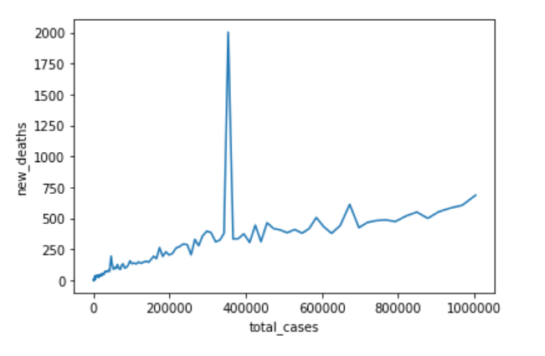
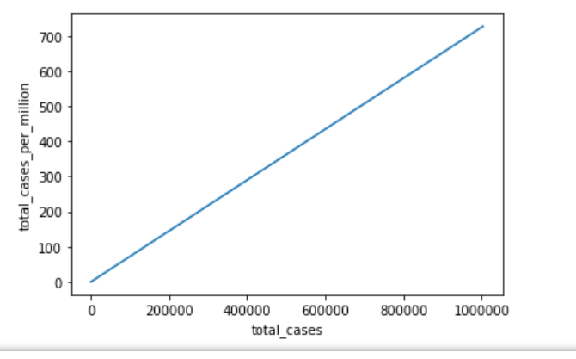
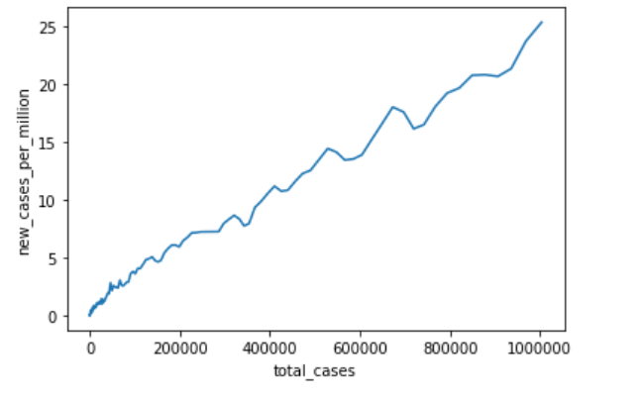

Slide 11
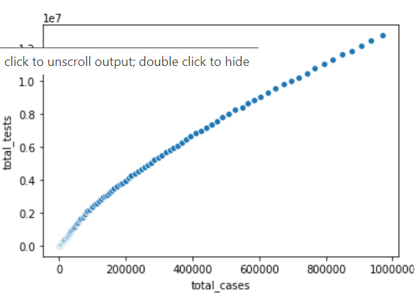
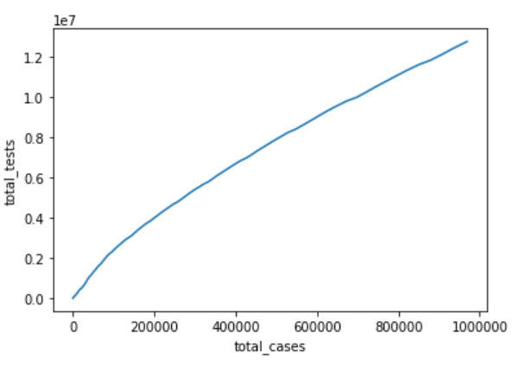
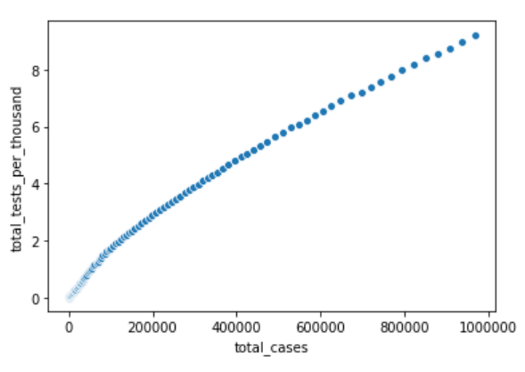
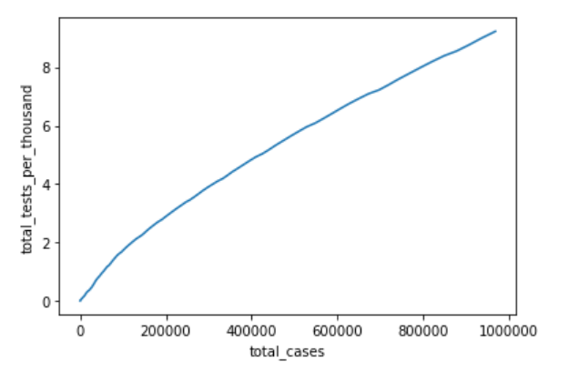

Slide 12
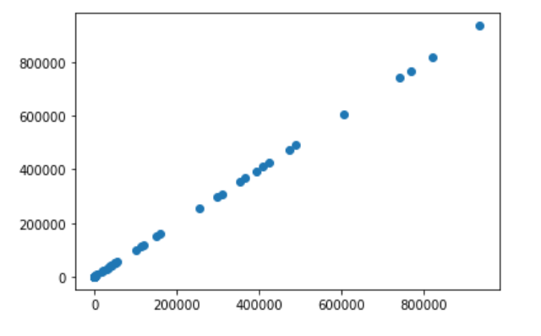
Linear Regression Model
Now Scatter plot with y_test and y_predLR is plotted
(it is a scatter plot between actual test data and linear regressor predicted data)
The Following Dataset after clearing the Null Values and Unnecessary Data columns the Model is fit to Linear Regression Model.
Train test split was done and the training data is fit into the model.
Then the testing is done accordingly.
Y_
predLR
y_test

Slide 13
Linear Regression Model Accuracy
3
Accuracy was found to be :0.9999999999968615
2. RMSE score:
0.4202825401794529
3.Five fold Cross val score:
0.9865092359544476
Conclusions:
The Conclusion is that the Model is quiet in good fit with data and can be expected to give good prediction results near to the originals.
The Analysis done were
Accuracy score
RMSE score
Fivefold Cross Validation.

Slide 14
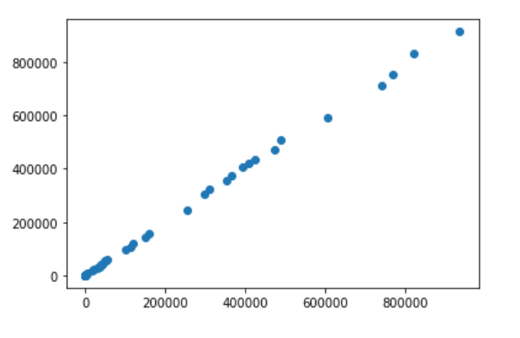
Random Forest Regression:
Now Scatter plot with y_test and y_predRF is plotted
(it is a scatter plot between actual test data and linear regressor predicted data)
The Following Dataset which was cleared for Linear regression from Null Values and Unnecessary Data columns is used .
Model is fit to Linear Regression Model.
Train test split was done and the training data is fit into the model.
Then the testing is done accordingly.
The testing prediction was scatter plotted against y_test in the data and deviations were found
Y_
predRF
y_test

Slide 15
Random Forest Regression Analysis:
8
Accuracy was found to be :
0.998994974199048
2. RMSE score:
0.4202825401794529
3.Five fold Cross Val score:
-3.59914
Conclusions:
The Model has good Accuracy and RMSE score but the Five fold Cross Val score is negative. Hence the prediction might be of less accuracy
The Analysis done were
Accuracy score
RMSE score
Fivefold Cross Validation.

Slide 16
Data prediction of Total Cases on 17th July,2020
The following data was given as input to the to the Linear Regression model and Random Forest Regression Model.
Date | 737623(Ordinal value of 2020-07-17)
New_cases | 34956
Total_deaths | 25602
New_deaths | 687
Total_cases_per_million | 727.412
New_cases_per_million | 25.33
Total_deaths_per_million | 18.552
New_deaths_per_million | 0.498
Total_tests | 3.757080e+06
New_tests | 116709.277778
total_tests_per_thousand | 2.722544
new_tests_per_thousand | 0.084565

Slide 17
new_tests_smoothed | 99516.638655
new_tests_smoothed_per_thousand | 0.072118
stringency_index | 55.309005
Results:
1.Linear Regression Prediction on Total cases = 1003831.90603254
2.Random Forest Regression prediction on Total cases=813695.315
3.Total Number of Covid cases on 17th July in Actual= 1003832
(as per data)

Slide 18

Conclusion
The Dataset given fits and performs best with Linear Regression Model
The Dataset has not performed upto the expectation during the usage of Random forest Regressor
Hence usage of Linear Regressor can be better.
This Photo by Unknown Author is licensed under CC BY-ND

