Slide 1

Java Database Connectivity

Slide 2
What is JDBC ?
The Most Important part of any software application in today’s world is going to be data
Data storage and management as well as Querying required user data at given time plays a very important role among in any Software application
Software application developed with any programming language such as Python,Java etc., must be able to provide the required API’s inorder to enable a user friendly environment to be able to develop a Software application and interact with the required database on the backend.

Slide 3
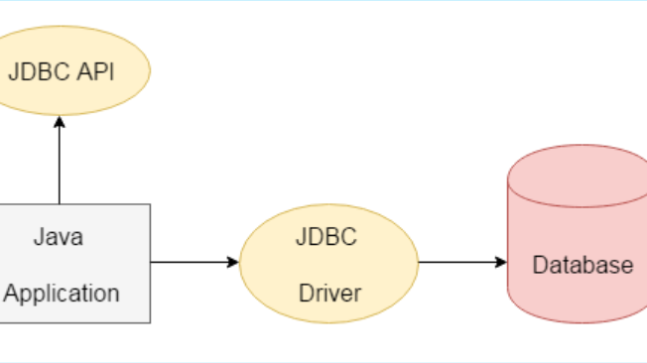
What is JDBC ?
JDBC is a Java API to connect and execute the query with the database
It is a part of JavaSE (Java Standard Edition). JDBC API uses JDBC drivers to connect with the database.
We can use JDBC API to access tabular data stored in any relational database. By the help of JDBC API, we can save, update, delete and fetch data from the database. It is like Open Database Connectivity (ODBC) provided by Microsoft.

Slide 4
Why Should JDBC be used ?
JDBC Has the Ability to do the Following:
Connect to a Database
Execute different queries that can be executed with SQL
Produce the Result of any action or query as required.

Slide 5
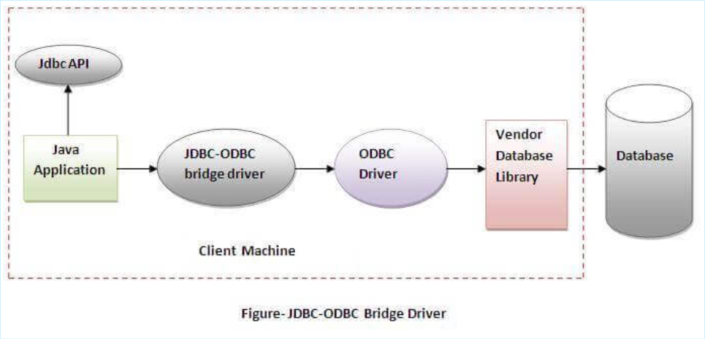
Types of JDBC Drivers
1. JDBC-ODBC bridge driver
The JDBC-ODBC bridge driver uses ODBC driver to connect to the database. The JDBC-ODBC bridge driver converts JDBC method calls into the ODBC function calls. This is now discouraged because of thin driver.
The Latest version of Java 8 do not have JDBC-ODBC bridge.

Slide 6
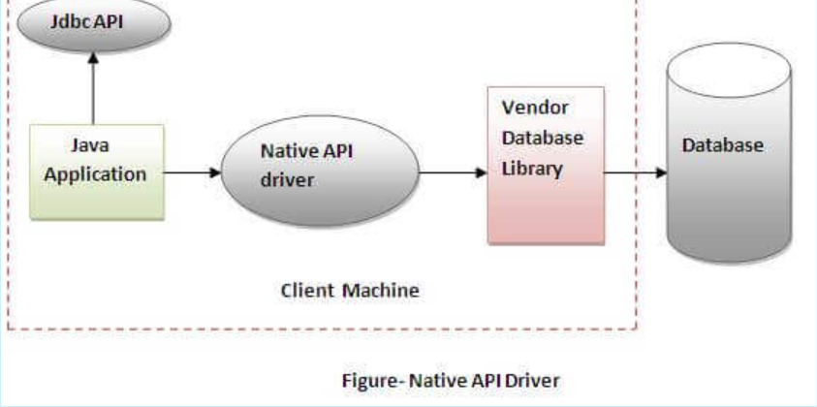
Types of JDBC Drivers
The Native API driver uses the client-side libraries of the database. The driver converts JDBC method calls into native calls of the database API. It is not written entirely in java

Slide 7
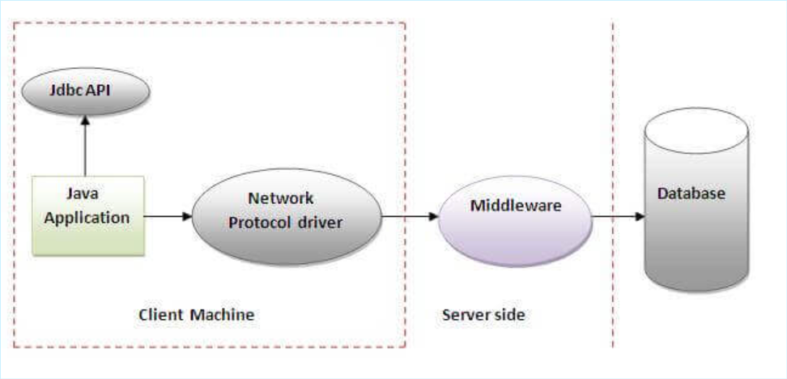
Types of JDBC Drivers
Network Protocol driver
The Network Protocol driver uses middleware (application server) that converts JDBC calls directly or indirectly into the vendor-specific database protocol. It is fully written in java.

Slide 8
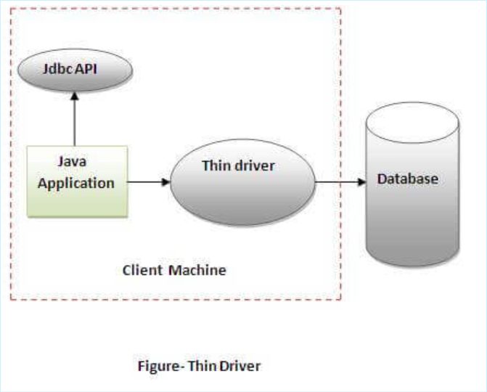
Types of JDBC Drivers
The thin driver converts JDBC calls directly into the vendor-specific database protocol. That is why it is known as thin driver. It is fully written in Java language.

Slide 9
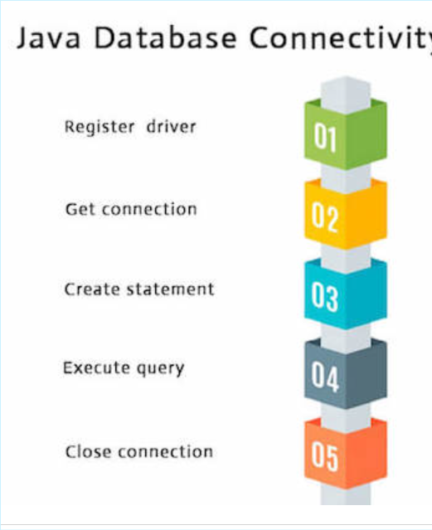
Use JDBC in these 5 Steps

Slide 10

It’s Time For a Demo now !

Slide 11
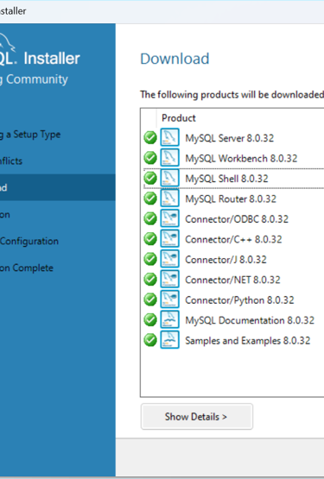
Requirements For the Demo
1. MySQL Installer to install the Basic requirements of Connector,Router,Server,and The Workbench GUI. This can be done by selecting Developer Full or the Developer Mode in the MySQL installer
https://dev.mysql.com/downloads/installer/
Important: For MySQL Connector J is a very important requirement that is required. Make sure it is compatible with the current MySQL version. Here it is 8.0.32

Slide 12
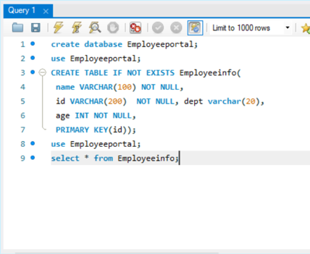
Database Setup
1. First we will be creating a Simple Database with following Settings:
So first we will be creating a Employee Database, with the following information:
2. Execute the Query as given below in MySQL shell or MySQL GUI.

Slide 13

JDBC Setup
Makesure to install JDBC Driver or Connector J is available as a part of MySQL installer or else install it externally.
This demo is done on Intelij IDE. To follow the similar thing on Eclipse use the following link: https://youtu.be/lX0FhmpHGrc
For Intellij IDE follow: https://youtu.be/-MDPYDi01dM
Link to Connector J: https://dev.mysql.com/downloads/windows/installer/8.0.html
By Default You will find Connector J in your Program Files(x64 or x86)folder on Windows.

Slide 14

What Are the Things We will be seeing in this demo
Connecting to the Database
Executing Insert, Update, Delete in MySQL
Executing Query, Prepared Statement
Demo on Batch statements.
CLOB and BLOB

Slide 15
Connecting to the Database
We Connect to the database using DriverManager.getConnection() method of the java.sql.DriverManager Package

Slide 16
Executing a few basic things
executeUpdate() method for insert,update and delete of the data.
executeQuery() method for select command.
executeUpdate() can also be used to create database and table similar to SQL

Slide 17
Prepared statement
The PreparedStatement interface is a subinterface of Statement. It is used to execute parameterized query.
Improves performance: The performance of the application will be faster if you use PreparedStatement interface because query is compiled only once.
No SQL Injection threats
Makes it Easier to set SQL Parameters

Slide 18
Stored Procedure
These are a Group of SQL Statements that are insisted to perform a particular task or a group of tasks.
Created in a SQL Language supported by native database
Can have combinations of Input, Output or both Input-Output parameters
First a stored procedure must be created and registered in SQL
Then we call that stored procedure by using JDBC API.

Slide 19
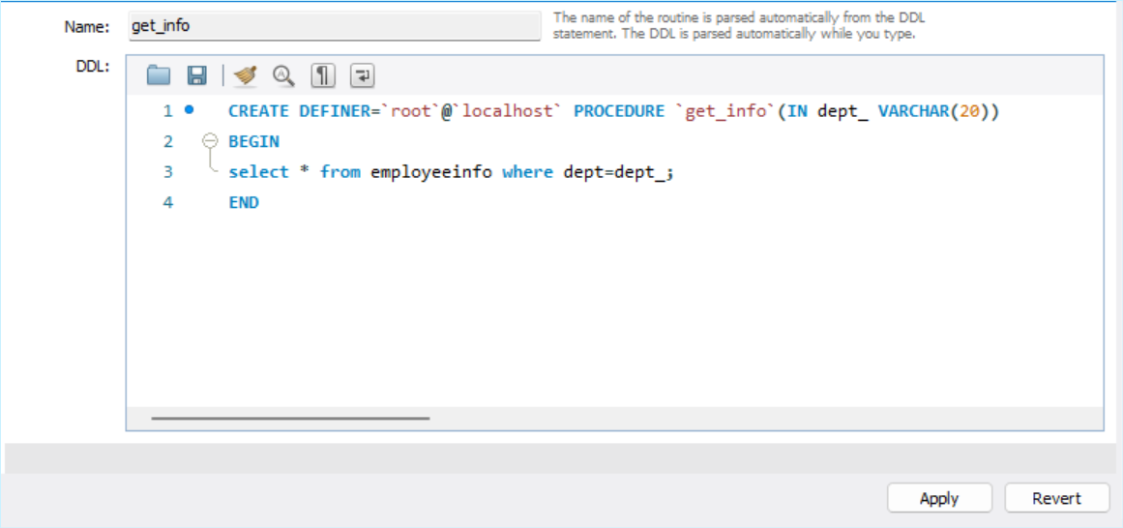
Stored Procedure
On MySQL workbench click on schema
Select your database and right click on ‘Stored Procedures’
Click on Create Stored Procedure.
And Create as follows(“you need to do the editing as required”)
Click on Apply and proceed as said.

Slide 20

Thank You

