Slide 1
Leveraging Earth Observation Data for Informed Agricultural Decision-Making
By Team - Meteoric Minds

Slide 2
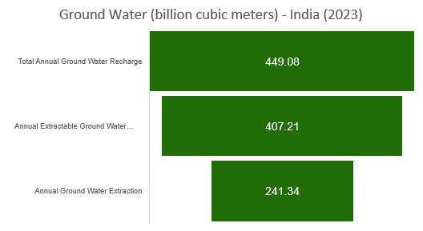
Groundwater in India
Groundwater (GW) is the water that seeps through rocks and soil and is stored below the ground. The rocks in which GW is stored are called aquifers.
The underground (hydrogeological) setting in India can be divided into -
Hard-rock aquifers of peninsular India: These represent around 65% of India’s overall aquifer surface area, mostly found in central peninsular India.
Alluvial aquifers of the Indo-Gangetic plains: Found in the Gangetic and Indus plains in Northern India, these have significant storage spaces.
70-80% of Indian farmers depend on Groundwater.
* Stage of Ground Water Extraction – 59.26%
Source: Ground Water Resource Assessment - 2023
* Stage of groundwater extraction is a measure of annual ground water extraction for all uses (irrigation, industrial and domestic uses) over annual extractable ground water resource

Slide 3
Solution Steps
1
2
3
4
Objective
Data
Models
Results Website
Understand the weekly trend of ground water in India and its states and forecast the ground water levels to take precautions on time.
NASA GRACE weekly data from 1st Jan 2023 to 27th May 2024. Features:
Ground water storage (gws_inst)
Root Zone Soil Moisture (rtzsm_inst)
Surface Soil Moisture (sfsm_inst)
Week Number
State (Added from external source)
LSTM
ST-CNN
Create a Streamlit website with Ground water forecasting
GRACE (Instruments) - Gravity Recovery And Climate Experiment: Since water has mass, changes in groundwater storage can be detected as changes in gravity. GRACE and GRACE-FO measurements help assess water storage changes in monthly, total surface, and groundwater depth.

Slide 4
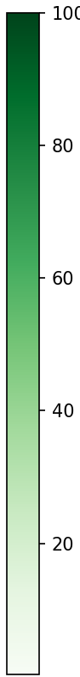
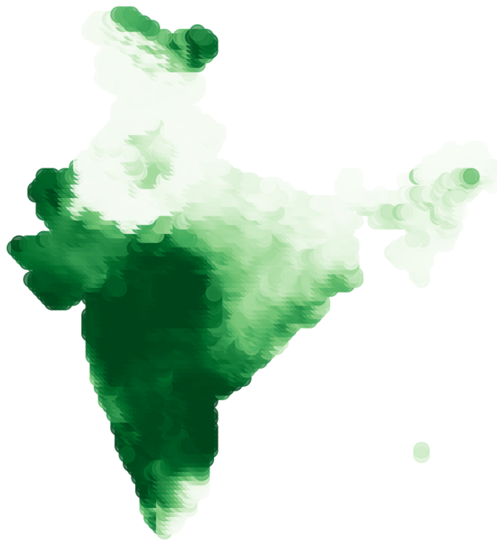
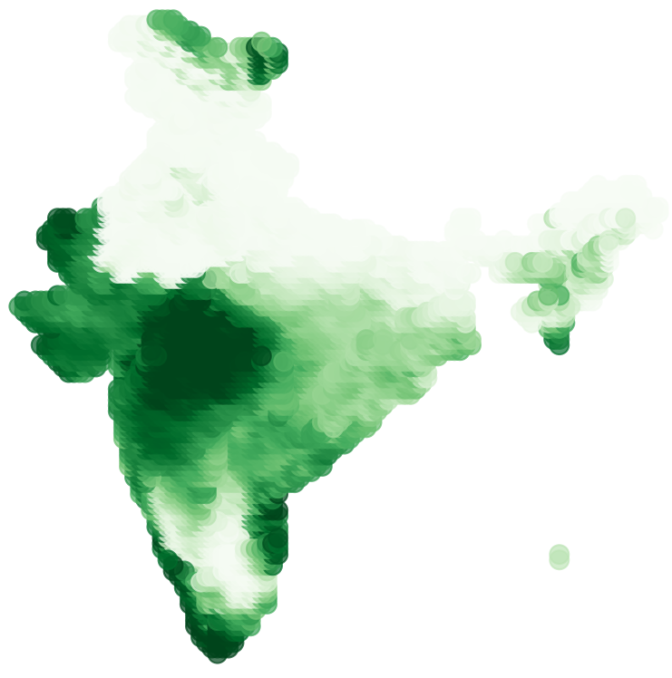
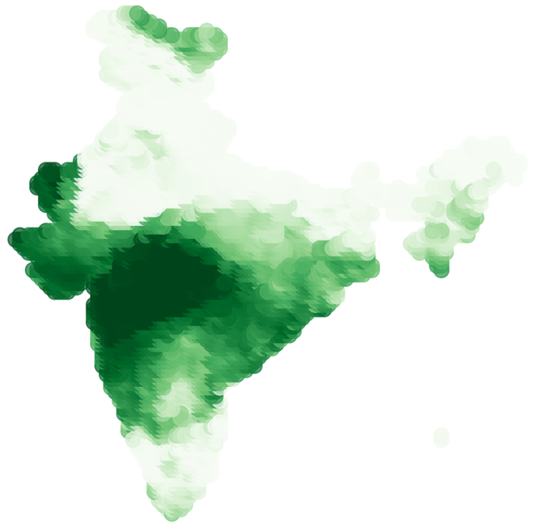
Ground Water Storage Variations across India
Ground Water Storage
Week 1 (2nd Jan 2023)
Week 53 (1st Jan 2024)
Week 71 (6th May 2024)
We can see significant fall in GWS across Southern part of India.

Slide 5
Ground Water Storage falls in the last quarter of 2023 for southern states, but increases for Mizoram.

Slide 6
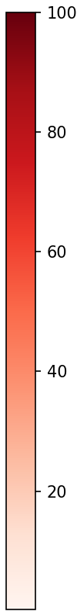
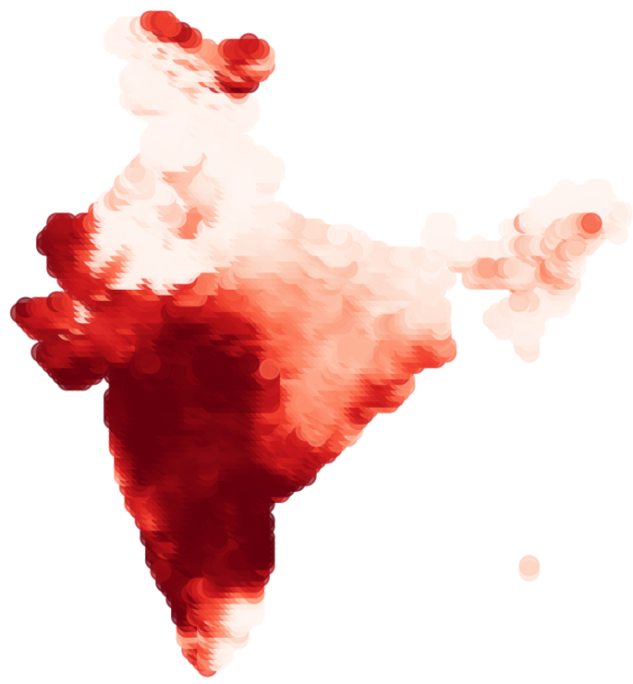
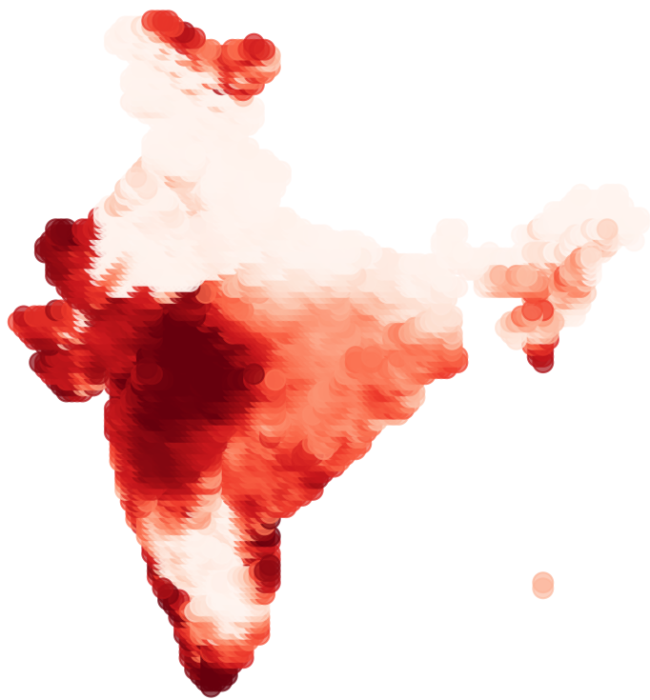
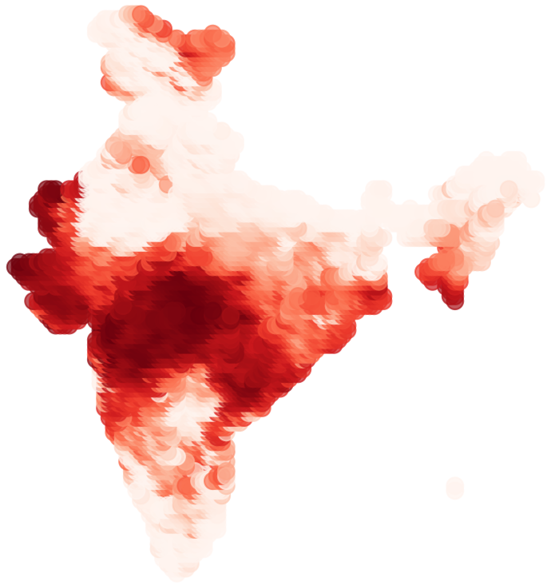
Ground Water Storage Variations across India
Root Zone Soil Moisture
Week 1 (2nd Jan 2023)
Week 53 (1st Jan 2024)
Week 71 (6th May 2024)
We can see significant fall in RZSM across Southern part of India.

Slide 7

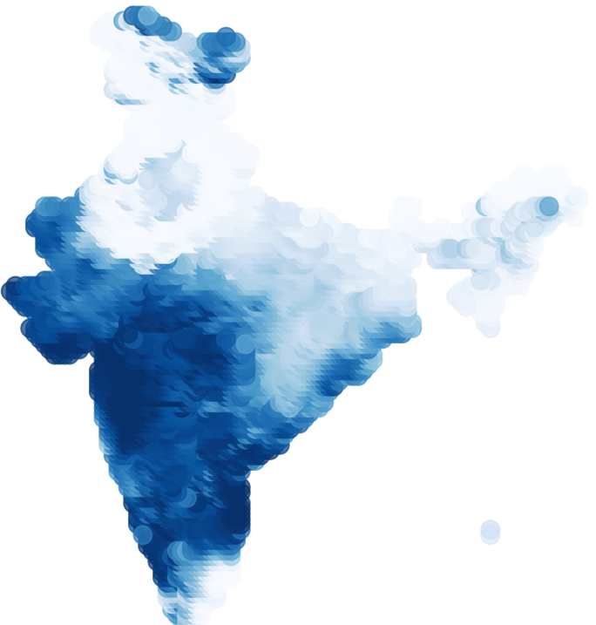
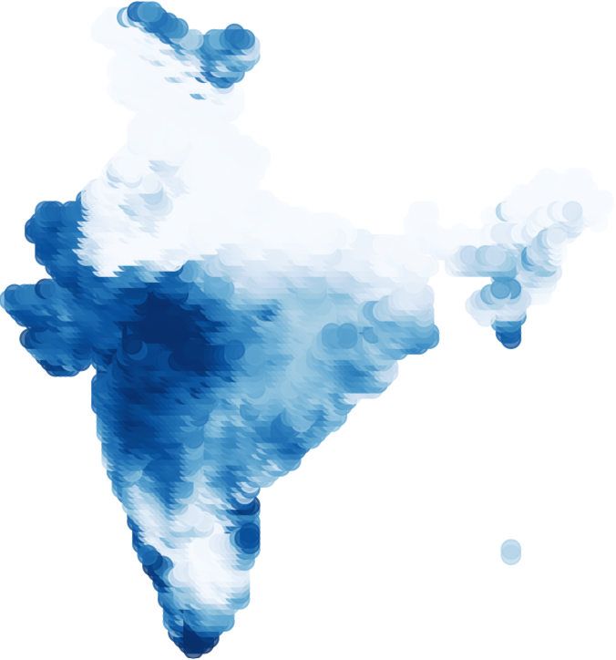
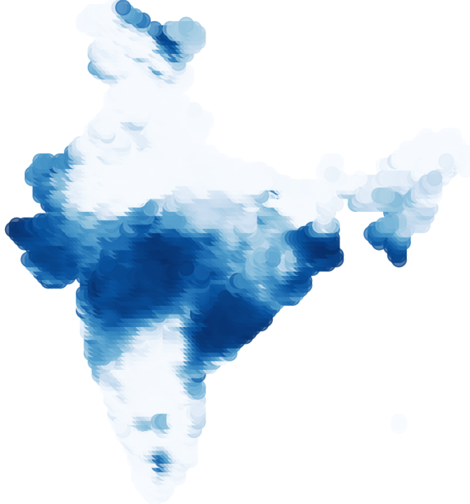
Ground Water Storage Variations across India
Surface Soil Moisture
Week 1 (2nd Jan 2023)
Week 53 (1st Jan 2024)
Week 71 (6th May 2024)
We can see significant falls in SFSM across Southern part of India.

Slide 8




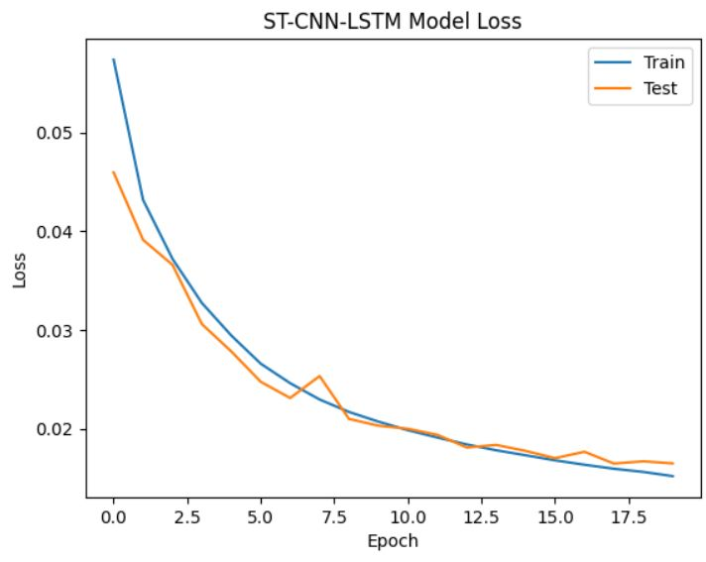
Model Evaluation Metrics
Metric | Formula | LSTM | ST-CNN
Mean Absolute Error (MAE) |  | 9.46 | 8.63
Mean Squared Error (MSE) |  | 207.04 | 163.9
Root Mean Squared Error (RMSE) |  | 14.38 | 12.8
R-squared |  | 84.59 | 87.82

Slide 9
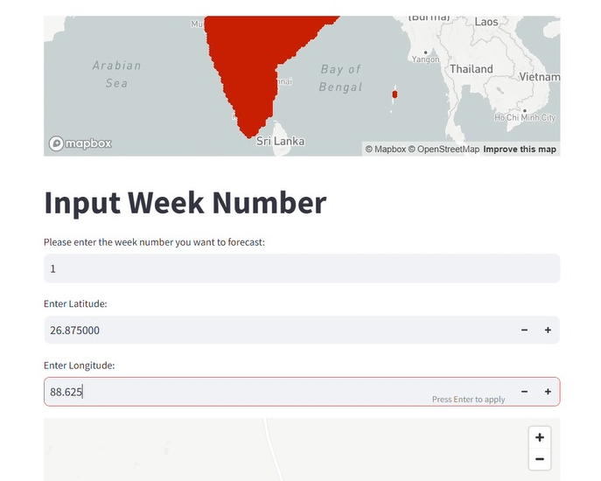
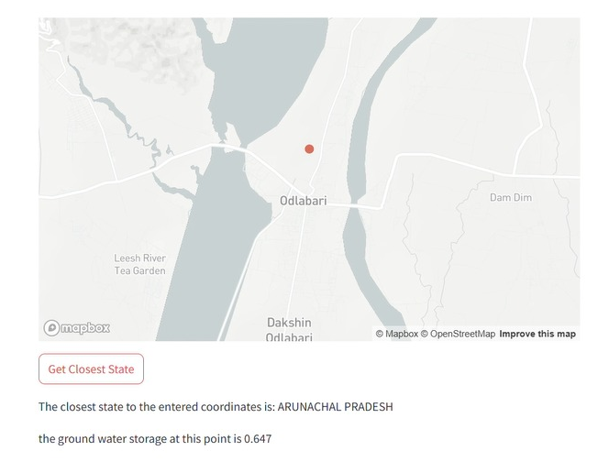
Streamlit Website
Pending:
Not published online, only on localhost and an error while displaying forecasted output.
Change week number to dates.
Change enter latitude, longitude, to select on map which picks latitude and longitude as input

Slide 10
Actions
Future Work
Include other factors like precipitation, population with more historical data.
A warning system in regional language.
Use other factors affecting agriculture like weather data, water reservoirs, vegetation and build a one stop app for entire agriculture community
Warning System for farmers when Ground water has reached critical threshold.
Provisions for rainwater harvesting and water storage and other irrigation methods.
Develop Aquifer Management Plans to ensure the sustainability of groundwater resources in India

