Slide 1
JAVA FULL STACK TRAINING PROJECT
LIBRARY MANAGEMENT SYSTEM
A. SAI VARDHAN - 2411CS060093
K. SUSHVIKA - 2411CS060107
U. ADITHI RAJ - 2411CS060111
K. MADHU SREE - 2411CS060119

Slide 2
ABSTRACT
Library Management System (LMS) is a software application that automates and simplifies library operations.
Replaces manual record-keeping, reducing errors and saving time.
Enables librarians to manage books, members, book issue/return, and overdue fine calculations.
Allows users to search books by Title, Author, Category, or ISBN and check availability instantly.
Stores all library data securely in a centralized database for quick and reliable access.
Generates reports on issued, returned, and overdue books to support efficient library management.
Improves accuracy, productivity, and overall library service with a simple and user-friendly interface.

Slide 3
INTRODUCTION
Library Management System (LMS) is a computerized application that automates daily library operations.
Helps manage books, members, book issue/return, and library records efficiently.
Replaces manual record-keeping, reducing errors, paperwork, and time consumption.
Stores all library information in a centralized database for easy access and management.
Supports key functions such as adding, updating, deleting, searching, issuing, and returning books.
Automatically tracks overdue books, calculates fines, and generates reports.
Improves accuracy, productivity, and overall efficiency of library management.
Suitable for schools, colleges, universities, and public libraries.

Slide 4
TECH STACK
FRONTEND
REACT.JS
DATABASE
MYSQL
BACKEND
JAVA
SPRING BOOT
SPRING DATA JPA (HIBERNATE)
RESTFUL APIS
MAVEN
DEVELOPMENT TOOLS
VISUAL STUDIO CODE
POSTMAN
GIT & GITHUB

Slide 5
PROPOSED SYSTEM
Full-stack web application for managing library operations digitally, replacing manual record-keeping
Smart Waiting List: Automated FIFO queue system — notifies users when a reserved book becomes available, with a 24-hour claim window before it passes to the next person
Automated Notifications: Real-time alerts for due dates, fines, and book availability — no manual follow-up needed
Role-based Access: Separate views for library users (borrow, track, get notified) and admins (manage inventory and members)
Automatic Fine Calculation: System computes late fees on return, eliminating manual tracking errors.

Slide 6
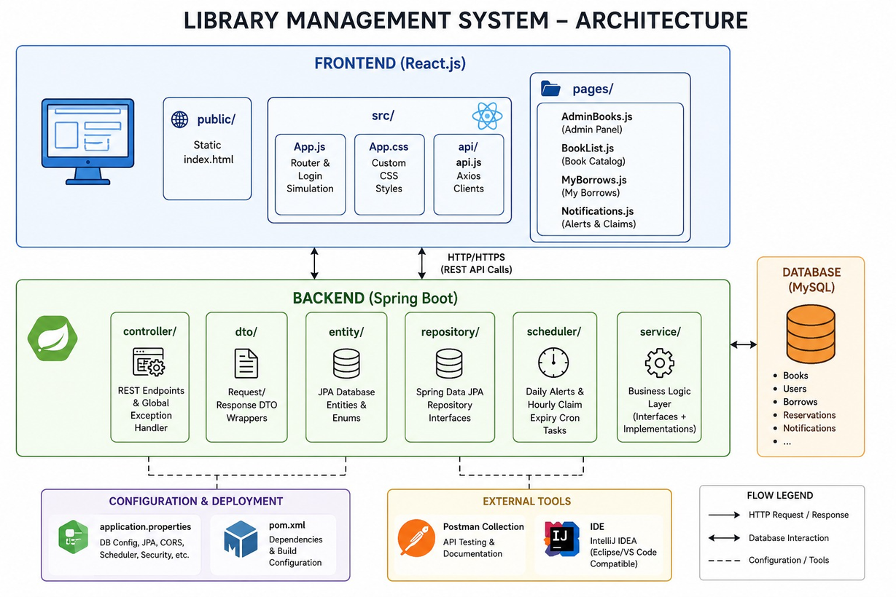
SYSTEM ARCHITECTURE

Slide 7
CONCLUSION
Improves the overall library experience for both librarians and members.
Provides quick access to book information and streamlines daily library operations.
Saves time, increases productivity, and enhances service efficiency.
Features a user-friendly interface with secure, role-based access for data protection.
Suitable for schools, colleges, universities, and public libraries.
Can be extended with barcode/QR code scanning, online reservations, email notifications, mobile app integration, and cloud storage.
Demonstrates how technology modernizes library management by delivering an accurate, efficient, and reliable solution.

