Slide 1
AADHAAR LINKED BDS
SUBMITTED BY
Adithiya Guru Patham.V
B.E., (CSE)
Coimbatore Institute of Technology
Coimbatore – 641 014.

Slide 2
PROBLEM STATEMENT
To remove the obstacles in the domain of blood donation
To eliminate the rumors of blood donation .
To provide a reliable and secure mode of blood donation for the society.

Slide 3
Algorithm Used
Verhoeff’s Algorithm
    - used for error detection
    -used by Govt. to validate aadhaar
    -uses 3 tables for validation
    * multiplication table
        * permutation table
        * inverse table

Slide 4
MODULES
Aadhaar Validator
Mail Validator
Mail Notifier
SMS Notifier

Slide 5
Aadhaar Validator
Uses Verhoeff’s algorithm to validate
It detects all single digit error and all transposition errors.
Uses the checksum method to validate the number
Terminates in case of error in aadhaar number
Consistency of data is maintained.

Slide 6
Mail Validator
Uses regex to validate the mail id
We also use the default mailchecker
The syntax of the entered mail id is noted
It uses the concept of pattern matching
Terminated if invalid mail is entered

Slide 7
Mail Notifier
Uses SMTP protocol
Used to send notification to the registered mail-id
Used to send mail dynamically from the mail

Slide 8
SMS Notifier
Safe and easy method
Uses TextLocal Service Provider
Uses the HTTP mode of notification
Can be extended for bulk notification purpose
Easy to reach the people

Slide 9
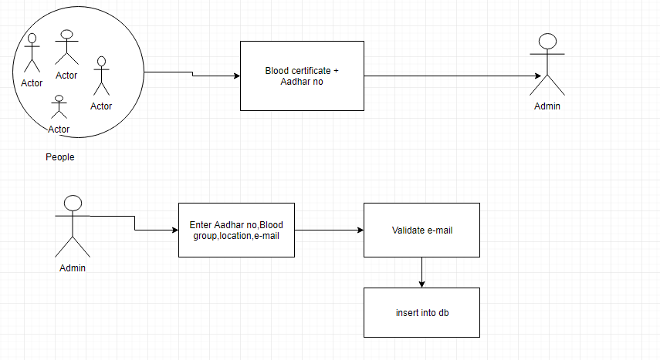
WORKFLOW DIAGRAM – ADMIN

Slide 10
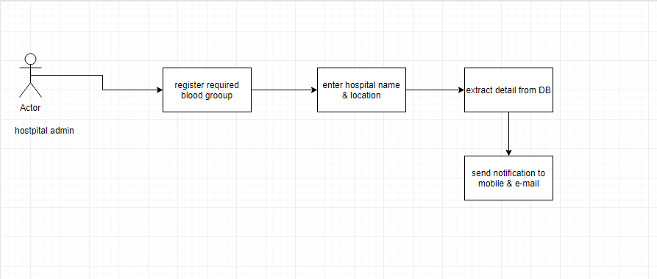
WORKFLOW DIAGRAM – HOSPITAL ADMIN

Slide 11
HOW IT WORKS?
Admin holds the right to link aadhaar with blood group
Citizens need to provide their blood certificate with aadhaar
Reporting of required blood
Notification sent to people within the locality

Slide 12
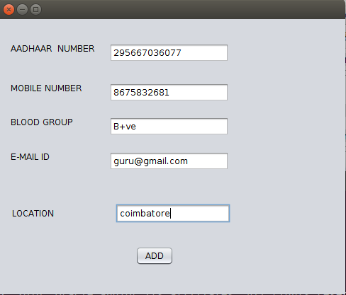
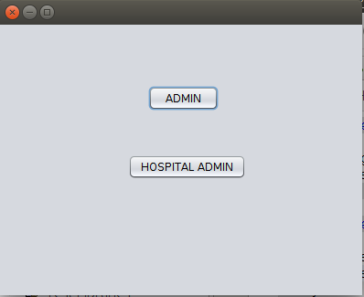
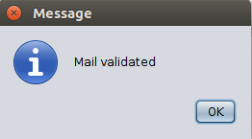
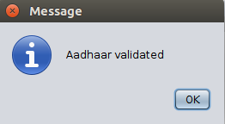
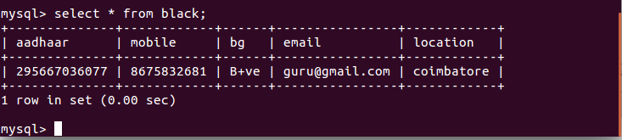

Slide 13
REFERENCE
https://www.uidai.gov.in
http://www.wikipedia.com
https://www.britannica.com/science/blood-biochemistry

Slide 14


Slide 15


