Slide 2
Credit Card Application ( Sprint 1 ) - PSI-2020 Sep ASDEII BLR Batch
September 21, 2020

Slide 3
Agenda

Slide 4
Problem Statement
Create an application that can be used to visualize the credit card transaction records.
It should be fault tolerant and check for validation of data.
Must ensure low latency for all operations.
Dynamic dashboard generation for all the available credit cards.

Slide 5

Objective
Simplify the management of Credit Card transactions.
Clean data visualisation for past records
Secure the data on both ends
Ensure fault-tolerance

Slide 6
Goals and Deliverables – Sprint 1
Processing .csv file
Validating transaction

Slide 7
POD Speakers
POD1 | POD2 | POD3 | POD4 | POD 5
Shashank
Harsh
Dhruv
Ashutosh
Jyotsana
Karan
Ishika
Suresh
Garvit
AkashDeep
Khalandar
Kancharla
Uday
Divyansh
Gaurav
Abhimanyu
Rishab
Shrut
Mukul
Chandan
Vishal
Namit
Saiteja

Slide 8
Plan
CC Transaction Processor
CC Transaction Handler
CC Application ( UI )
Notes:
The plan is simple, to break the task into 3 echos as we build upon them.

Slide 9
CC Transaction Processor
Done
Kafka Topic
mTLS
New
Processing
Error
Garbage
Notes:
First major task is to make a CC transaction processor which will process the transaction data.Major milestones during this stage will be:
1. To dump the faulty transactions into a garbage folder.
2. Process multiple files in parallel to ensure minimal latency.
3. Secure the processing channels.
4. System should be robust enough to handle 10k records per second.

Slide 10
CC Transaction Processor
Process the data files – for Validation and fault tolerance
Segregation of data files into separate directories.
Transfer processed and secured data to a kafka topic

Slide 11




CC Application
Admin
Customer
Merchant
Credit Card

Slide 12
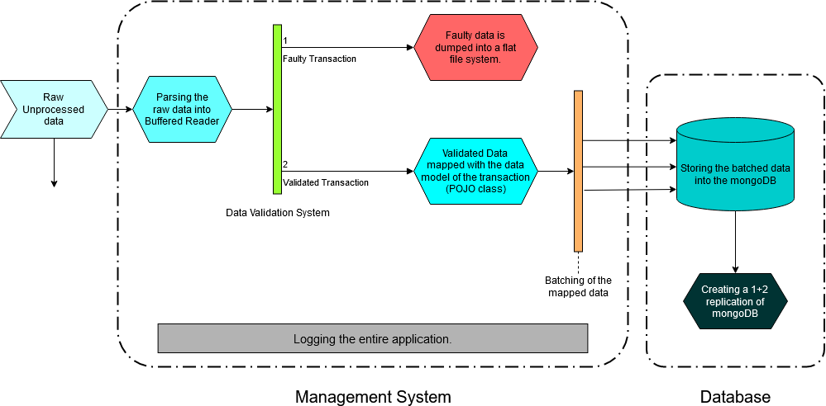
Project Milestone

Slide 13
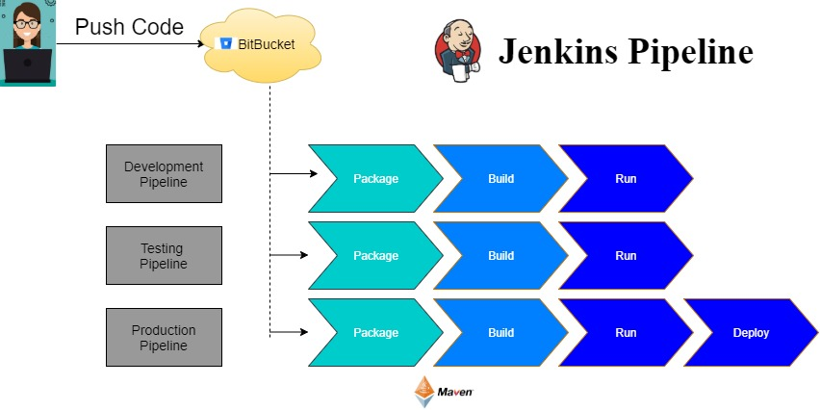
Deployment Architecture

Slide 14
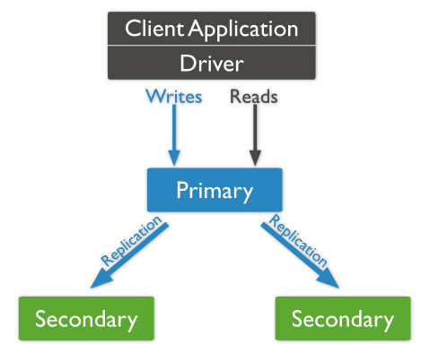
MongoDB Replica

Slide 15
Future Proposals

Slide 16

CC Transaction Handler
mTLS
Kafka Topics
Listener
DB
Log

