Slide 1


Principal, Computational Tools and Case Studies With Machine Learning And Data Science
ADITYA RATHOR
202100286
SECTION - B

Slide 2
Contents
INTRODUCTION
WHAT IS MACHINE LEARNING AND TYPES
PROJECT: SPAM MAIL DETECTION
REFERENCE

Slide 3
INTRODUCTION
Data Science and Machine Learning are two of the most exciting and rapidly growing fields in technology today. At their core, they involve using data to make predictions or decisions, often with the help of algorithms and statistical models.
Data Science involves collecting, cleaning, and analysing data to extract insights and knowledge from it. Machine Learning is a subset of Data Science that focuses on building models that can learn and make predictions based on data. Both fields are highly interdisciplinary, drawing on mathematics, statistics, computer science, and domain-specific expertise.

Slide 4
What is Machine Learning?
Machine Learning is the field of study that gives computers the capability to learn without being explicitly programmed. ML is one of the most exciting technologies that one would have ever come across. As it is evident from the name, it gives the computer that makes it more similar to humans: The ability to learn. Machine learning is actively being used today, perhaps in many more places than one would expect.

Slide 5
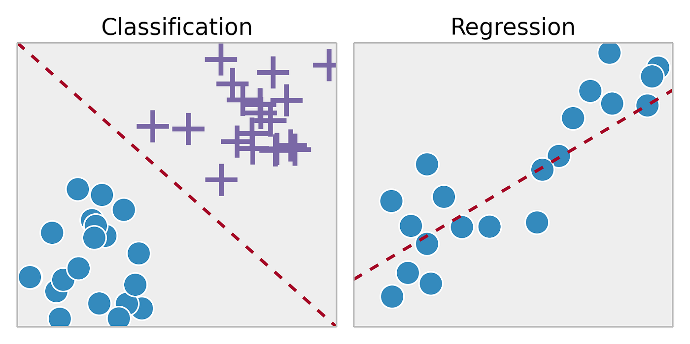
Types of Machine Learning
Roughly, Machine Learning is divided into Supervised and Unsupervised Learning and their respective subtypes.
Supervised Learning – Like a teacher teaching its students to identify each object. Student compare their answer with teachers' answer and learn from their mistakes and keeps on learning on the rest of the data.
Example – K-means Clustering, Hierarchical Clustering, Gaussian Mixture Models
Unsupervised Learning – Like sorting marbles with different colours but we don’t know what each colour signifies but we keep on sorting the marbles and find patterns on our own where we try to differentiate the data.
Example – Linear Regression, Logistic Regression, Support Vector Machines

Slide 6
Project:- SPAM MAIL DETECTION
Aim : To Successfully Train a Model to detect Ham and Spam in a mail
Tools Required : 1. CSV file containing the data
2. Python with the required libraries [NumPy, Pandas and Scikitlearn]
3. Jupyter Notebook for easier compilation of data project [Optional]
Algorithm Used : Logistic Regression– Models the probability that an email is spam based on input features
Works by Binary Classification of Data which can be used in Spam Detection on deciding whether the Email is Spam / Not Spam

Slide 7
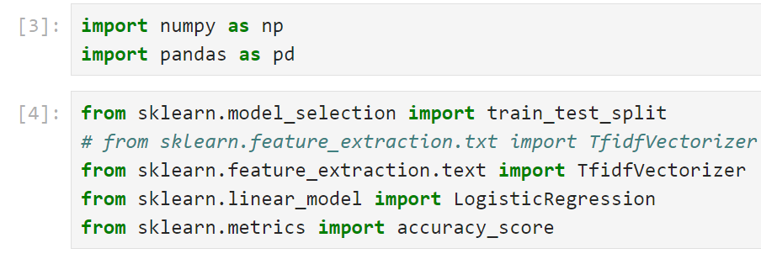
LIBRARIES INCLUDED
NumPy:- It is powerful python library for numerical computing.
Pandas:- It is used for data manipulation and analysis.
ScikitLearn:- It provides wide range of tools and algorithms for various ML tasks including classification, regression, clustering.

Slide 8
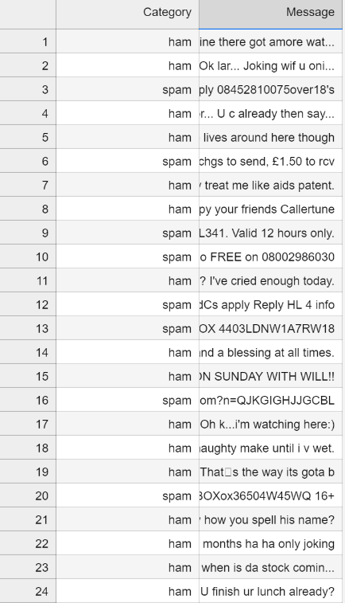
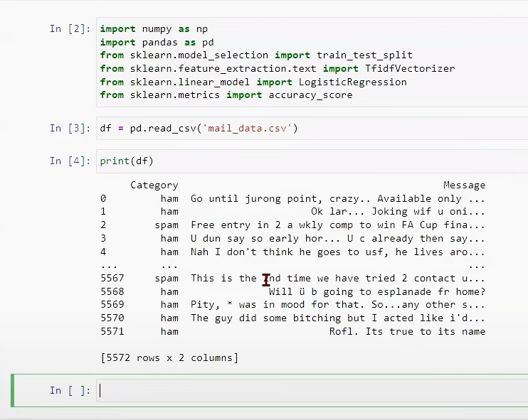
Preparing the Data in CSV File
Importing Libraries and Extracting the Data from CSV

Slide 9
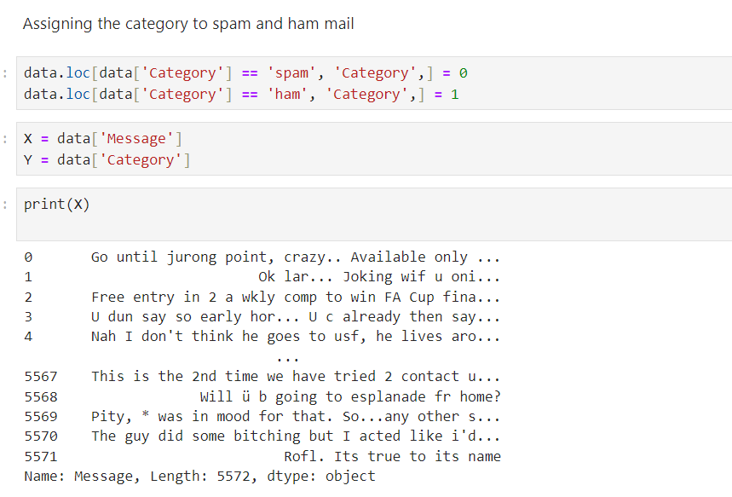
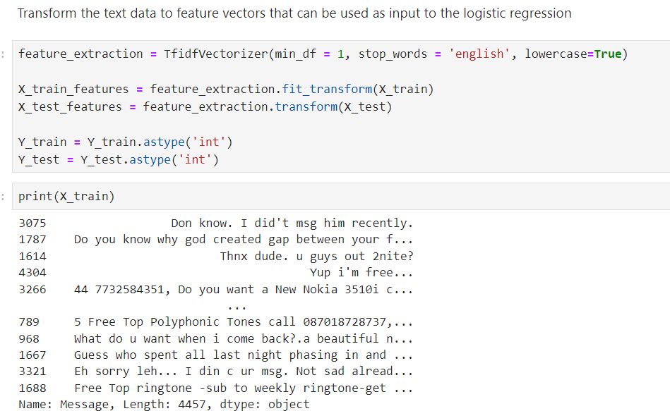
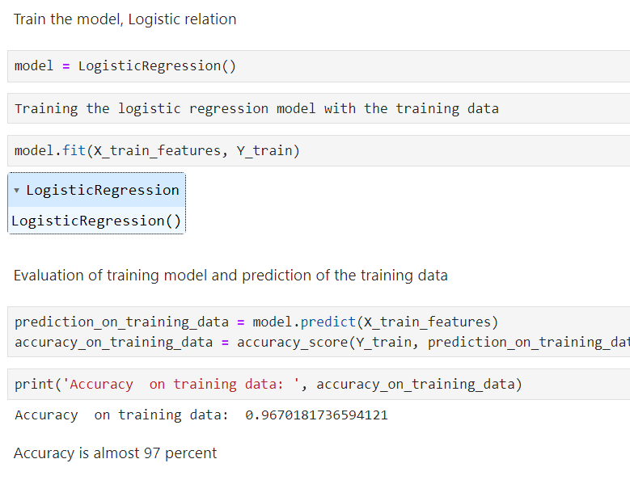
Implementing Logistic Regression Model and Getting the Output

Slide 10
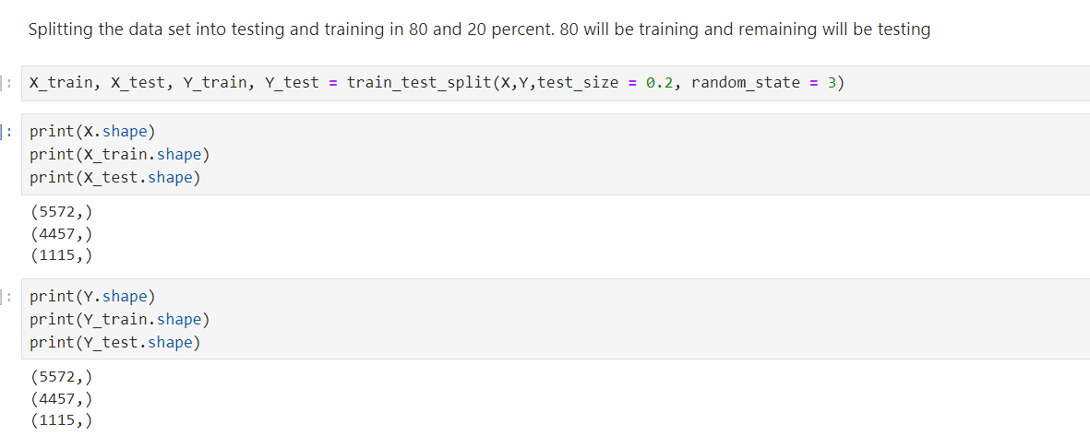
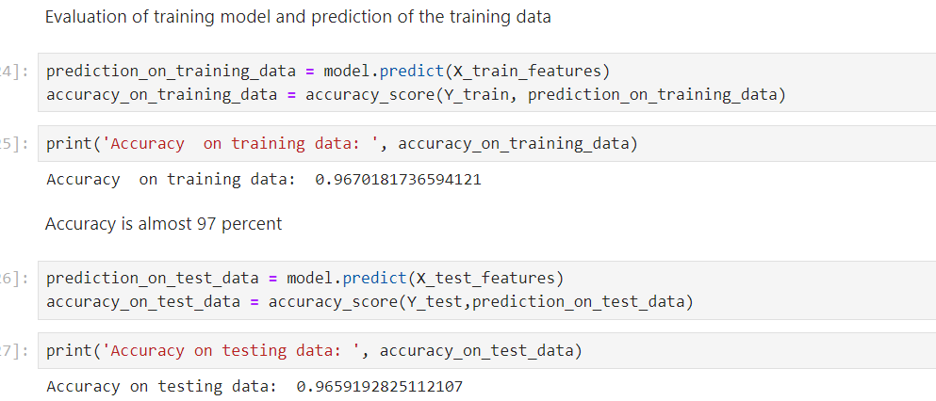
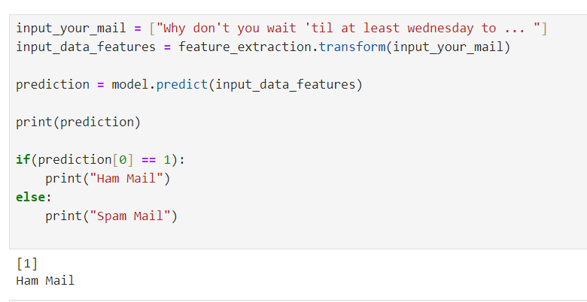

Slide 11
REFERENCE
STUDENT REFERENCE GUIDE BY
1. Dr. Deevesh Choudhary, Assistant Professor,
Manipal University Jaipur.
2. Dr. Shamik Tiwari, Professor, University of Petroleum and
Energy Studies, Dehradun.
3. Dr. Aprna Tripathi, Assistant Professor, Manipal University, Jaipur

Slide 12
THANK YOU

