Slide 1
PLACEMENT POLICY IN FOG COMPUTING
Team Details
A.Sai Manideep Reddy (20EG105402)
B.Harshitha (20EG105405)
K.Adithya (20EG105417)
Project Supervisor
Dr. Pallam Ravi
Assistant Professor

Slide 2
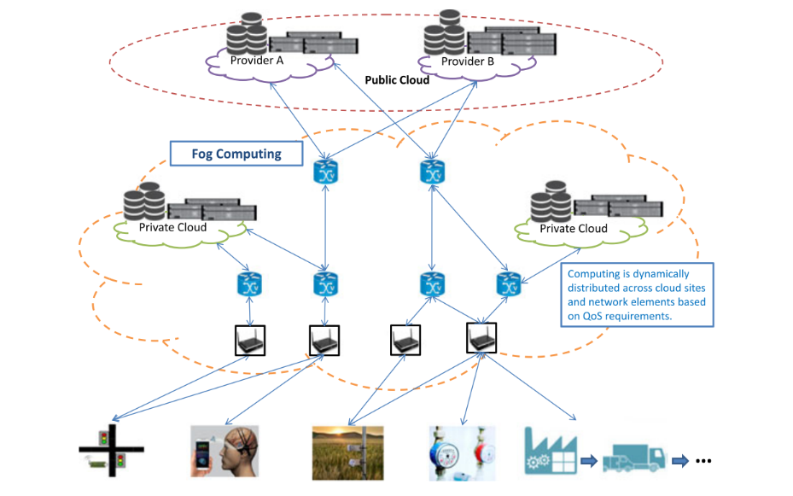
Introduction
Fog Computing is distributed computing paradigm that extents the services provided by the cloud to the edge of network.

Slide 3
Introduction
A placement policy in fog computing refers to a set of rules, algorithms, and strategies used to determine where to deploy and allocate applications, services, and resources within a fog network.
iFogSim is a popular simulation framework designed specifically for modeling and simulating fog computing environments.
The requirements to simulate a placement policy using iFogSim:
Java Development Kit (JDK) installed (required for running Java-based simulations)
Eclipse IDE
iFogSim framework
Applications of Fog Computing are Smart Cities, Smart Grids, Industrial IoT ,Smart Appliances etc,.

Slide 4
Literature
Sl.no | Author (s) | Method | Advantages | Disadvantages
1 | Xi Li, Yiming Liu, Hong Ji, Heli Zhang, and Victor CM Leung, 2019 | Non-Orthogonal multiple access (NOMA) approach. | Decreased Computational Delay, QoS Compliance. | Complexity, NP-hard problem, Algorithm Dependency.
2 | Chao Zhu, Jin Tao, Giancarlo Pastor, Yu Xiao, Yusheng Ji, Quan Zhou, Yong Li, and Antti Yla-Jaaski, 2018 | Folo Proposal , Dynamic task allocation. | Latency and quality optimization, Mobility Support. | Complex Optimization, Real-World Implementation Problems.
3 | Zheng Chang, Liqing Liu, Xijuan Guo, and Quan Sheng, 2020 | Dynamic optimization, System cost minimization. | Latency and energy improvement, Subproblem solving. | High Complexity, Resource Constraints.
4 | Keke Gai, Xiao Qin, and Liehuang Zhu, 2020 | Energy-aware Fog resources Optimization, Heuristic Algorithm. | Time efficiency, Performance improvement. | Complexity, Real world deployment problems.
5 | Olena Skarlat, Matteo Nardelli, Stefan Schulte, Michael Borkowski, and Philipp Leitner, 2017 | Genetic algorithm, Service Placement algorithm. | Resource utilization. Reduction in network communication delays. | Complexity, Resource constraints.

Slide 5
Problem Statement
Implementation of Placement Policy for minimizing the Energy Consumption in Fog Computing Environments.
Objective
The main objective is to leverage fog computing to enhance the efficiency and Energy Consumption of IoT networks while addressing challenges related to data distribution, module placement, and resource allocation. The final aim is to improve the overall performance of these networks, as evidenced by the reduction in energy consumption.

Slide 6
Proposed Method
The proposed method - JAYA algorithm
JAYA algorithm is an optimization algorithm, which can employed to optimize the resource allocation, task scheduling , energy efficiency, and latency minimization.
Jaya algorithm generally works in the following steps:
Problem formation
Fitness evaluation
Identify the best and worst solutions
Update the candidate solutions
Termination criteria
Repeat or Output

Slide 7
Project status
S.No | Functionality | Status (Completed /in-progress/Not started)
1 | Setup the experiment environment (iFogSim) | Completed
2 | Simulation of work bench applications | Completed
3 | Implementation of JAYA algorithm | In-Progress
4 | Result Analysis | Not yet started

Slide 8
References
[1] Xi Li, Yiming Liu, Hong Ji, Heli Zhang, and Victor CM Leung. Optimizing resources allocation for fog computing-based internet of things networks. IEEE Access, 7:64907–64922, 2019.
[2] Chao Zhu, Jin Tao, Giancarlo Pastor, Yu Xiao, Yusheng Ji, Quan Zhou, Yong Li, and Antti Yl ̈a-J ̈a ̈aski. Folo: Latency and quality optimized task allocation in vehicular fog computing. IEEE Internet of Things Journal, 6(3):4150–4161, 2018.
[3] Zheng Chang, Liqing Liu, Xijuan Guo, and Quan Sheng. Dynamic resource allocation and computation offloading for iot fog computing system. IEEE Transactions on Industrial Informatics, 17(5):3348–3357, 2020.
[4] Keke Gai, Xiao Qin, and Liehuang Zhu. An energy-aware high performance task allocation strategy in heterogeneous fog computing environments. IEEE Transactions on Computers, 70(4):626–639, 2020.
[5] Olena Skarlat, Matteo Nardelli, Stefan Schulte, Michael Borkowski, and Philipp Leitner. Optimized iot service placement in the fog. Service Oriented Computing and Applications, 11(4):427–443, 2017.

Slide 9
THANK YOU !

