Slide 1

ECG-BASED SLEEP APNEA DETECTION USING MACHINE LEARNING

Slide 2
Introduction:
Sleep apnea is a serious sleep disorder causing interrupted breathing during sleep
Leads to:
Poor sleep quality
Cardiovascular risks
Daytime fatigue
Traditional diagnosis using Polysomnography (PSG) is:
Expensive
Complex
Requires hospital setup
So the solution use ECG-based analysis for simple, cost-effective detection

Slide 3
Objective:
To develop a machine learning model for detecting sleep apnea using ECG signals
To classify:
Apnea patient ECG
Normal healthy ECG
To achieve:
High accuracy classification
Automated diagnosis
To enable future real-time wearable solutions

Slide 4
Problem Statement
Manual diagnosis of sleep apnea is:
Time-consuming
Requires expert interpretation
PSG-based systems are expensive and not accessible to all
Need for:
Automated detection system
Low-cost alternative using ECG
Our ultimate aim is to detect apnea from ECG using ML with high reliability

Slide 5
Dataset:
ECG datasets collected from:
Sleep apnea patients
Normal healthy individuals
Data characteristics:
Single-channel ECG
Recorded during sleep
Dataset used for:
Training
Testing
Validation
Focus on real physiological signals

Slide 6
Pre-processing:
Raw ECG signals processed to improve quality:
Noise removal (Bandpass filtering)
Baseline correction
Normalization (Z-score)
Feature extraction:
R-R intervals
Heart rate variability (HRV)
QRS complex features
Ensures clean and meaningful input to model

Slide 7
Model Working:
Machine Learning model trained on ECG features
Input ECG signal
Extract features
Model learns normal vs apnea patterns
Predict unknown ECG
Model detects:
Irregular breathing patterns
Variations in HRV

Slide 8
METHODOLOGY
Step 1: Data Collection
ECG signals are collected from:
Sleep apnea patients
Healthy individuals
Data is recorded during sleep to capture real physiological variations
Step 2: Preprocessing
Raw ECG signals are cleaned to remove noise and artifacts
Bandpass filtering removes unwanted frequencies
Normalization standardizes signal amplitude
Segmentation divides signals into smaller windows for analysis
Ensures clean and consistent input data

Slide 9
Step 3: Feature Extraction
Important features are extracted from ECG:
R-R intervals → time between heartbeats
HRV (Heart Rate Variability) → variation in heart rhythm
QRS complex features → cardiac activity patterns
These features help the model distinguish apnea from normal signals

Slide 10
Step 4: Model Training
The ML model is trained using labeled ECG data (Apnea / Normal)
Extracted features are given as input to the model
The model learns patterns and relationships in the data
It forms decision boundaries to separate:
Normal ECG
Apnea ECG
Enables the model to automatically classify new signals
Step 5: Testing & Validation
The trained model is tested on unseen ECG data
Ensures the model is not just memorizing but generalizing well
Performance Evaluation:
Accuracy → Overall correct predictions
Precision → How many predicted apnea cases are correct
Recall → How well actual apnea cases are detected
Confirms the reliability and effectiveness of the model

Slide 11
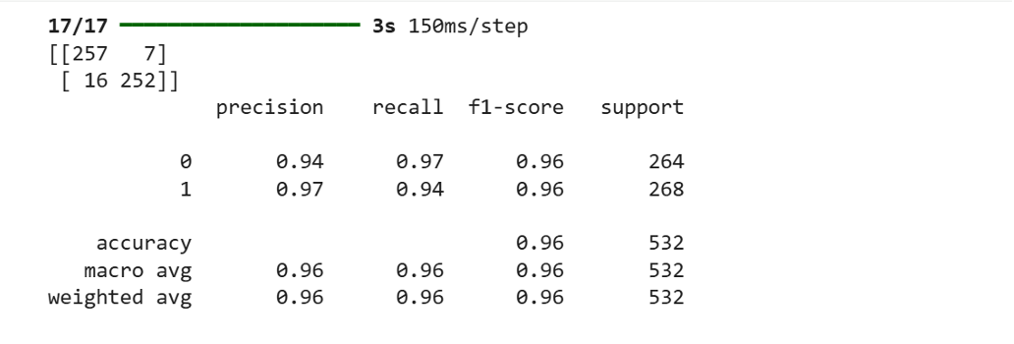
Results & Inference
Achieved classification accuracy: 96%
High performance in distinguishing: Apnea vs Normal
Performance Insights:
Model effectively captures:
Subtle ECG variations
Sleep-related physiological changes
Inference:
ECG is a strong indicator of sleep apnea
ML model reduces dependency on manual analysis
Suitable for early diagnosis and screening
Significance:
Cost-effective alternative to PSG
Can be used for continuous monitoring

Slide 12
Conclusion & Future Work
Successfully developed an ECG-based apnea detection system
Achieved high accuracy using ML techniques
Demonstrated that:
Single-channel ECG is sufficient
Automated detection is feasible
Advantages:
Non-invasive
Cost-effective
Easy to deploy
Future Work:
🔸 Real-time monitoring system
Integration with wearable devices
🔸 Deep Learning Models
CNN / LSTM for improved accuracy
🔸 Multi-class classification
Sleep stage detection (Wake, REM, etc.)
🔸 Hardware implementation
Portable ECG-based apnea detection device

Slide 13
Thank you

