Slide 1















SCHOOL OF COMPUTING
Organizes
CHROMAGUARD
EFFLUENT COMPLIANCE SYSTEM
A pipe-mounted IoT system that senses textile effluent, classifies it in real time, and automatically diverts non-compliant discharge before it reaches rivers or groundwater.
TEAM TECHNOZ · HACKFUSION 2026
COMMUNITY PARTNERS :

Slide 2


Meet the Builders
TEAM TECHNOZ
Manieswari M. V.
Team Leader · EEE
sec25ee009@sairamtap.edu.in
Poojasree P.
Team Member · EEE
sec25ee076@sairamtap.edu.in
Prathiksha S.
Team Member · EEE
sec25ee061@sairamtap.edu.in
Adithya S.
Team Member · CSE · 3rd Year
secl25cs08@sairamtap.edu.in
TEAM MEMBER
MENTOR
Anantha Balan R.
Team Member · CSE · 3rd Year
sec24cs114@sairamtap.edu.in
R. Sivaprasad
Faculty Mentor · Sri Sairam Engineering College
sivaprasad.eee@sairam.edu.in

Slide 3

PROBLEM STATEMENT
01
The Problem
Textile effluent is usually verified through lab tests only after it has left the pipe. Existing sensor systems may record contamination, but they do not physically stop the discharge.
02
Why It Matters
The Tiruppur dyeing cluster generates about 96 MLD of wastewater. Published Noyyal-basin readings cited in the concept deck show peak river TDS at 6,400–7,900 mg/L versus a 2,100 mg/L discharge standard.
03
Who Is Affected?
Nearby farming communities and groundwater users; TNPCB and municipal regulators; CETP operators; and 700+ dyeing and bleaching units across the Noyyal basin.
Case context: Noyyal River, Tiruppur–Erode belt · 18 operating CETPs cited in the original concept deck

Slide 4
OUR APPROACH
01
The Idea
A pipe-mounted sensor-and-actuator pod that converts continuous water-quality readings into an immediate compliance action at the discharge point.
02
How It Works
pH, TDS, turbidity and RGB sensors feed a weighted rule-based fusion classifier on an ESP32. Compliant flow continues; non-compliant flow is diverted by a solenoid valve.
03
Sense → Classify → Decide → Act
Decision loop: sensing (~1 s), classification (~1 s), decision (~0.5 s) and valve actuation (~1.5–2 s). Fail-safe design defaults to DIVERT on sensor fault or power loss.

Slide 5
Innovation & Differentiation
WHAT SETS US APART
Why ChromaGuard Stands Out
• Uniqueness: Detect + act in one device, not monitoring alone.
• Speed: Classifies and actuates in under five seconds.
• Accountability: Tamper-evident event and bypass logs.
• Modularity: Plan A detects + diverts; Plan B adds a holding tank and dosing buffer.
• Accessibility: Low-cost prototype path designed for smaller units.
US VS. THE REST
EXISTING SOLUTIONS
• Lab result in 2–5 days
• Detects after discharge
• Requires a human response
• No continuous audit trail
CHROMAGUARD
• Classifies + acts in <5 seconds
• Diverts before release
• Fully automated intervention
• Tamper-evident action log

Slide 6
Market Potential & Impact
REACH & RELEVANCE
Why This Matters
Environmental: prevents untreated dye effluent from reaching rivers and groundwater.
Economic: reduces penalty and shutdown risk for compliant units.
Social: improves source accountability and protects nearby farming communities.
Target Users
Primary: TNPCB, municipal bodies, CETP operators and dyeing-unit owners.
Secondary: environmental NGOs, researchers and CSR programmes.
Initial Reach
700+ dyeing and bleaching units along the Noyyal basin.
18 operating CETPs in the Tiruppur cluster.
Expected Impact
Days-to-seconds compliance response.
Continuous auditable records.
Earlier intervention before irreversible downstream contamination.

Slide 7
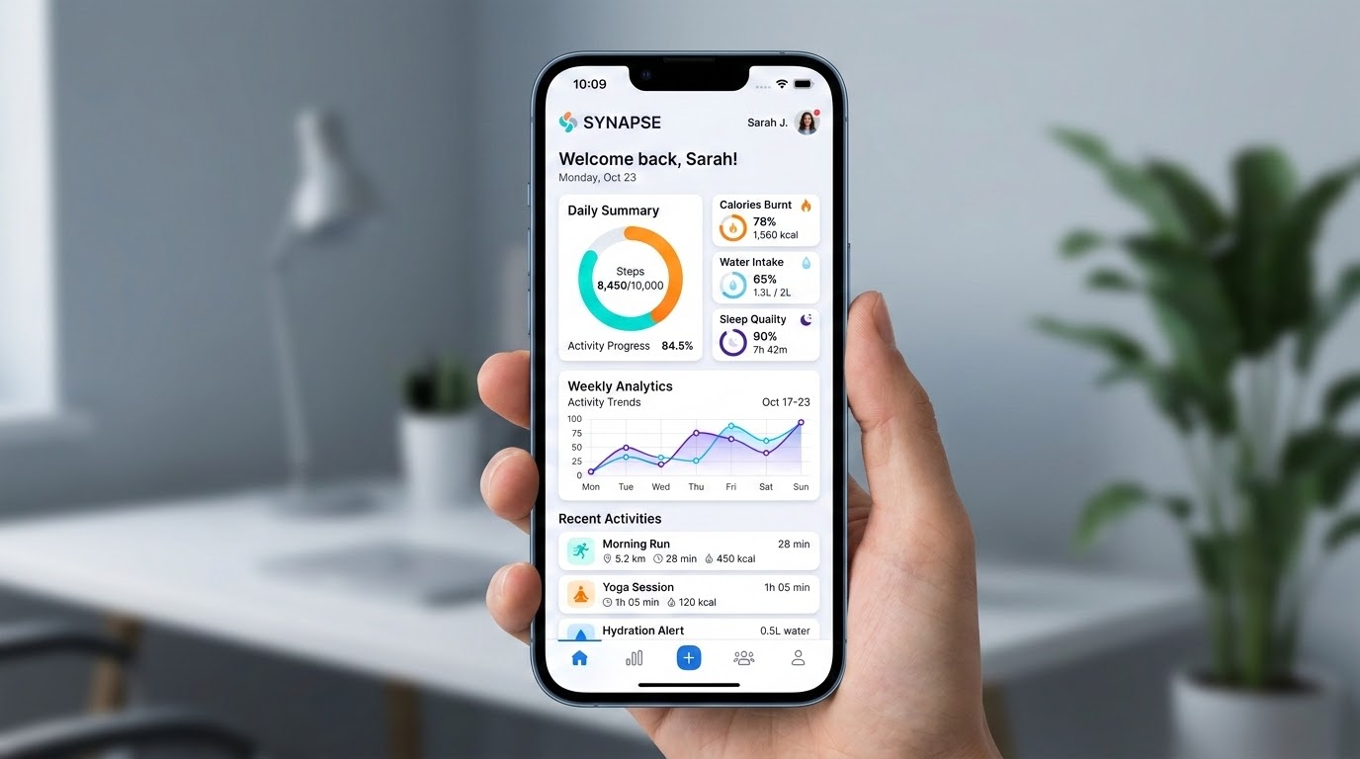
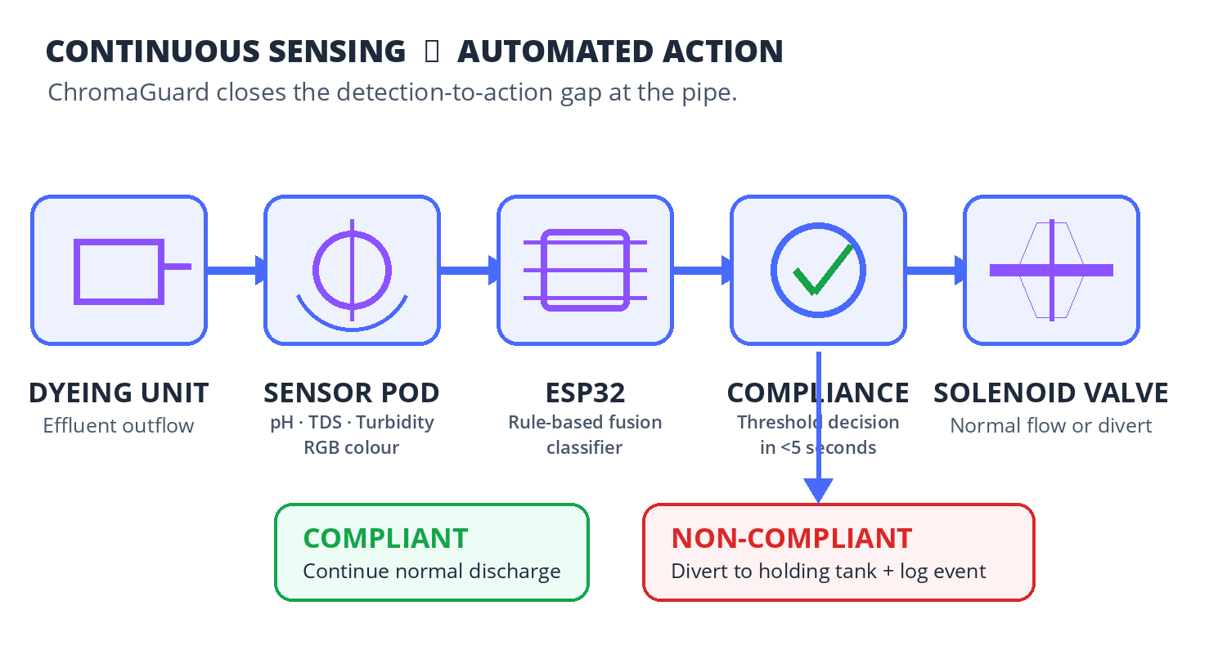
System Workflow
SEE IT IN ACTION
Key Features
01 Continuous multi-sensor monitoring of pH, TDS, turbidity and dye colour.
02 Weighted rule-based fusion today; trained ML upgrade after field-labelled samples.
03 Fail-safe valve defaults to DIVERT on sensor fault or power loss.
04 Every anomaly, diversion and manual bypass is logged for audit.
05 Optional holding tank + dosing pump provides a pre-treatment buffer.

Slide 8
Business & Sustainability Model
HOW THIS LIVES ON
Implementation
1. Build and calibrate Plan A on one outflow line.
2. Pilot with 2–3 member units connected to one CETP.
3. Add Plan B pre-treatment and validate reduction.
4. Pursue a TNPCB-backed regional rollout.
Revenue Model
Hardware sale or lease for the sensor pod and valve system.
Annual SaaS subscription for the compliance dashboard.
AMC for calibration, probe cleaning and tamper audits.
Partnerships
TNPCB and municipal regulators.
CETP operators and pilot dyeing units.
Sensor vendors, academic labs and green-tech / CSR grant partners.

Slide 9
Market Sizing
SIZING THE OPPORTUNITY
Initial Addressable Base
TAM
700+
Dyeing and bleaching units operating along the Noyyal basin.
Serviceable Cluster
SAM
18
Operating CETPs in the Tiruppur cluster that can host multi-unit pilots.
Year-One Pilot
SOM
1 + 2–3
One CETP plus two to three connected member units for field validation.
GROUNDING: Sizing is shown as deployment count, not speculative revenue. Wider industrial-cluster expansion follows validated pilots.

Slide 10

Where We're Headed
ROADMAP & NEXT STEPS
01
PROTOTYPE & CALIBRATE
PHASE 1
Build Plan A on a single outflow line, collect labelled samples, establish thresholds and validate the fail-safe valve.
02
CETP PILOT
PHASE 2
Deploy across 2–3 member units feeding one CETP; verify sensor accuracy, intervention timing and audit logs.
03
ADD PRE-TREATMENT
PHASE 3
Introduce the holding-tank and dosing layer; measure contaminant reduction before CETP hand-off.
04
REGULATORY SCALE
PHASE 4
Pursue a TNPCB pilot and procurement pathway; replicate across pollution-heavy industrial clusters.
LONG-TERM VISION: A state-wide effluent intervention network feeding a live compliance map for regulators across Tamil Nadu.

Slide 11
Prototype Readiness
BUILD, VALIDATE & DEMONSTRATE
CURRENT PROTOTYPE SCOPE
• Sensor stack: turbidity, pH, TDS, RGB colour and ESP32.
• Plan A: sensor pod + classifier + solenoid diversion valve.
• Plan B: holding tank + dosing pump as a pre-treatment buffer.
• Status: concept architecture complete; hardware build and field validation are next.
Validation gates: sensor calibration, false-positive control, valve fail-safe testing, tamper logging and labelled-effluent trials.
CORE SENSING
₹3,100–4,400 Shared sensing stack
PLAN A
₹3,500–5,300 Detect + divert
PLAN B
₹4,600–7,500 Detect + divert + treat
Prototype estimate only. Industrial-grade probes, enclosures, valves and certification can raise deployable cost to ₹40,000–₹1,00,000.

Slide 12
THANK YOU
ChromaGuard turns compliance from a delayed report into an immediate physical action.
EMAIL
SOCIAL
PHONE
sec25ee009@sairamtap.edu.in
Team leader email
Manieswari Murugan
LinkedIn profile
+91 88709 09047
Team leader contact
TEAM TECHNOZ · SRI SAIRAM ENGINEERING COLLEGE · HACKFUSION 2026

