Slide 1
Image Restoration using Adaptive local noise reduction filter using pixel adjacency
Adithya Ram Ballem

Slide 2
Schedule
Image restoration
Adaptive Local Noise Filter
Noise Variance
Global noise variance
Mean of local window noise variance
Connected noise variance
Connected with neighborhood bounds
Results
Future Scope

Slide 3
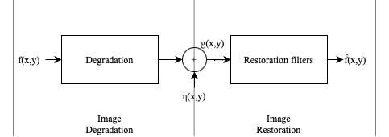
Image Restoration
Degradation
Digitization
Noise
Spatial Domain : g(x,y) = (h ∗ f )(x, y) + η(x, y)
Frequency Domain : G(u,v) = H(u,v)F(u,v)+N(u,v)
Target is to achieve f(x,y) by removing noise

Slide 4
Noise reduction filter
Mean Filter – Noise removal | Smoothing of Rapid Frequencies | Blur
Arithmetic Filter
Geometric Filter – Performs better | Compromises sharpness for smoothing | Less loss of detail
Harmonic and Contraharmonic – Salt and Pepper
Ordered Statistic Filter – Ranking | Excellent results for random noise | Less blurring
Median Filter
Min-Max Filter
Midpoint Filter
Alpha Trimmed Mean Filter – Combination of multiple noises
Adaptive Filters – Mean and Variance
Adaptive local noise reduction filter
Adaptive median filter

Slide 5
Adaptive local noise reduction filter
Mean and Variance
Mean is average, but with variance it can inform the level of deviation
Higher variance indicates – Higher varying pixel intensities
Example : Flat image
Added complexity than mean or ordered filters

Slide 6

Adaptive local noise reduction filter
g(x,y) is image with noise
σ2η variance of noise
σ2Sxy variance of neighborhood
ZSxy mean of neighborhood
σ2η = 0 indicates no noise
σ2Sxy >> σ2η indicates rapid change in variance. Sub component edge
If the ratio is 1, it indicates similar overall noise and window
Requires prior knowledge of σ2η
Padding also applied
Results of this filtering are sharp denoised image, unlike mean filters

Slide 7
Adaptive local noise reduction filter
The algorithm works best for
σ2η <= σ2Sxy
Due to randomness of noise in some cases , σ2Sxy < σ2η
This can lead to negative pixel intensities
Avoiding this situation is better by setting the noise to neighborhood ratio to 1
Although this can be avoided by rescaling, dynamic range drops

Slide 8

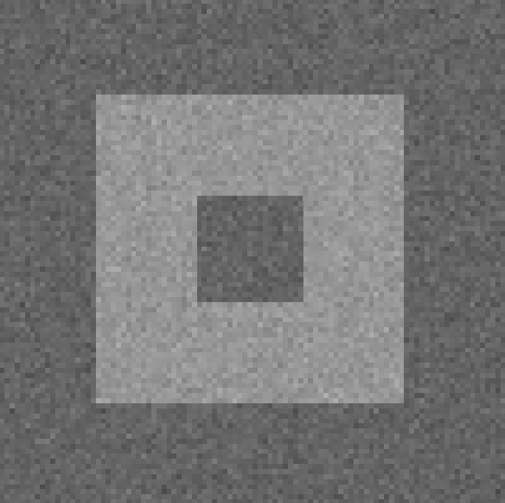
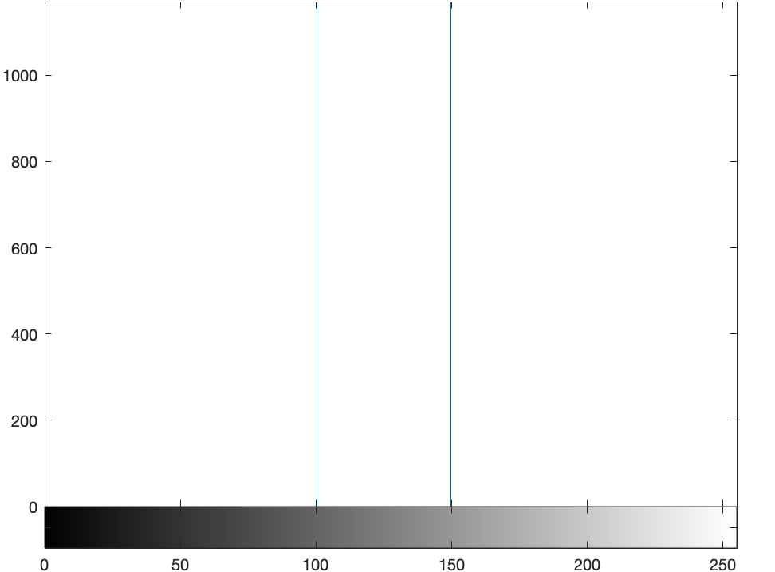
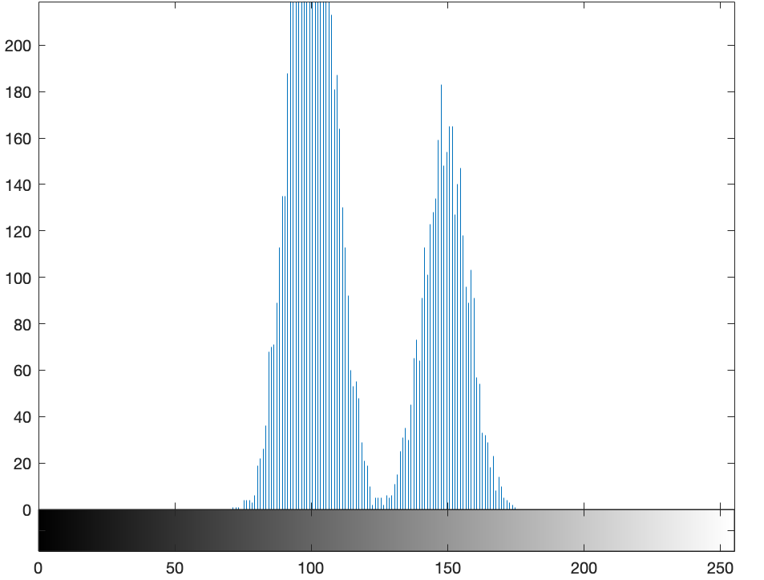
Adaptive local noise reduction filter
Variance levels of noise
Global noise variance
Mean of local window noise variances
Connected noise variance
Connected noise variance with neighborhood bounds

Slide 9

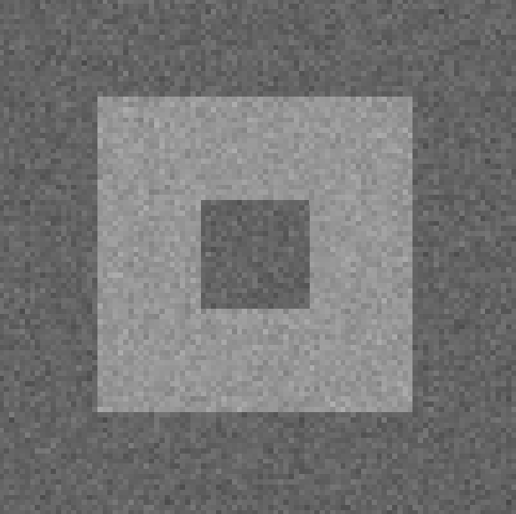

ALNF - Variance levels of noise
Original Image – 3 sub components
100 grayscale
150
Gaussian Noised Image
Mean = 0
Variance = 0.001

Slide 10
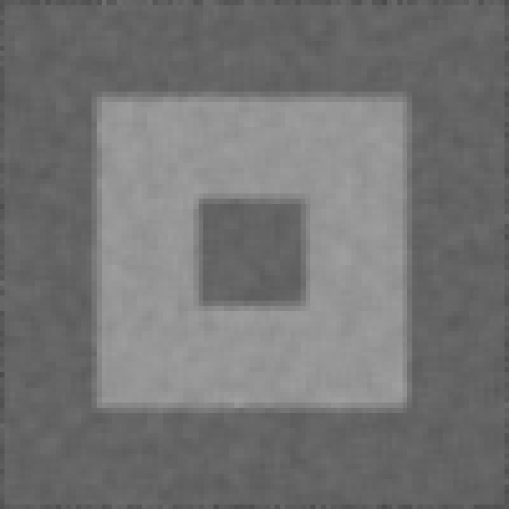
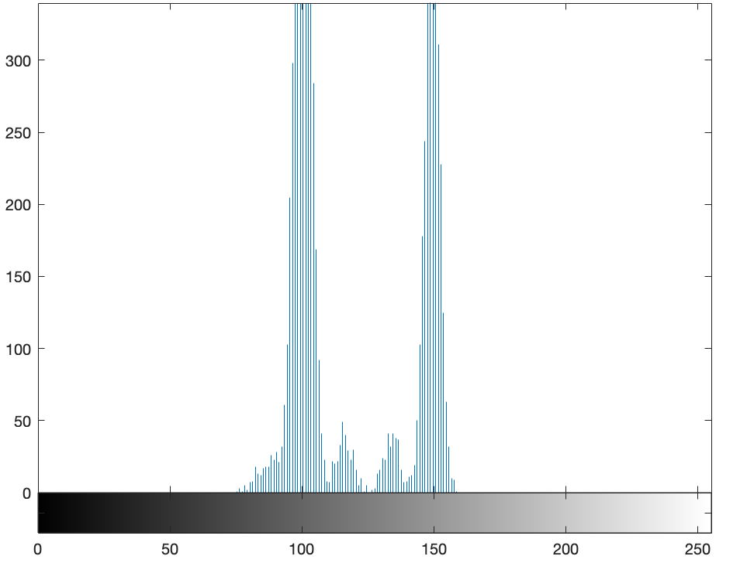
ALNF - Global noise variance
Overall variance of pixel intensities

Slide 11
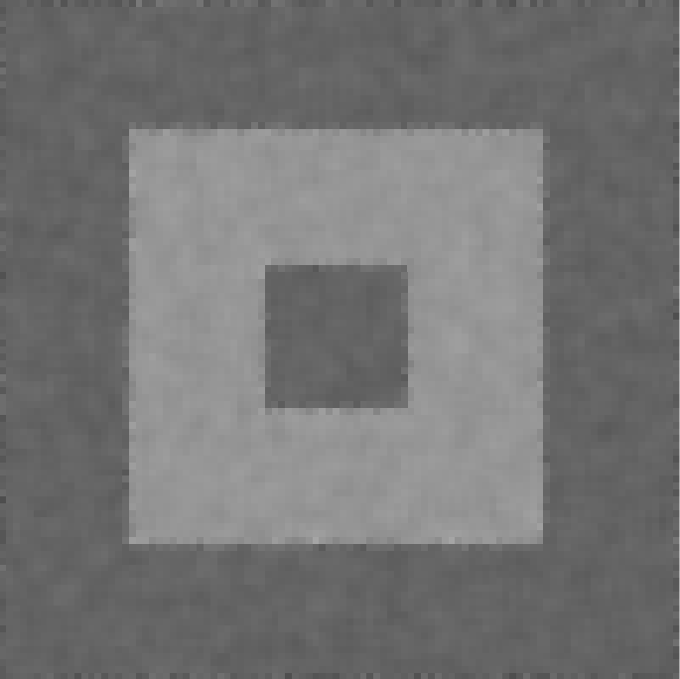
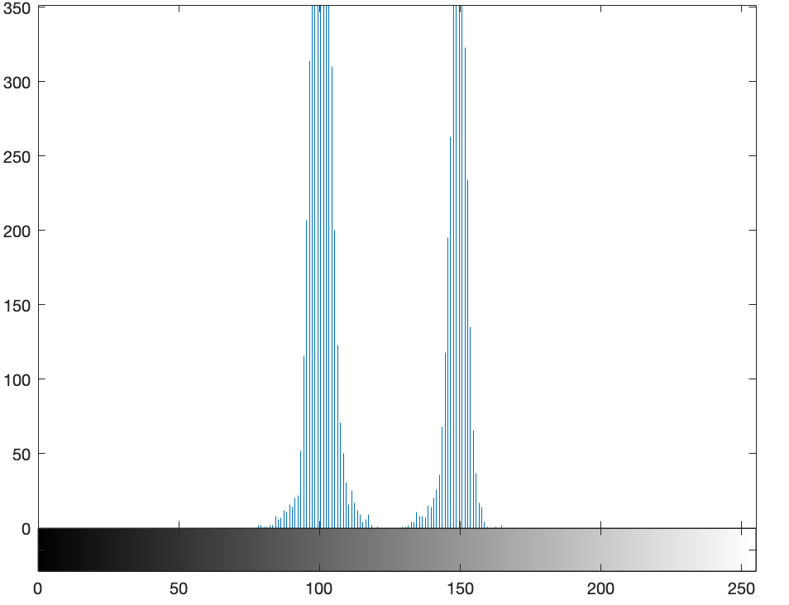
ALNF – Mean of local window noise variance
Capture all neighborhood variances
Compute mean of all these sub variance

Slide 12
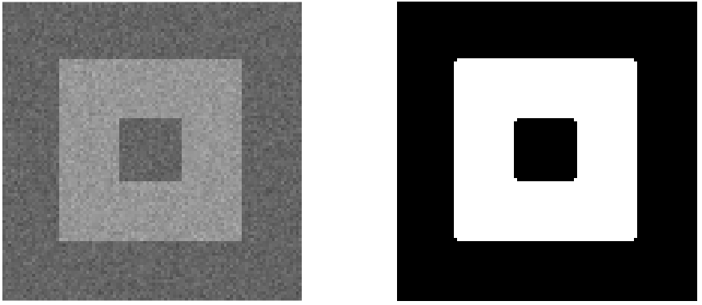
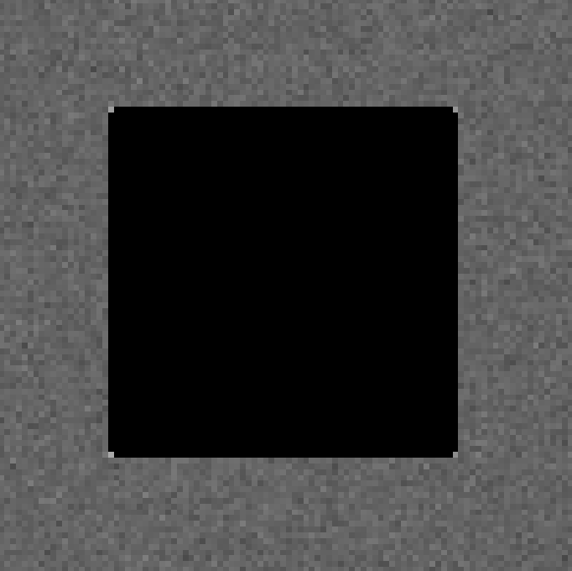
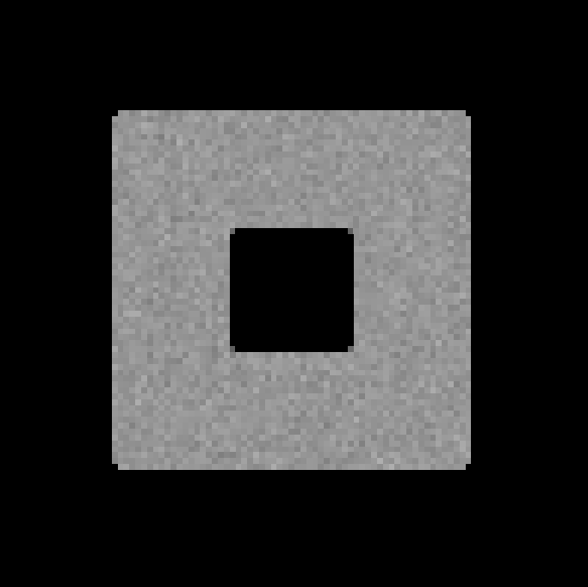
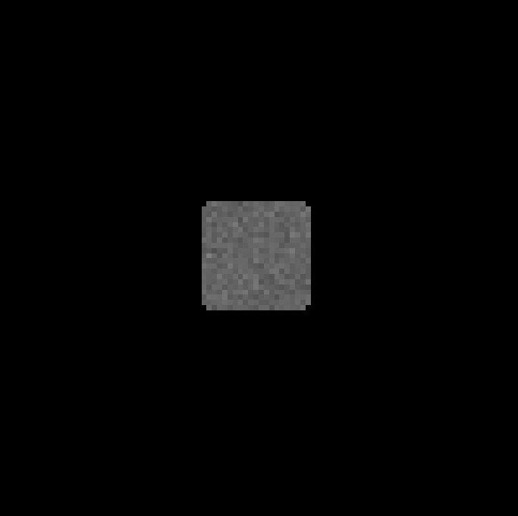
ALNF – Connected noise variance
σ2η – Noise Variance
4-adjacency
Capture all connections of image
Identify components
Use the noise variance of its object while denoising
σ2Sxy – Noise Variance of Sxy window

Slide 13
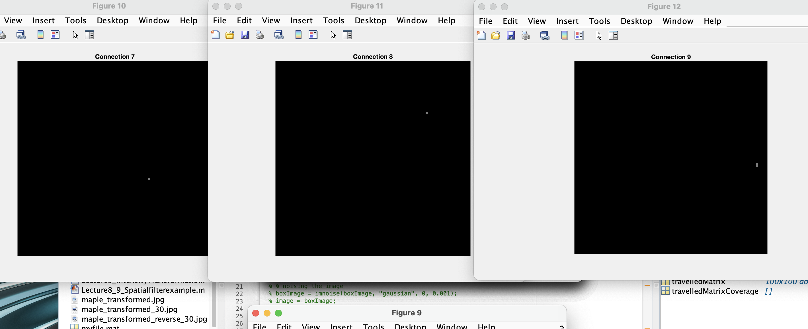
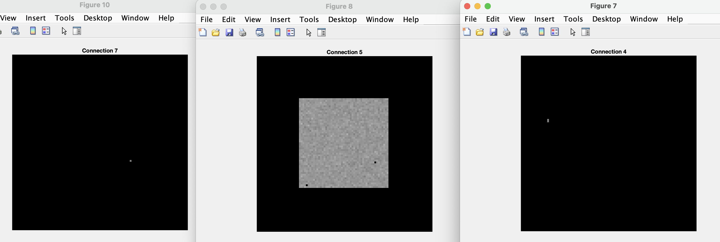
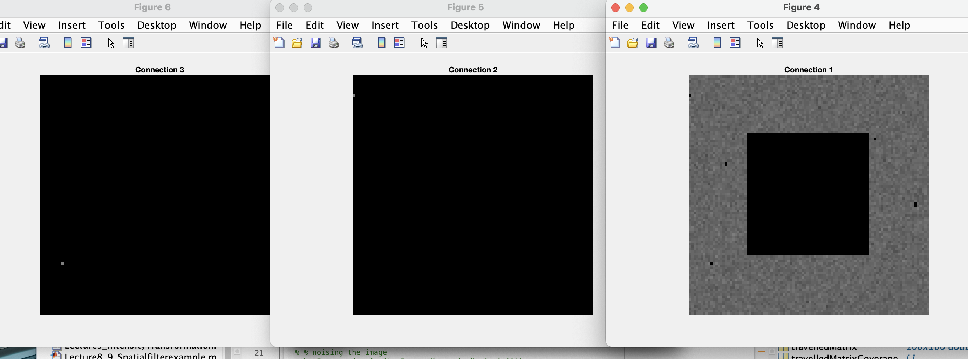
ALNF – Connected noise variance
Connection Issues
Solved it by a mean filter cleaning

Slide 14
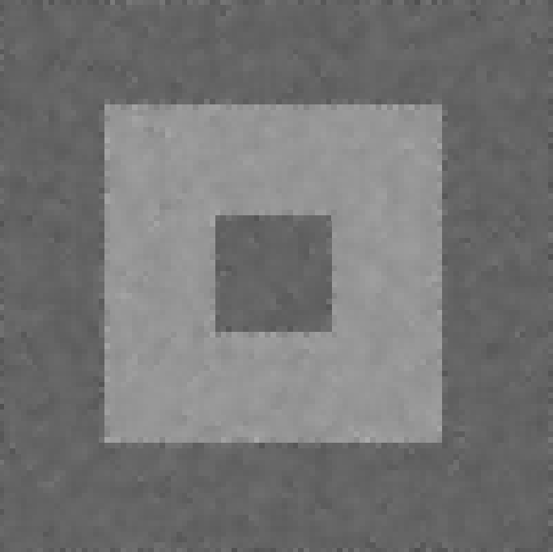
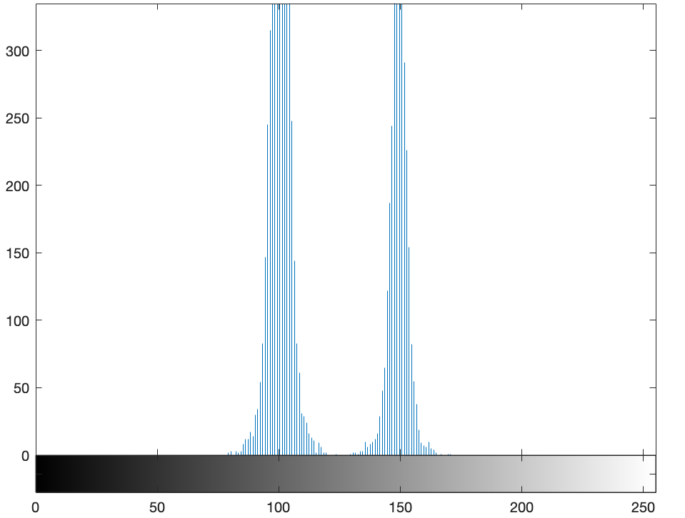
ALNF – Connected noise variance
σ2η – Noise Variance
4-adjacency
Capture all connections of image
Identify components
Use the noise variance of its object while denoising
σ2Sxy – Noise Variance of Sxy window

Slide 15
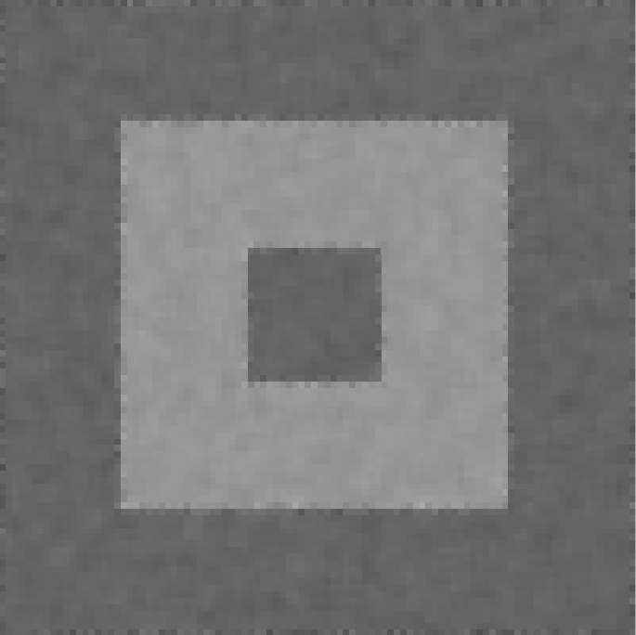

ALNF – Connected noise variance with neighborhood bounds
σ2η – Noise Variance
4-adjacency
Capture all connections of image
Identify components
Use the noise variance of its object while denoising
σ2Sxy – Noise Variance of Sxy window
Compute window noise variance with bounds
Carefully consider the edge
Knowledge of 4-adjacency
Results are sharper than 3, 4

Slide 16
Results Table – Gaussian Noised image
Filter Type | Residual | Percentage
Noisy Gaussian image | 32599 | 100%
Variance levels of noise(0.001) | 32599 | 100%
Global noise variance | 18802 | 57.68%
Mean of local window noise variances | 14002 | 42.95%
Connected noise variance | 14792 | 45.38%
Connected noise variance with neighborhood bounds | 13744 | 42.16%
Arithmetic Mean Filters | 28806 | 88.36%
Ordered Statistic Median Filters | 16795 | 51.52%

Slide 17
Results Table – Salt and Pepper Noised image
Filter Type | Residual | Percentage
Noisy Gaussian image | 6050 | 100%
Variance levels of noise(0.001) | 6050 | 100%
Global noise variance | 15012 | 248.13%
Mean of local window noise variances | 10021 | 165.64%
Connected noise variance | 8712 | 144%
Connected noise variance with neighborhood bounds | 9469 | 42.16%
Arithmetic Mean Filters | 24007 | 396.80%
Ordered Statistic Median Filters | 396.81 | 9.92%

Slide 18
Future Scope
Works well for gaussian noise
Doesn’t have any influence on random noise like Salt and Pepper noise
Evaluate ALNF on other periodic noises
Rayleigh Noise
Gamma Noise

