Slide 1





IIT MADRAS ENCRYPTCON
TEAM
Team Members
Vishwa Kumaresh
Adithya Vedhamani
Lohith K Saradhi
L Achintya

Slide 2
INTRODUCTION
PS3 - Behavioral Analytics for Security in Financial Transactions
In the realm of finance, security reigns supreme. Every transaction, every click, every exchange embodies trust, a delicate dance between convenience and confidence. Yet, within this digital crossroads, fraudsters lurk, weaving intricate webs of deceit to exploit vulnerabilities. How do we combat these invisible adversaries? By stepping beyond traditional safeguards and venturing into the arena of behavioral analytics.

Slide 3
$4.7 TRILLION!
5% of global corporate revenue, translating to a mind-boggling $4.7 trillion(According to a report by ACFE), is pocketed by fraudsters. Astonishingly, 93% of banking-related fraud happens online (According to the Financial Crime Report Q2 2021). This shows the pressing need for an improved Anomaly Detection System.

Slide 4
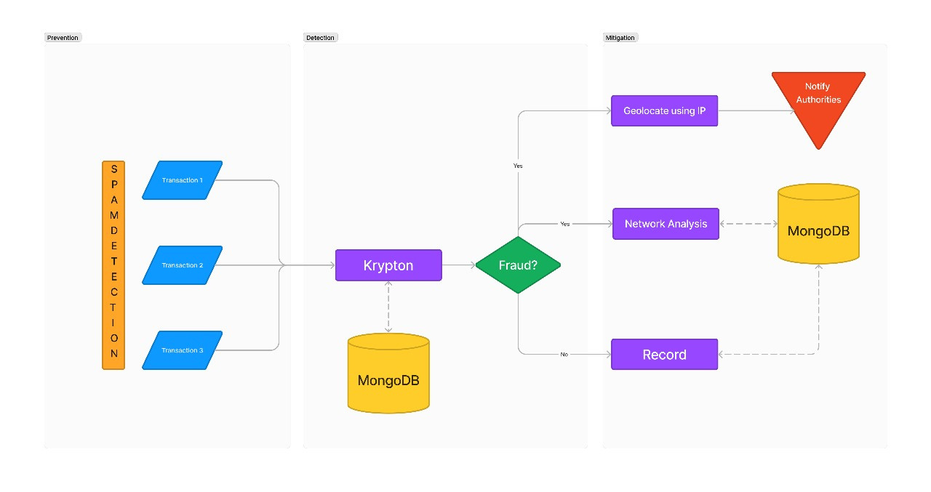
FLOWCHART

Slide 5
USER EXPERIENCE
Transaction Order
IP Tracking
Network Analysis
The user gives an order for a transaction. We need to verify that the user is who he says he is.
If the transaction is marked as fraudulent, then we need to mark their location
We use graph algorithms to analyse the relationships between these transactions
2
4
6
1
3
5
Mobile App
Fraud Prediction
Transaction History
Create a Mobile app with inbuilt Edge-based model to classify phishing emails
In case of any suspicious activity, we need to flag the transaction
If the user has a history of malicious tracking, then they need to be flagged. This is done using the score

Slide 6
LIST OF FEATURES
Real-time Software:- Developing a user-friendly software for Behavioral Analytics.
Real-time API:- Exposing the software as an API facilitating easy integration with various banking applications.
Random Forest ML Model:- Utilizes XG Boost for effective and real-time anomaly detection.
Feature Enhancements:- IP Tracking: Tracks advanced details, including IP addresses.
Phishing Detection- Used a Tensorflow based model to detect harmful phishing mails.

Slide 7
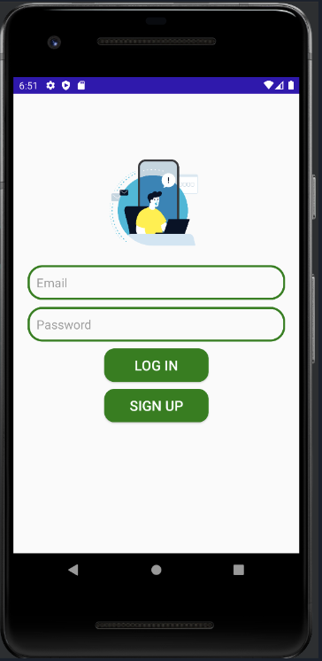
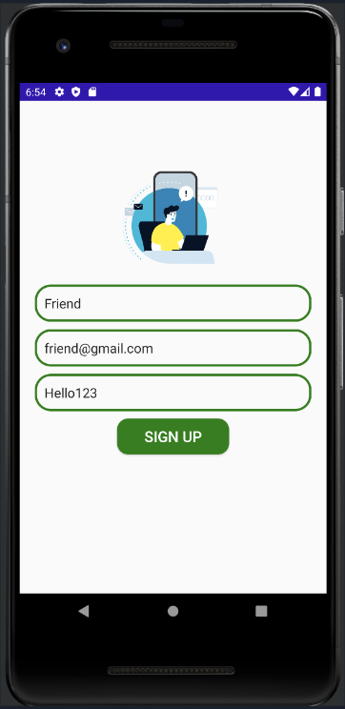
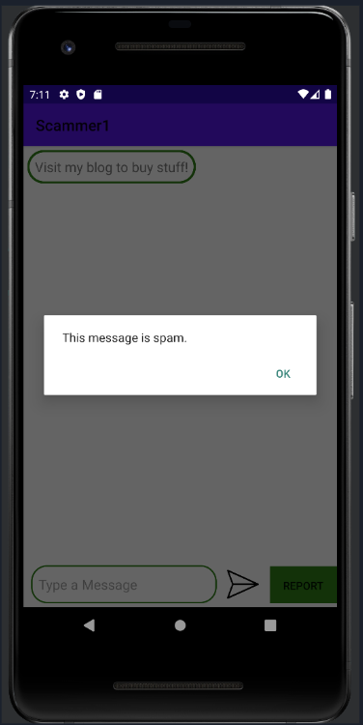
SCREENSHOTS

Slide 8
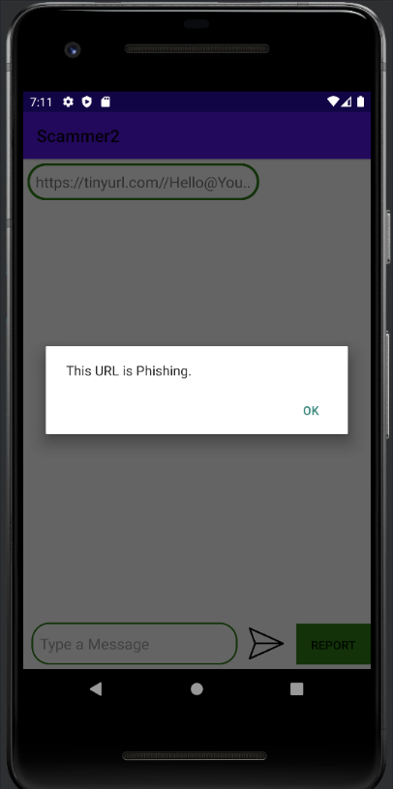
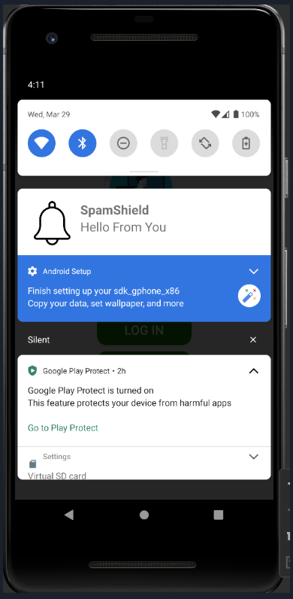
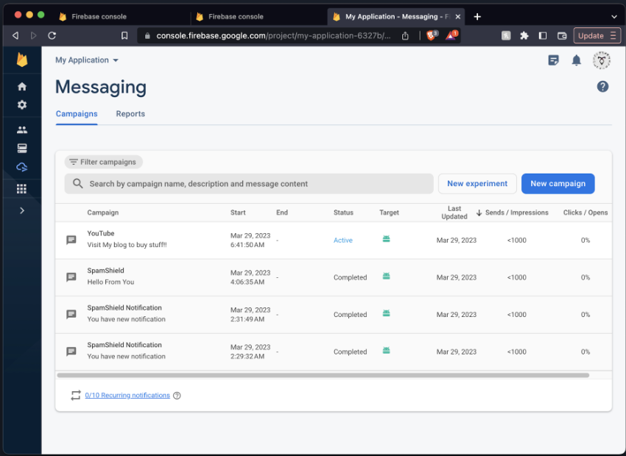
SCREENSHOTS

Slide 9
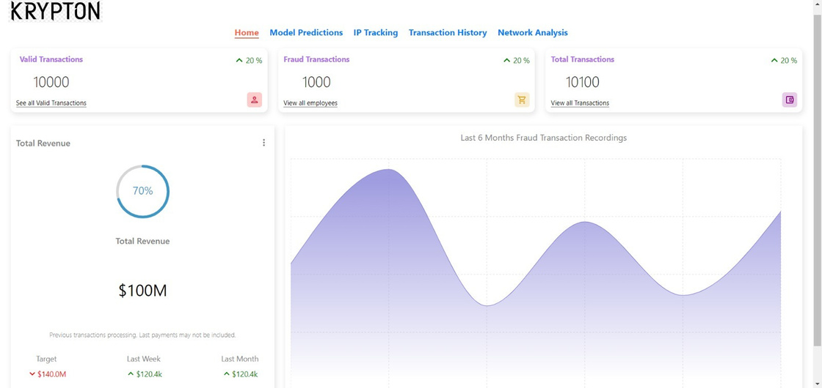
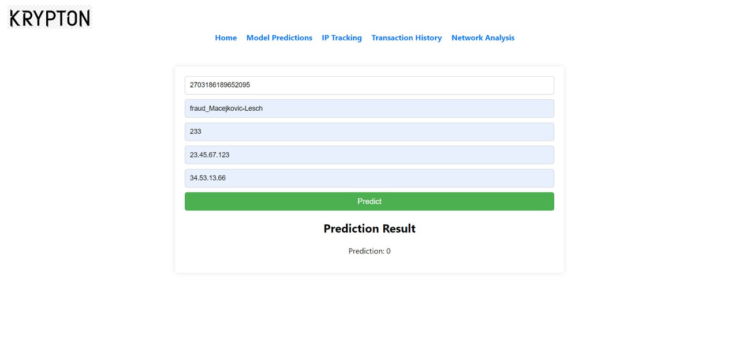
SCREENSHOTS

Slide 10
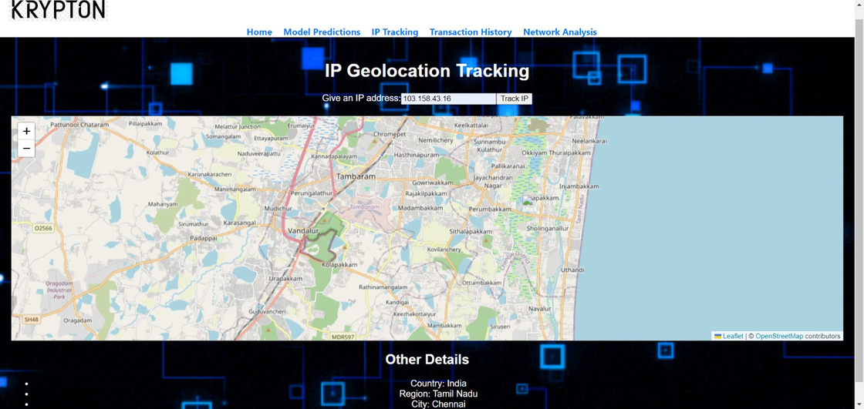
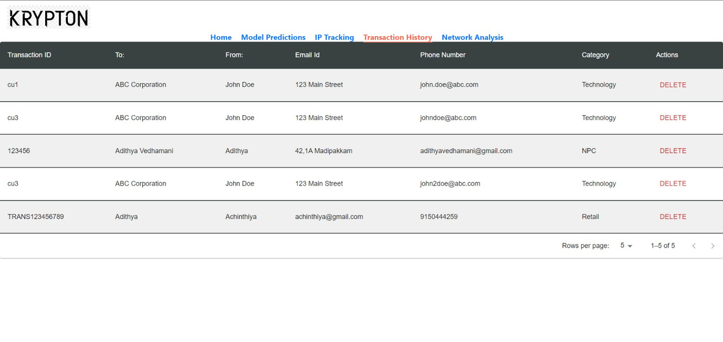
SCREENSHOTS

Slide 11









TECHSTACK

Slide 12
INNOVATIONS
Geospatial Analysis
Utilizing IP-based location distance metrics for
geographical analysis.
Real-time Network Analysis
Analyzes financial transactions in real-time for
enhanced security.
Crypto-Based Authentication
Implements an hash-based authentication for secure user login.
Phishing and Spam Detection on the Edge

Slide 13
BUSINESS CONSIDERATION AND FUTURE POTENTIAL
MARKET OPPURTUNITY
BENEFITS
CHALLENGES
Reduced Fraud Losses
Increased Revenue
Improved Efficiency
Scalability and Flexibility
Accessibility
Growing Demand
Diverse Customer Base
Competitive Advantage
Data Advantage
Security and Privacy
Competition
Pricing Strategy
Technical Infrastructure

Slide 14
THANK YOU
https://github.com/Vishwa-docs/IIT-Madras-Encryptcon

