Slide 1

Orinson Technologies Internship
Task-1
- Adithya S.T.

Slide 2
Task
Develop a model for Object Detection in Images. Focus on accurately detecting and classifying objects and ensuring the model performs well across different scenarios

Slide 3
Tech stack used
1. Google Colab
2. Detecto
3. Matplotlib
4. Torchvision

Slide 4
Steps involved in building custom object detection model
1. Importing data
2. Preprocessing data
3. Model training
4. Predicting object labels

Slide 5
What is Detecto?
Detecto is an open-source library for computer vision programming that helps us in fitting state-of-the-art computer vision and object detection models into our image data. One of the great things about this package is we can fit these models using very few lines of code.
We can install detecto using the below lines of code:
!pip install detecto
In the installation, we also find that this library also includes computer vision libraries such as open-cv, torchvision, and pillow.
We’ll use the GPU to train the model so that process can get faster and because the size of the models is higher

Slide 6
Building a custom object detection model
This library claims that we can train a model on the custom dataset using the below 5 lines of codes from detecto.core import Model,
Dataset dataset = Dataset('custom_dataset/’)
model = Model(['dog', 'cat', 'rabbit’])
model.fit(dataset) model.predict(...)
Where in the first line we are importing the model and dataset module. The second line is for defining the instance of data, the third line is for instantiating the models and the fourth line is to train or fit the model into data and the last line will tell us the prediction of the model

Slide 7
Importing data
The dataset is from here: detecto/docs/_static/dog_dataset.zip at master · alankbi/detecto · GitHub
This dataset is already labelled by the developers of the Detecto and we just need to import this into our environment. This dataset has 300 labelled images of golden retrievers and chihuahuas dogs
Read more at: https://analyticsindiamag.com/ai-mysteries/a-tutorial-on-building-custom-object-detection-models-using-detecto/

Slide 8
Mounting the data
Mounting can be done using the following lines of codes.
from google.colab import drive drive.mount('/content/drive’)
Now let’s set the directory as the working directory where we have uploaded the data
# change working directory to the dataset folder in drive
import os
os.chdir('/content/drive/MyDrive/Orinson_dataset/dog_dataset')

Slide 9
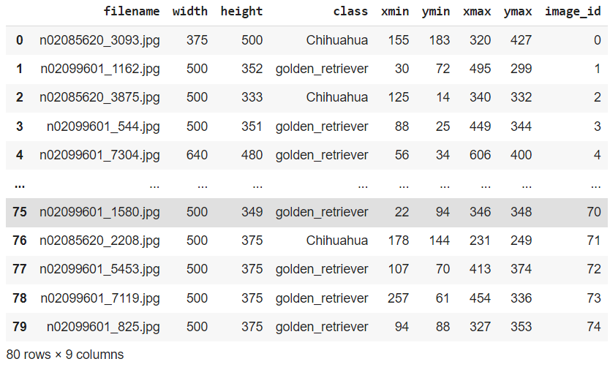
Converting XML files into CSV files
from detecto
import utils detecto.utils.xml_to_csv('train_labels', 'train.csv’)
detecto.utils.xml_to_csv('val_labels', 'val.csv')

Slide 10
Visualizing an image from the data
import matplotlib.pyplot as plt
import matplotlib.image as img
image = img.imread('images/n02085620_8611.jpg’)
plt.imshow(image)
plt.show()

Slide 11
Preprocess data
To work with this library we are required to preprocess data according to the utilities of the library. In this section, we will look at how we can do this using the Detecto library. In this section we will perform the following preprocessing:
Transformation of image
Combining images and labels
Image labeling

Slide 12
Preprocess data
Let’s start with the transformation of images
from torchvision import transforms
from detecto import core
transform_img = transforms.Compose([
transforms.ToPILImage(),
transforms.Resize(800),
transforms.RandomHorizontalFlip(0.5),
transforms.ToTensor(), utils.normalize_transform(),
])

Slide 13
Now using the above function and core function of Detecto, let’s transform images and combine and label the train images.
dataset = detecto.core.Dataset('train.csv', 'images/', transform=transform_img)
Here we have performed most of the preprocessing using one line of code.
Let’s visualize one labeled image. from detecto import visualize image, information
from detecto import visualize image, information = dataset[50] detecto.visualize.show_labeled_image(image, information['boxes'], information['labels'])

Slide 14
Model training
After preprocessing the data, we are ready to train our model. We are going to use the Faster-RCNN-resnet50 model on our data. The training process can be completed in the following two steps. Instantiating data loader Instantiating and fitting models. Instantiating data loader To fit the data
Instantiating data loader
Instantiating and fitting models.

Slide 15
Instantiating data loader
To fit the data into the model we are required to instantiate an object as our loader that can hold the data. Using the below code we can do this.
dataloader = detecto.core.DataLoader(dataset)
dataloader
Output: Here we can see that the above object is a Detecto.core module.

Slide 16
Instantiating and fitting model
In this section, we will feed the data loader instance to the image classifier. To measure the accuracy we are required to put labels in our validation image data. That can be using the following codes.
validation_data = detecto.core.Dataset('val.csv', 'images/’)
Now we are required to make the model know what are the categories we have in the data. We can do this while instantiating the model.
categories = ['Chihuahua', 'golden_retriever’]
classifier = core.Model(categories)
Output:

Slide 17
Now we are ready to fit this model into our training data and validation data.
history = classifier.fit(dataloader, validation_data, epochs = 20, verbose = True)

Slide 18
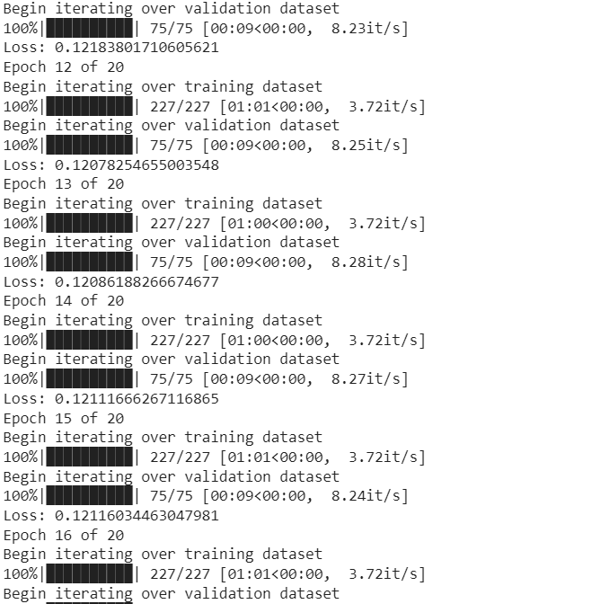
Output:

Slide 19
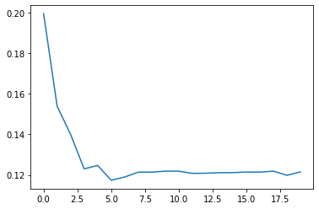
In the output, we can see that we have trained our model using 20 epochs. Let’s plot the losses from the model.
plt.plot(history)
Output:

Slide 20
Here we can see the loss of the models has decreased with the epochs. Predicting object labels Now we can plot object label predictions using our trained model. For this, we will first extract some images from the data using the following codes.
images = [] for i in range(0,36,3):
image,_ = validation_data[i]
images.append(image)
image.shape
Output:

Slide 21
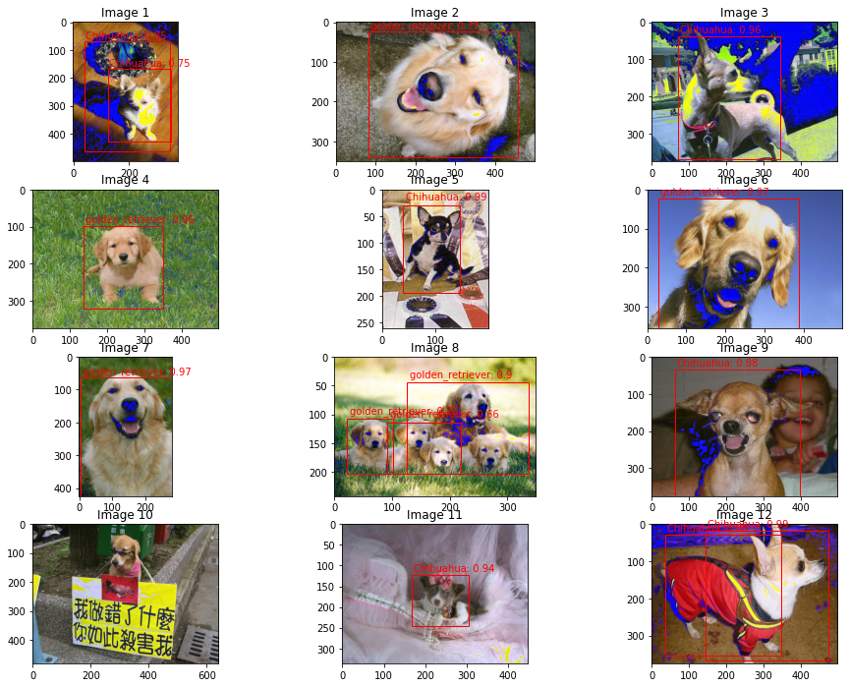
Now we can use Detecto to visualize the images.
visualize.plot_prediction_grid(classifier, images, dim=(4, 3), figsize=(16, 12))
Output:

Slide 22
References:
1. A tutorial on building custom object detection models using detecto (analyticsindiamag.com)
2. Building custom-trained object detection models in Python | by Alan Bi | Towards Data Science
3. detecto/docs/_static/dog_dataset.zip at master · alankbi/detecto (github.com)

