Slide 1
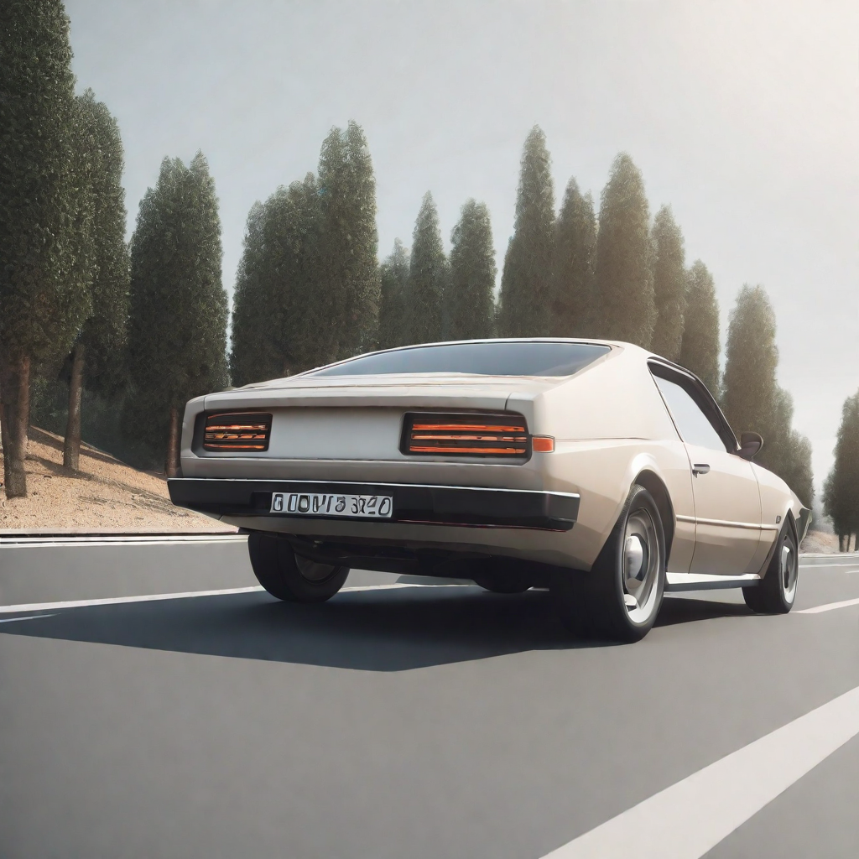
CAR PRICE PREDICTION
ALLA SAI ADITHYA REDDY
UX02894

Slide 2

TABLE OF CONTENTS
INTRODUCTION
PROBLEM STATEMENT
DATA SOURCE AND PREPARATION
EXPLORATORY DATA ANALYSIS
MACHINE LEARNING MODEL
CHALLENGES AND LEARNINGS
CONCLUSION AND FUTURE WORK
REFERENCES

Slide 3

INTRODUCTION
The automobile industry has witnessed a significant surge in data generation, capturing various aspects of vehicles such as make, model, year, mileage, engine specifications, and other features. This wealth of data presents an opportunity to harness the power of machine learning to predict car prices accurately. Car price prediction is a valuable application that can benefit both consumers and sellers in making informed decisions.

Slide 4

PROBLEM STATEMENT
The purpose of this project is to assist car buyers and sellers in making informed decisions by providing them with accurate price predictions.This will support vendors in establishing competitive prices and buyers in negotiating reasonable prices. By utilizing data-driven insights, the initiative also seeks to increase the general efficiency and transparency of the automotive sector.

Slide 5
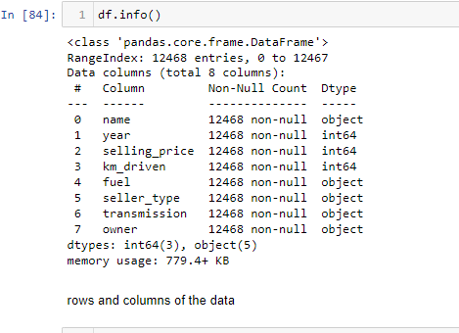
DATA SOURCE AND PREPARATION
I used a dataset of car prices collected from Kaggle
The dataset contains information on different car models, their specifications, and their corresponding prices like kilometers driven ,fuel type ,owner, car type etc.
Details:
Size: 980 mb
Rows : 12469
Columns: 8

Slide 6
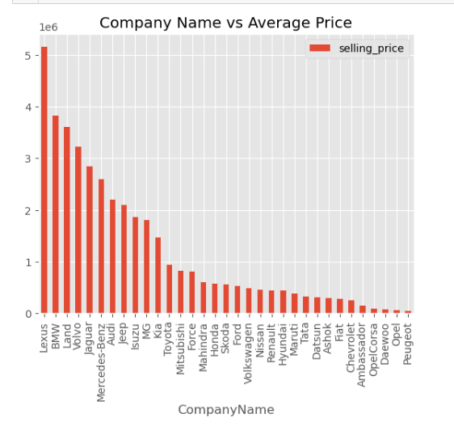
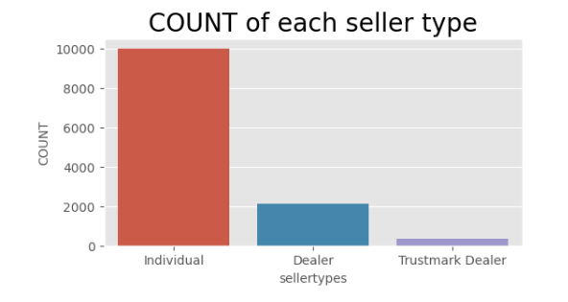
Exploratory Data Analysis

Slide 7
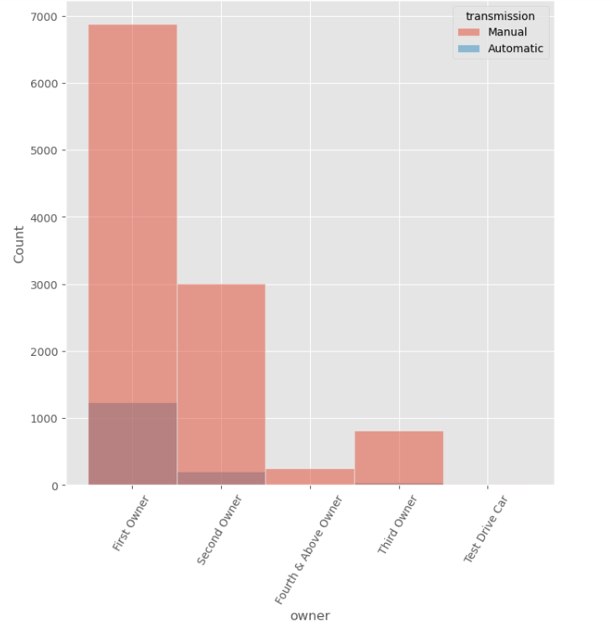
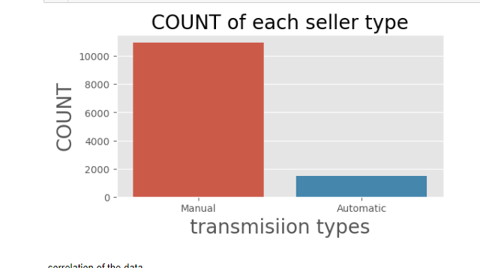

Slide 8
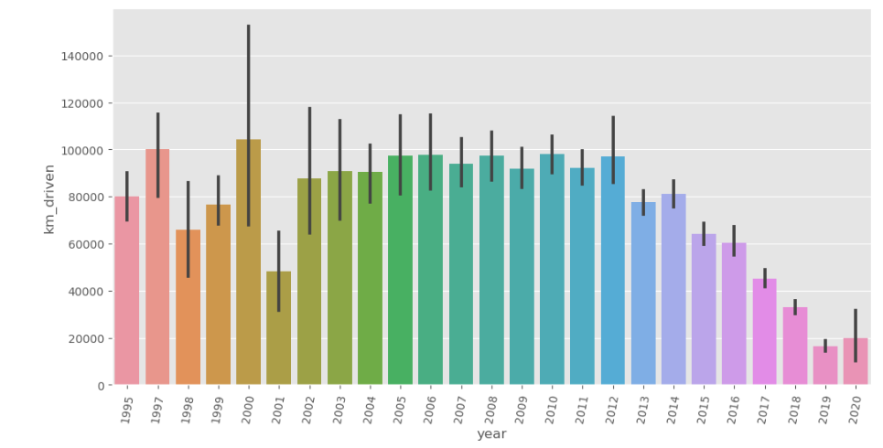
Km driven vs year

Slide 9
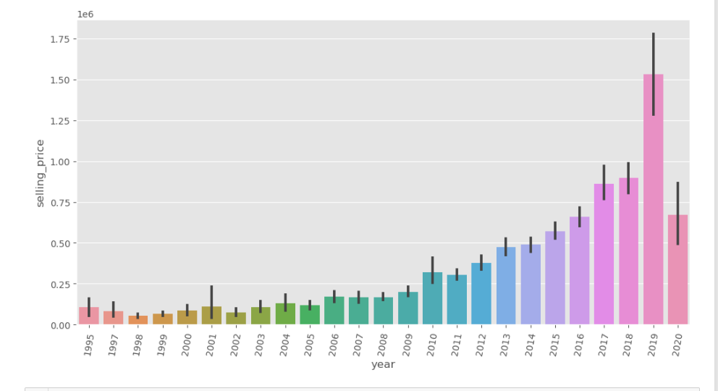
Selling_price vs year

Slide 10
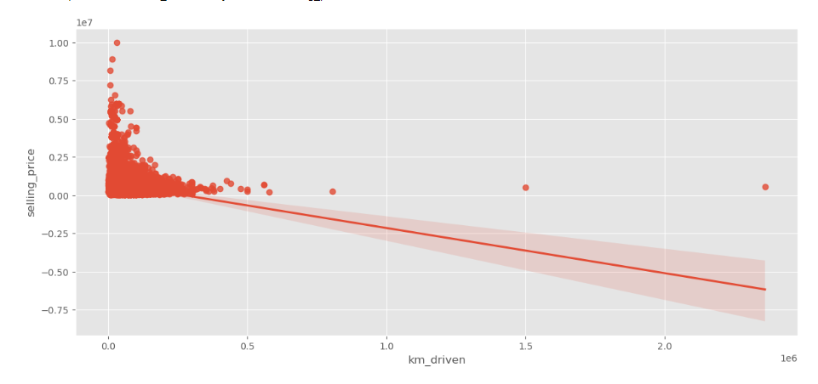
The price of the car is high If the km driven by the car is less

Slide 11
MACHINE LEARNING MODEL
Regression Models
Linear Regression
Random forest Regression
Decision Tree Regression
XGBoost Regression
GB Regression
Clustering
K Nearest Neighbor Clustering
Hyper parameter tuning
Using RandomizedsearchCV

Slide 12
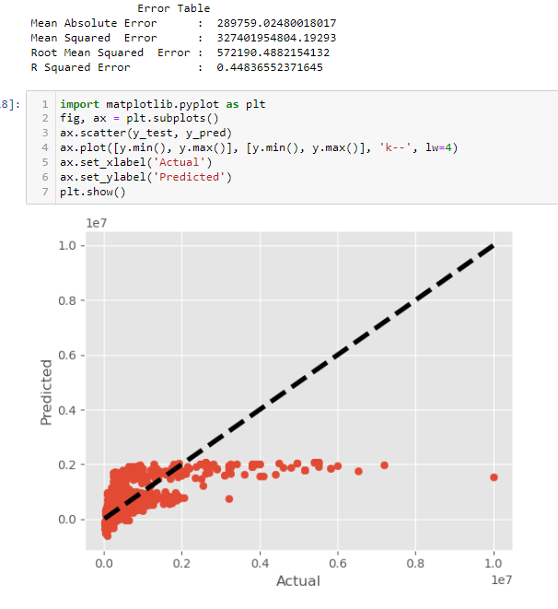
Linear regression

Slide 13
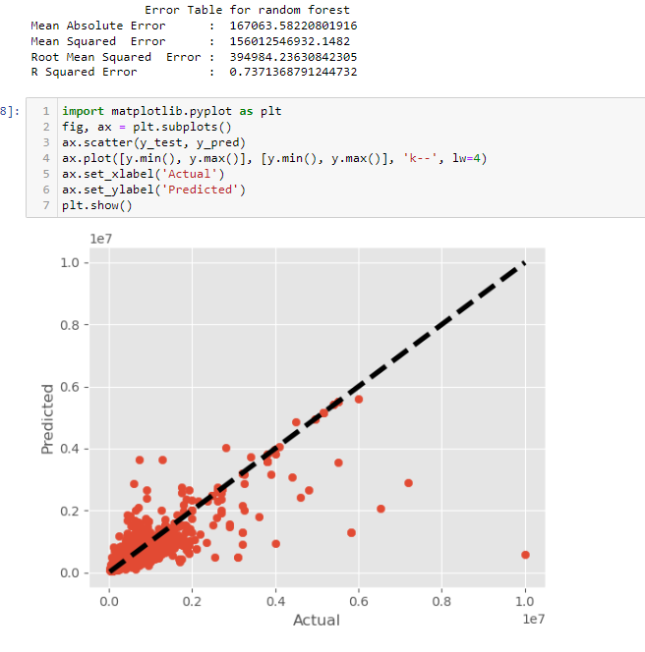
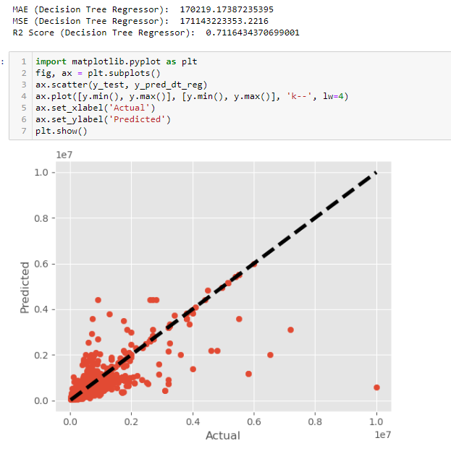
Random forest Decision true

Slide 14
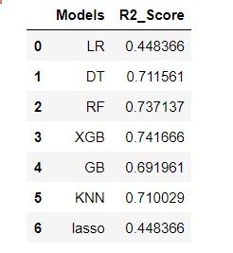
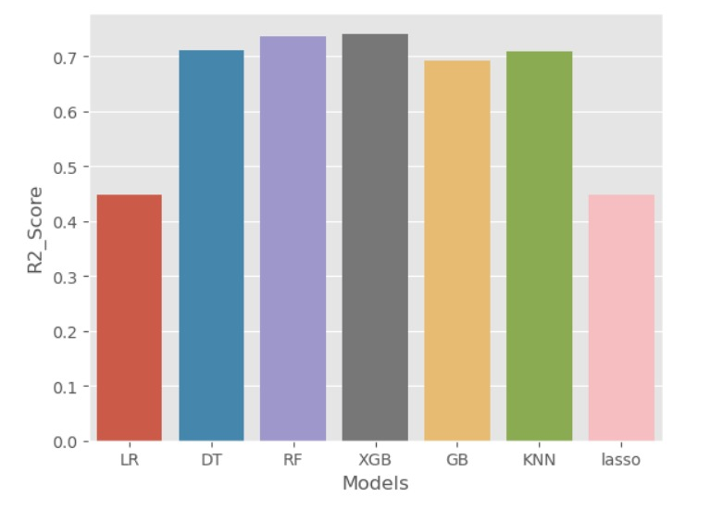
RESULTS

Slide 15
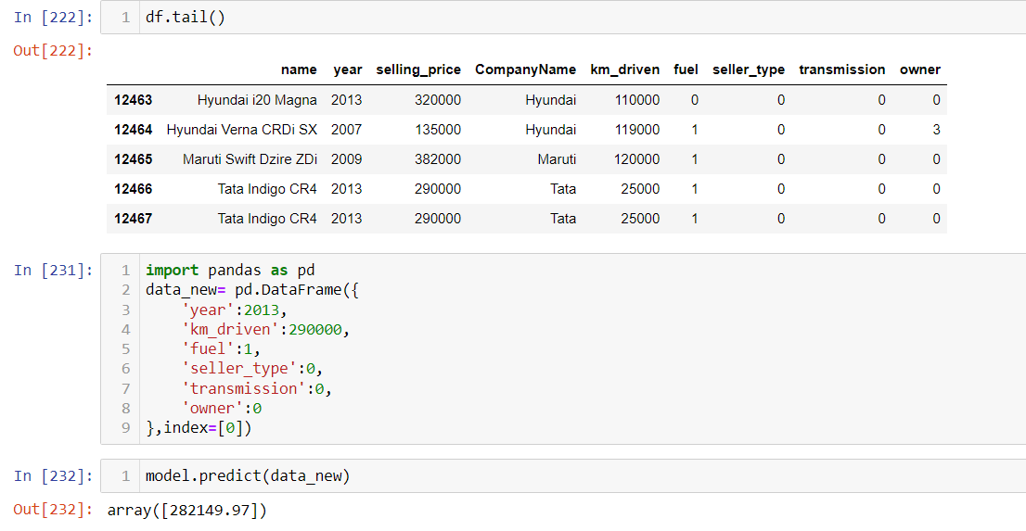
Sample Prediction of car price from the dataset

Slide 16

CHALLENGES AND LEARNINGS
Challenges Faced
Some of the key challenges I faced include:
Data Quality: The availability and quality of data were major challenges. We had to clean and preprocess the data to ensure accuracy and reliability.
Feature Engineering: Creating meaningful features from the raw data was a complex task. We had to experiment with different techniques to extract relevant information.
Model Selection: Choosing the right algorithm and model architecture was a challenge. We had to evaluate multiple models and fine-tune their hyperparameters.

Slide 17

Key Learnings
Data Preprocessing: The importance of data cleaning and preprocessing cannot be overstated. It significantly impacts the performance of the models.
Feature Selection: Selecting the right set of features is crucial for model accuracy. It requires domain knowledge and experimentation.
Model Evaluation: Rigorous evaluation and validation of models are essential to ensure their reliability and generalizability.

Slide 18

FUTURE WORK
Incorporating more features: By including additional car features such as engine size, horsepower, and safety ratings, we can further enhance the accuracy of the model.
Exploring other machine learning algorithms: While our current model performs well, there may be other algorithms that can provide even better predictions. It would be beneficial to compare and evaluate different algorithms to find the most suitable one for this task.
Expanding the dataset: Increasing the size and diversity of the dataset can help improve the model's generalization ability and make it more robust.

Slide 19
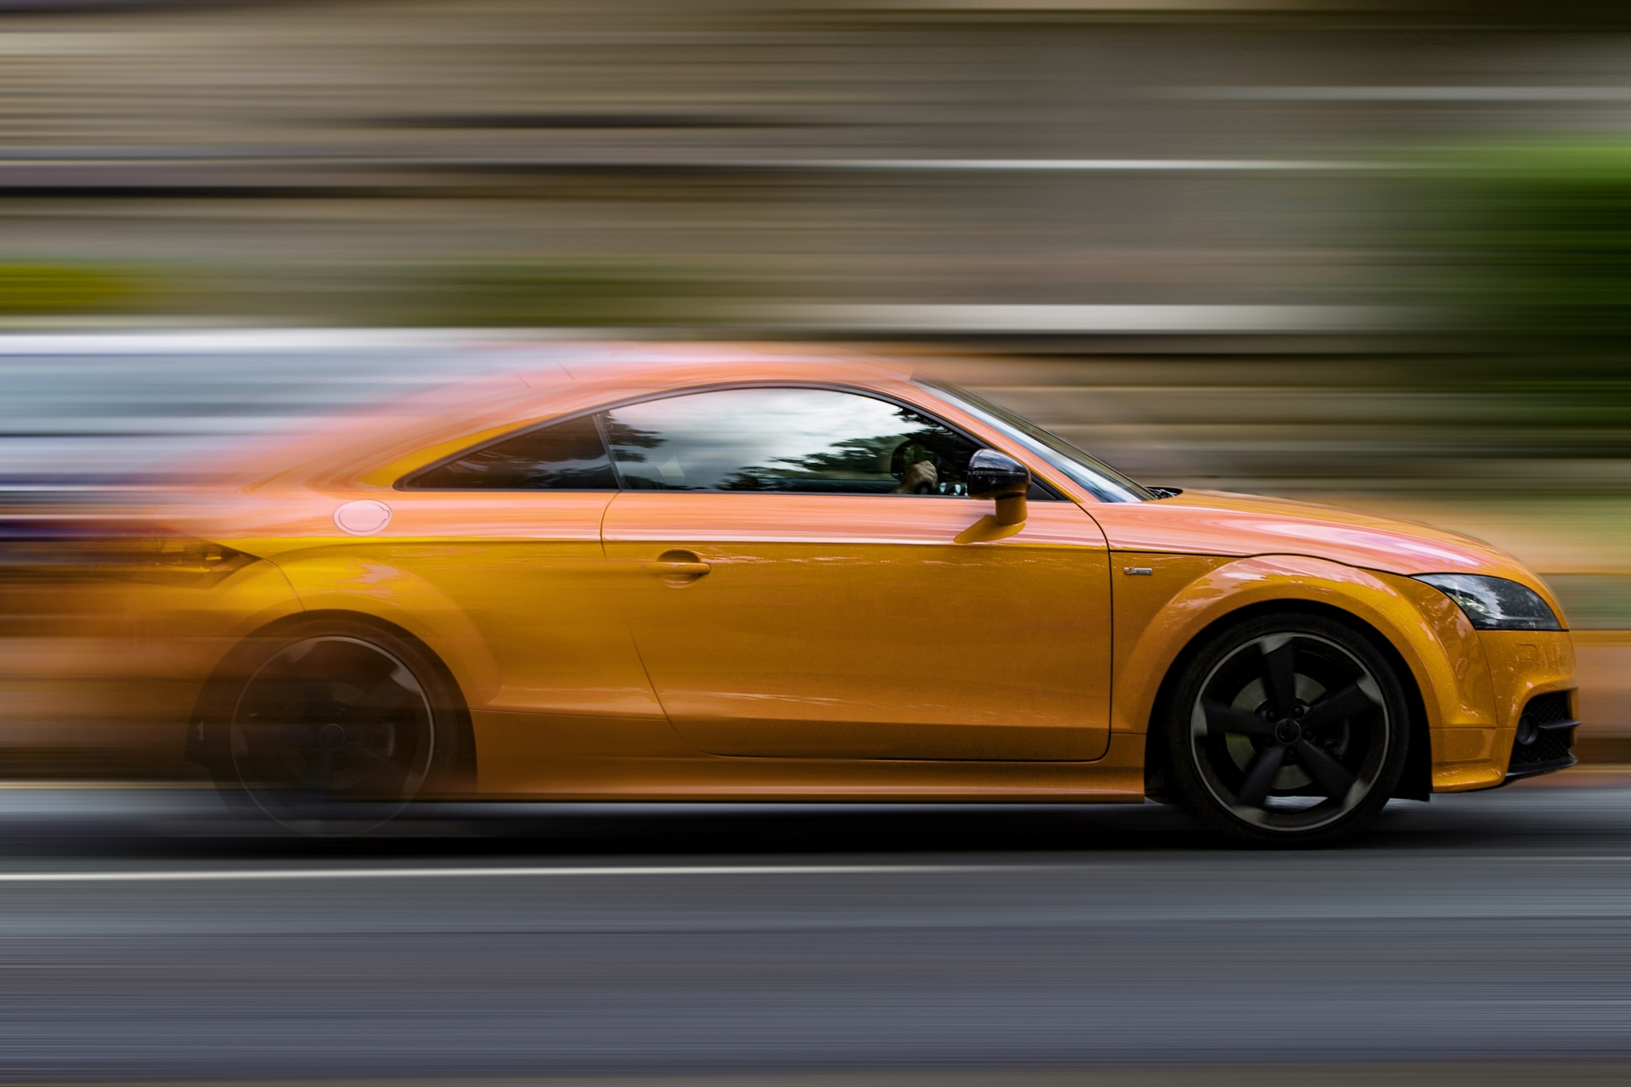
Conclusion
In conclusion, we were able to show that machine learning models are effective in properly predicting automobile prices through our car price prediction study. With careful data analysis and model assessment, we were able to gather important information about the variables affecting car prices. Overcoming challenges including model selection and data quality, the project emphasizes the need of careful model fine-tuning.

Slide 20
REFERENCES
Satapathy, S. K., Vala, R., & Virpariya, S. (2022). An automated car price prediction system using effective machine learning techniques. 2022 International Conference on Computational Intelligence and Sustainable Engineering Solutions (CISES). https://doi.org/10.1109/cises54857.2022.9844350
Mammadov, H. (2022). Car Price Prediction in the USA by using Liner Regression. ResearchGate.
https://doi.org/10.14276/2285-0430.3049
Prashant G, Akshay G, Jenish K(2021).Old Car Price Prediction With Machine Learning. https://www.irjmets.com/uploadedfiles/paper/volume3/issue_3_march_2021/6681/1628083284.pdf

Slide 21

This Photo by Unknown Author is licensed under CC BY-SA

