Slide 1
LOAN DEFAULT PREDICTION Using ML Algorithms
UMBC Data Science Capstone Project -606
Dr. CHAOJIE (JAY) WANG
ALLA SAI ADITHYA REDDY
Campus ID: UX02894
GitHub Profile: https://github.com/adithya123344

Slide 2

INTRODUCTION
The objective of loan default prediction is to predict the probability that a borrower will be unable to fulfill their debts.
It is essential for financial organizations
to be able to predict loan defaults to evaluate the risk associated with lending and to reduce the possibility of losses.
.

Slide 3
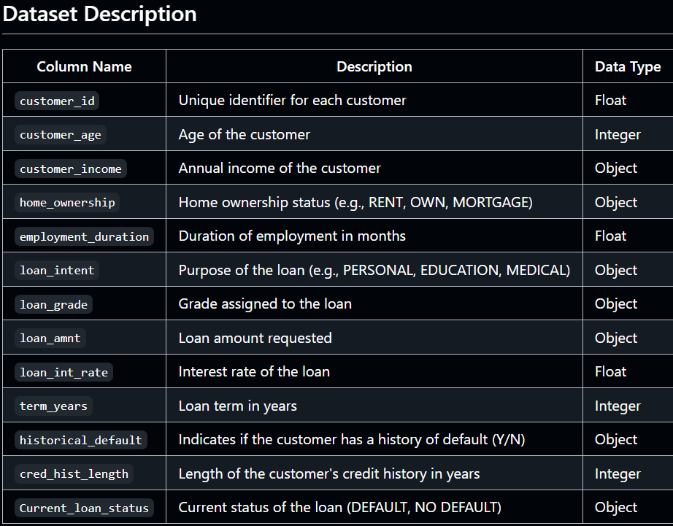
DATASET
Data sources:
https://www.kaggle.com/code/renjiabarai/loan-classification/input
Data size: 2.23 MB
Rows: 32586
Columns: 13
Target Variable: “Current_loan_status”
Feature Variables: “customer_income,home_ownership,employment_duration,loan_intent,loan_grade,loan_amt,loan_int_rate,term_years,cred_hist_length”

Slide 4
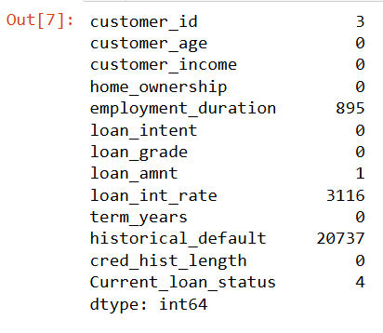
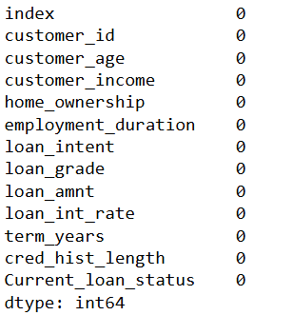
DATA PREPROCESSING
DATA CLEANING: Removed all null values by replacing the with mean values

Slide 5
Data Transformation
Normalize or standardize numerical features to ensure comparability.
Encode categorical variables using techniques like one-hot encoding or label encoding.
Example:
Converted the Value of loan_amt from £35,000 to 35000
Label Encoded for home_ownership ,loan_intent ,loan_grade ,Current_loan_status
Saved the Preprocessed dataset with a new name

Slide 6
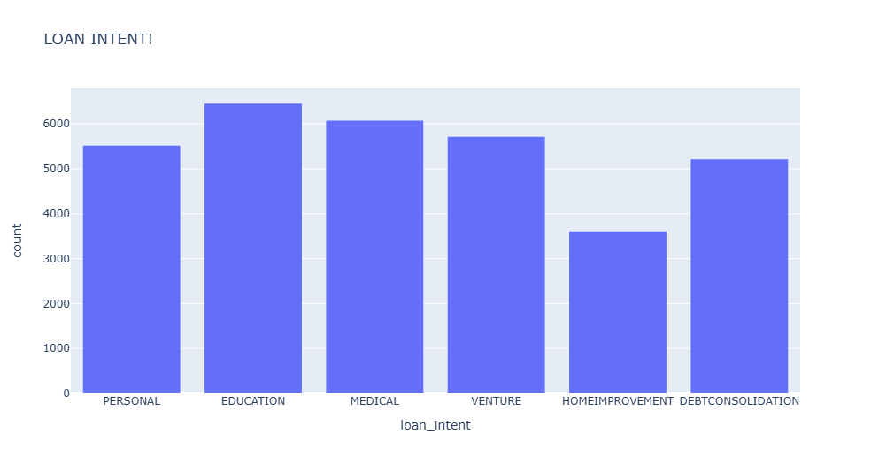
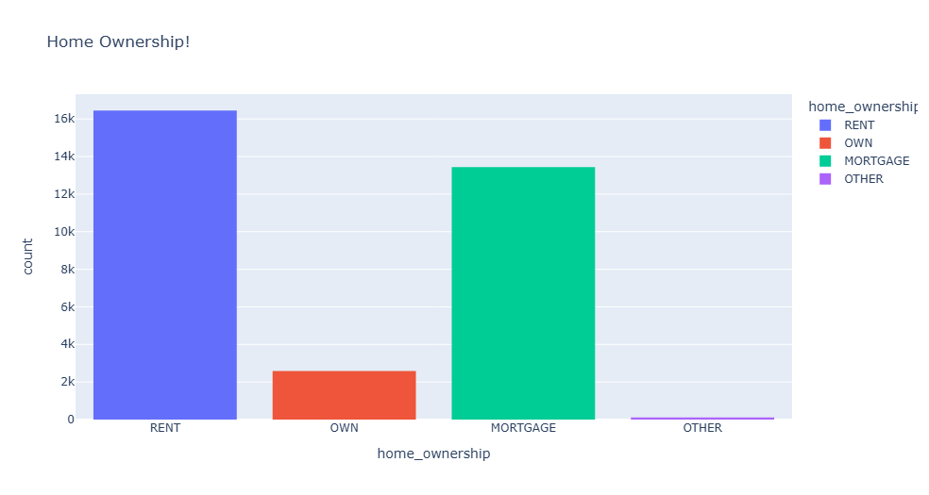
EXPLORATORY DATA ANALYSIS
Most loans were taken for Education purpose
Most Loans were taken by rented home applicants

Slide 7
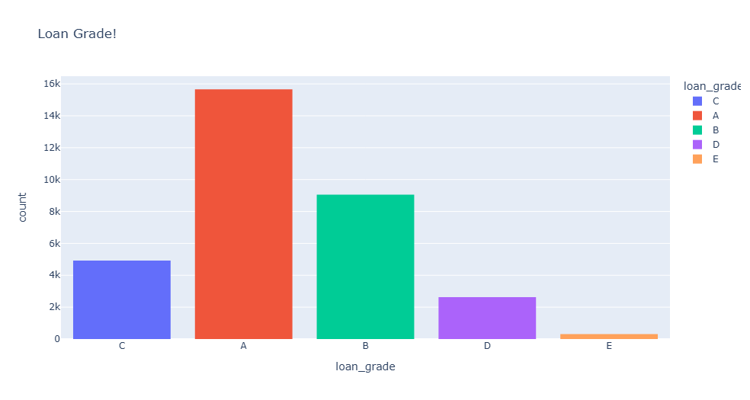
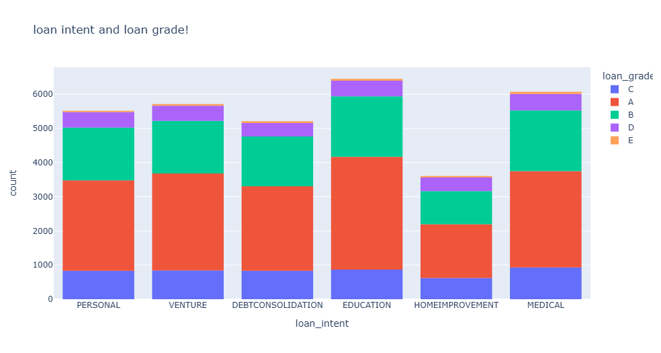
Bank Issued more number of A grade loans in all categories

Slide 8
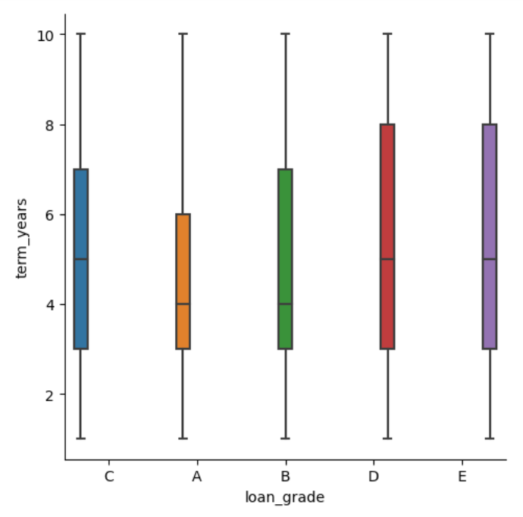
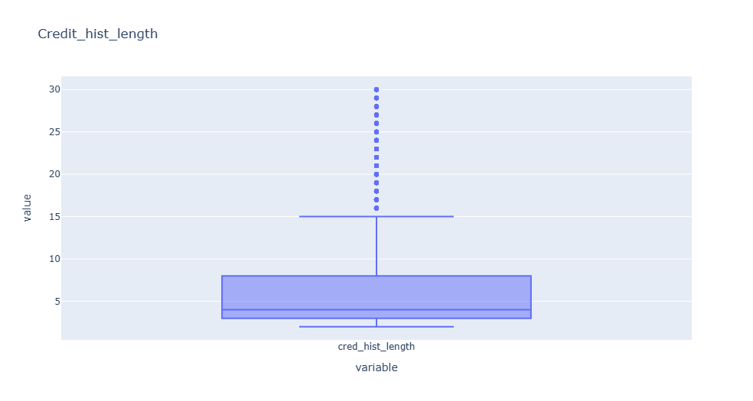
Loan grade vs Tem Years
Credit History Length

Slide 9

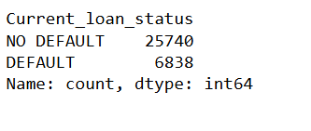
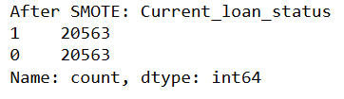
DATA PREPARATION
Dropped the unnecessary columns like Index ,Customer ID, Customer Age.
Data Splitting:
Training Data: 80%
Validation Data: 10%
Testing Data: 10%
As there is an imbalance in the target variable
I used SMOTE to balance them to train the data to get more accuracy
Then I did the Standard Scalar to transform the data for better training.

Slide 10
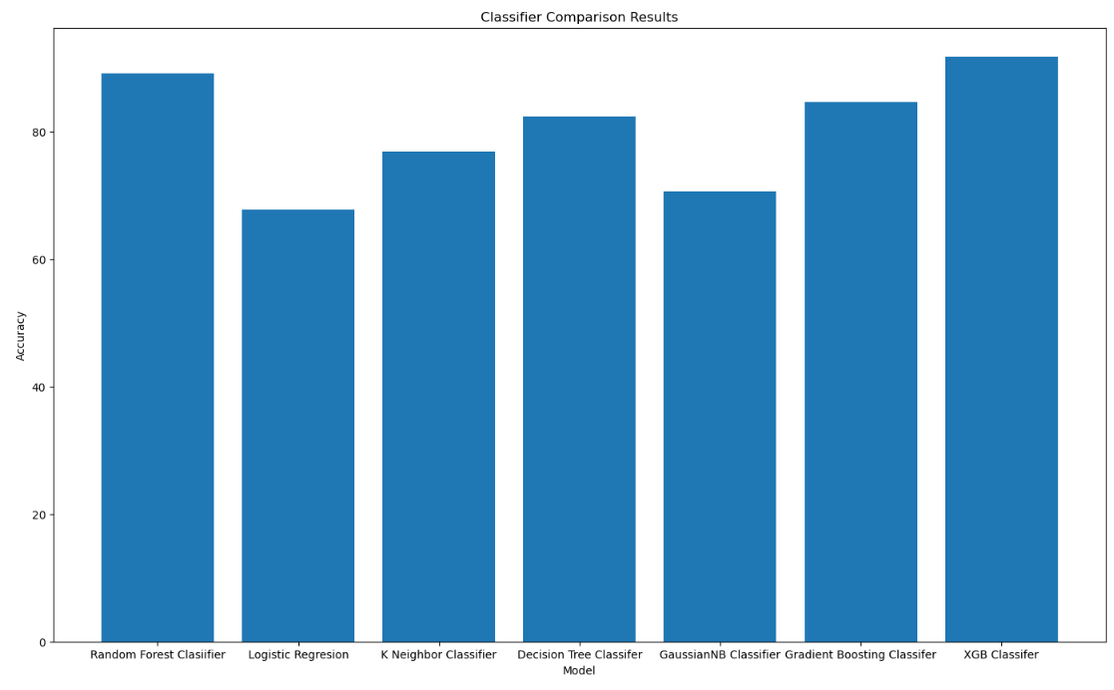
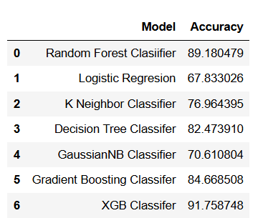
MODEL EVALUATING
Used Different Classification models to train and predict the accuracy of the model.

Slide 11
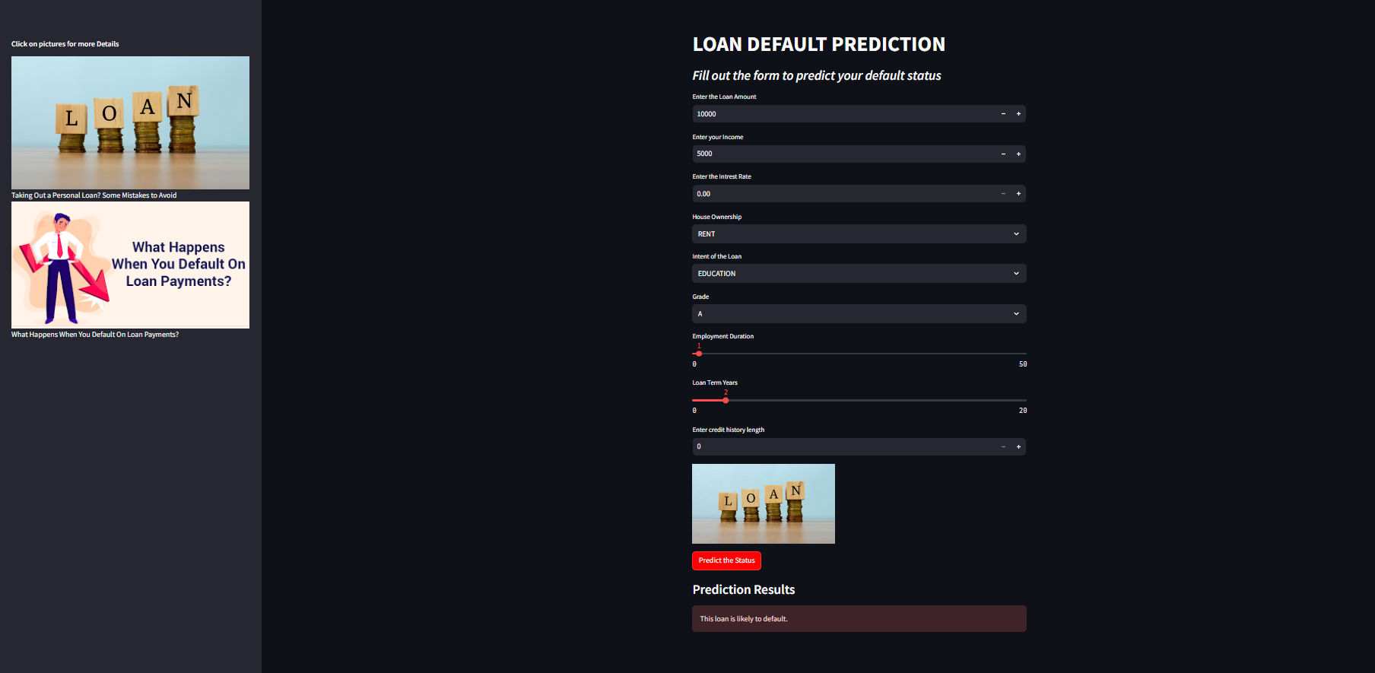
STREAMLIT WEB APP

Slide 12
Future Use of Machine Learning in Loan Default Prediction
Potential Improvements
More Applications
Enhanced Data Integration: Leveraging more diverse data sources, such as social media and transaction data, for a comprehensive borrower profile.
Advanced Algorithms: Adoption of more sophisticated algorithms like deep learning to improve prediction accuracy.
Real-Time Analysis: Implementation of real-time data processing to provide instant insights and decisions.
Personalized Loan Products: Tailoring loan offerings based on predictive insights to better serve individual borrower needs.
Fraud Detection: Using predictive models to identify and mitigate potential fraudulent activities in loan applications.
Risk Management: Enhancing financial institutions' risk management frameworks by integrating predictive analytics.

Slide 13

CONCLUSION
Machine learning algorithms for loan default prediction can improve financial organizations' risk management. These accurate and scalable models detect high-risk borrowers, optimize lending methods, and reduce financial losses by using historical data and advanced predictive analytics. This study tested Logistic Regression, Random Forest, and XGBoost. The comparative analysis showed that [selected model, e.g., XGBoost] had the best precision-recall ratio, making it the ideal choice for real-world deployment.

Slide 14

Lessons Learned
Challenges Faced
Data Quality: Inconsistent and incomplete data required extensive preprocessing.
Feature Engineering: Identifying relevant features was complex due to the diverse nature of financial data.
Model Overfitting: Initial models were too complex, leading to overfitting on training data.
Imbalanced Dataset: The dataset had a low proportion of default cases, affecting model performance.
Solutions Implemented
Data Cleaning: Implemented rigorous data cleaning and preprocessing steps to improve data quality.
Feature Selection: Utilized domain expertise and automated feature selection techniques to identify impactful features.
Regularization Techniques: Applied regularization methods to prevent overfitting and improve model generalization.
Resampling Methods: Used techniques like SMOTE (Synthetic Minority Over-sampling Technique) to balance the dataset.

Slide 15


THANK YOU

