Slide 1
Decentralized Voting
System

Slide 2
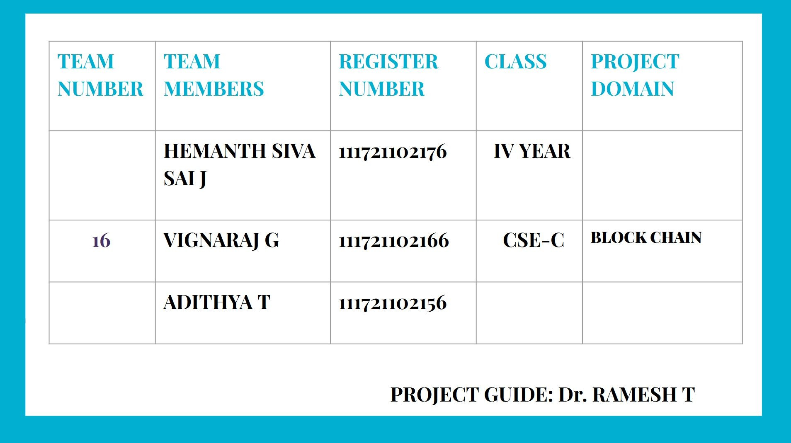

Slide 3
Abstract
The project aims to develop a decentralized voting system leveraging blockchain technology and smart contracts to ensure a secure, transparent, and tamper-proof electoral process.
By utilizing the immutable nature of blockchain and the automation capabilities of smart contracts, the system addresses critical issues such as voter fraud, tampering, and lack of transparency in traditional voting systems.
The proposed solution includes secure voter authentication, real-time vote recording, and anonymity preservation, enabling a trustworthy and scalable voting platform for both organizational and national elections.
This innovative approach has the potential to revolutionize the democratic process by enhancing voter trust, reducing electoral malpractices, and encouraging higher participation.

Slide 4
Knowledge on the Fundamental Concepts
Blockchain Technology
Distributed ledger system ensuring transparency and immutability.
Key features: decentralization, consensus mechanisms, and cryptographic security.
Decentralized Voting
Secure and tamper-proof voting system leveraging blockchain.
Eliminates intermediaries and ensures voter anonymity.
Smart Contracts
Self-executing contracts with terms directly written into code.
Operates on blockchain platforms like Ethereum.

Slide 5
Innovation in the Project
Problem statement
Traditional voting systems are prone to tampering, fraud, and lack transparency.
Manual vote counting is time-consuming and error-prone.
Centralized systems are vulnerable to cyberattacks and data breaches.
Lack of trust among voters due to opacity in the electoral process.
High costs associated with the
Proposed solution
A blockchain-based voting system ensuring security, transparency, and immutability.
Use of smart contracts for automated vote tallying and validation.
Integration of multi-factor authentication for secure voter veriﬁcation.
Implementation of a voter-friendly interface for ease of use.
Real-time vote auditing capabilities for election observers.
Decentralized storage to safeguard voter and election data.
Scalability solutions such as sidechains or sharding to handle large-scale elections.
deployment and management of
or
traditional voting methods.
●
Limited accessibility for remote differently-abled voters.

Slide 6


Innovative Features
Decentralization
Tamper-Proof
Transparency
Supports remote and inclusive voting
Immutable ledger to record votes
Real-time monitoring for election
Accessibility
Eliminates central authority
2
3
stakeholders.
4
1

Slide 7
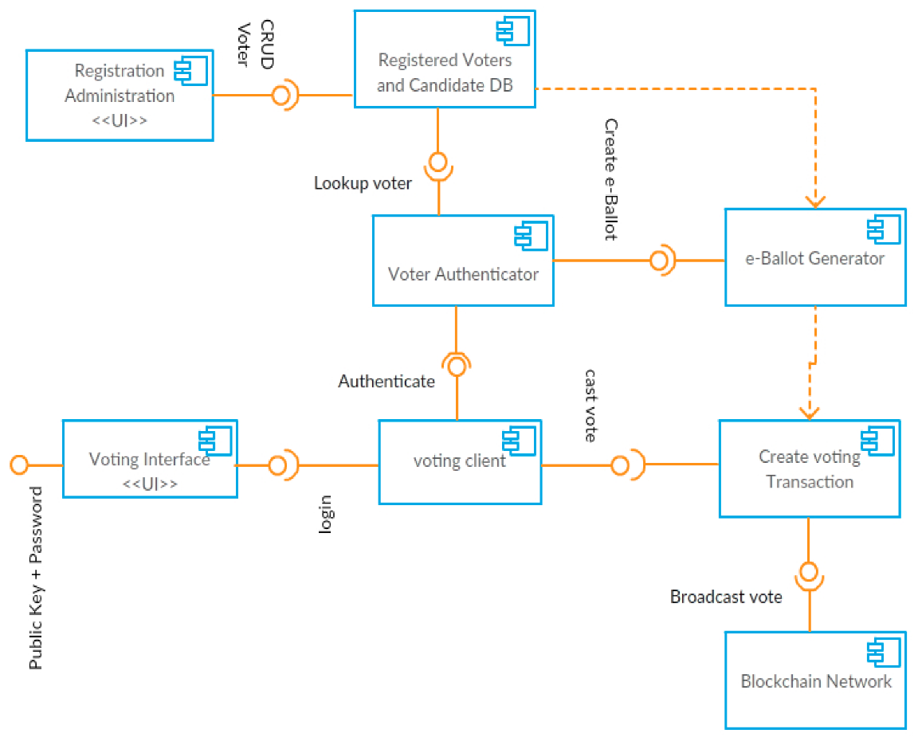
Architecture diagram

Slide 8
LITERATURE SURVEY
S.NO | Authors | Key Insights | Gaps Identiﬁed
1 | V Lalitha; S Samundeswari; R Roobinee; Lakshme S Swetha | Recognizes the importance of voting Addresses limitations of traditional voting | Lack of detail on implementation Potential concerns not addressed
2 | Sachin Kumar; Shoaib Akhtar; Soumalya Ghosh; Kavita Saini | Focus on security and transparency Proposes Blockchain as a solution | Cybersecurity threats Digital divide Legal and regulatory challenges

Slide 9
LITERATURE SURVEY
S.NO | Authors | Key Insights | Gaps Identiﬁed
3 | Hrithvick Rao Rewatkar; Devansh Agarwal; Anmol Khandelwal; Subho Upadhyay | Recognition of scalability Emphasis on security and privacy | Potential challenges not addressed Social and ethical implications
4 | Ashish Balti; Abhishek Prabhu; Sanskar Shahi; Shrutika Dahifale; Vrajesh Maheta | Limitations of Electronic Democracy Emphasis on mobile voting | Vague description of Blockchain implementation Security and privacy concerns

Slide 10
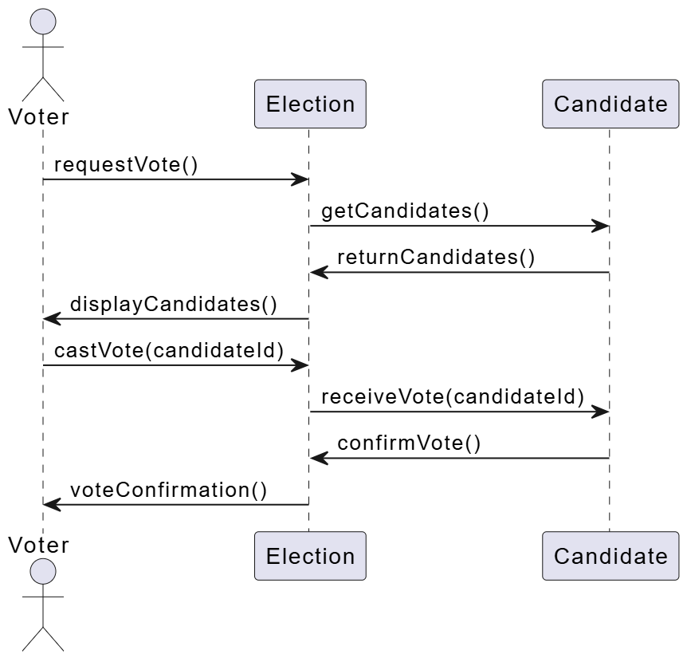
SEQUENCE DIAGRAM

Slide 11
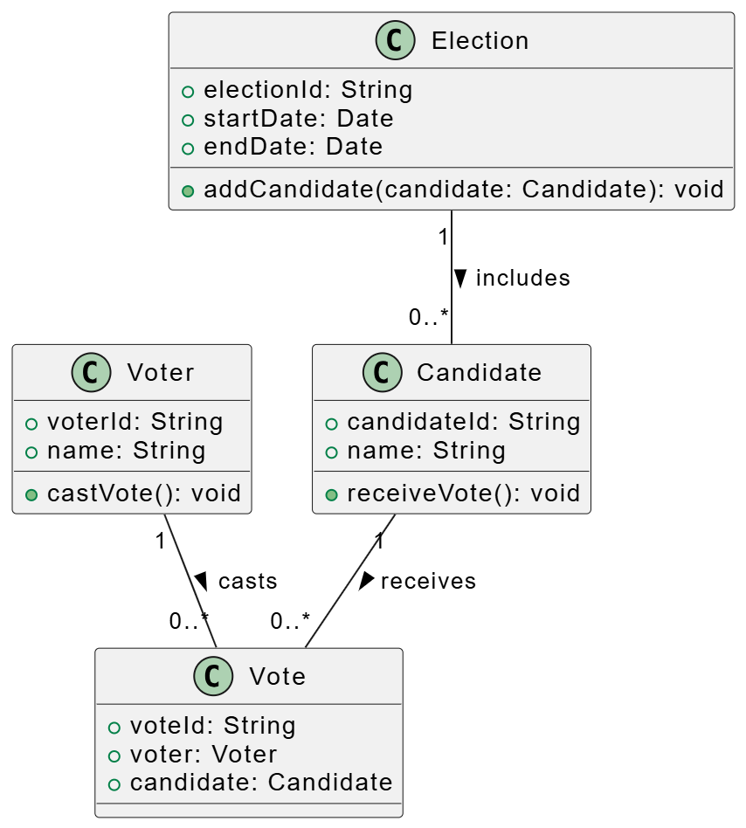
CLASS DIAGRAM

Slide 12
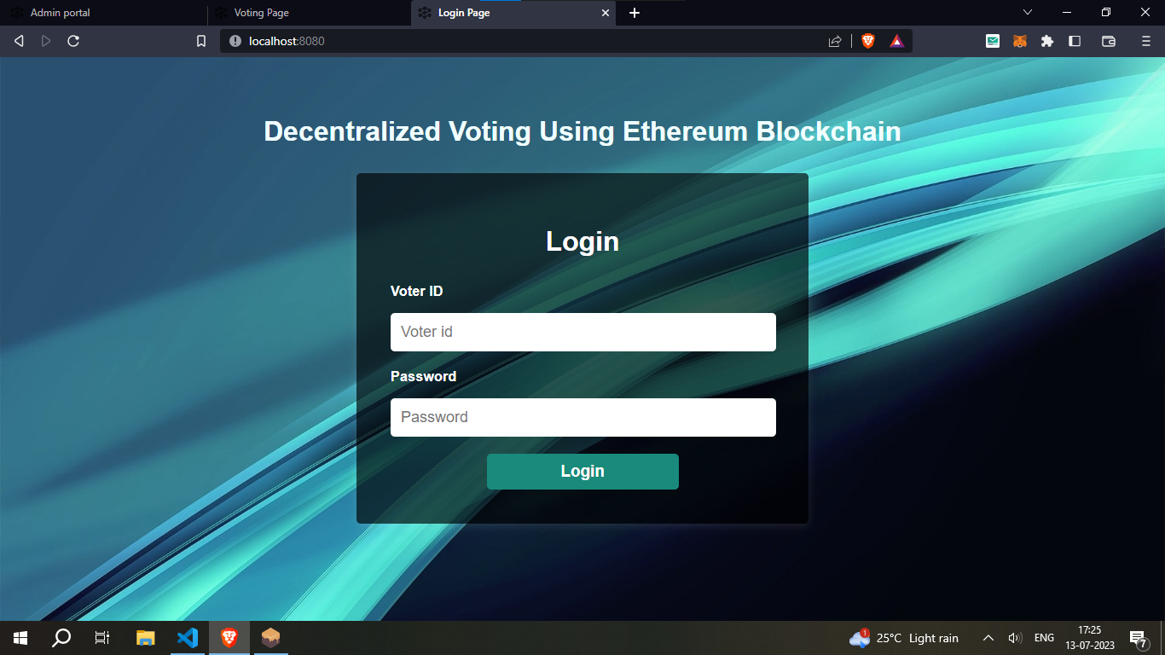

Slide 13
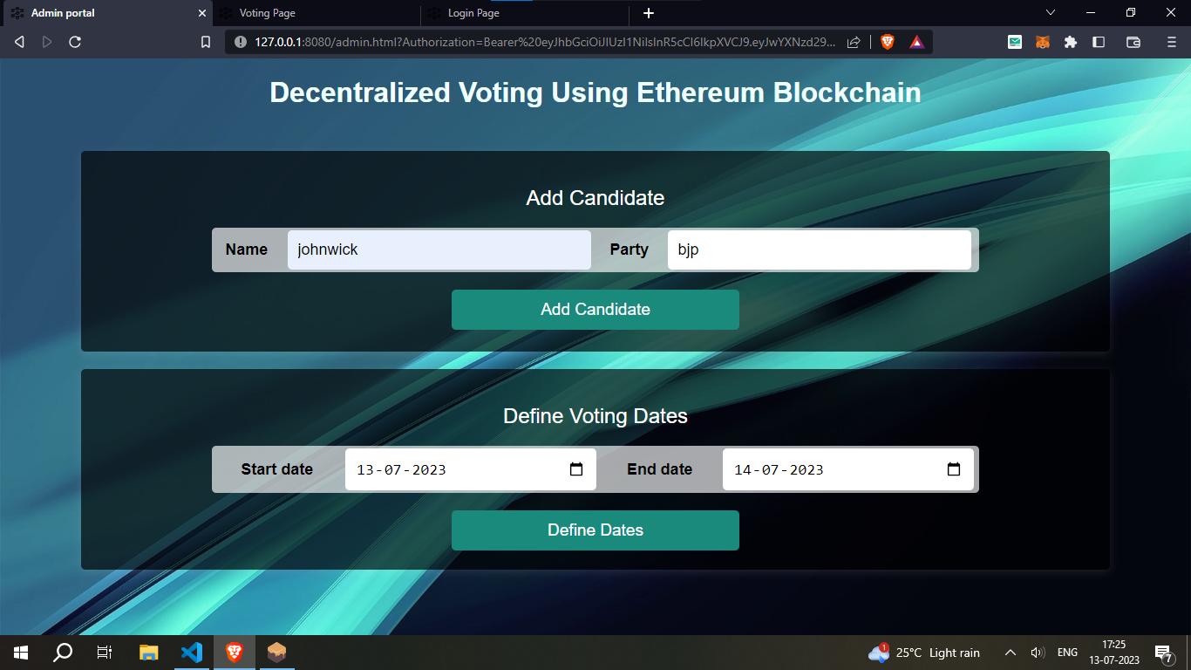

Slide 14
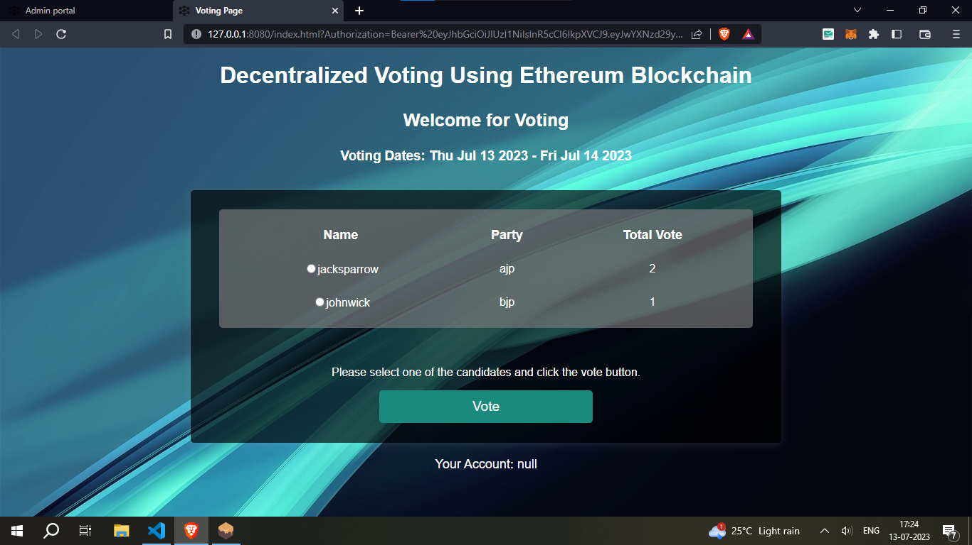

Slide 15
Work Initiation and Ability to Work as a Team
Team Formation
Composed of individuals with expertise in blockchain, programming, and UI/UX design.
Initial Steps Taken
Requirement analysis and feasibility study.
Selection of blockchain platform (e.g., Ethereum, Hyperledger).
Basic architecture design and task allocation.
Team Collaboration
Regular brainstorming sessions and progress tracking.
Use of tools like GitHub for version control and task management.
Key Strengths
Strong technical foundation and effective communication.
Commitment to delivering a scalable and efficient solution.

