Slide 1
Overlay Network
Peer-to-peer Networks
  Structured Overlays
    A well-known technique for mapping names into address is to use a hash table, so that
      hash(x) → n
    implies object x is first placed on node n, and at a later time, a client trying to locate x would only have to perform the hash of x to determine that it is on node n.
    A hash-based approach has the nice property that it tends to spread the objects evenly across the set of nodes, but straightforward hashing algorithms suffer from a fatal flaw: how many possible values of n should we allow?
    Naively, we could decide that there are, say, 101 possible hash values, and we use a modulo hash function; that is,
      hash(x)
      return x % 101.
Notes:
The University of Adelaide, School of Computer Science
Chapter 2 — Instructions: Language of the Computer

Slide 2
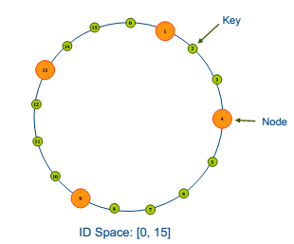
Structured Overlays
  A well-known technique for mapping names into address is to use a hash table, so that
    hash(x) → n
  Naively, we could decide that there are, say, N possible hash values, and we use a modulo hash function; that is,
    hash(x)
    return x % N.
Notes:
The University of Adelaide, School of Computer Science
Chapter 2 — Instructions: Language of the Computer

Slide 3
Terminology
Values: The set of values V such as files, etc.. With a key from the set Keys(V ), which could be checksum.
Nodes: The set P of machines/processes also referred to as nodes or peers. Keys(P ) is the set of unique keys for members of P.
The Identifier Space: A common and fundamental assumption of all DHTs is that the keys of the values and the keys of the nodes are mapped into one range using a hashing function.

Slide 4
Items: We use the term “item” to refer to a key-value pair.
The basic problem is:
  Given: A set of shared objects in a network.
  Goal: Designing an access scheme that is efficient w.r.t both time and space.

Slide 5
Underlying Idea
Map the nodes and objects to b-ary numbers of m-digits.
Assign each object to the node with which it shares the largest prefix.
  e.g. b = 4 and m = 6:
321231
321302
321201

Slide 6
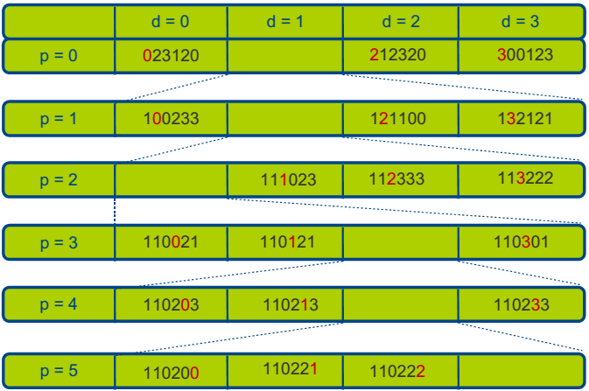
b = 4, m = 6; nodeID = 110223
110220

Slide 7
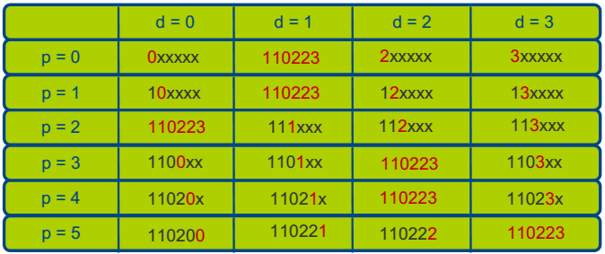
Routing table
Arranging things in graph like structure.
  Level i matches i prefix entries.
  Number of rows = m.
  Number of entries per level = b.
  b = 4, m = 6 (b-ary numbers of m digits)
  nodeID = 110223

Slide 8
Routing
At node A find object O:
  Let the shared prefix of A and O be of length n,
  Look at level n+1 in routing table of A,
  Find the entry at level n+1 that matches digit n+1 of O's id (call it the node B),
  Send the message to node B,
  Eventually the message gets relayed to the destination.
Move closer to the target one digit at the time

Slide 9
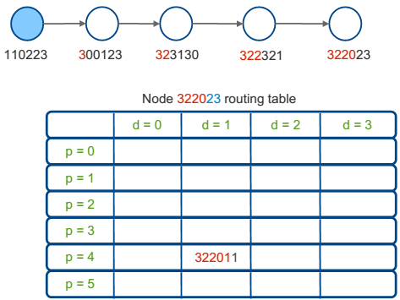
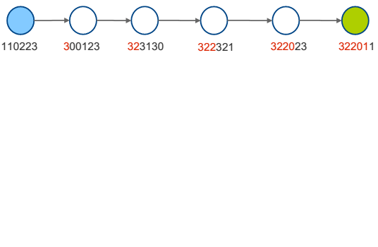
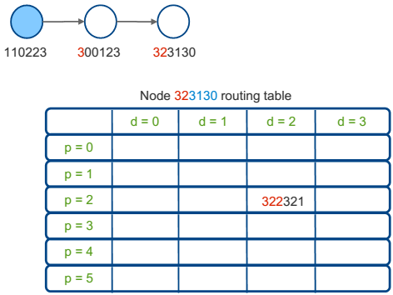
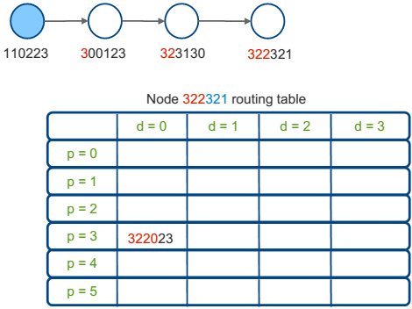
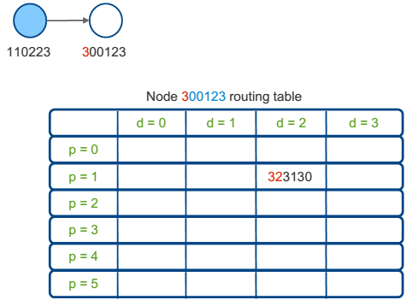
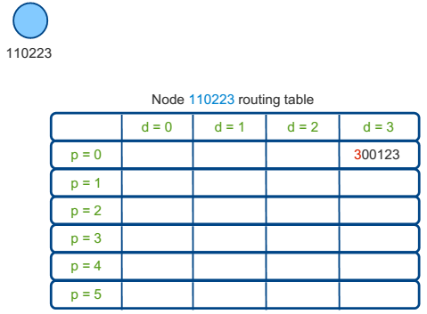
Example
b = 4, m = 6, nodeID = 110223 → 322010 lookup(322010)

Slide 10
Pastry: Scalable, decentralized object location and routing for large-scale peer-to-peer systems
Antony Rowstron
Peter Druschel

Slide 11
Motivation
Node IDs are assigned randomly
  With high probability nodes with adjacent IDs are diverse
Considers network locality
  Seeks to minimize distance messages travel
    Scalar proximity metric
      #IP routing hops
      RTT

Slide 12
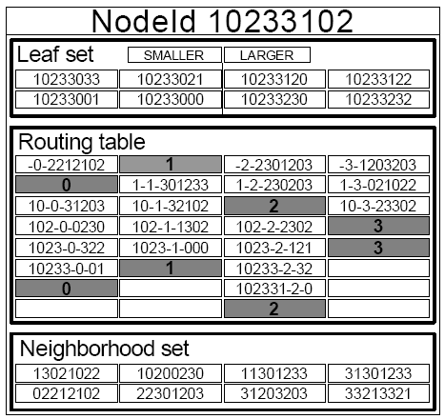
Pastry: Node Soft State
Storage requirement in each node = O(log N)
Immediate Neighbors in ID space
(Used for routing)
Similar to successor and predecessor
Used for routing
Similar to finger table entries
Nodes closest according to locality
(Used to update routing table)

Slide 13
Identifier Space
Nodes and data items (objects) are m-bit identifiers that creates an identifier space of 2^{m} points distributed uniformly on a circle in the clock-wise direction (Usually m=128)
An identifier is seen as an n-digit string in base 2^{b} in which b is normally 4 and n=(m/b)
In this identifier space, a key is stored in the node whose identifier is numerically closest to the key

Slide 14
Routing
A node in Pastry should be able to resolve a query
  Given a key, the node should be able to find the node identifier responsible for that key, or
  Forward the query to another node
  Each node uses a “routing table” and a “leaf set” to do so

Slide 15
Routing Table
n rows and 2^{b} columns
In general, when m=128 and b=4, n=32 (128/4)
32 rows and 16 columns (hexadecimal)
In other words, A row for each digit in the identifier and a column for each hexadecimal value (0 to F)

Slide 16
Routing Table
Common prefix length | 0 | 1 | 2 | 3 | 4 | 5 | 6 | 7 | 8 | 9 | A | B | C | D | E | F
0
1
…
31
Table[i,j] gives the identifier a node (if exists) that shares the i leftmost digits with the identifier of N and its (i+1)th digit has a value of j

Slide 17
Routing Table; Example
Common prefix length | 0 | 1 | 2 | 3 | 4 | 5 | 6 | 7 | 8 | 9 | A | B | C | D | E | F
0
1
…
31
If N = (574A234B12E374A2001B2345EEE4BCD)₁₆
Value of Table[2,D] can be the identifier of a node such that (57D…)
If there are more nodes with prefix 57D, then the closest one is chosen

Slide 18
Leaf Set
Set of 2^{b} identifiers called Leaf set
Half of the set is a list of identifiers that are numerically smaller than the identifier of the current node and the other half – larger than current node
In other words, leaf set gives the identifier of 2^{b-1} live nodes before the current nodes in the ring and the list of 2^{b-1} nodes after the current node in the string

Slide 19
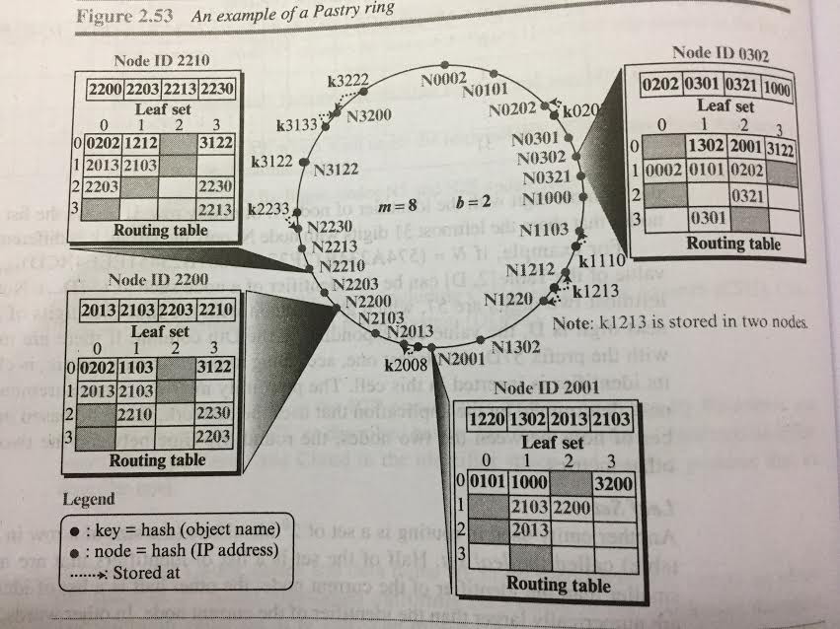
Example
Lets assume m=8 bits and b=2
We have 2^{m} = 256 identifiers
m/b = 4 digits in base 2^{b} = 4

Slide 20
Example
Notice that, closer nodes on either sides are inserted into leaf set
Table [i,j]
Table[1,2]
  1 (i) digit same as node and second digit to be 2 (j) = 0202
  Table[3,1] means, three digits to be same and following 4th digit is 1 = 0301

Slide 21
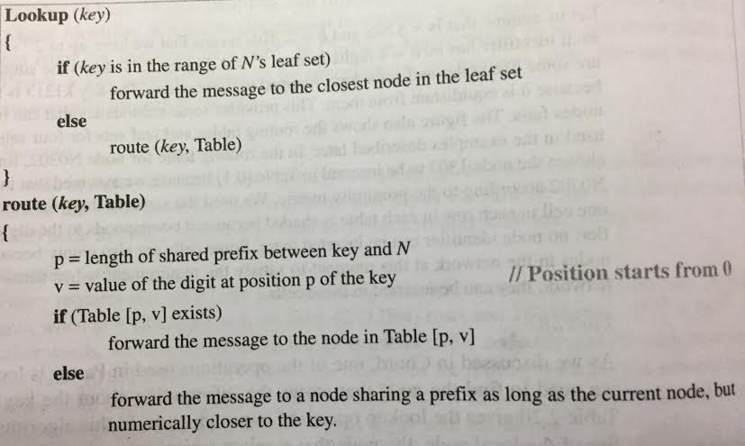
Lookup

Slide 22
Example
Assume node N2210 receives a query to find the node containing the key 2008
First checks leaf set → Not there
Uses routing table

Slide 23
Assume node N2210 receives a query to find node with key 2008
Common prefix, p=1
Value of the digit at position 1 in the key, v=0
Table[1,0] = 2013; Query forwarded to 2013 which is actually responsible for the key

Slide 24
Pastry: Node Soft State
Leaf Set
  Contains L nodes, closest in the ID space
Neighborhood Set
  Contains M nodes, closest according to proximity metric
Routing Table
  Entries of row n, shares exactly the first n digits with the local node
  Nodes are chosen according to proximity metric

Slide 25
Pastry: Routing
Case I
  Key within leaf set
    Route to the node in the leaf set with ID closest to key
Case II (Prefix Routing)
  Key not within leaf set
    Route a node in the routing table, such that the new node shares one more digit with the key than the local node
Case III
  Key not within leaf set
  Case II not possible
    Route to a node which shares at least same number of digits with the key, but is closer to the key than the local node

Slide 26

Routing Example
d471f1
d467c4
Cuts the ID space into 1/(2^b)
Number of hops needed is log_{2^b}N
d46a1c
d462ba
d4213f
lookup(d46a1c)
d13da3
65a1fc

Slide 27
Self Organization: Node Join
d471f1
Z=d467c4
X=d46a1c
d462ba
d4213f
New node: X=d46a1c
A is X’s neighbor
Route(d46a1c)
d13da3
A = 65a1fc
Notes:
Each node has a randomly assigned 128-bit nodeId, circular namespace
Basic operation: A message with key X, sent by any Pastry node, is delivered
to the live node with nodeId closest to X in at most log₁₆ N steps (barring node failures).
Pastry uses a form of generalized hypercube routing, where the routing tables are initialized and updated dynamically.

Slide 28
THANK YOU

