Slide 1

TRAVEL THROUGH THE WORLD

Slide 2
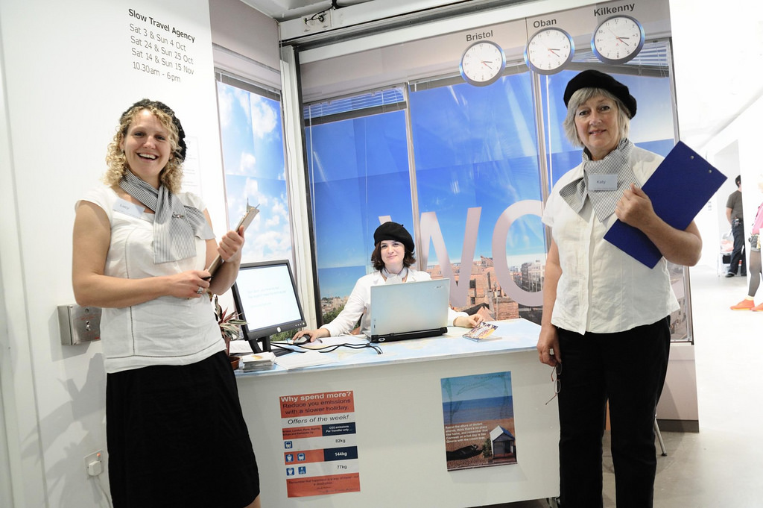
ENJOY EVERYWHERE

