Slide 1
IBM Hack Challenge
(USER QUERY ON STACK OVERFLOW)

Slide 2

Techieez
Adithya AN
Niresh Kumar R
Frontend Developer
Backend Developer

Slide 3
Technology Stack
Tools
WebStorm
Languages and Frameworks
ReactJS
Platform
Google Chrome
APIs
Watson NLU Sentiment
Analyzer
Stack Exchange
`

Slide 4

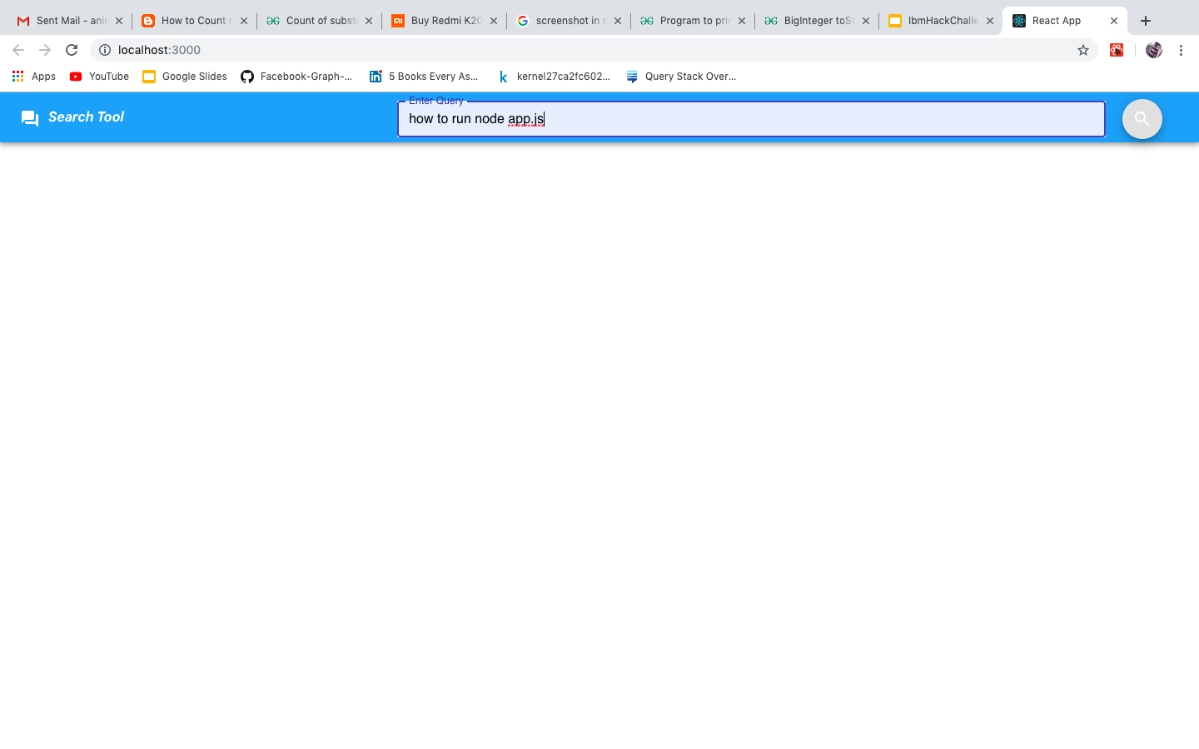
Screenshots

Slide 5
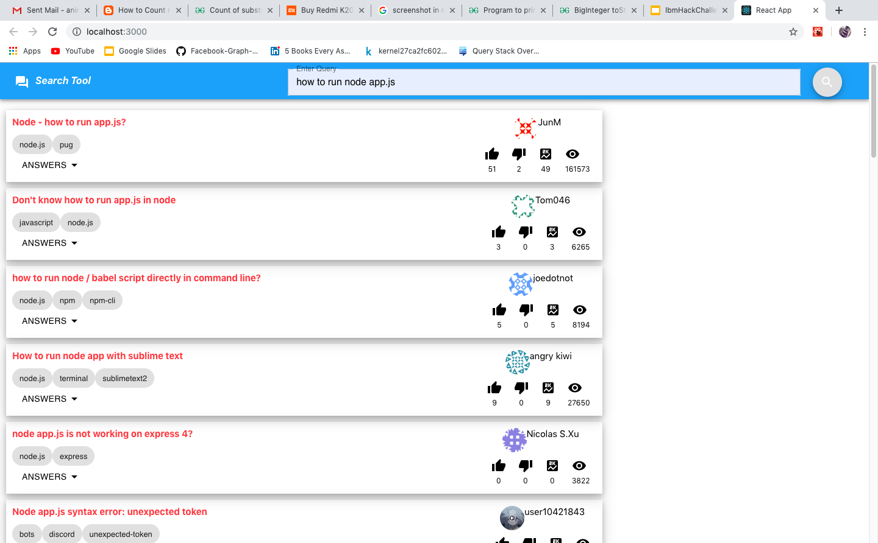
Screenshots

Slide 6
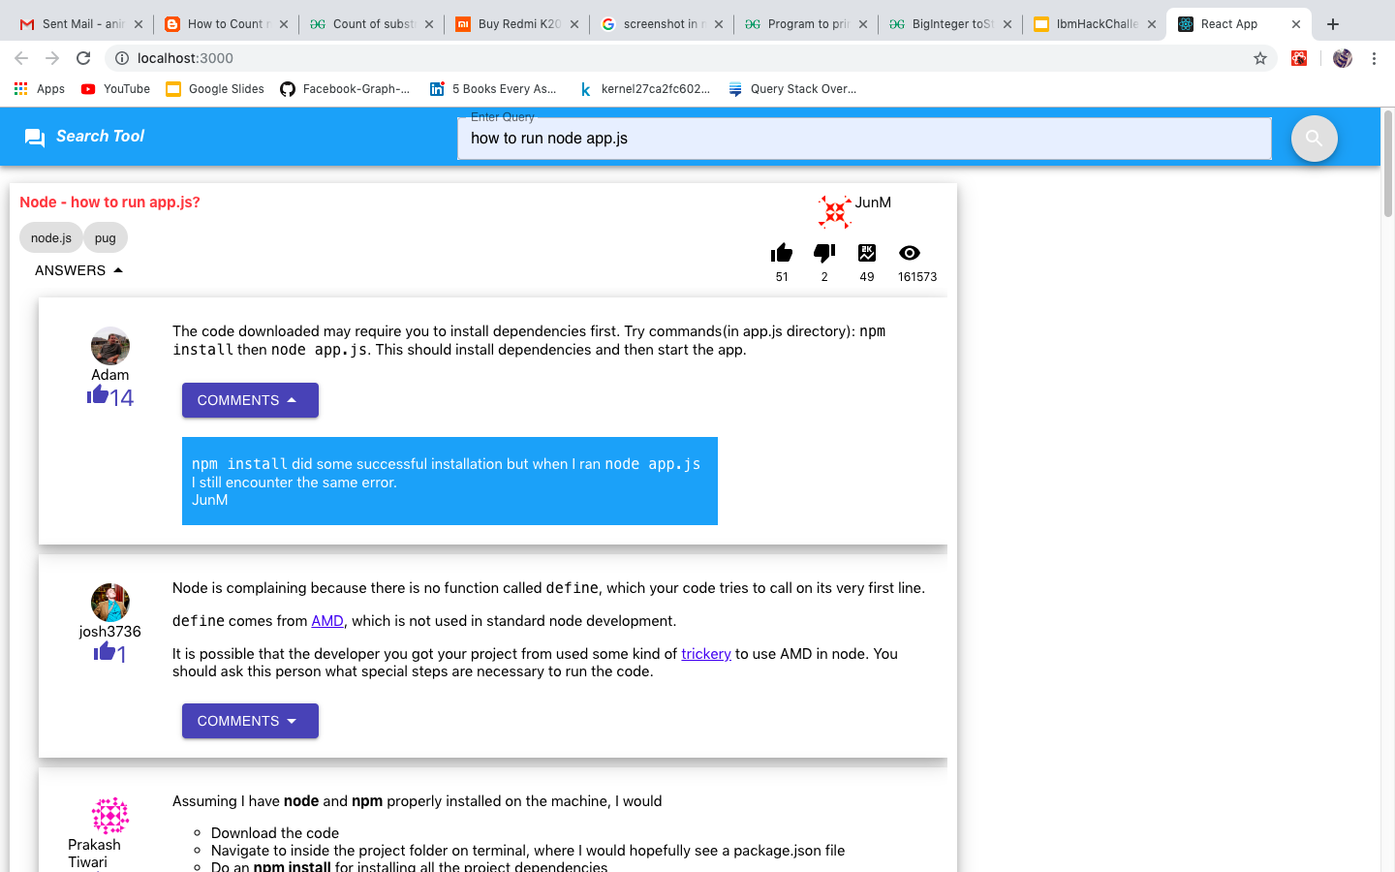
Screenshots

Slide 7
Key Functionalities
IBM Sentiment Analysis
Stack Exchange API
Our Mobile App
Get data for users query
Does sentiment analysis on user content
The application uses the sentiment analysis from ibm sentiment analyser and provides the top k solutions to the user.

Slide 8
Material Design
Make important things fast
Pictures are faster than words
Real objects are more fun than buttons and menus

Slide 9
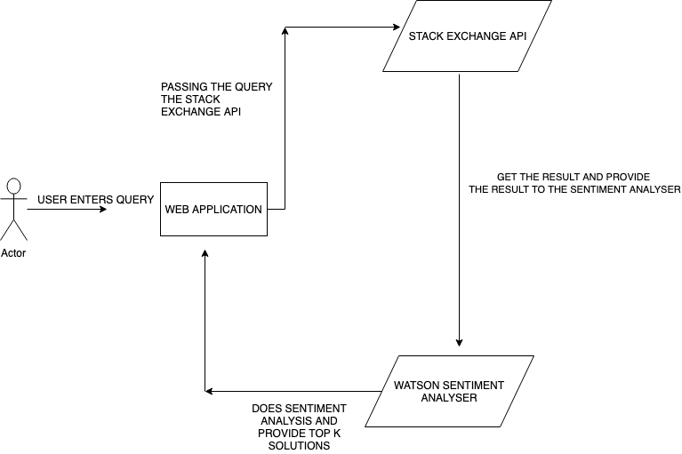
ARCHITECTURE

Slide 10
Links to the Project;
GITHUB URL:
https://github.com/adithyaan/IBMHackChallenge2k19
Youtube Demo Url:
https://youtu.be/lZK7ZRFcnx4

Slide 11

Thank you.

