Slide 2
IP0355 – Using AI to estimate State of Charge (SOC) for a battery pack

Slide 3
Objective
Accurate and reliable method for assessing SOC of batteries
Leverage AI and machine learning algorithms for analysis of battery data
Deploy the AI model on a microcontroller, such as TC4XX
Enable real-time battery SOC monitoring and management
Facilitate the integration of the system with existing battery management systems.

Slide 4
Overview of the workflow
Data Collection and Preparation: Collect battery data, clean and preprocess it for training the LSTM model.
LSTM Model Development: Develop an LSTM model and train it using the pre-processed battery data.
Model Evaluation and Testing: Evaluate the trained LSTM model to test its accuracy in predicting battery SoC.
Deployment on Microcontroller: Once the LSTM model is trained and tested, deploy it on a microcontroller.
Integration with Battery Management System

Slide 5
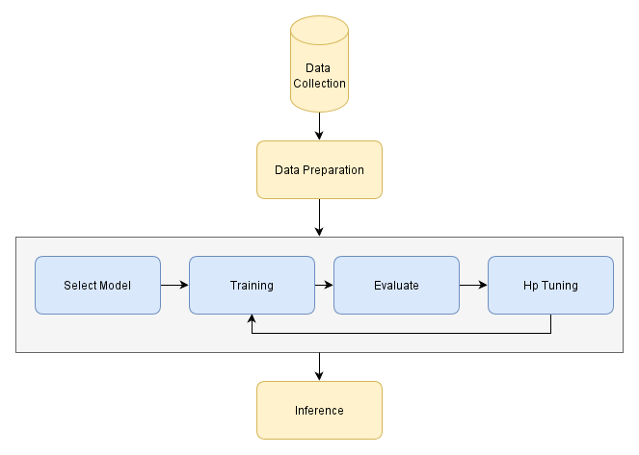
LSTM Model : Data Preparation, TRAINING and Testing
Dataset Acquisition/ Data Collection
Data Preparation
Training and Evaluating the Neural network
Inference

Slide 6
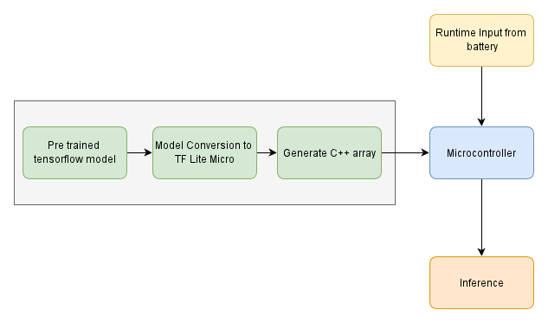
Model Conversion and deployment
Use the TensorFlow Lite converter to convert the TensorFlow model to a TensorFlow Lite Microcontroller format
Optimize the model for microcontrollers by quantizing the weights
Generate C++ Header array
Load the Model into the Microcontroller

Slide 7
REFERENCES
AI Workflow
AI Workflow - API Documentation
AI Workflow - Model conversion to microcontroller format
AI Workflow - Deploy model to microcontroller device

Slide 8
Thank You!!

