Slide 1

Flexible State Machine Replication
Adithya Bhat

Slide 2
State Machine Replication Applications
Bulletin board / broadcast channel implementation
MPC
Cryptographic setup protocols
Distributed Database (E.g., Google Drive)

Slide 3
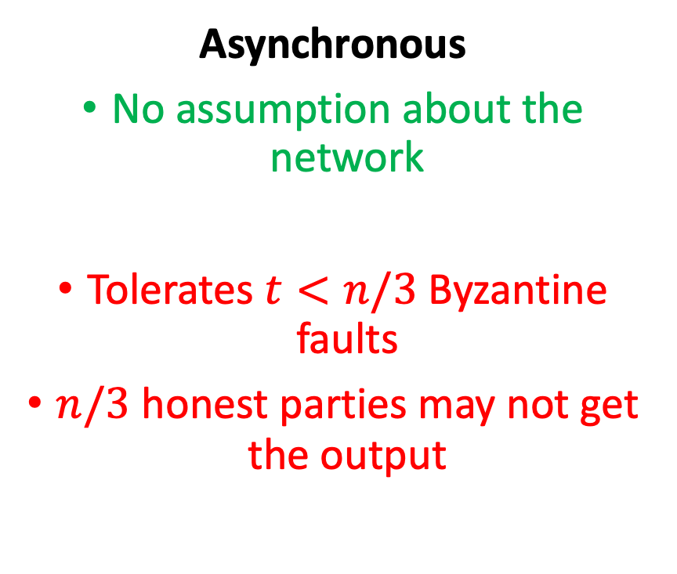
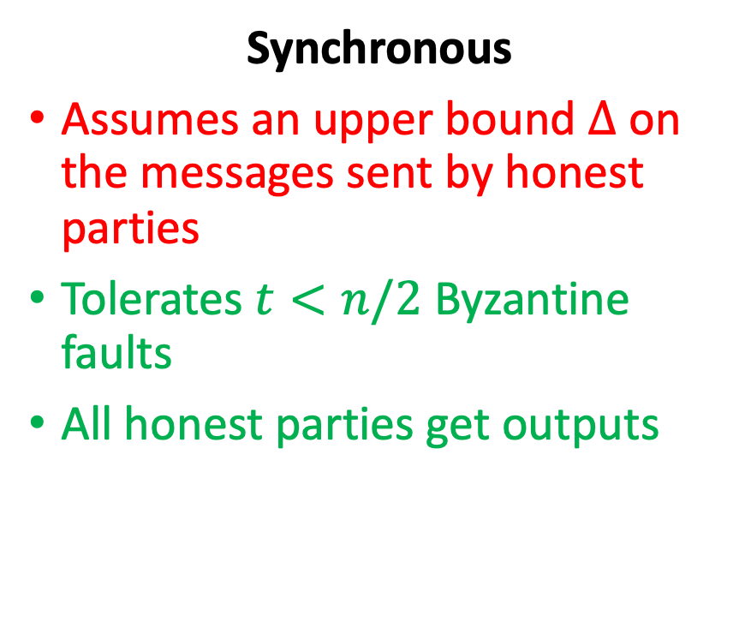
Network Models
Synchronous
Assumes an upper bound $Δ$ on the messages sent by honest parties
Tolerates $t<n/2$ Byzantine faults
All honest parties get outputs
Asynchronous
No assumption about the network
Tolerates $t<n/3$ Byzantine faults
$n/3$ honest parties may not get the output

Slide 4
For State Machine Replication, what network assumption do we choose?

Slide 5



Ideal Solution
Flexible SMR
…
…
Servers are network agnostic
Servers ensure that the log of transactions always grow

Slide 6

Ideal Solution
Flexible SMR
…
…
I believe that
the network is synchronous
The adversary is adaptive
I believe that
the network is asynchronous
The adversary is static

Slide 7
FSMR Problem
FSMR protocol guarantees:
Chain growth (server responsibility)
Safety (based on client assumption)
Commit liveness (based on client assumption)
Execution liveness (based on client assumption)

Slide 8
Our Solution
We construct a flexible SMR protocol where
Servers ensure that a chain keeps growing
Clients choose their assumptions (Flexibility)
Static vs. adaptive
Number of faults (1, 4, n/10, n/3)
Type of faults: crash and/or Byzantine
Network: synchronous vs. partially synchronous

