Slide 1




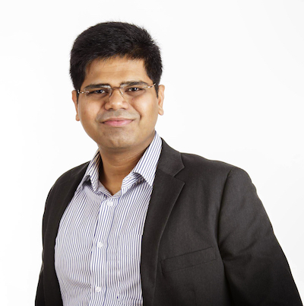
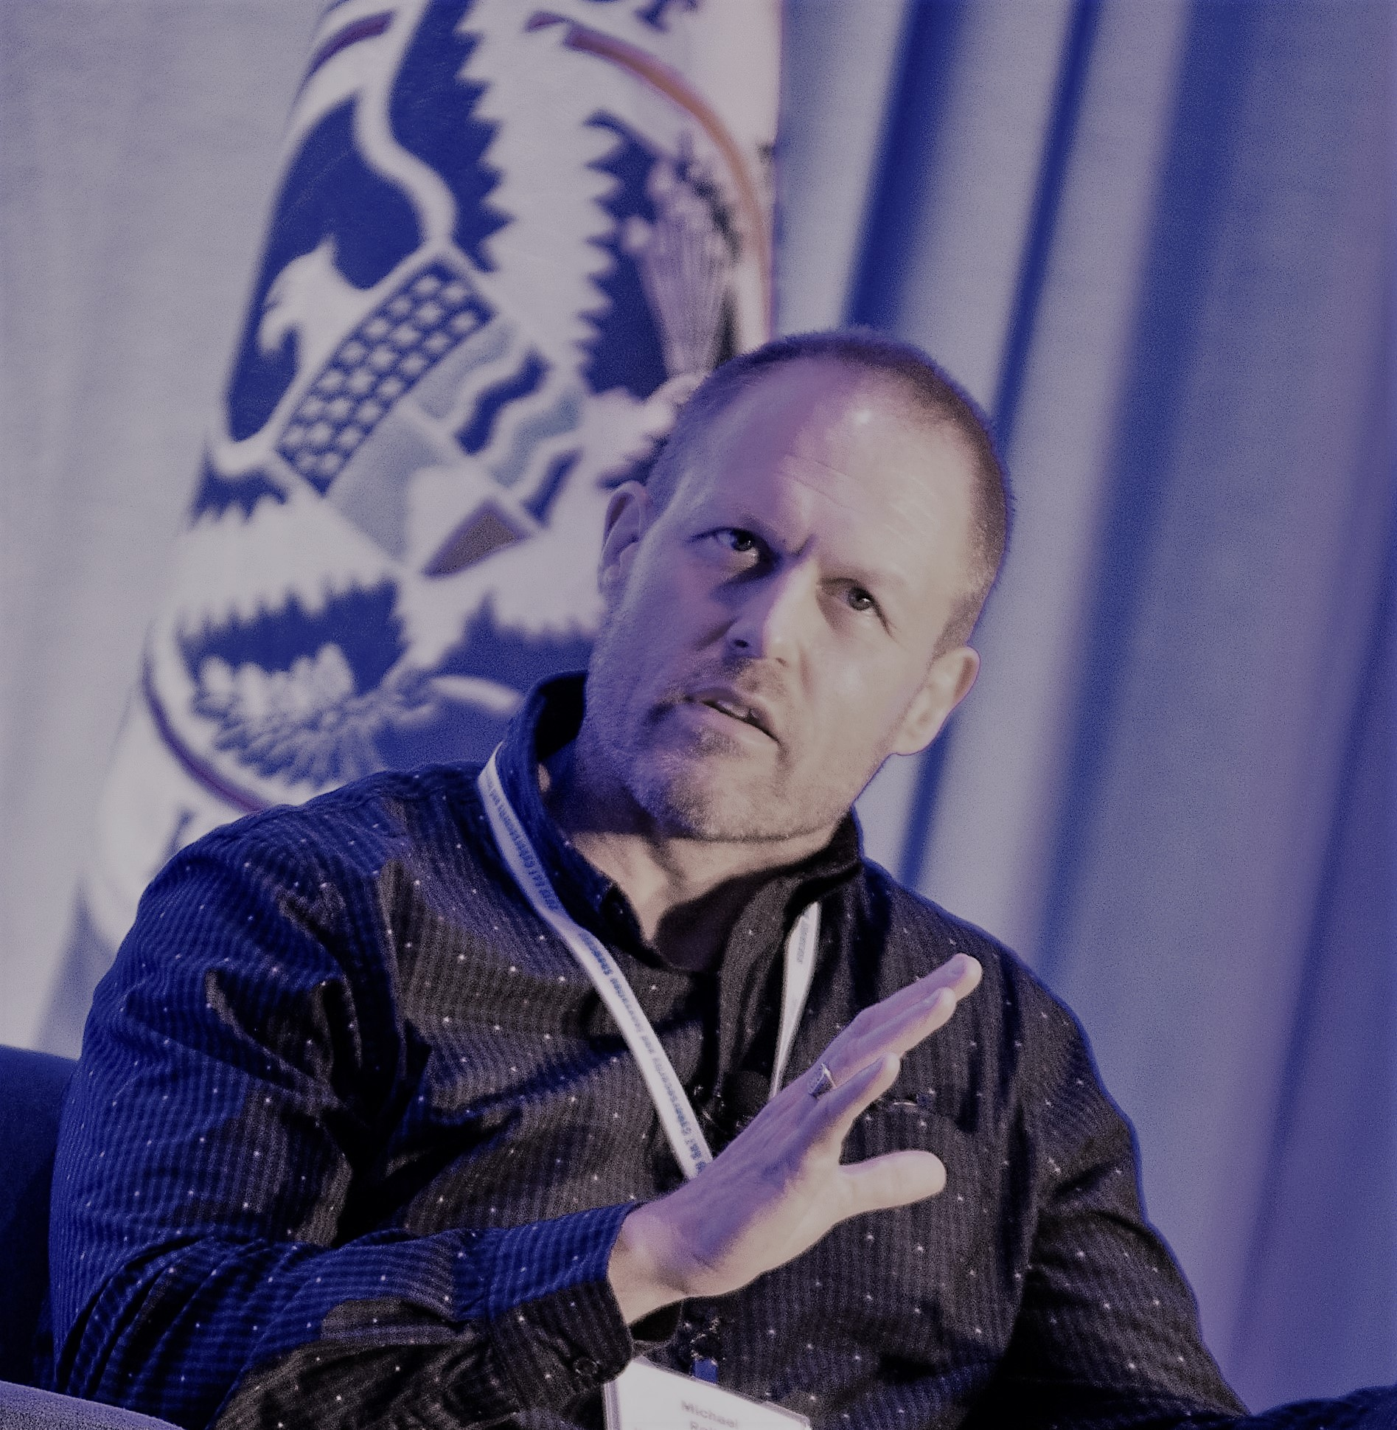














Unique Chain Rule and its Applications
$$r+1$$
$$r+2$$
$$r+3$$
$$r+4$$
$$r+5$$
$$r+6$$
$$r+7$$
$$r+8$$
$$L$$
$$L$$
$$L$$
$$L$$
$$L$$
1
2
3
4
5
1
2
3
Adithya Bhat
Akhil Bandarupalli
Saurabh Bagchi
Aniket Kate
Michael K Reiter

Slide 2













State Machine Replication (SMR)
$$r+1$$
$$r+2$$
$$r+3$$
$$r+4$$
$$r+5$$
$$r+6$$
$$r+7$$
$$r+8$$
$$L$$
$$L$$
$$L$$
$$L$$
$$L$$
Hash links
Blocks with client requests
Roughly, SMR is a distributed protocol with interfaces implementing a single trusted state machine
Generally constructed by ordering blocks of client requests
Let’s understand some typical SMR protcols

Slide 3

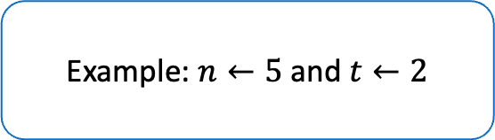




Typical SMR Protocols
Example: $n←5$ and $t←2$
$$1$$
$$2$$
$$3$$
$$4$$
$$5$$

Slide 4










Typical SMR Protocols
One or more servers act as a leader and propose blocks
$$1$$
$$1$$
$$2$$
$$2$$
$$3$$
$$3$$
$$4$$
$$4$$
$$5$$
$$5$$
One or more leaders

Slide 5





Typical SMR Protocols
Collect feedback
(DAG or a quorum certificate of signatures)
$$1$$
$$1$$
$$1$$
$$2$$
$$2$$
$$2$$
$$3$$
$$3$$
$$3$$
$$4$$
$$4$$
$$4$$
$$5$$
$$5$$
$$5$$
One or more leaders
All-to-all
or
all-to-one

Slide 6






Typical SMR Protocols
Propose again
$$1$$
$$1$$
$$1$$
$$1$$
The feedback round
Adds latency to the block production/commit rate
Forces synchronization (enough servers need to catch up)
Adds computation/communication overheads
$$2$$
$$2$$
$$2$$
$$2$$
$$3$$
$$3$$
$$3$$
$$3$$
$$4$$
$$4$$
$$4$$
$$4$$
$$5$$
$$5$$
$$5$$
$$5$$
One or more leaders
All-to-all
or
all-to-one
Same or different leader

Slide 7
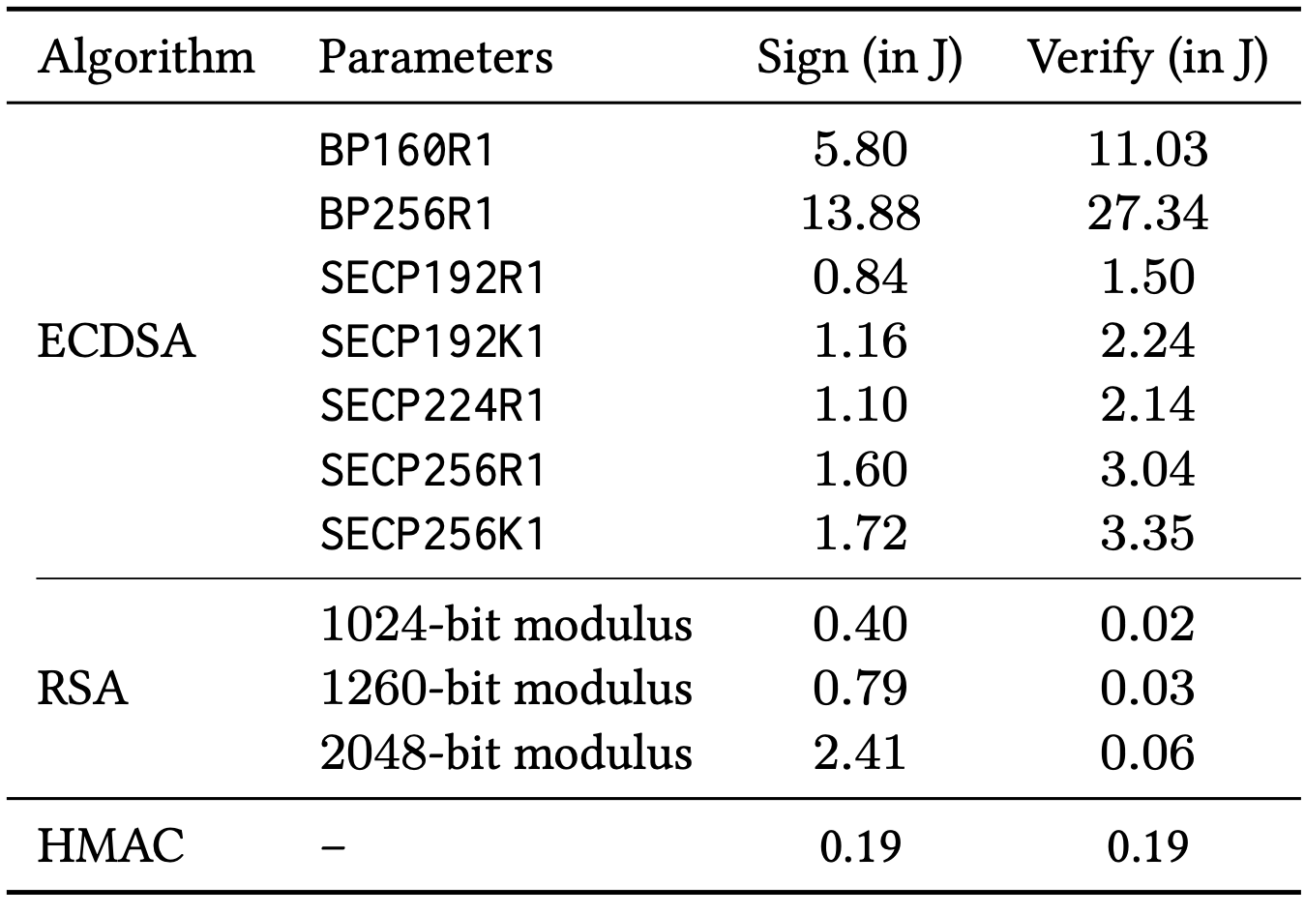
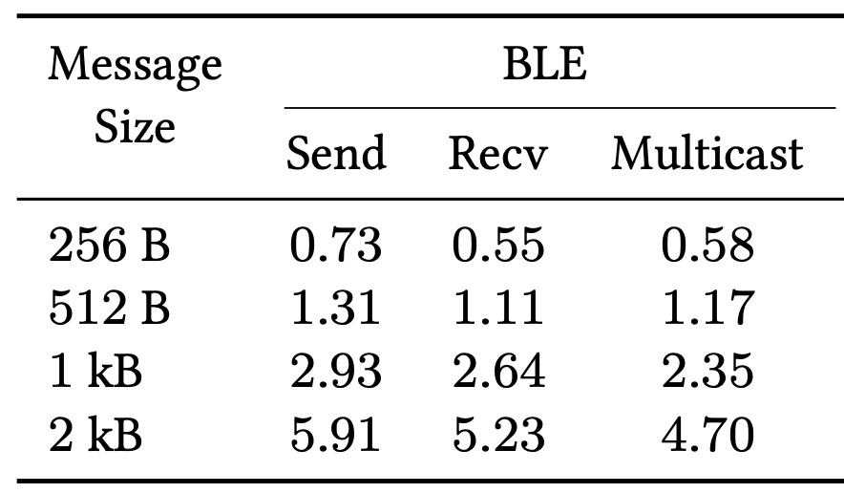
Energy-efficiency
On embedded devices, digital signature operations are expensive🔥
In signature size and/or
Computation
Feedback protocols are energy-intensive
The units are in mJ

Slide 8
🥅 Goals
Feedback-free protocol
Improved usage of digital signatures
Optimal block commit rate (aka block period)
Optimal fault-tolerance

Slide 9
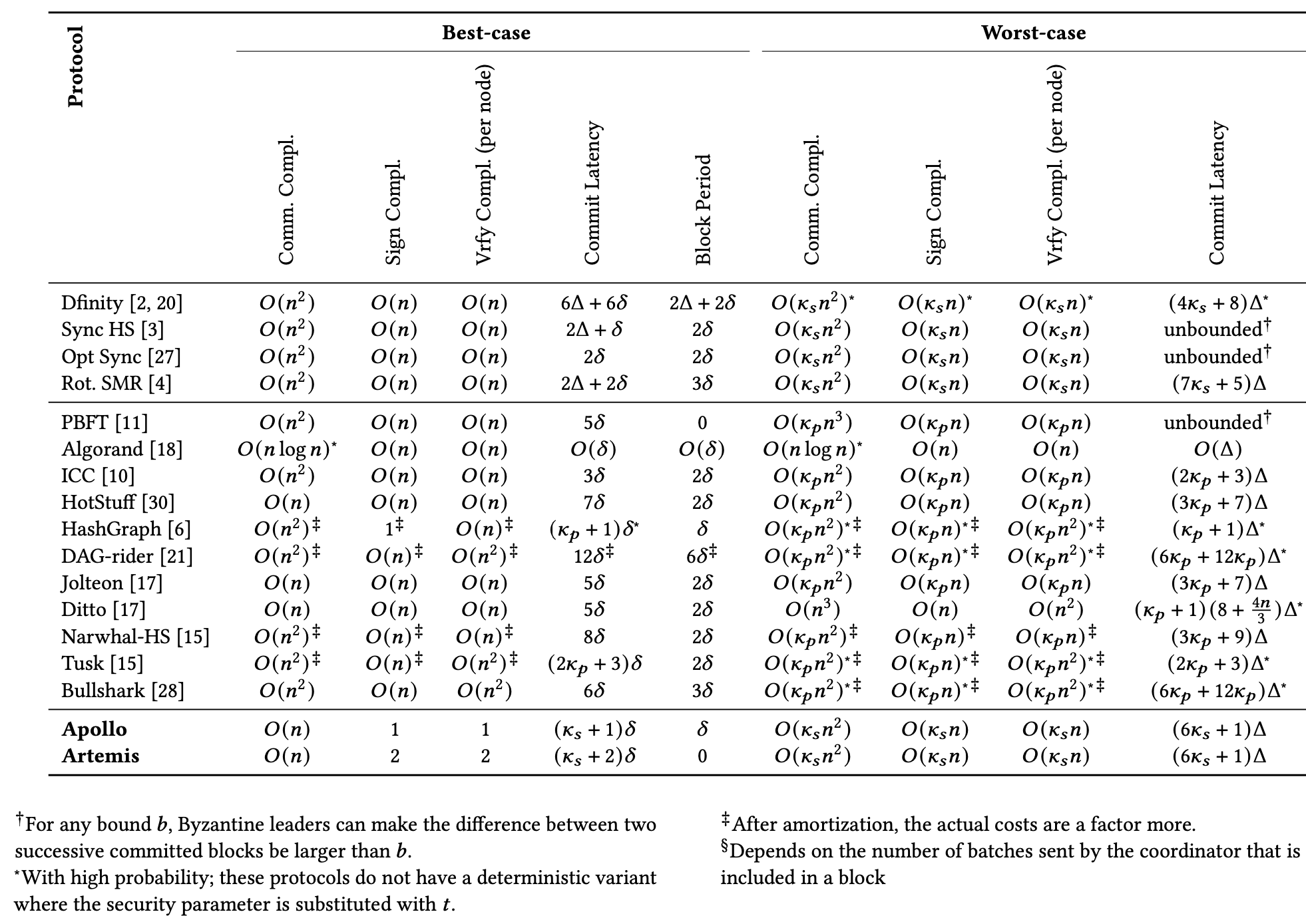
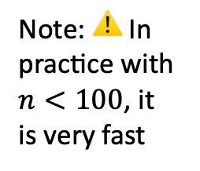
✅
✅
✅
⚠️
✅
✅
✅
✅
⚠️
Note: ⚠️ In practice with $n<100$, it is very fast

Slide 10
Permissioned Bitcoin Protocol
A thought experiment

Slide 11
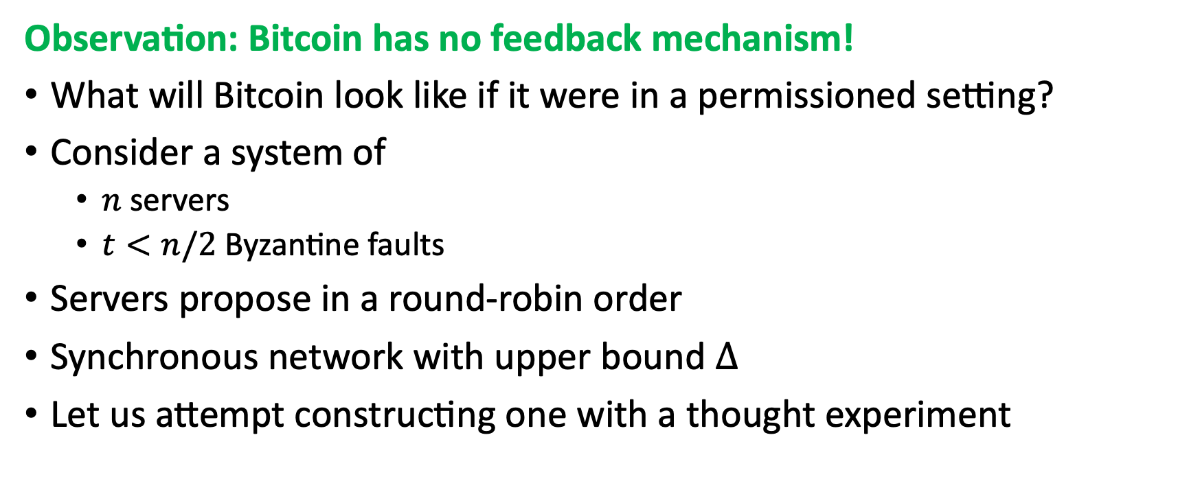
Permissioned Bitcoin Protocol
Observation: Bitcoin has no feedback mechanism!
What will Bitcoin look like if it were in a permissioned setting?
Consider a system of
$n$ servers
$t<n/2$ Byzantine faults
Servers propose in a round-robin order
Synchronous network with upper bound $Δ$
Let us attempt constructing one with a thought experiment

Slide 12

Permissioned Bitcoin Protocol
Example: $n←5$ and $t←2$
$$1$$
$$2$$
$$3$$
$$4$$
$$5$$

Slide 13
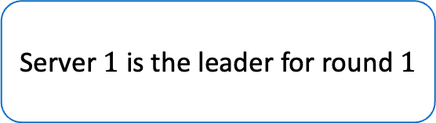

Permissioned Bitcoin Protocol
Server $1$ is the leader for round $1$
$$1$$
$$2$$
$$3$$
$$4$$
$$5$$

Slide 14

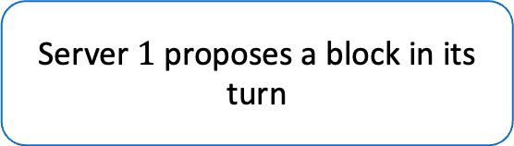




Permissioned Bitcoin Protocol
Server $1$ proposes a block in its turn
$$1$$
$$1$$
$$2$$
$$2$$
$$3$$
$$3$$
$$4$$
$$4$$
$$5$$
$$5$$

Slide 15

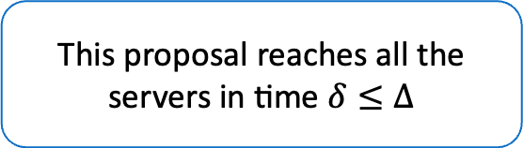

Permissioned Bitcoin Protocol
This proposal reaches all the servers in time $δ≤Δ$
$$1$$
$$1$$
$$2$$
$$2$$
$$3$$
$$3$$
$$4$$
$$4$$
$$5$$
$$5$$
$$T=0$$
$$T=δ$$

Slide 16
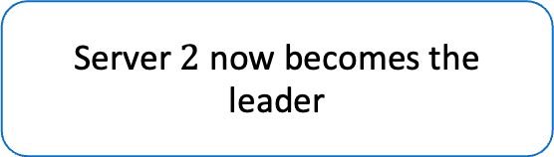

Permissioned Bitcoin Protocol
Server $2$ now becomes the leader
$$1$$
$$1$$
$$2$$
$$2$$
$$3$$
$$3$$
$$4$$
$$4$$
$$5$$
$$5$$
$$T=0$$
$$T=δ$$

Slide 17

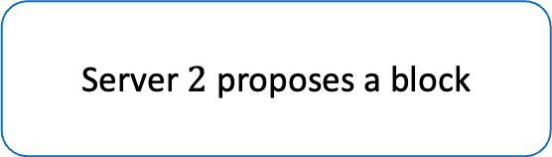





Permissioned Bitcoin Protocol
Server $2$ proposes a block
$$1$$
$$1$$
$$1$$
$$2$$
$$2$$
$$2$$
$$3$$
$$3$$
$$3$$
$$4$$
$$4$$
$$4$$
$$5$$
$$5$$
$$5$$
$$T=0$$
$$T=δ$$
$$t=2δ$$

Slide 18
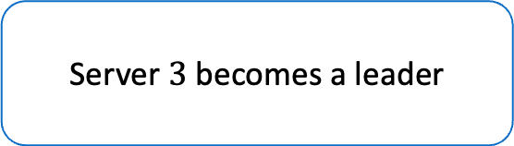


Permissioned Bitcoin Protocol
Server $3$ becomes a leader
$$1$$
$$1$$
$$1$$
$$2$$
$$2$$
$$2$$
$$3$$
$$3$$
$$3$$
$$4$$
$$4$$
$$4$$
$$5$$
$$5$$
$$5$$
$$T=0$$
$$T=δ$$
$$T=2δ$$

Slide 19
Permissioned Bitcoin Protocol
The protocol continues …
$$1$$
$$1$$
$$1$$
$$2$$
$$2$$
$$2$$
No fault-tolerance yet. 😢
$$3$$
$$3$$
$$3$$
$$4$$
$$4$$
$$4$$
$$5$$
$$5$$
$$5$$
$$T=0$$
$$T=δ$$
$$T=2δ$$

Slide 20
Handling Crash Faults
Adding Crash Fault-tolerance to our candidate protocol

Slide 21

Handling Crash Faults
Server can crash
By sending blocks to some servers and not others
By not sending blocks to any server
Technique: Construct blame quorum certificates ($t+1)$ if crash is detected

Slide 22

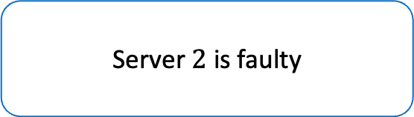
Handling Crash Faults
Server $2$ is faulty
$$1$$
$$3$$
$$4$$
$$5$$

Slide 23






Handling Crash Faults
First round proceeds normally
$$1$$
$$1$$
$$3$$
$$3$$
$$4$$
$$4$$
$$5$$
$$5$$
$$T=0$$
$$T=δ$$

Slide 24
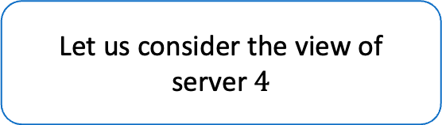
Handling Crash Faults
Let us consider the view of server $4$
$$1$$
$$1$$
$$3$$
$$3$$
$$4$$
$$4$$
$$5$$
$$5$$
$$T=0$$
$$T=δ$$

Slide 25


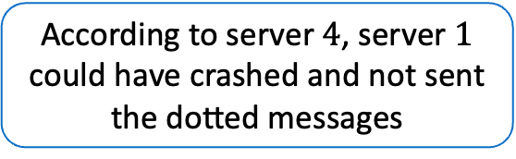
Handling Crash Faults
According to server $4$, server $1$ could have crashed and not sent the dotted messages
$$2$$
$$2$$
$$3$$
$$3$$
$$4$$
$$4$$
$$5$$
$$5$$
$$T=0$$
$$T=δ$$

Slide 26



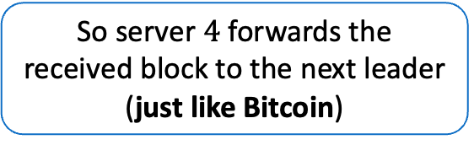



Handling Crash Faults
So server $4$ forwards the received block to the next leader (just like Bitcoin)
$$1$$
$$2$$
$$2$$
$$2$$
$$3$$
$$3$$
$$3$$
$$4$$
$$4$$
$$4$$
$$5$$
$$5$$
$$5$$
$$T=0$$
$$T=δ$$
$$T=2δ$$

Slide 27
Handling Crash Faults
In general, in every round, all servers forward their blocks to the next leader
$$1$$
$$1$$
$$1$$
$$3$$
$$3$$
$$3$$
$$4$$
$$4$$
$$4$$
$$5$$
$$5$$
$$5$$
$$T=0$$
$$T=δ$$
$$T=2δ$$

Slide 28
Handling Crash Faults
On forwarding the blocks, all servers start a timer
$$1$$
$$1$$
$$1$$
$$3$$
$$3$$
$$3$$
$$4$$
$$4$$
$$4$$
$$5$$
$$5$$
$$5$$
$$T=0$$
$$T=δ$$
$$T=2δ$$

Slide 29






Handling Crash Faults
After some time, servers times out
$$1$$
$$1$$
$$1$$
$$1$$
$$3$$
$$3$$
$$3$$
$$3$$
$$4$$
$$4$$
$$4$$
$$4$$
$$5$$
$$5$$
$$5$$
$$5$$
$$T=0$$
$$T=δ$$
$$T=2δ$$
$$T=4Δ+δ$$

Slide 30





Handling Crash Faults
They send a signed blame message
$$1$$
$$1$$
$$1$$
$$1$$
$$1$$
$$3$$
$$3$$
$$3$$
$$3$$
$$3$$
$$4$$
$$4$$
$$4$$
$$4$$
$$4$$
$$5$$
$$5$$
$$5$$
$$5$$
$$5$$
$$T=0$$
$$T=δ$$
$$T=2δ$$
$$T=4Δ+δ$$
$$T=4Δ+2δ$$

Slide 31










Handling Crash Faults
Blame certificates for a round are treated as normal blocks
$$1$$
$$1$$
$$1$$
$$1$$
$$1$$
$$3$$
$$3$$
$$3$$
$$3$$
$$3$$
$$4$$
$$4$$
$$4$$
$$4$$
$$4$$
$$5$$
$$5$$
$$5$$
$$5$$
$$5$$
$$T=0$$
$$T=δ$$
$$T=2δ$$
$$T=4Δ+δ$$
$$T=4Δ+2δ$$

Slide 32






Handling Crash Faults
Normal protocol resumes …
$$1$$
$$1$$
$$1$$
$$1$$
$$1$$
$$1$$
$$3$$
$$3$$
$$3$$
$$3$$
$$3$$
$$3$$
$$4$$
$$4$$
$$4$$
$$4$$
$$4$$
$$4$$
$$5$$
$$5$$
$$5$$
$$5$$
$$5$$
$$5$$
$$T=0$$
$$T=δ$$
$$T=2δ$$
$$T=4Δ+δ$$
$$T=4Δ+2δ$$
$$T=4Δ+3δ$$

Slide 33
Handling Byzantine Faults
Adding Byzantine Fault-tolerance to our candidate protocol

Slide 34
Handling Byzantine Faults
Server $2$ is faulty
$$1$$
$$3$$
$$4$$
$$5$$

Slide 35
Handling Byzantine Faults
Normal protocol
$$1$$
$$1$$
$$3$$
$$3$$
$$4$$
$$4$$
$$5$$
$$5$$
$$T=δ$$

Slide 36
Handling Byzantine Faults
Normal protocol
$$1$$
$$1$$
$$1$$
$$3$$
$$3$$
$$3$$
$$4$$
$$4$$
$$4$$
$$5$$
$$5$$
$$5$$
$$T=δ$$
$$T=2δ$$

Slide 37
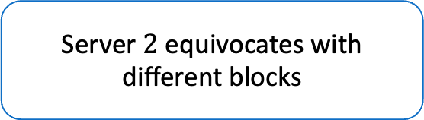
Handling Byzantine Faults
Server $2$ equivocates with different blocks
$$1$$
$$1$$
$$1$$
$$3$$
$$3$$
$$3$$
$$4$$
$$4$$
$$4$$
$$5$$
$$5$$
$$5$$
$$T=δ$$
$$T=2δ$$

Slide 38
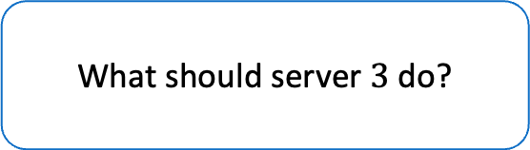

Handling Byzantine Faults
What should server $3$ do?
$$1$$
$$1$$
$$1$$
$$3$$
$$3$$
$$3$$
$$4$$
$$4$$
$$4$$
$$5$$
$$5$$
$$5$$
$$T=δ$$
$$T=2δ$$

Slide 39
Handling Byzantine Faults
NOTHING! Pick a block and move on.
$$1$$
$$1$$
$$1$$
$$3$$
$$3$$
$$3$$
$$4$$
$$4$$
$$4$$
$$5$$
$$5$$
$$5$$
$$T=δ$$
$$T=2δ$$

Slide 40
Handling Byzantine Faults
Zero cost Byzantine Fault-tolerance
$$1$$
$$1$$
$$1$$
$$3$$
$$3$$
$$3$$
$$4$$
$$4$$
$$4$$
$$5$$
$$5$$
$$5$$
$$T=δ$$
$$T=2δ$$

Slide 41
How to commit blocks?
Unique Chain Rule to the rescue!

Slide 42
Committing Blocks
$$r+1$$
$$r+2$$
$$r+3$$
$$r+4$$
$$r+5$$
$$r+6$$
$$r+7$$
$$r+8$$
$$L$$
$$L$$
$$L$$
$$L$$
$$L$$
1
2
3
4
5
1
2
3

Slide 43
Committing Blocks
$$r+1$$
$$r+2$$
$$r+3$$
$$r+4$$
$$r+5$$
$$r+6$$
$$r+7$$
$$r+8$$
$$L$$
$$L$$
$$L$$
$$L$$
$$L$$
1
2
3
4
5
1
2
3
For every round, we either have a blame certificate or a proposed block

Slide 44
Committing Blocks
$$r+1$$
$$r+2$$
$$r+3$$
$$r+4$$
$$r+5$$
$$r+6$$
$$r+7$$
$$r+8$$
$$L$$
$$L$$
$$L$$
$$L$$
$$L$$
1
2
3
4
5
1
2
3
If the leader of a round is honest, its block can never obtain a blame certificate, i.e., its block is permanent

Slide 45
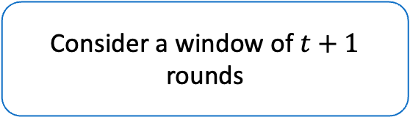
Committing Blocks
$$r+1$$
$$r+2$$
$$r+3$$
$$r+4$$
$$r+5$$
$$r+6$$
$$r+7$$
$$r+8$$
$$L$$
$$L$$
$$L$$
$$L$$
$$L$$
1
2
3
4
5
1
2
3
Consider a window of $t+1$ rounds

Slide 46
Committing Blocks
$$r+1$$
$$r+2$$
$$r+3$$
$$r+4$$
$$r+5$$
$$r+6$$
$$r+7$$
$$r+8$$
$$L$$
$$L$$
$$L$$
$$L$$
$$L$$
1
2
3
4
5
1
2
3
One of these blocks come from an honest leader

Slide 47



Committing Blocks
$$r+1$$
$$r+2$$
$$r+3$$
$$r+4$$
$$r+5$$
$$r+6$$
$$r+7$$
$$r+8$$
$$L$$
$$L$$
$$L$$
$$L$$
$$L$$
1
2
3
4
5
1
2
3
The prefix becomes unique, i.e., all valid chains in the future must extend this chain

Slide 48

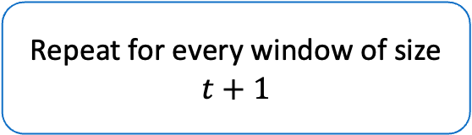
Committing Blocks
$$r+1$$
$$r+2$$
$$r+3$$
$$r+4$$
$$r+5$$
$$r+6$$
$$r+7$$
$$r+8$$
$$L$$
$$L$$
$$L$$
$$L$$
$$L$$
1
2
3
4
5
1
2
3
This is the unique chain rule!
Repeat for every window of size $t+1$

Slide 49
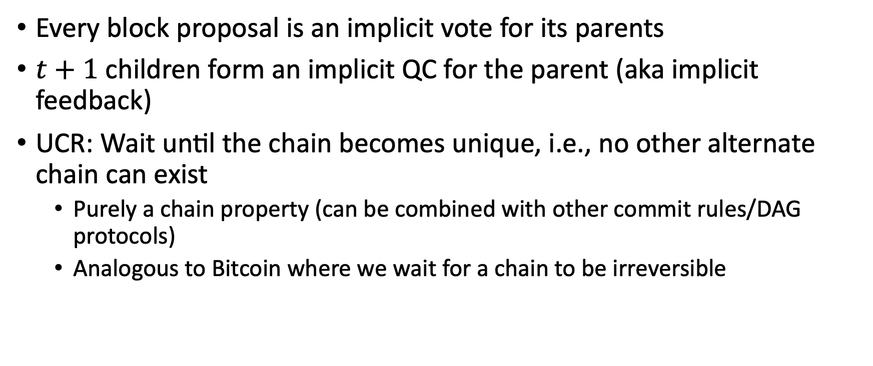
Unique Chain Rule
Every block proposal is an implicit vote for its parents
$t+1$ children form an implicit QC for the parent (aka implicit feedback)
UCR: Wait until the chain becomes unique, i.e., no other alternate chain can exist
Purely a chain property (can be combined with other commit rules/DAG protocols)
Analogous to Bitcoin where we wait for a chain to be irreversible

Slide 50
Applications of Unique Chain Rule
Apollo, Artemis, Publicly Verifiable SMR

Slide 51
The never-ending debate
Round-robin protocols
Fair
One slow server in the round-robin can slow everybody
Not efficient
Stable leader protocols
Leader does the heavy-lifting
Slow leader can slow everybody
A fast leader can be extremely efficient

Slide 52

Apollo
(Spoiler) Bitcoin Thought experiment protocol is Apollo
Use leader randomization for constant latency $\left(κ+1\right)δ$
Block production rate is $δ$, commit rate is also $δ$
Can we do better than $δ$ for block period?

Slide 53
Artemis
$$r+1$$
$$r+2$$
$$r+3$$
$$r+4$$
$$r+5$$
$$r+6$$
$$r+7$$
$$r+8$$
$$L$$
$$L$$
$$L$$
$$L$$
$$L$$
1
2
3
4
5
6
7
8
Consider the Apollo blockchain

Slide 54





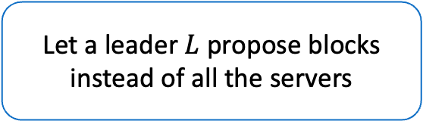


Artemis
$$r+1$$
$$r+2$$
$$r+3$$
$$r+4$$
$$r+5$$
$$r+6$$
$$r+7$$
$$r+8$$
$$L$$
$$L$$
$$L$$
$$L$$
$$L$$
$$L$$
$$L$$
$$L$$
$$L$$
$$L$$
$$L$$
$$L$$
$$L$$
Time between the production of successive blocks is $0$
Let a leader $L$ propose blocks instead of all the servers

Slide 55



Artemis
$$r+1$$
$$r+2$$
$$r+3$$
$$r+4$$
$$r+5$$
$$r+6$$
$$r+7$$
$$r+8$$
$$L$$
$$L$$
$$L$$
$$L$$
$$L$$
$$L$$
$$L$$
$$L$$
$$L$$
$$L$$
$$L$$
$$L$$
$$L$$
Vote $r+1$
Vote $r+3$
Vote $r+7$
System eventually catches up
1
2
3
Servers propose the head of their local chain
Can be more than one block long
Construct a second chain to apply unique chain rule

Slide 56
Artemis
$$r+1$$
$$r+2$$
$$r+3$$
$$r+4$$
$$r+5$$
$$r+6$$
$$r+7$$
$$r+8$$
$$L$$
$$L$$
$$L$$
$$L$$
$$L$$
$$L$$
$$L$$
$$L$$
$$L$$
$$L$$
$$L$$
$$L$$
$$L$$
Vote $r+1$
Vote $r+3$
Vote $r+7$
1
2
3
Apply Unique Chain Rule
Apply unique chain rule on the second chain

Slide 57
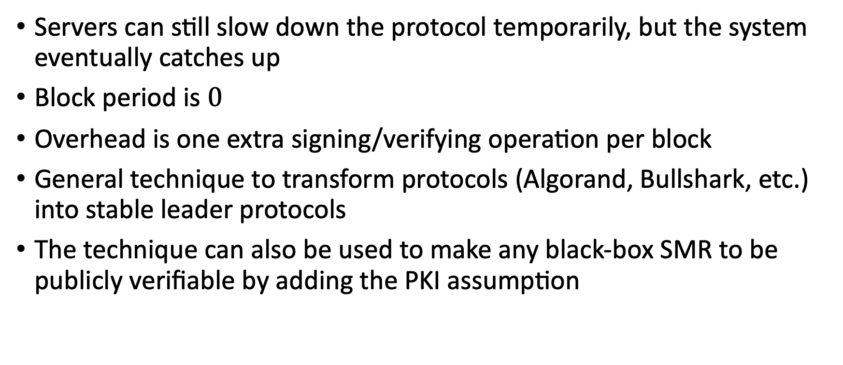
Artemis and Publicly Verifiable SMR
Servers can still slow down the protocol temporarily, but the system eventually catches up
Block period is $0$
Overhead is one extra signing/verifying operation per block
General technique to transform protocols (Algorand, Bullshark, etc.) into stable leader protocols
The technique can also be used to make any black-box SMR to be publicly verifiable by adding the PKI assumption

Slide 58
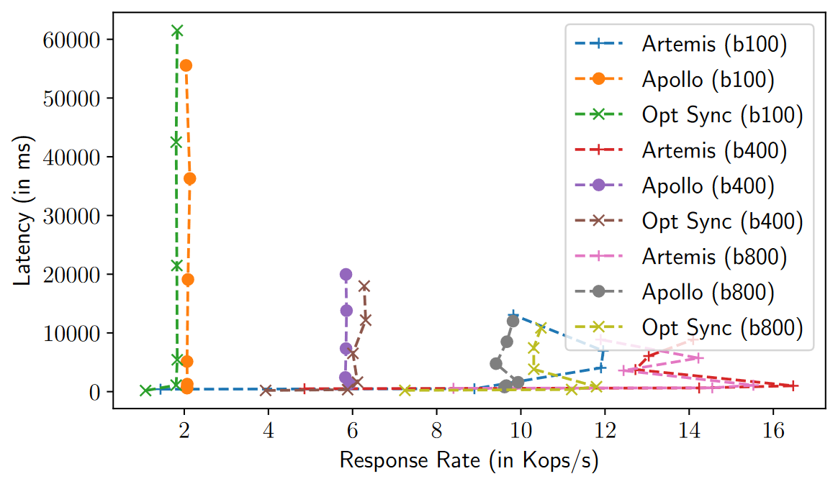
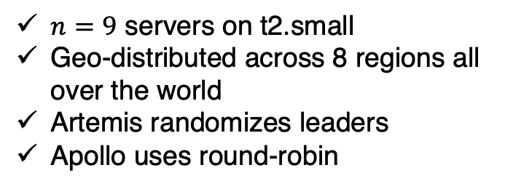
General Performance
$n=9$ servers on t2.small
Geo-distributed across 8 regions all over the world
Artemis randomizes leaders
Apollo uses round-robin

Slide 59
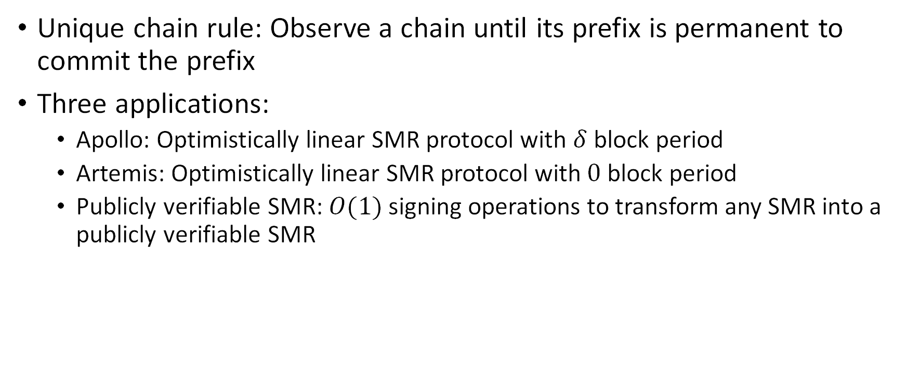
Summary
Unique chain rule: Observe a chain until its prefix is permanent to commit the prefix
Three applications:
Apollo: Optimistically linear SMR protocol with $δ$ block period
Artemis: Optimistically linear SMR protocol with $0$ block period
Publicly verifiable SMR: $O(1)$ signing operations to transform any SMR into a publicly verifiable SMR

Slide 60


Thank you!
Link to Eprint

